Slide 1

NETw200 Final Project
Kimberly Hernandez
DeVry University
NETW200
06/25/20
Joseph Pedalino

Slide 2

Introduction
There is always room for networks to expand and having that knowledge of creating a small network is just the beginning.
Whether networks are large or small, business network or home networks, they can expand depending on their needs.
Networking does not only stop at the point of setting up a network, but there are also few other points to consider after:
  virtual machines,
  subnetting,
  password salt/hashes,
  network traffic monitoring,
  vulnerability assessments, and
  IP routing
These points will be covered in this project along with challenges encountered and career skills obtained.

Slide 3

A Small Network
This small network will stage a host machine, two travel routers, and three guest virtual machines.
The host machine is:
An HP Laptop.
The travel routers used are:
The GL-MT300N-V2
GL-AR750
The VMware environment contains:
Ubuntu VM
Kali VM
Linux Server VM

Slide 4
Import Kali Virtualized Appliance to VMware Player
The Kali VM was installed on the VMware environment that is on the HP laptop. (Image on next slide.)
The GL-MT300N-V2 travel router was plugged into the HP laptop using a cat5e ethernet cable and power cable.
The VMware environment settings were bridged to make sure Kali had access to the network along with the Ubuntu VM.
Once the Kali machine was up and running, the “ifconfig” command was entered in the Terminal window to confirm the IPv4 address of Kali and the same was done to the Ubuntu VM.
Following the confirmation, a “ping” connectivity test was performed to check and confirm the connection between Kali VM and Ubuntu VM.

Slide 5
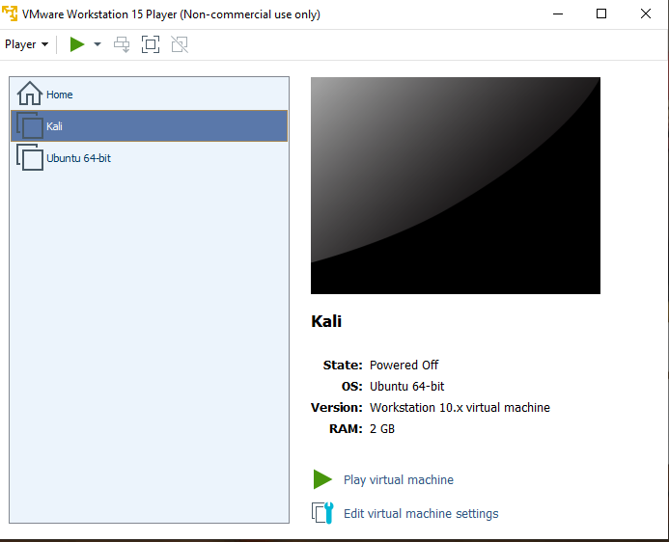
VMware Player Environment with Both VMs
The VMware Player environment with both Ubuntu and Kali VMs

Slide 6
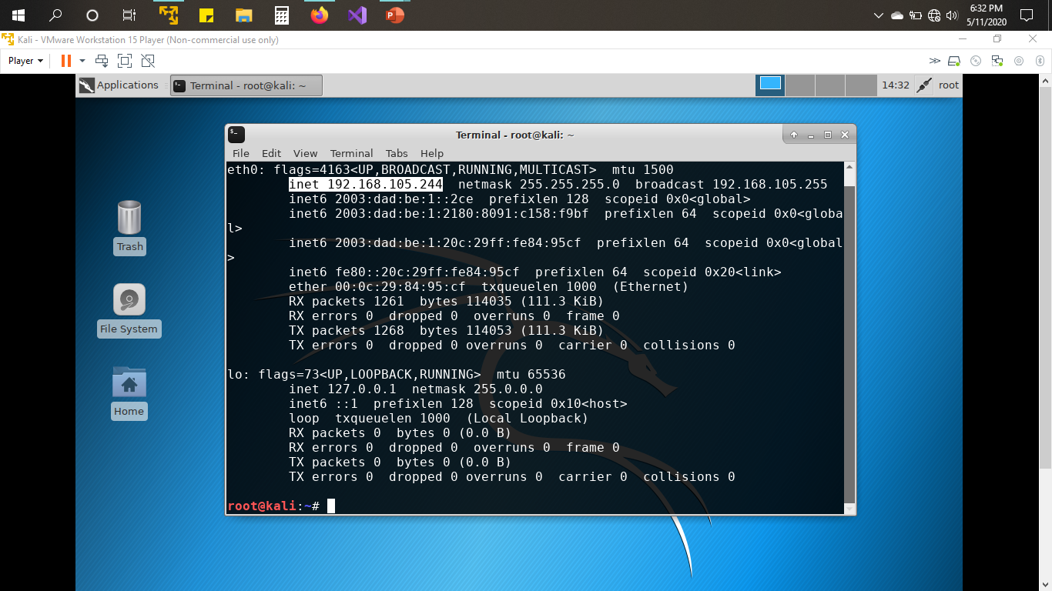
Kali VM IPv4 address
The Kali Terminal window with IPv4 address from Travel Router

Slide 7
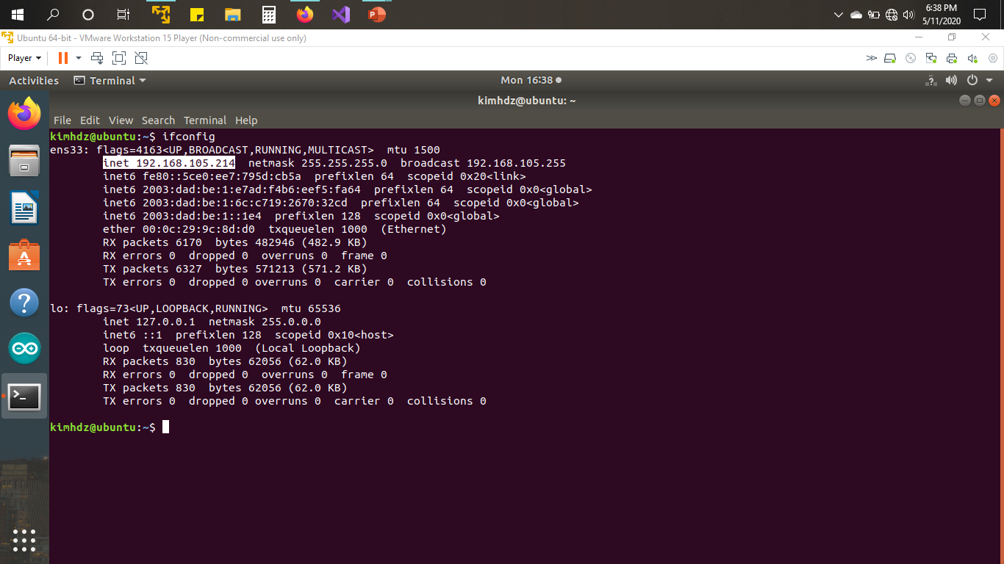
Ubuntu VM IPv4 address
The Ubuntu Terminal window with IPv4 address from Travel Router

Slide 8
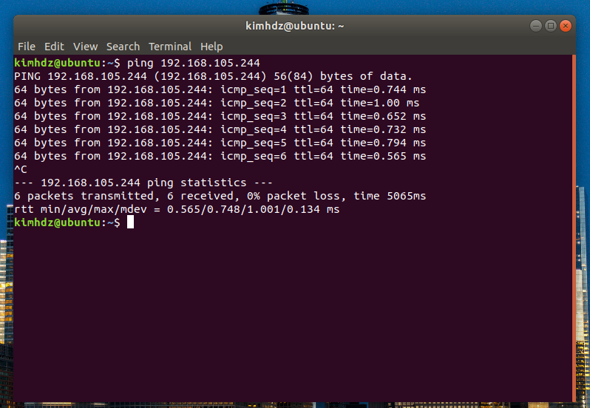
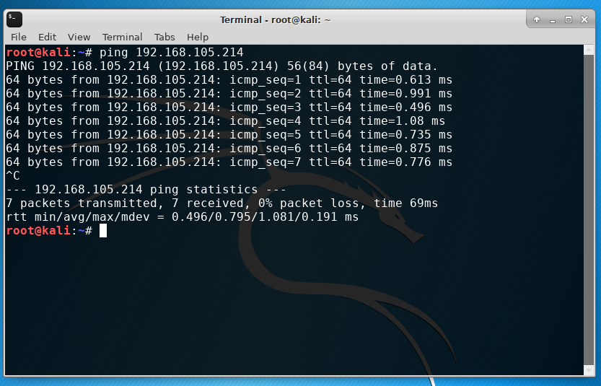
Ping connectivity test between two VMs
Terminal window using the “ping” command to test connectivity between the Kali and Ubuntu VMs.

Slide 9
IP Subnetting and
Virtual Local Area Network (VLAN)
IP Subnetting is also important when it comes to potential growth in a network.
192.168.2.0/24 IP address was used as an example of a major network and it was divided into subnets.
The subnetting required:
  Four /26 networks, two /27 networks, and four /29 networks.
  Including network addresses(the first IP address on a subnet), first usable addresses, last usable addresses, and broadcast addresses(the last IP address on a subnet).
Considering that the more subnetting that is performed there will be two less IP addresses available since the network address is reserved for the router, and the broadcast address is used to communicate with all nodes on a network.
The router’s switch settings were checked for the current VLAN configurations.

Slide 10
Subnetting Step 1
 | Network Address x.x.x.x/x | First Usable Host Address | Last Useable Host Address | Broadcast Address
First subnet | 192.168.2.0/26 | 192.168.2.1 | 192.168.2.62 | 192.168.2.63
Second subnet | 192.168.2.64/26 | 192.168.2.65 | 192.168.2.126 | 192.168.2.127
Third subnet | 192.168.2.128/26 | 192.168.2.129 | 192.168.2.190 | 192.168.2.191
Fourth subnet | 192.168.2.192/26 | 192.168.2.193 | 192.168.2.254 | 192.168.2.255
Four /26 networks,
including network addresses,
first usable addresses,
last usable addresses, and
broadcast addresses.

Slide 11
Subnetting Step 2
 | Network Address x.x.x.x/x | First Usable Host Address | Last Useable Host Address | Broadcast Address
First subnet | 192.168.2.64/27 | 192.168.2.65 | 192.168.2.94 | 192.168.2.95
Second subnet | 192.168.2.96/27 | 192.168.2.97 | 192.168.2.126 | 192.168.2.127
Two /27 networks,
including network addresses,
first usable addresses,
last usable addresses,
and broadcast addresses.

Slide 12
Subnetting Step 3
 | Network Address x.x.x.x/x | First Usable Host Address | Last Useable Host Address | Broadcast Address
First subnet | 192.168.2.96/29 | 192.168.2.97 | 192.168.2.102 | 192.168.2.103
Second subnet | 192.168.2.104/29 | 192.168.2.105 | 192.168.2.110 | 192.168.2.111
Third subnet | 192.168.2.112/29 | 192.168.2.113 | 192.168.2.118 | 192.168.2.119
Fourth subnet | 192.168.2.120/29 | 192.168.2.121 | 192.168.2.126 | 192.168.2.127
Four /29 networks,
including network addresses,
first usable addresses,
last usable addresses,
and broadcast addresses.

Slide 13
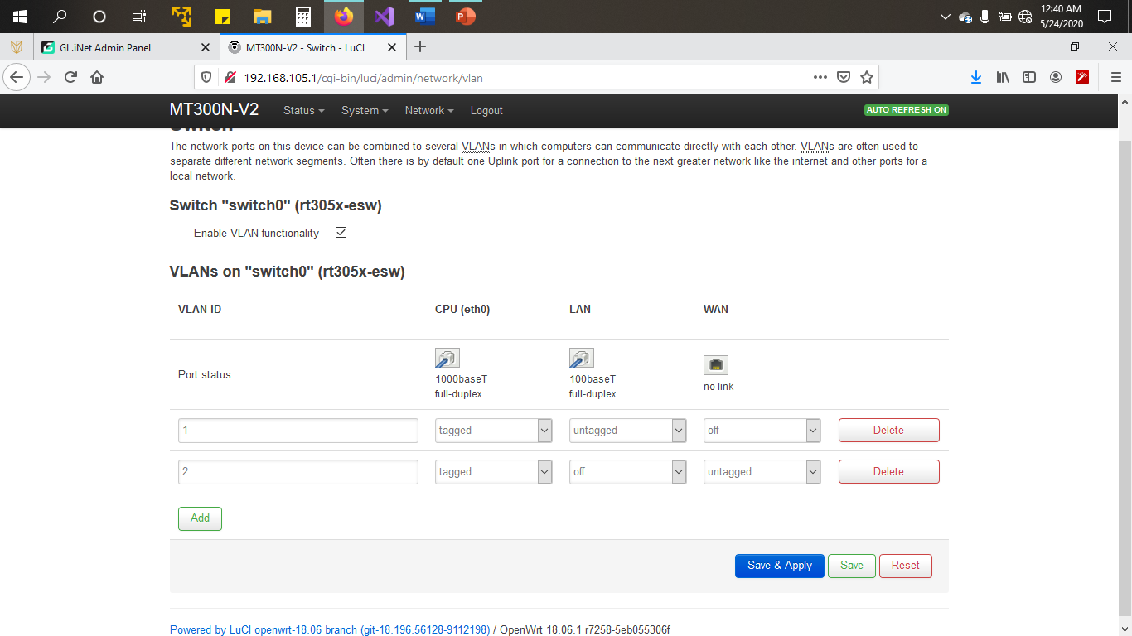
Travel Router VLAN Configuration
Currently configured VLANs on the GL-MT300N-V2 Travel Router.

Slide 14
Vulnerability Assessment
A new guest VM called Linux-Server was added to the VMware environment.
The VMware settings were checked to verify the bridged network connection.
After logging into the Linux-Server the “ifconfig” command was used to verify the IPv4 address of the Linux-Server and the same was done under the Kali VM.
After confirming the IPv4 addresses, the “nmap –Pn 192.168.105.0/24” command was used in the Kali terminal window to view the IP addresses of the hosts on this subnet.

Slide 15
Vulnerability Assessment (continued)
In the Kali VM terminal widow the “openvas-start” command was executed.
Following this the OpenVAS vulnerability scanner application was accessed.
The Linux-Server VM was used as a target to scan.
Once the scan was complete the vulnerability report were reviewed.
Each vulnerability report showed the severity level, the host IP address, location, and further details showing the summary and solution. (Images on the next slides.)

Slide 16
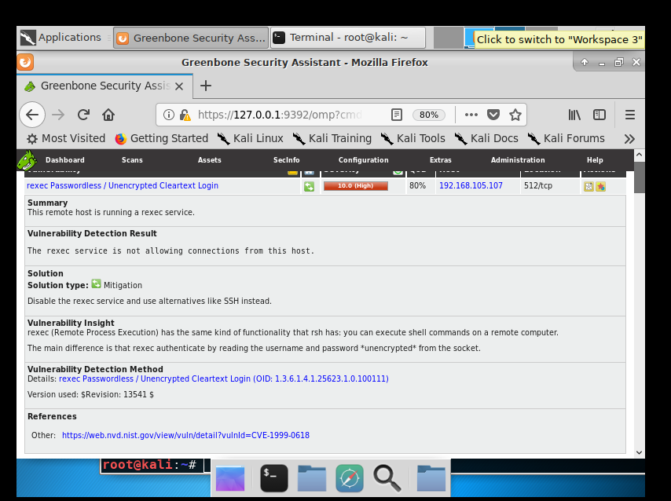
High Severity Rating Vulnerability
High severity rating vulnerability and its recommended solution.

Slide 17
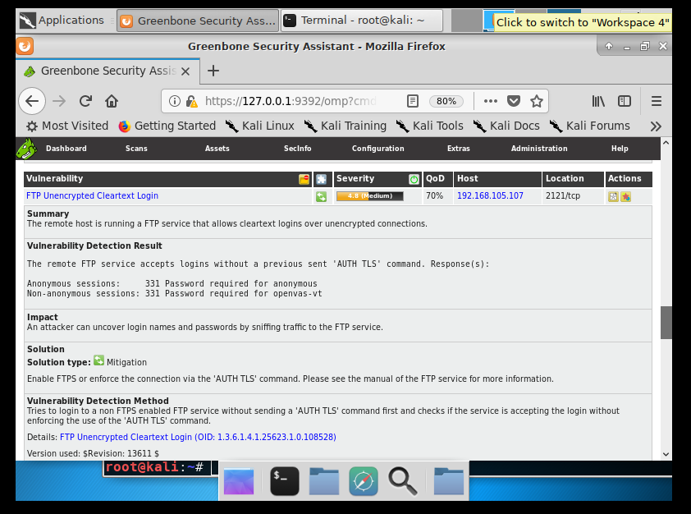
Medium Severity Rating Vulnerability
Medium severity rating vulnerability and its recommended solution.

Slide 18
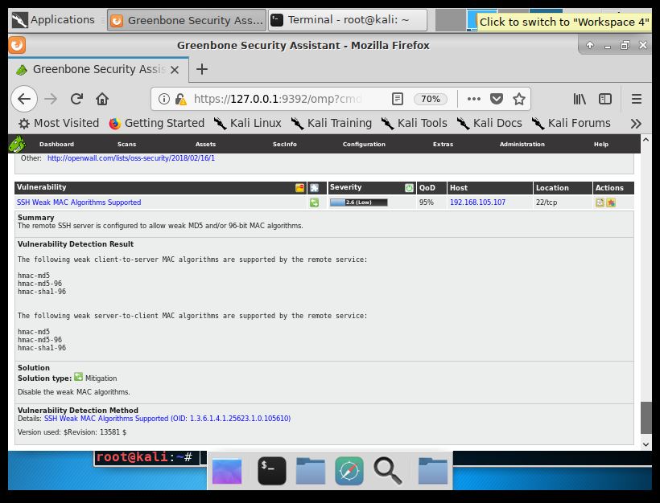
Low Severity Rating Vulnerability
Low severity rating vulnerability and its recommended solution.

Slide 19
Password Management
Network administrators check credentials such as usernames and passwords to see if they are weak credentials.
Five usernames and passwords were created in the Kali VM to verify the strength of the credentials using John the Ripper security tool.
The password hashes were viewed using the “/etc/shadow “command in Kali.
Lastly the “/var/log/auth.log” was used to verity account modification.

Slide 20
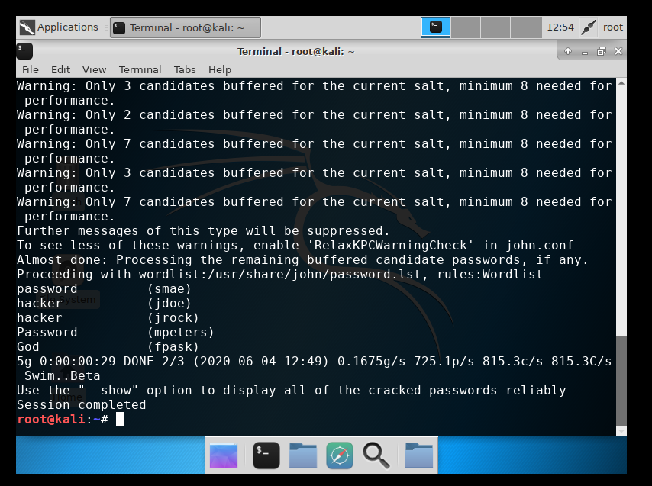
John the Ripper security tool in action
The cracked user passwords by using the John the Ripper security tool.

Slide 21
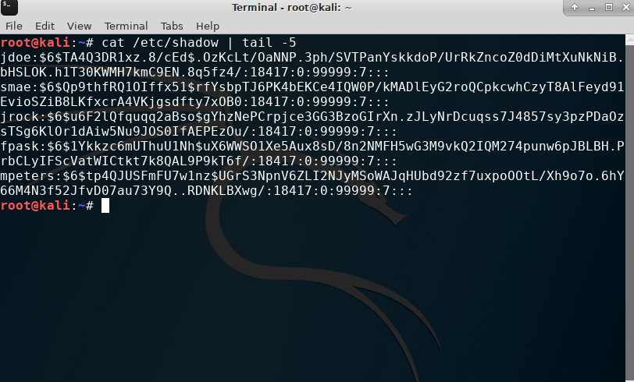
Last five user password hashes
The /etc/shadow file, including password hashes of the last five user accounts from Kali VM.

Slide 22
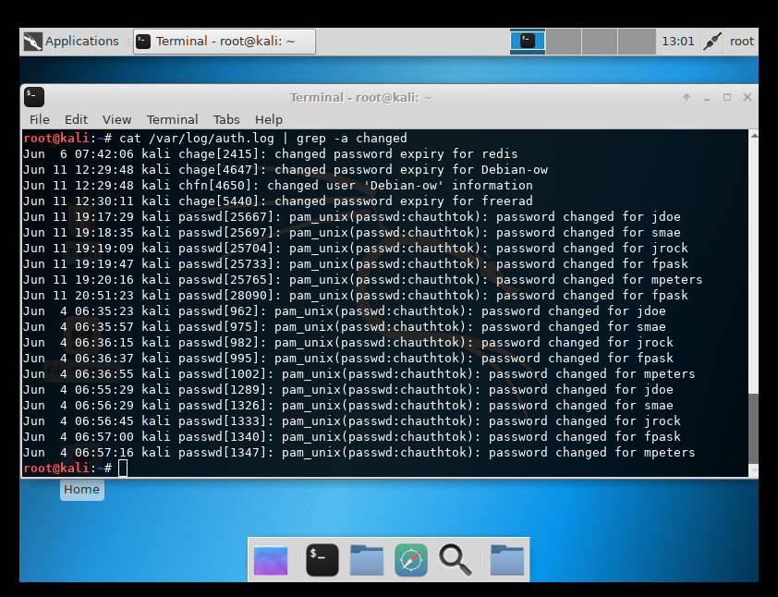
Account modification in the Auth.log File
The /var/log/auth.log file with information on account modification.

Slide 23
Network Performance Monitoring
Not only does network monitoring determine if a network should expand. It is needed to monitor traffic flow and can be used as a precaution to prevent network issues.
The three tools that were used in this case were:
  EtherApe
  Monitorix
  Wireshark Performance Analysis
The “ifconfig eth0” command in the Kali terminal window was executed to verify the IP address.
Then a “ping” test was performed to verify connectivity between Kali VM, Linux-Server, and the HP laptop.

Slide 24
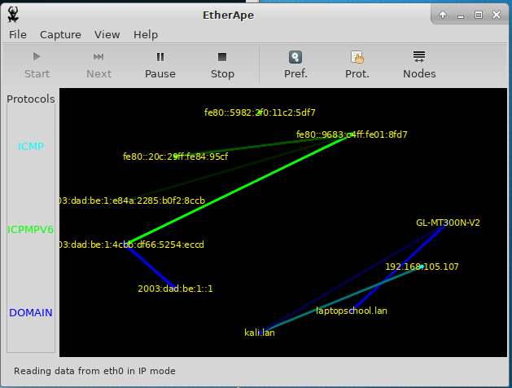
EtherApe Graphical Packet Flows
Using the “etherape” command launched the tool.
The EtherApe graphical screen opened showing the traffic flow between the Kali, the HP laptop, the travel router, and the Linux-Server.

Slide 25
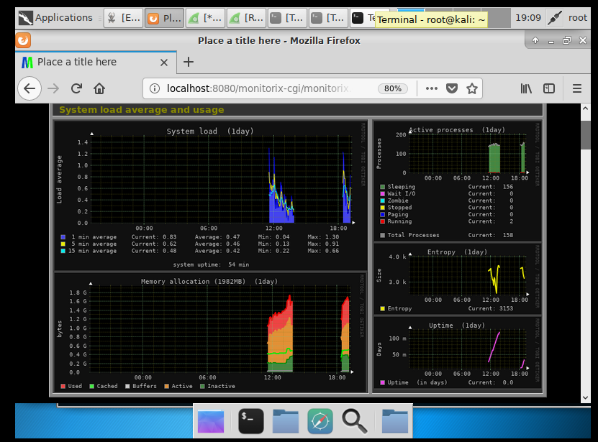
Monitorix
The Monitorix System Load Average and Usage screen.
Using the terminal window in the Kali VM the “service monitorix start” command was executed.
The Monitorix Graphical user interface was accessed, and several graphs of traffic monitoring displayed.
Although this is not connected to the internet traffic was manually generated to display the results in the image.

Slide 26
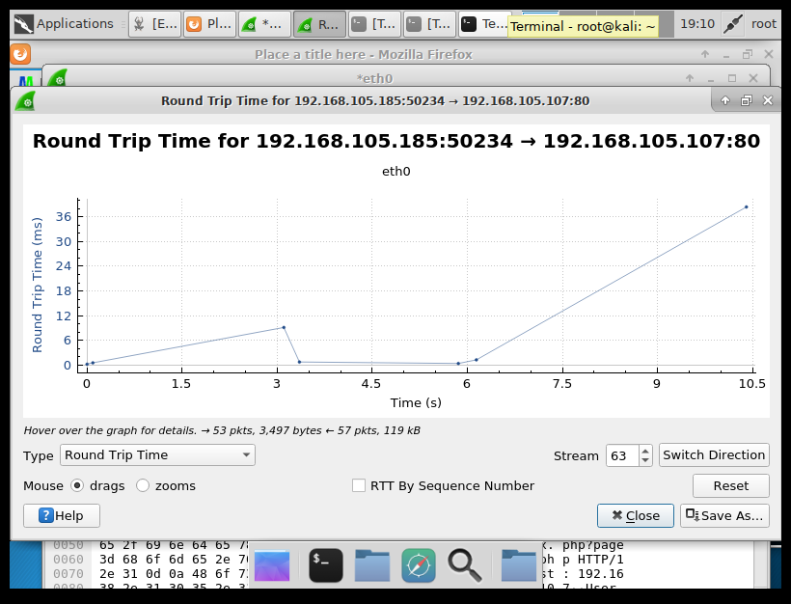
Wireshark Performance Analysis
The terminal window was used in the Kali VM to execute the “wireshark” command.
The eth0 was selected to show traffic and packet flow.
The Round-Trip Time was selected to show a graphical chart of traffic flow between the Kali VM and the Linux-Server.
The image shows the Round-Trip Time of the HTTP traffic between the Kali VM and the Linux-Server VM.

Slide 27
IP Routing
In most cases the need to expand a network is necessary due to business growth or customer needs.
At this point of the project the GL AR750 is implemented on the small network.
The GL AR750 router is used as an extender for the GL-MT300N-V2 travel router. (Image on next slide.)
  In this case it will extend and strengthen the signal of the GL-MT30N-V2 travel router and allow wireless connectivity.
The loopback interface on the GL-MT300N-V2 is configured to simulate local area network segments.
The two local area network segments called Lo5 and Lo6 are created.
The “ping” command in the terminal window on the host computer was used to test connectivity between the two new segments and the same was done on the Kali VM.

Slide 28
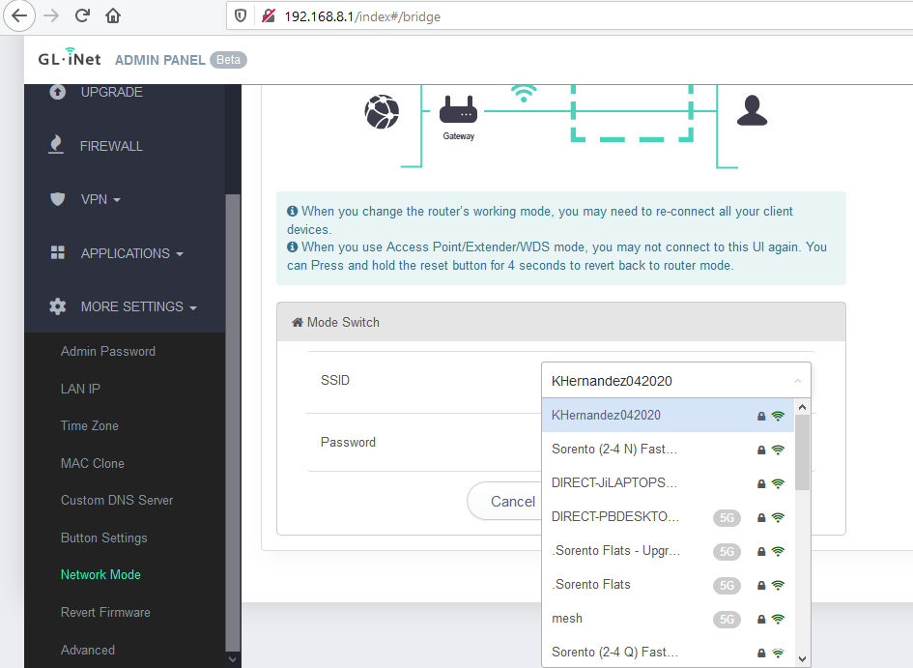
WLAN SSID
The WLAN SSID of the yellow GL-MT300N-V2 router shown in the extender configuration window of the GL AR-750 router.

Slide 29
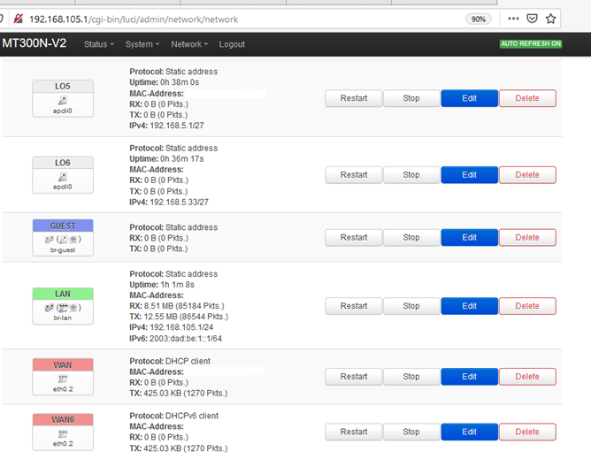
IP configurations of Lo5 and Lo6 interfaces
Loopback 5 and Loopback 6 interfaces on the GL-MT300N-V2 Router.

Slide 30
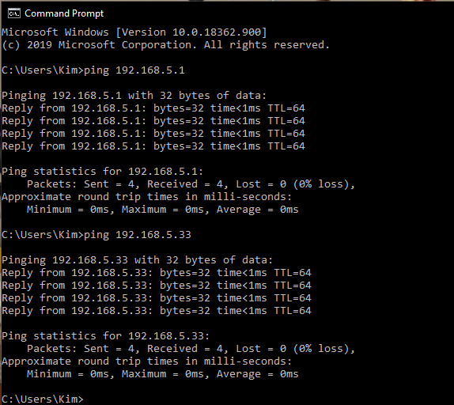
Ping results from the Host Computer to two loopback interfaces
The ICMP Ping tests from the Host Computer to two Loopback interfaces.

Slide 31
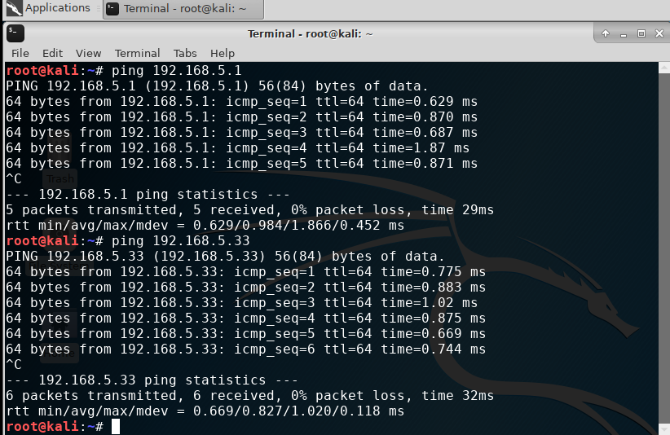
Ping results from the Kali VM to two loopback interfaces
  A screenshot of the ICMP Ping tests from the Kali VM to two Loopback interfaces.

Slide 32
Challenges
One challenge faced was having difficulty generating enough traffic without internet connectivity during the performance monitoring.
To fix this issue different links that were able to be used offline were accessed multiple times and this allowed traffic to generate.
The Kali VM IP address changed during mid project without any changes being made.
While there was trouble trying to find the issue of why this could occur. It was concluded that with exiting the VMware containing the Kali VM and Linux server have the potential to reset IP addresses from the DHCP of the GL-MT300N-V2 travel router .
Figuring out the subnets of the major network was very challenging.
Reviewing the chapter in subnetting and several practice runs were done in order to feel comfortable in this area and overcome this challenge.

Slide 33
Career Skills Obtained
Networking-
Being able to create a small network.
Security-
Being able to monitor password credentials of users with the John The Riper security tool and with the “/var/log/auth.log ” command.
Hardware-
Using the HP laptop, and the two travel routers have added more experience with hardware.
Troubleshooting-
Using different commands in the Kali VM terminal window as well as the HP laptop.
Software-
Using and managing the two travel routers GUI and the VMware environment/settings, as well as, the Kali VM, Ubuntu VM, and the Linux-Server.
Data Analysis-
The EtherApe, Monitorix, and Wireshark have provided experience to obtain these skills.

Slide 34
Conclusion
Networks, whether large or small can grow due to business or customer needs.
There is more to consider when implementing a large or small network such as subnetting, IP routing, virtual machines, password salt/hashes, network traffic monitoring, and vulnerability assessments.
Considering this small network has the potential for growth still, this is just a bit of what can be done to it.
Overall, this project implemented a small networking using a HP computer, two travel routers, and a VMware environment including three guest VMs.

