Slide 1
A SMALL NETWORK
NETW190 Final
Project
Kimberly Hernandez
DeVry University NETW190
04/20/20
Jingdi Zeng

Slide 2
Introduction
The IoT (Internet of Things) is ever growing.
All these IoT devices are connect to different types of networks.
Whether at home, work, or at a local place using the Wi-Fi, these are all places with different types of networks.
This project will show the fundamentals of a small network.
Also including challenges faced and career skills obtained.

Slide 3
A Small Network
The build of the small network consist of:
  Creating a diagram using Visio as documentation.
  The IPv4 (Internet Protocol Version 4) and IPv6 (Internet Protocol Version 6) addressing.
  Incorporating the Ubuntu virtual machine (VM) to bridge the host network adapter.
  Verify the dynamic IP assignment.
  Testing connectivity between network devices using “ping”.
  Creating and testing an ethernet cable with following the EIA/TIA 568B standards.
  And lastly implementing wireless local area network (WLAN).

Slide 4
Microsoft Visio Network Diagram
Network documentation is important when any network is implemented.
Hardware, software, and network troubleshooting are the main reasons why network documentation is needed.
A network topology whether physical or logical shows the arrangement of a network.
In this case, a physical topology is documented for a small network.
The planning and documentation of this project is set in motion as a Microsoft Visio Diagram is created for a small network. (Imagine on next slide)

Slide 5
Visio Network Diagram
The physical Network Topology Diagram Shows:
-A Travel Router
-Unshielded Twisted Pair (UTP) cable
-Student HP Laptop
-Ubuntu Virtual Machine (VM)

Slide 6
Furthering the network diagram
The physical Network Topology Diagram:
Student HP Laptop
The student HP laptop will take part in setting up the router for IPv4 and IPv6 assignments, running the VM, retrieve the DHCP IP addresses, and test connectivity between the router and the VM.
Travel Router
The travel router is used to set up the network that each, the student HP laptop & the VM will connect to.
Unshielded Twisted Pair (UTP) cable
Ubuntu Virtual Machine (VM)
The UTP cables will be used to further the knowledge of EIA/TIA 586B standards in making a straight-through working cable. The straight through cable will be used to connect the travel router to the student HP laptop.
The VM will take part in bridging the network adapter of the host computer, retrieving the DHCP IP addresses, and test connectivity between the router and the host computer.

Slide 7
IPv4 and IPv6 Addressing
The next step was assigning the IPv4 and IPv6 address on the router for the dynamic host configuration protocol(DHCP) to send out IP addresses to devices that connect to it.
The yellow travel router components (UTP cable & micro-USB) were connected to the student HP laptop.
To reach the management interface, 192.168.1.1 was entered.
After logging into the admin panel, the advanced settings proceeded to the root login which after the network interfaces tab was selected.
Under the LAN settings the IPv4 address was assigned as 192.168.105.1 with a netmask of 255.255.255.0 and saved. (image on next page)

Slide 8
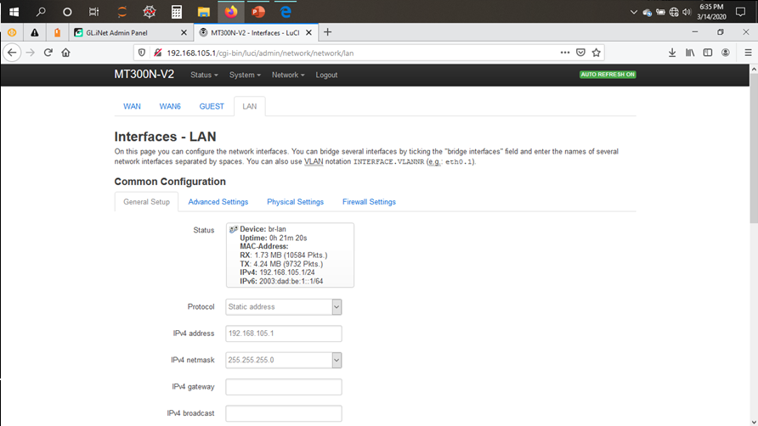
IPv4 Address Assignment of the Travel Router
IPv4 address
IPv4 netmask

Slide 9
IPv4 and IPv6 Addressing (continued)
The network interface page shows the “Global network options” where the IPv6 ULA-Prefix was changed to 2003:DAD:BE::/48
The LAN settings were accessed again this time making sure the “IPv6 assignment length” was 64.
The “IPv6 assignment hint” was assigned as 1::
Lastly, “The IPv6 suffix” was assigned as ::1
The image on the next slide shows these saved changes.

Slide 10
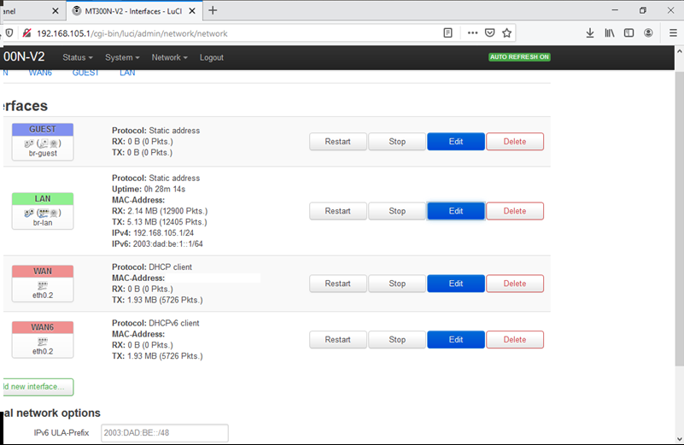
IPv6 Address Assignment of the Travel Router
The screenshot includes:
IPv6 address
IPv6 prefix

Slide 11
Virtual Machine (VM)& Host Windows computer
Dynamic IP Assignment
Bridging of the student HP laptop network adapter was required in order for the VM to connect to the travel router as well.
When the VM was opened and the “Edit virtual machine settings” was selected.
The “Network Adapter” option was selected under the hardware tab.
The “Bridged” option was chosen allowing the “Configure Adapters” to be edited.
When clicking into the “Configure Adapters” the “Realtek PCIe GbE Family Controller” was the only host network adapter checked off and the settings were saved. (Image following the next slide)

Slide 12
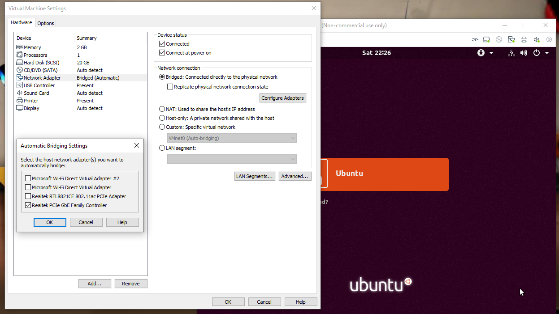
VMware Player Bridging Settings
The screenshot shows the host network adapter that the VM will automatically bridge to.

Slide 13
Virtual Machine (VM) & Host Windows computer
Dynamic IP Assignment
(continued)
After assigning the IPv4 and IPv6 addresses & bridging the host network adapter the student HP laptop and VM are now connected to the travel router.
At this point verification is needed to determine what IP addresses the DHCP has assigned to the student HP laptop and the VM now that they are connected to the travel router.
The command window was brought up on the student HP laptop and the “ipconfig /all” was entered to view the IPv4 address and IPv6 address of the host computer. (Image on next slide.)
    IPv4: 192.168.105.154
    IPv6: 2003:dad:be:1::e83
The terminal window was brought up on the Ubuntu VM and the “ip addr” was entered to view the IPv4 and IPv6 address of the VM. (Image on following slide.)
    IPv4: 192.168.105.214
    IPv6:2003:dad:be:1::1e4

Slide 14
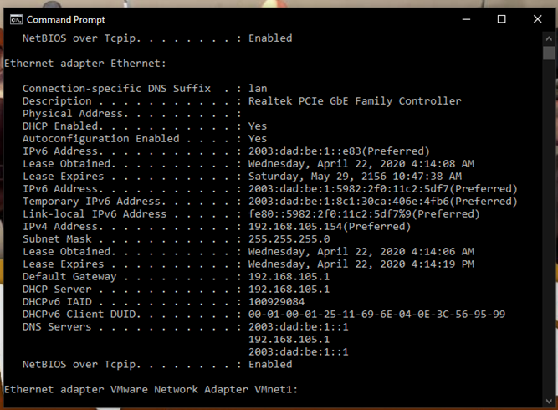
Host Computer Dynamic IP Assignment
The screenshot should show IPv4 and IPv6 addresses of the host Windows computer.

Slide 15
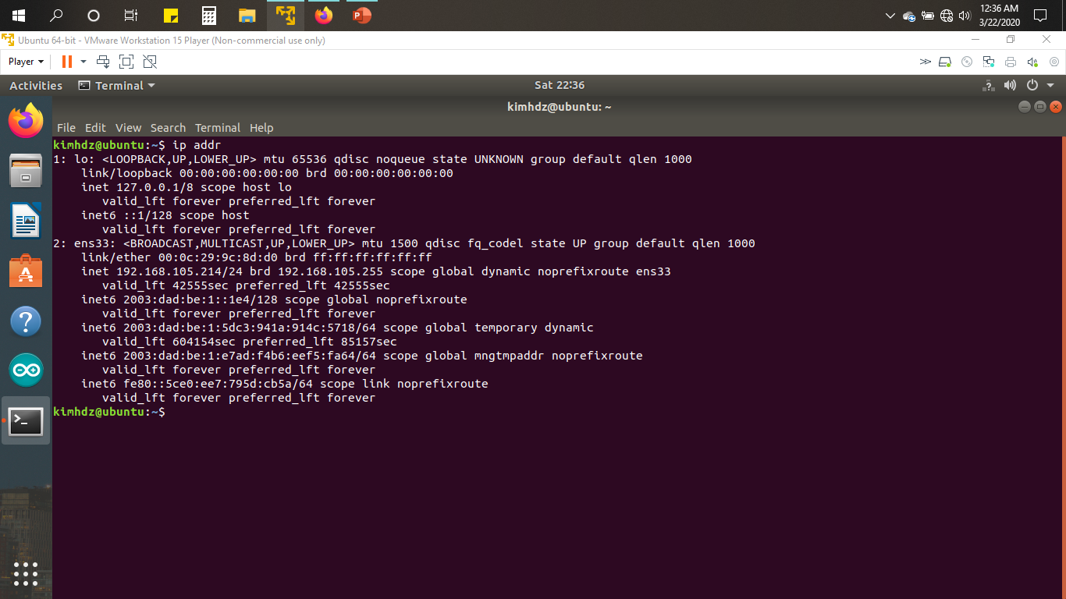
Guest Ubuntu VM Dynamic IP Assignment
The screenshot shows IPv4 and IPv6 addresses of the Guest Ubuntu VM.

Slide 16
After the IPv4 and IPv6 addresses were assigned and viewed, the student HP laptop and the Ubuntu VM connectivity test followed.
The “ping” command was used to test the IPv4 and IPv6 connectivity between:
  The HP student laptop and travel router.
  The HP student laptop and the Ubuntu VM.
  The Ubuntu VM and the travel router.
  The Ubuntu VM and the HP student laptop.
Connectivity Test - Ping

Slide 17
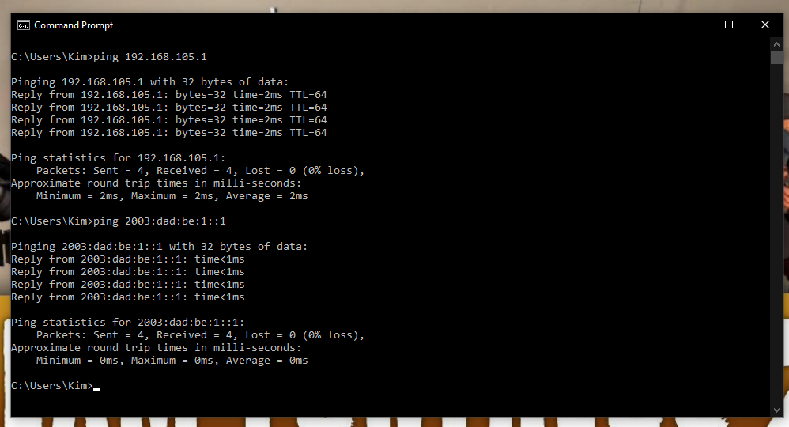
Connectivity Test between the Host Computer and Travel Router
The screenshot showing successful ping tests.

Slide 18

Connectivity Test between the Host Computer and Ubuntu VM
The screenshot shows successful ping tests.

Slide 19
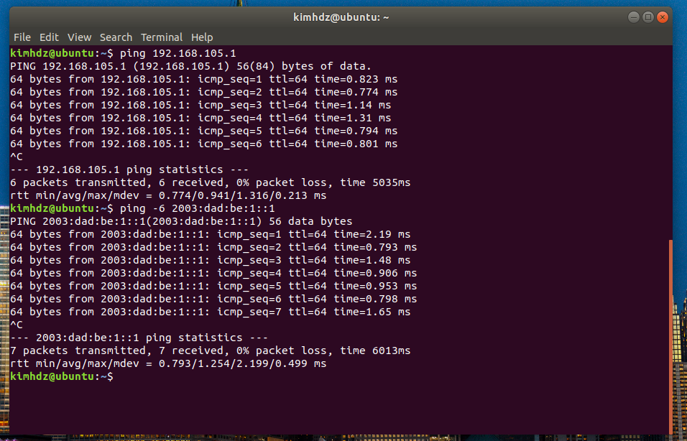
Connectivity Test between the Ubuntu VM and Travel Router
The screenshot shows successful ping tests.

Slide 20
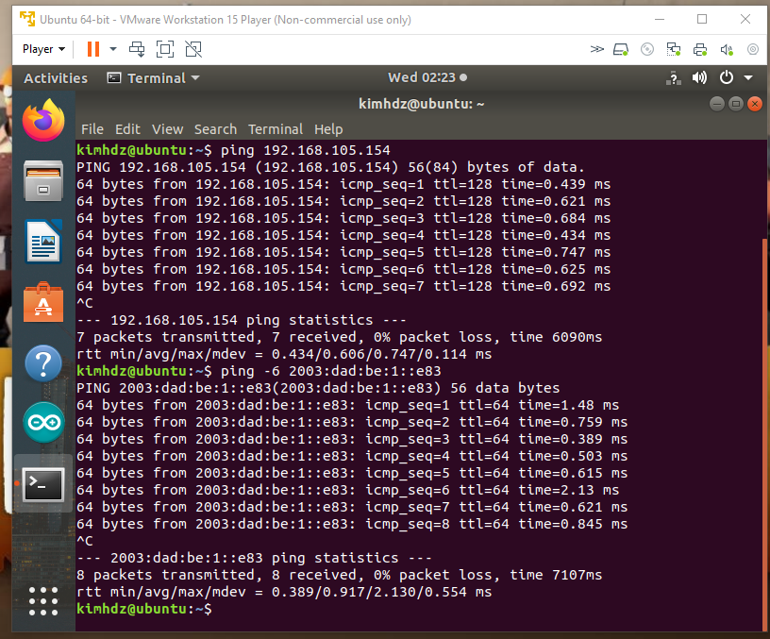
Connectivity Test between the Ubuntu VM and Host Computer
The screenshot shows successful ping tests.

Slide 21
Make and Test Ethernet Cable
An ethernet cable was made following EIA/TIA 568B standards to connect the travel router to the HP student laptop.
A black cat5e cable was stripped, untwisted, and straightened out on each end of the cable.
Each wire were put in order by color and are as follows:
The eight wires on each end were put into the RJ45 connectors and clamped using the crimp tool.
Then the ethernet cable was successfully tested using the UbiGear Cable tester.
  1) Orange
  2) Orange/White
  3) Green
  4) Blue/White
  5) Blue
  6) Green
  7) Brown
  8) Brown/White

Slide 22
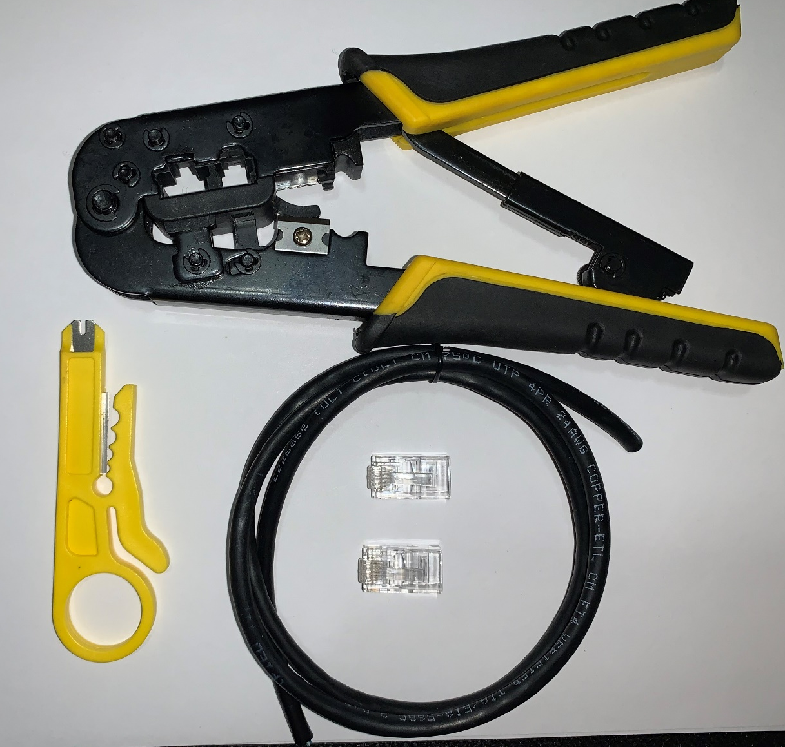
Tools To Make An Ethernet Cable
UTP cable
RJ-45 connectors
Crimp tool

Slide 23
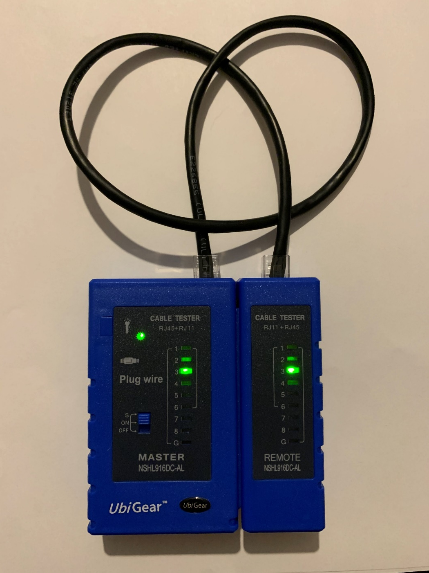
Successfully Tested Ethernet cable
Ethernet cable
UbiGear Cable Tester

Slide 24
WLAN Implementation
A simple wireless local area network (WLAN) was set up using a service set identifier (SSID).
The SSID was accessed by entering the management interface of the travel router by entering 192.168.105.1 was entered in a browser.
The admin panel’s wireless settings were modified and the SSID was changed to “KHernandez042020”.
The image on the next slide shows the new SSID that was created.
The following slide shows the IP address information of the student HP laptop that has a wireless connection to the travel router.

Slide 25
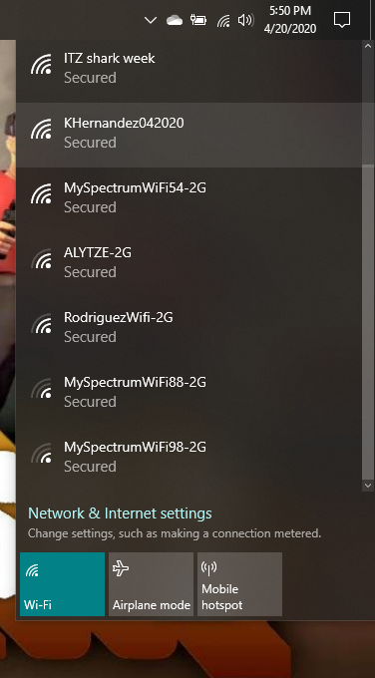
List of WLAN SSID Names
The screenshot shows the WLAN SSID you created and other available ones.

Slide 26
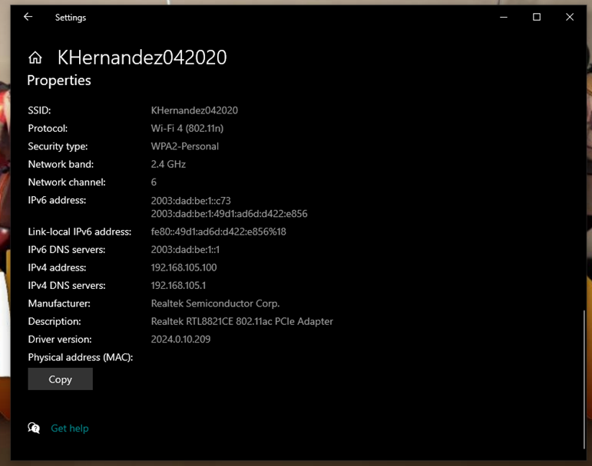
IP Address of the Device
The screenshot shows the IP address of the device that is connected to the WLAN SSID that was created.

Slide 27
Challenges In The Project
1) During this project was updating the firmware. The required firmware version 3.012 for this project was needed to proceed. After updating the firmware following several steps the travel router’s management interface was no longer accessible.
  Since the issue occurred right after the software was updated there was an attempt to reverse the update but was unsuccessful since the management interface was unreachable.
  The second troubleshooting method was by verifying the ethernet properties of the travel router and changing the IPv4 address to 192.168.8.2 and try to connect once again but was unsuccessful.
  The third troubleshooting method was testing connectivity to the router by pinging it after it was connected resulted in a “requested time out”.
  After attempting several troubleshooting methods, professor recommended the purchase of a new router.
2) Another challenge faced was testing a successful ping connectivity from the Ubuntu VM to the host computer.
  The first attempt was to turn off the firewall as this typically causes an unreachable connection.
  The second attempt was verifying no settings had changed to the VM.
  The third attempt was pinging connectivity between the VM and the travel router & host computer to travel router.
  The last attempt was verifying the host computers ethernet of the travel router, which had been changed when the firmware was being troubleshooted. The settings were changed to the default of IPv4 properties to obtain the IP address automatically and the DNS server address to be obtained automatically. Then the ping connectivity tested successfully.

Slide 28
Career Skills Obtained
Networking skills – Setting up a small network that consisted of the travel router, the student HP laptop, and the VM. This would also include assigning the IPv4 and IPv6 addresses of the travel router and obtaining the student HP laptop and the VMs after using the “ipconfig /all” & “ip addr”.
Troubleshooting skills- After testing the connectivity using “ping” had failed by turning off the firewall of the student HP laptop fixed the issue.
Hardware skills- Making the ethernet cable and setting up the travel router.
Software skills – Being able to manage the travel router’s software, as well as, using the command window on both the student HP laptop & the VM.

Slide 29
Conclusion
The IoT is ever growing.
So is the connectivity of these devices to networks whether they would be wireless or wired.
This project showed the development of a
simple small network using a:
      Travel router
      Unshielded Twisted Pair (UTP) cable
      Student HP Laptop
      And Ubuntu VM.
This is just one of many small networks that can be built, and who knows what the future may hold for networking.
Thank you!

