Slide 1

DJ Playlist Manager
Kimberly Hernandez
DeVry University
CIS170C
06/25/20
Susan Nachawati

Slide 2

Introduction
Whether you are using a phone, tablet, or computer to listen to music, write a paper, or Read a book performing any of these tasks on any of these devices all have one thing in common, they’re programmed.
To be able perform any of these tasks on these devices they must be programmed.
The program that is in these devices or applications set specific instructions that tell it how they can operate.
This project entails the development of a DJ playlist manager console application.

Slide 3

Purpose
This program will be developed for a DJ that needs to combine their music collection including all data such as artist, title, length, and genre.
A menu will be included to :
  add their music collection including playlist names, song information, and average song length as option 1.
  Display a report of current playlists, songs, total playlist length, and average song length.
  Save any of the playlists created including songs as option 3.
  Lastly if the user wants to exit that is done by choosing option 4.
Before creating this project, a full design process must take place.

Slide 4
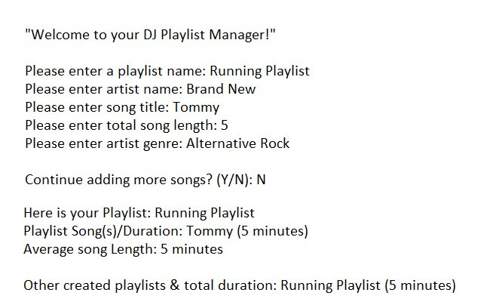
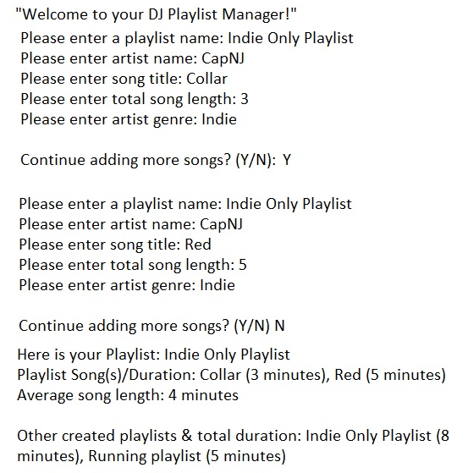
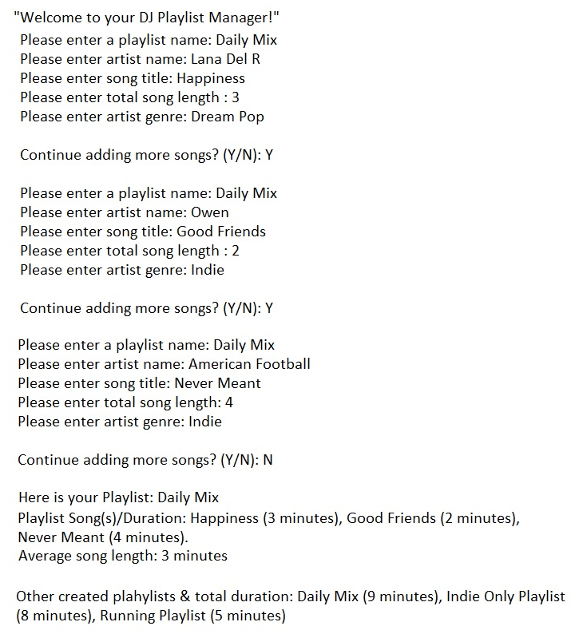
Visualize the program running
Visualizing the program as if it were already running gave an idea of which direction to take in creating it.
The images show the program if it were opened and running.
Each image shows different outputs of how the program will run:
  Adding playlist and song information.
  Adding more songs if the user decides to continue.
  Reporting the information that was entered in.

Slide 5
Pseudocode
Start
“Welcome to your DJ Playlist Manager!"
Loop until user set -> continue= N
Output “Here is your Playlist:” playlistName
Output “Playlist Song(s)/Duration: “ songTitle, songLength
Output “Average song length: “ averageSongLength
Output “Here are your previous playlists made: “ createdPlaylists, totalPlaylistLength
Output “Please enter a playlist name.”
Input playlistName
Output “Please enter artist name.”
Input artistName
Output “Please enter song title.”
Input songTitle
Output “please enter song total song length.”
Input songLength
Output “Please enter artist genre.”
Input artistGenre
Set song length summation = song length summation + song length
Output “Continue adding more songs? (Y/N)
Input continue
Set averageSongLength = (songLength + totalSong Lengths) / totalSongs
Set createdPlaylists = playlistName + previous playlist names
Set totalPlaylistLength = songLength + previous song lengths
Output “Here is your Playlist:” playlistName
Output “Playlist Song(s)/Duration: “ songTitle, songLength
Output “Average song length: “ averageSongLength
Output “Other created playlists & total duration: “ createdPlaylists, totalPlaylistLength
Pause
End
This image shows the steps that the program will go through.
When the program starts it will go into a looping where the user will add songs until the user breaks the loop by entering ‘N’ for “No.
Then when the user quits the loop the program will display the songs and playlist information that was entered.
The pseudocode contains the input of the user, processing of the data, and the output of the end results.

Slide 6
IPO Chart
The IPO chart is used to show the structure of the program.
Each part of the program is set up by the input, processing, and output.
Input:
  will be the user’s choice entered at the menu and the playlist and song information entered.
Processing:
  will be the song length, total songs lengths, average song length, and the total playlist length.
Output:
  will show the created playlists with the song information.

Slide 7
Flowchart
The design process continues with the flowchart of the program.
This simple flowchart shows the input, processing, and output of the program.
Like the IPO chart the flowchart shows how the program will flow, but instead using source code to show the flow of the program.
Next the program will work in the simplest form.

Slide 8
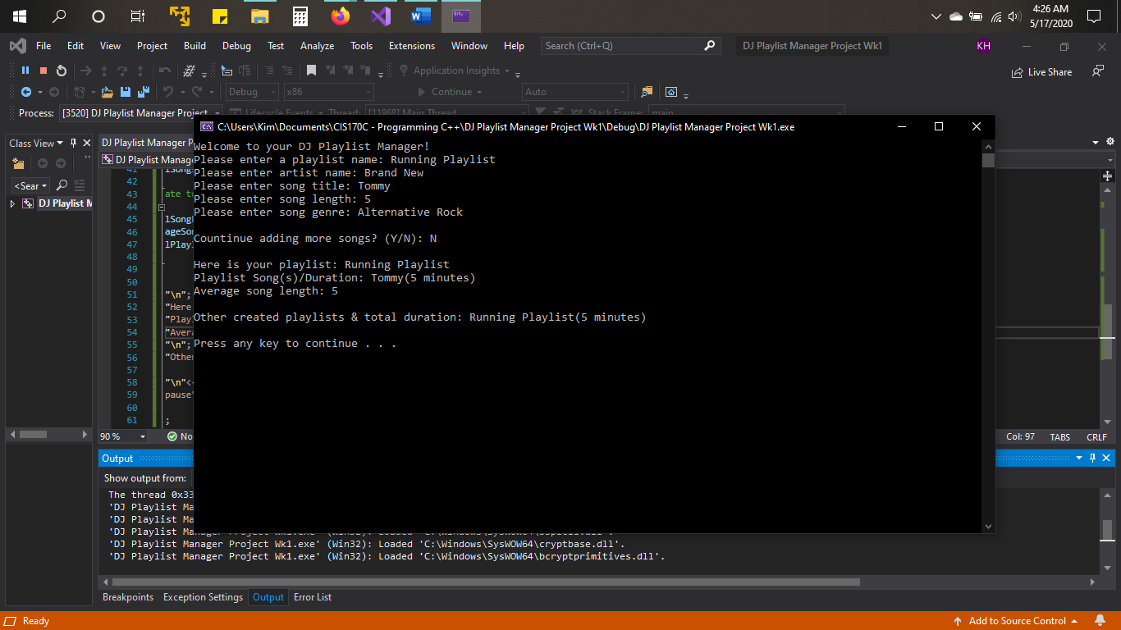
A simple working program
The first and easiest part of the program is getting user input.
By using “cout <<“ followed by a line of text in quotation marks and ending the line of code with a semicolon outputs the information on the console to the user.
By using “cin >>” and following a variable will take the user input and give the variable a new value.
In this case the image shows the user was prompted to enter a playlist name, artist name, song title, song length, and genre.
Each of the variables will now have a new value.
Then the user discontinues the program, and it ends.

Slide 9
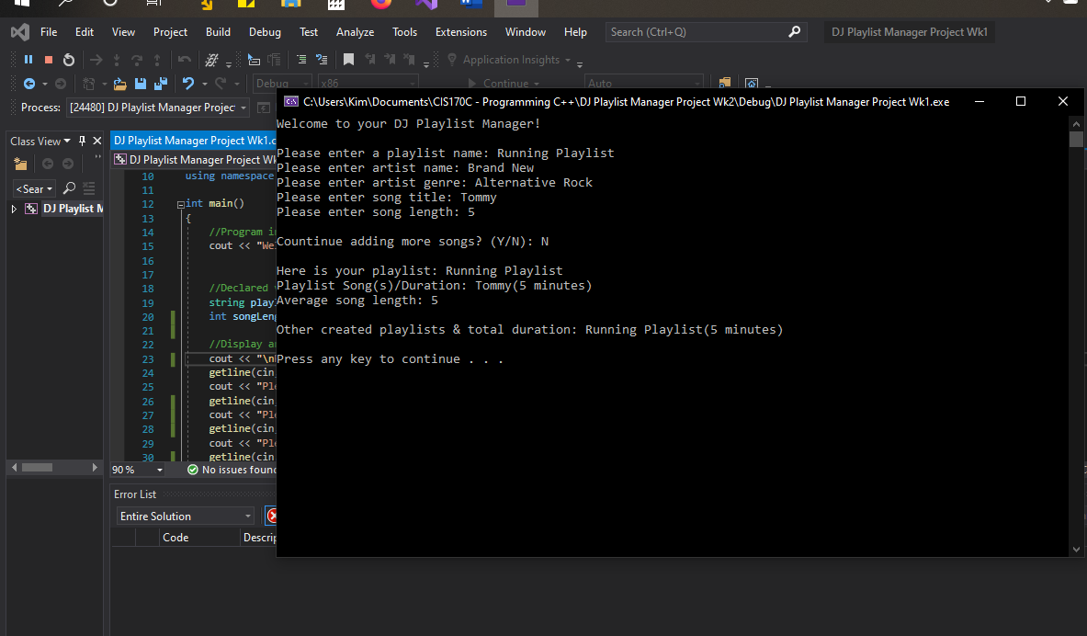
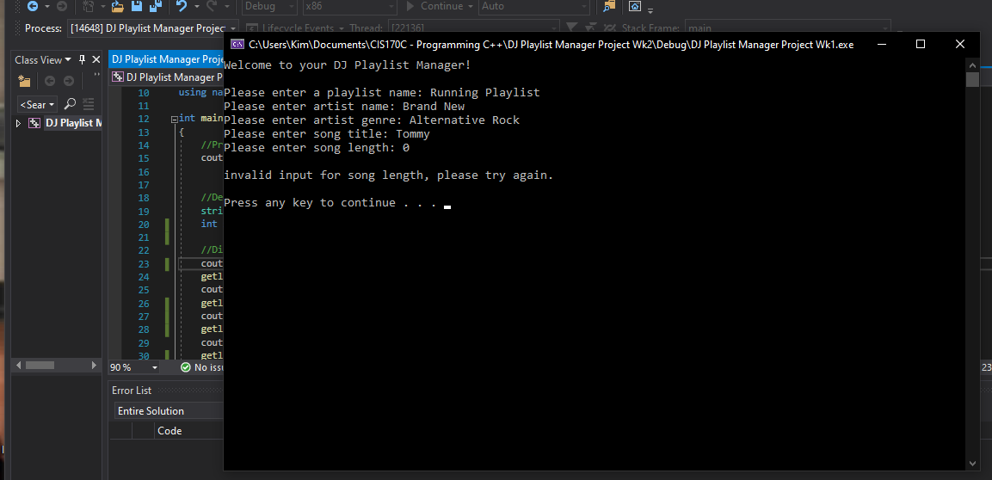
Adding a conditional expression
A conditional expression was added to the program to check if the song length is equal to less than or equal to 0.
If the expression is true, it will prompt the user to try again.

Slide 10
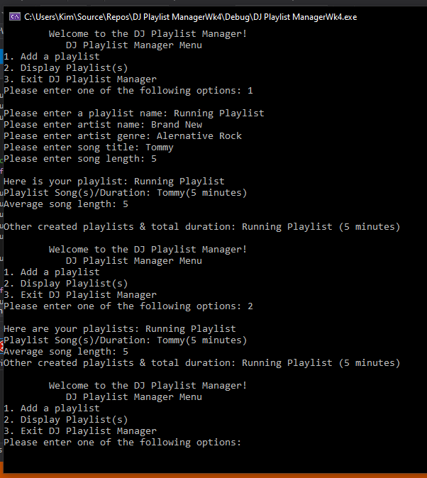
Add loops to validate data and a Menu
The program was set up with a simple menu including loops that contained conditional expressions to validate the menu.
If the user chose option 1 on the menu it would ask the user to add a playlist including the song information.
If the user chose option 2 it would display the information that was entered.
If the user chose option 3 it would display “The program is exiting..” and then proceeds to exit.
If the choice is not equal to 3, the program will loop back to the menu and proceed to ask the user which option they would like to select.

Slide 11
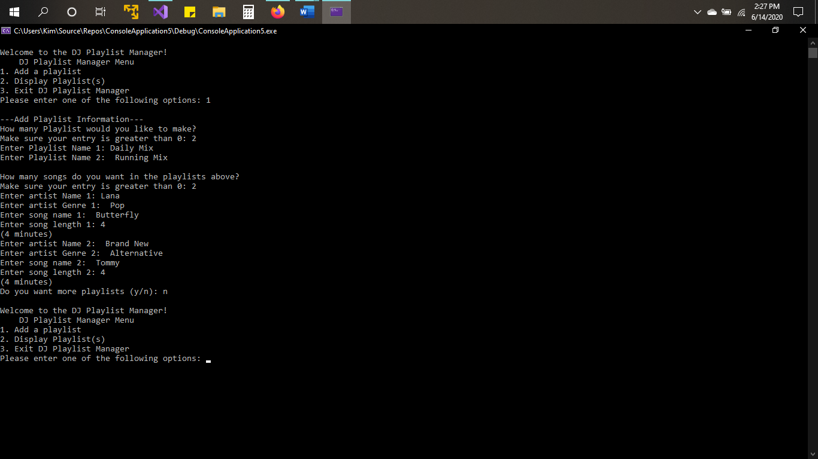
Adding Arrays to handle more data
Arrays are used to handle more data as it stores a collection of elements of the same data type.
The array’s elements can be accessed by using a for loop.
A playlist name, artist name, song title, song length, and artist genre arrays were created and used to store the information the user is entering.
The image shows the playlist and song information which are being stored into the arrays that were created.

Slide 12
Creating a hierarchy chart
As the program is reaching a complicating stage, a hierarchy chart is needed to modularize the code.
The hierarchy chart is designed to show the elements in order from highest to lowest.

Slide 13
Modularize the code
When a complex program is in development the program is then modularized to break down into smaller manageable parts.
These smaller parts are managed by functions which are called into the main() function.
Some benefits of using this approach is:
  Being able to easily track errors that could occur.
  Reusing the code in different parts of the program.
Next, the flowchart was updated based on the modular approach.

Slide 14
Final
Flowchart
The image shows the flowchart that is updated based on the hierarchy chart and modular approach of the code.

Slide 15
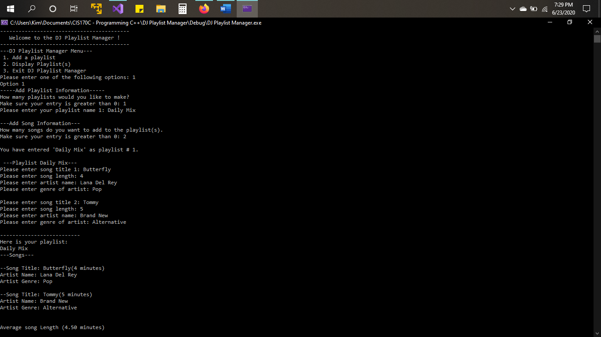
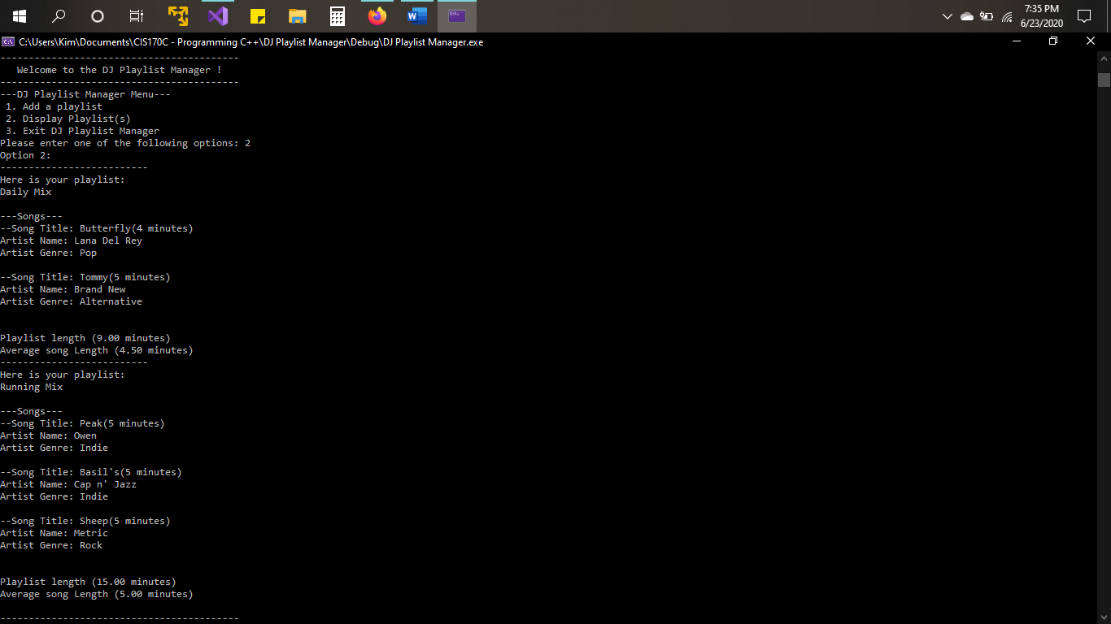
The modular approach In Effect
A structure of songs was added in order to handle the song information more efficiently.
A class called Playlist was added to handle all the playlist information.
Adding these to the program helped manage out the playlist and song information that was entered by the user.
The functions members allowed the ease of data manipulation.
All errors were easily determined when they occurred.

Slide 16
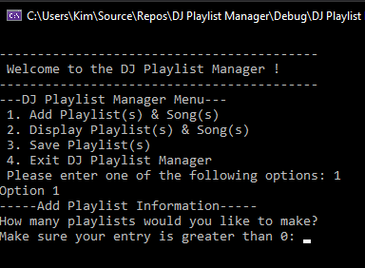
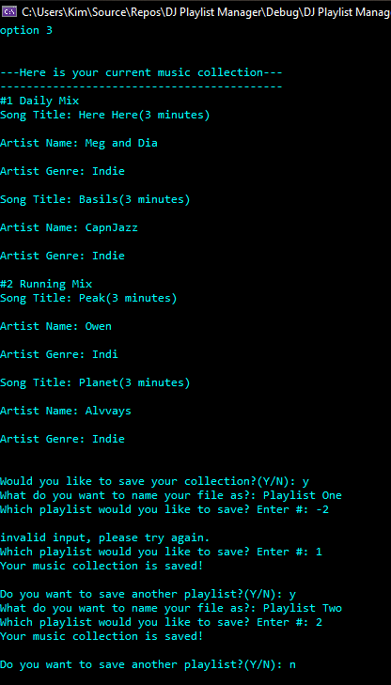
Add to Menu an option to save or retrieve data
A new option was added to the menu where the user can save the playlist(s) and all the song information.
The process of this menu options is as follows:
  The playlists were displayed and numbered.
  The program enters a loop where the user decides to save a playlist.
  If Y is entered, the user can name the file, and by selecting the number that corresponds to the playlist will save the playlist to a file.
  The file is saved to the user’s computer where the program resides.
  The loop prompts to save another playlist; if the user enters N the loop will break and return to the main menu.
In addition to a new menu option, the font color of the program was changed.

Slide 17
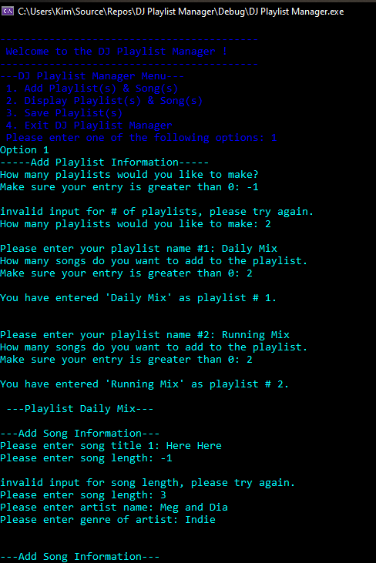
Adding color
Image of the program with color.

Slide 18
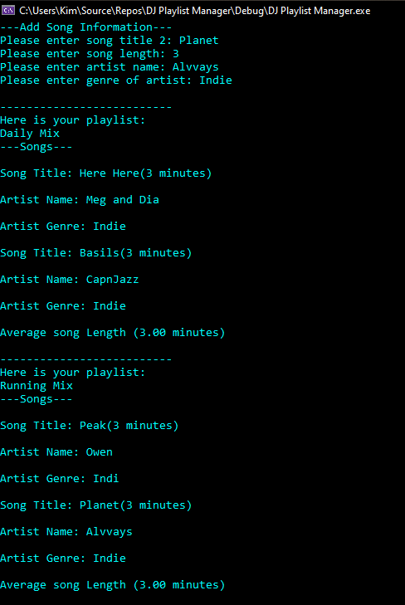
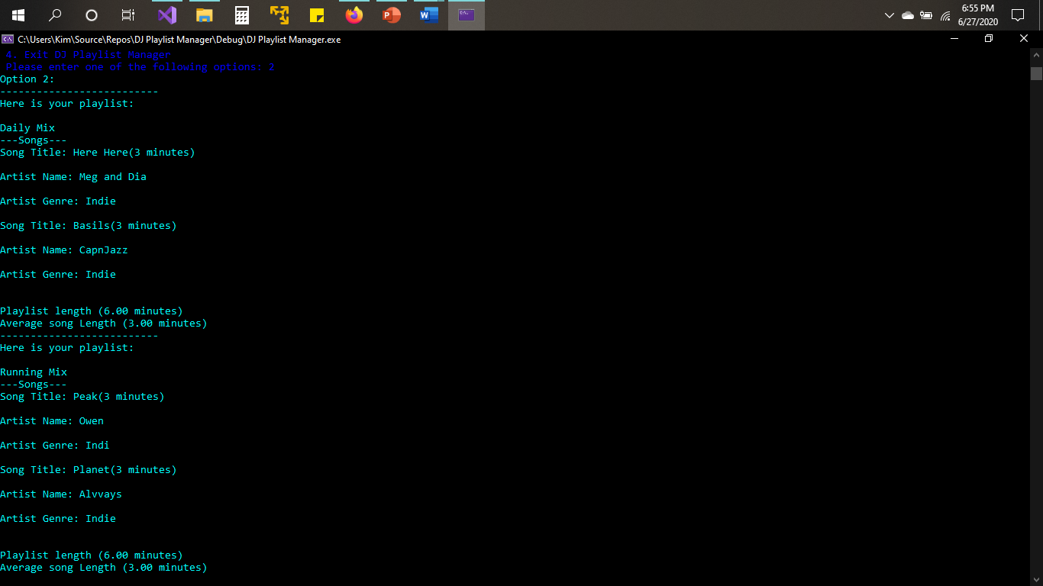
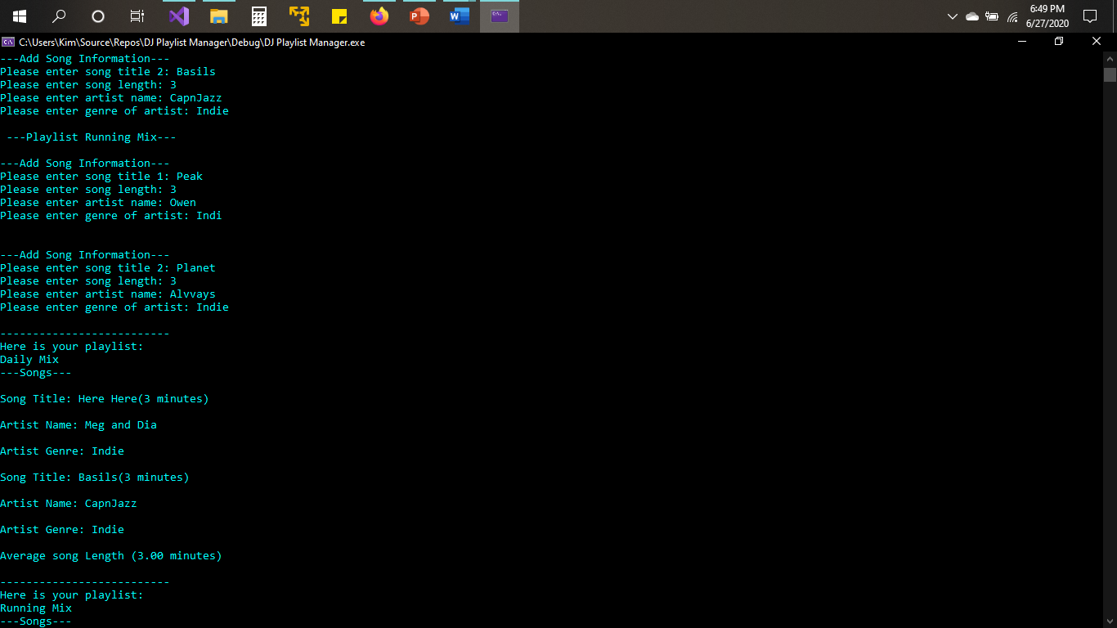
A Working Program (continued)
The program is fully functioning with the following:
  Inputs and outputs
  A conditional expression
  For loops
  Arrays
  A song structure
  A Playlist Class
  Color

Slide 19
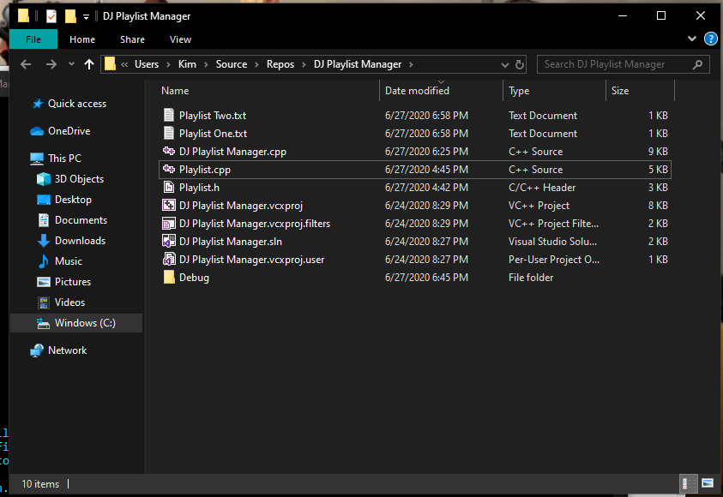
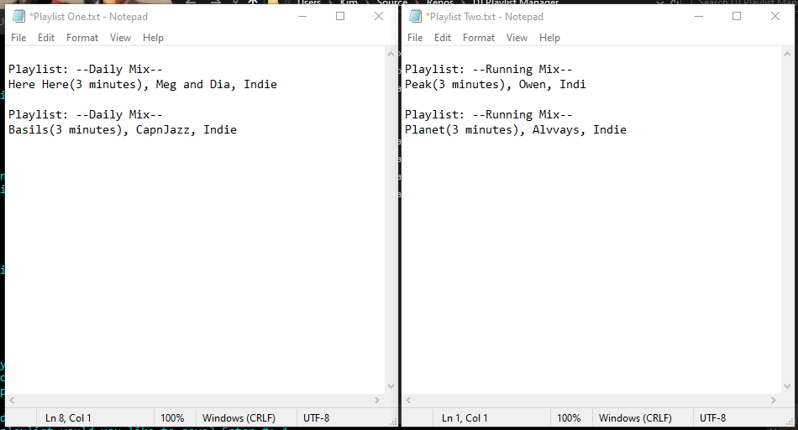
A Working Program(continued)
The image shows option three of the menu where the playlist and song information is saved.
A file is created then saved to the user’s computer and found where the program resides.

Slide 20
Challenges
A challenge faced in the code was displaying the playlists and songs of that playlist that were entered. A double for loop was needed, one for the playlists and another for the songs.
Once the code was modularized, the average song length output was inaccurate. Two methods needed a count of total songs from each playlist to average out correctly.
When the playlists were saved the file would show double the amount of the same songs. It was fixed by taking out one for loop from the main code.

Slide 21
Future Improvements
There are 3 improvements that can be implemented in this program:
  One improvement is to add all the songs on one menu option.
  Create individual playlists from the collection of songs on another menu option.
  Add more graphics to make the program look more appealing and not just color to the text such as a graphical user interface.

Slide 22
Conclusion
The development of this application is just the beginning as there is a lot more that can be done to it.
The more that can be done to it makes it more enjoyable for the user.
So, as my knowledge on C++ expands so will this program.
Thank you!

Slide 23
Reference
Gaddis, T. (2015) Starting Out with C++ from Control Structures to Objects. [VitalSource Bookshelf]. Retrieved from https://online.vitalsource.com
  /#/books/9781323312360/

