Slide 1
CEIS 114
IoT Traffic Controller
Final Project
Kimberly Hernandez
DeVry University CEIS 114
02/21/20
Mostafa Mortezaie

Slide 2
Introduction
As technology grows so does the internet of things (IoT).
This project will simulate a traffic light and in the event of:
  Motion detected on a minor street
  If a pedestrian presses a button to cross the street
  Or if an emergency button is activated incase of one.
During the developments add-ons, will also look at the output of the device through the serial monitor of the Arduino IDE software.
At the end of the development will include some challenges that were faced and career skills that were gained.
The planning & designing for the IoT traffic controller was done before developing the controller.

Slide 3
Plan for IoT Traffic Controller
Module 1
The first part of planning for the traffic controller is an inventory of items were taken (image in next slide).
Inventory items include:
  ESP32 Board
  Colored LEDs: Red, Yellow, Green, and Blue
  Wires
  Breadboard
  LCD Unit
  Buzzer
  Two Push Buttons
  Motion Detector
After all the supplies were gathered an Input, output, processing (or IOP) chart was put together.
A flowchart was then created based off the IPO chart to visualize the traffic controller if in the event of:
  Emergency button activated
  Pedestrian button activated
  Motion detected on minor street

Slide 4
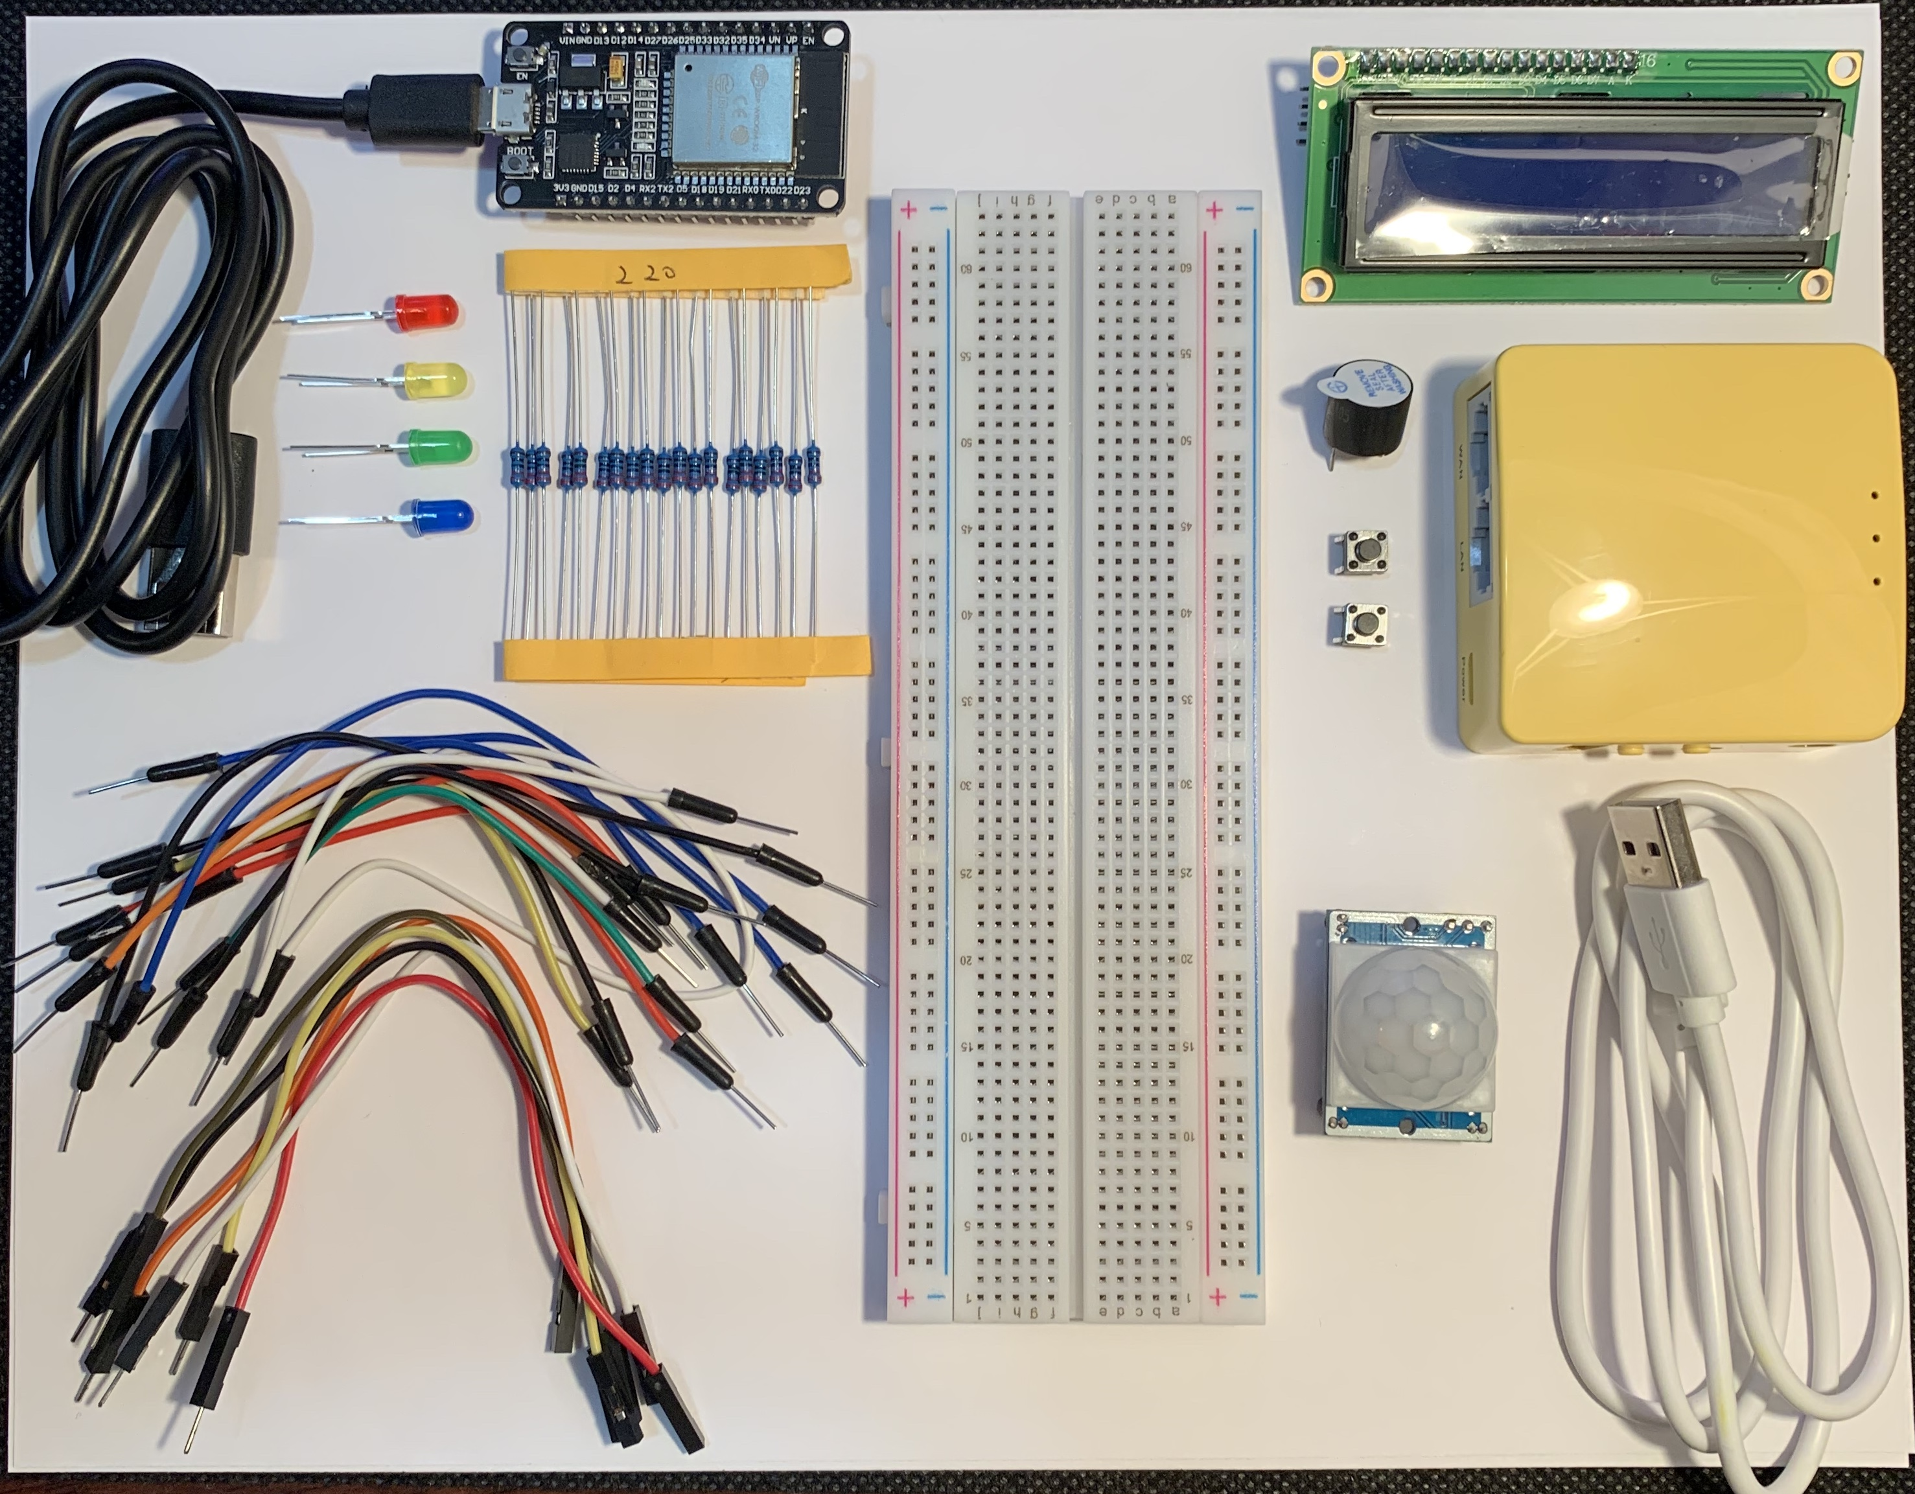
Picture of Inventory
ESP32 Board
Colored LEDs: Red, Yellow, Green, and Blue
220 Ohm Resistors (optional)
Wires
Breadboard
LCD Unit
Buzzer
Mini Router
Push Buttons – 2
Motion Detector

Slide 5
Input – Processing - Output
Fill out the following chart for the course project option you selected
Input | Process | Output
Emergency button activated Pedestrian button activated Motion detected on minor street | Change LED lights to red Change LED light for pedestrian Change LED lights | Notify pedestrian to walk/ or do not walk

Slide 6

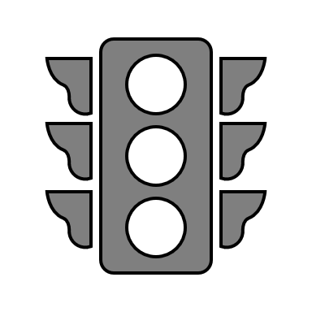
Project Flowchart
Start
Emergency button activated
Yes
Both streetlights are red
No
Pedestrian button activated
Change light for pedestrian
Display message for pedestrian to walk/ or do not walk
Include flowchart for the course project option you selected
Yes
No
Motion detected on minor street
Change light on major street and minor street
Yes
No
Keep light red for major street
End

Slide 7
Creating the Traffic Controller
Module 2
Before putting the circuit together appropriate software is downloaded and ready for use.
The software used for the IoT Traffic Controller is Arduino IDE with the code to run a single traffic light (image on next slide).
The Arduino IDE software required several changes to “Tools” menu in order for the program to run the circuit successfully:
  The board is changed to “DOIT ESP32 DEVKIT V1”
  The baud rate was set to “115200”
  The flash frequency was set to “80MHz”
The circuit was then set up using the several inventory items to start (image of circuit setup on following slide).
Once the circuit was set up and connected the correct “COM3” port was selected under the “Tools” menu.

Slide 8
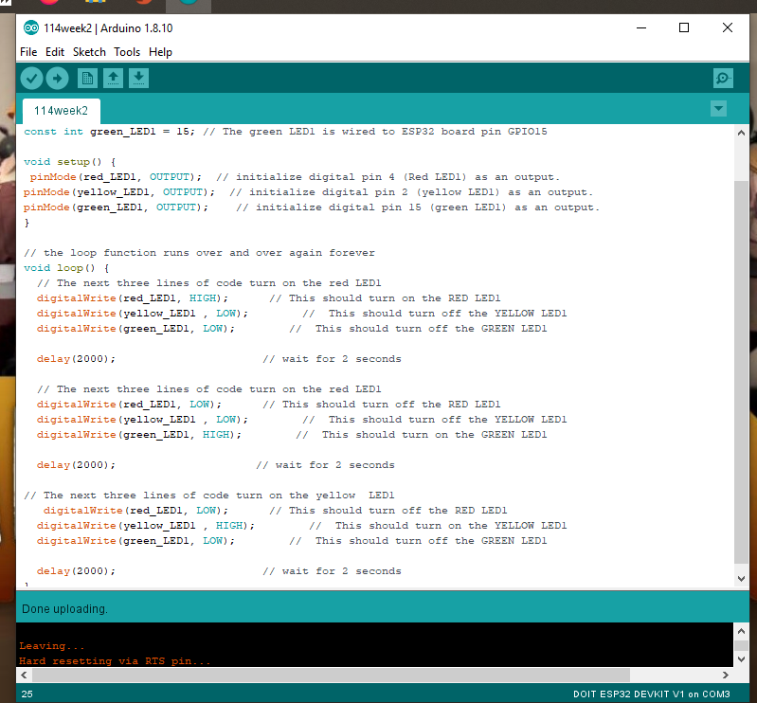
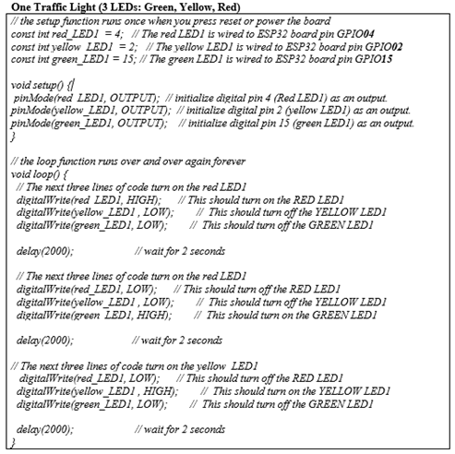
Picture of Arduino IDE
PC running Arduino IDE
Screen shot of the program

Slide 9
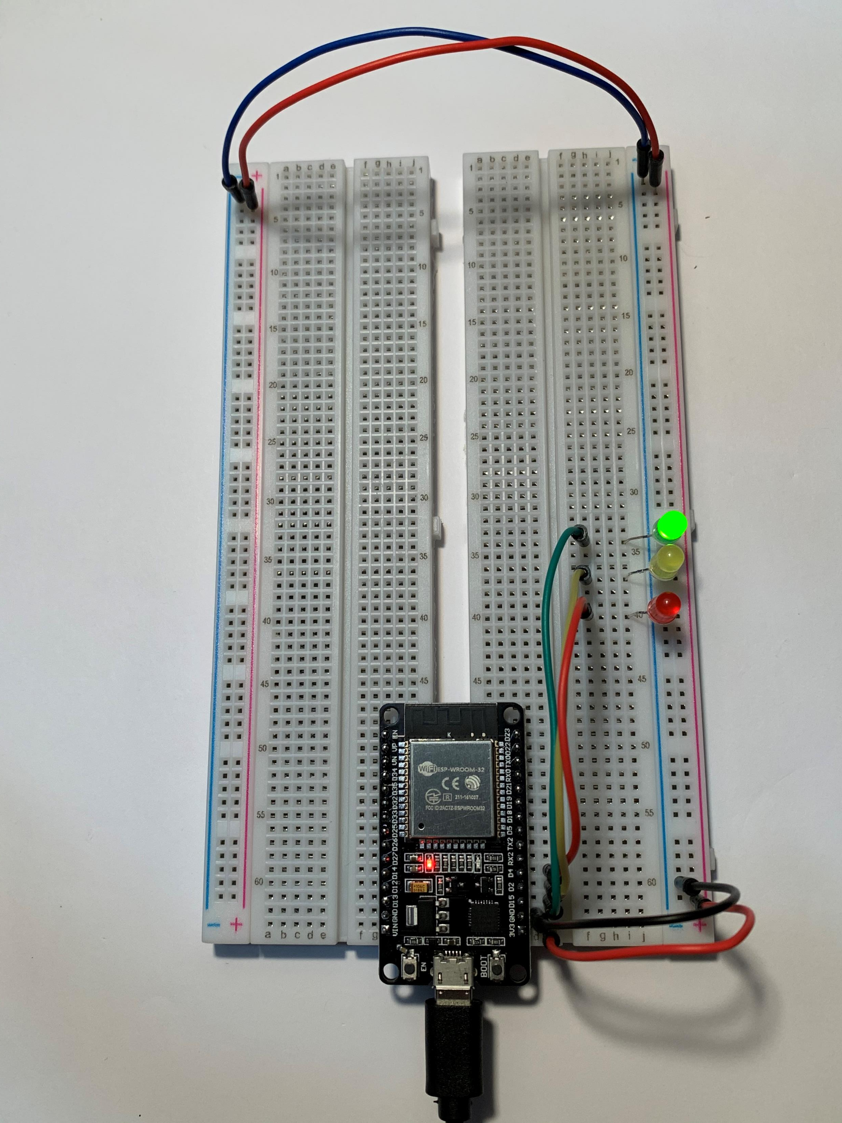

Picture of circuit
ESP 32 Board
Colored LEDs: Red, Yellow and Green
Wires
Breadboard

Slide 10

Creating a Multiple Traffic Light Controller
Module 3
The development of the circuit continues with adding another set of traffic lights.
The following items were added to the circuit:
  Another set of colored LEDs: Red, Yellow and Green
  Wires
A new code was input into the software to control both lights.
Once the code was uploaded and running the traffic lights alternate colors.

Slide 11
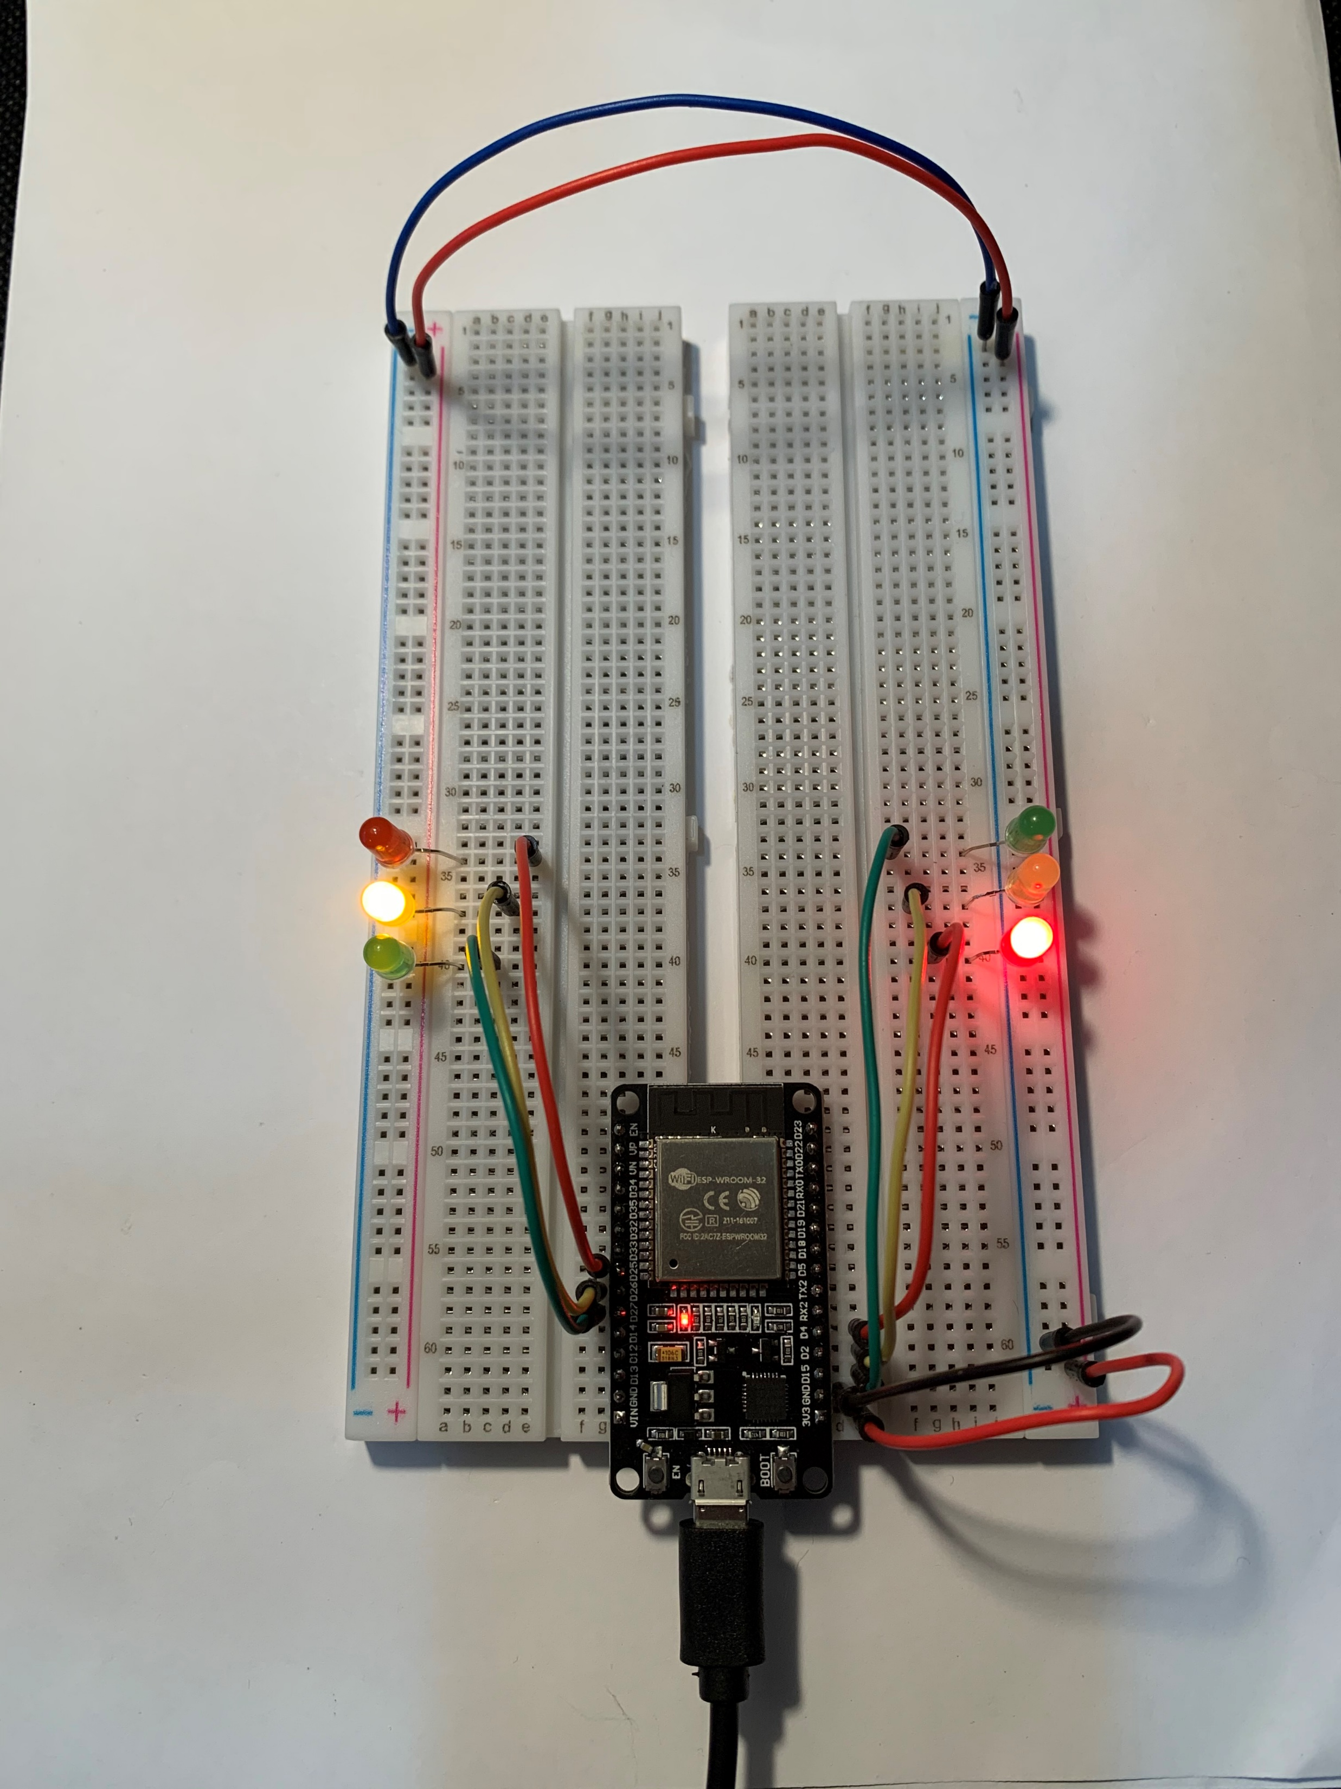
Picture of Circuit
At this point of the development we have:
ESP32 Board
Two sets of colored LEDs: Red, Yellow and Green
Wires
Breadboard

Slide 12
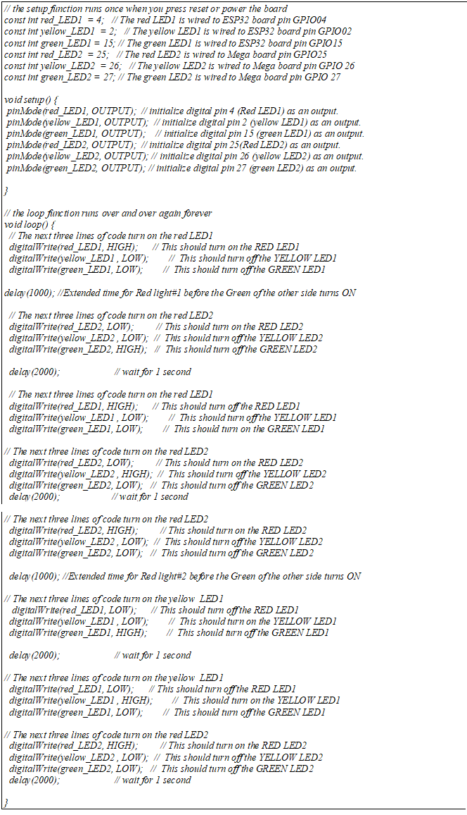
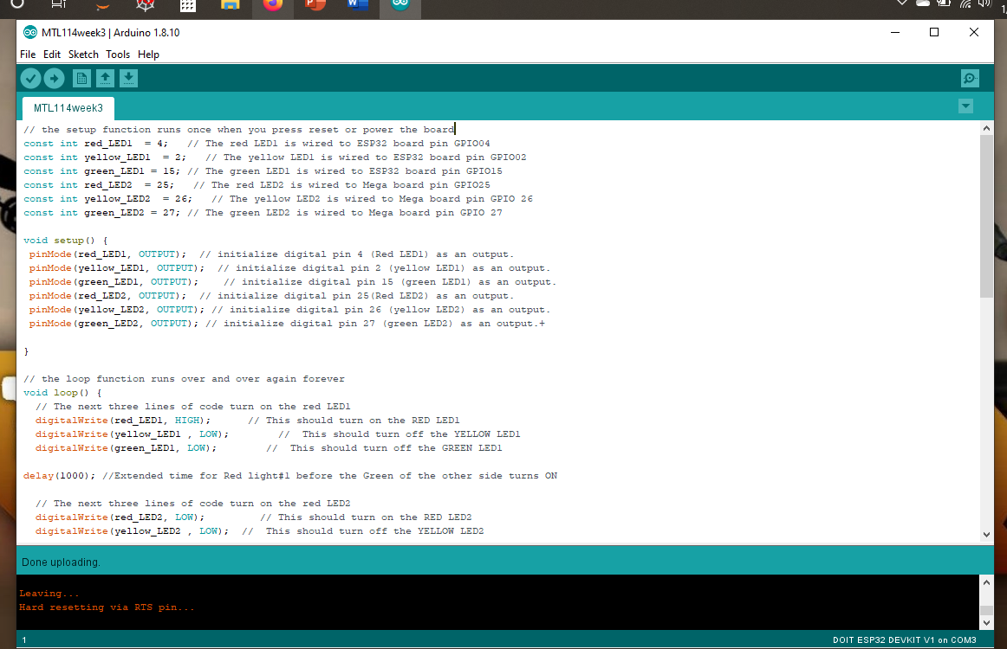
Screenshot of Arduino IDE
Screenshot of code in Arduino IDE

Slide 13

Creating a Multiple Traffic Light Controller with a Cross Walk
Module 4
Continuing the traffic light development a touch sensor is added.
The touch sensor wire is added to act as if the cross-walk button is activated and is used to change both lights red.
The image on the next slide shows when the touch sensor wire is activated. (image of circuit with touch sensor wire on next slide)
After the touch sensor wire is added to the circuit a new code is uploaded to the Arduino IDE software.
When the serial monitor is open it displays the allotted time a pedestrian has to walk.

Slide 14
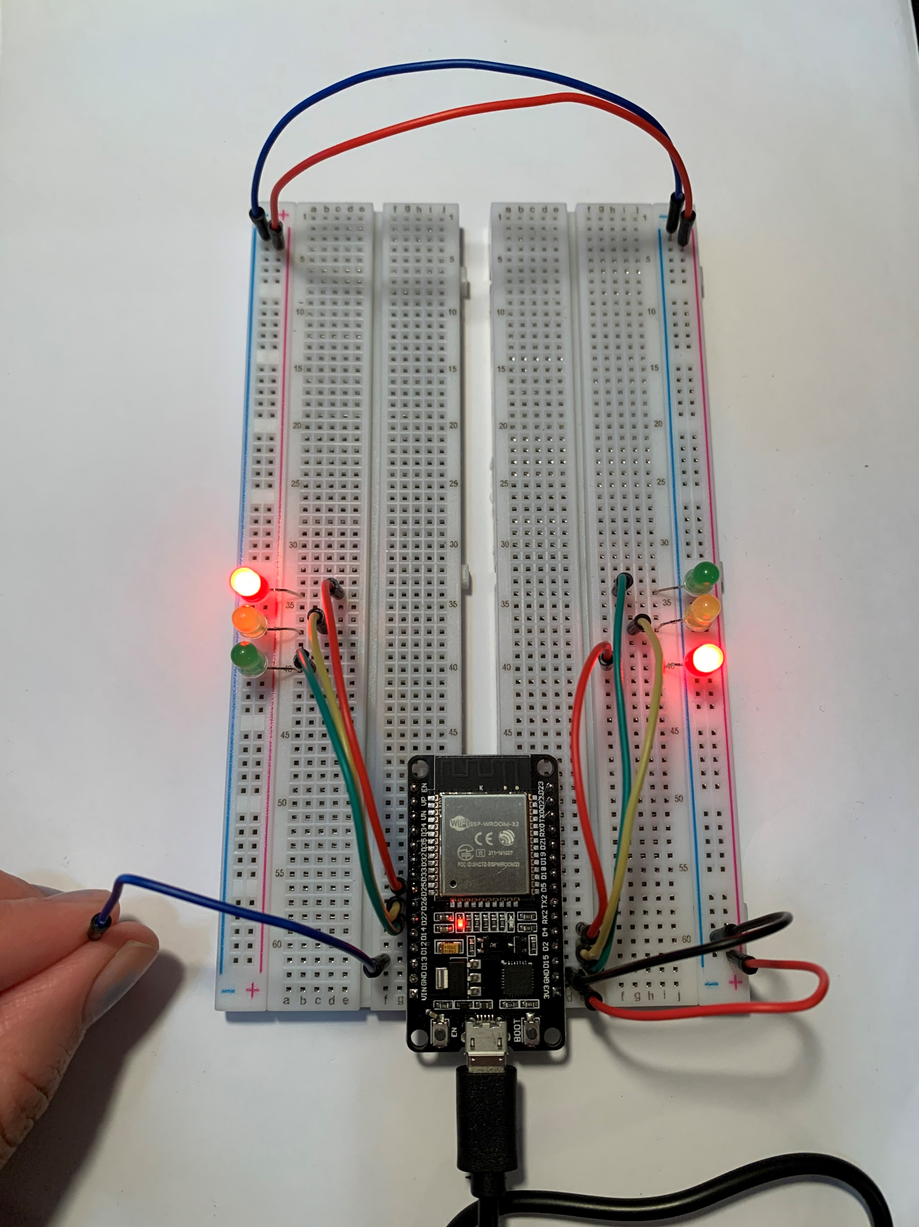
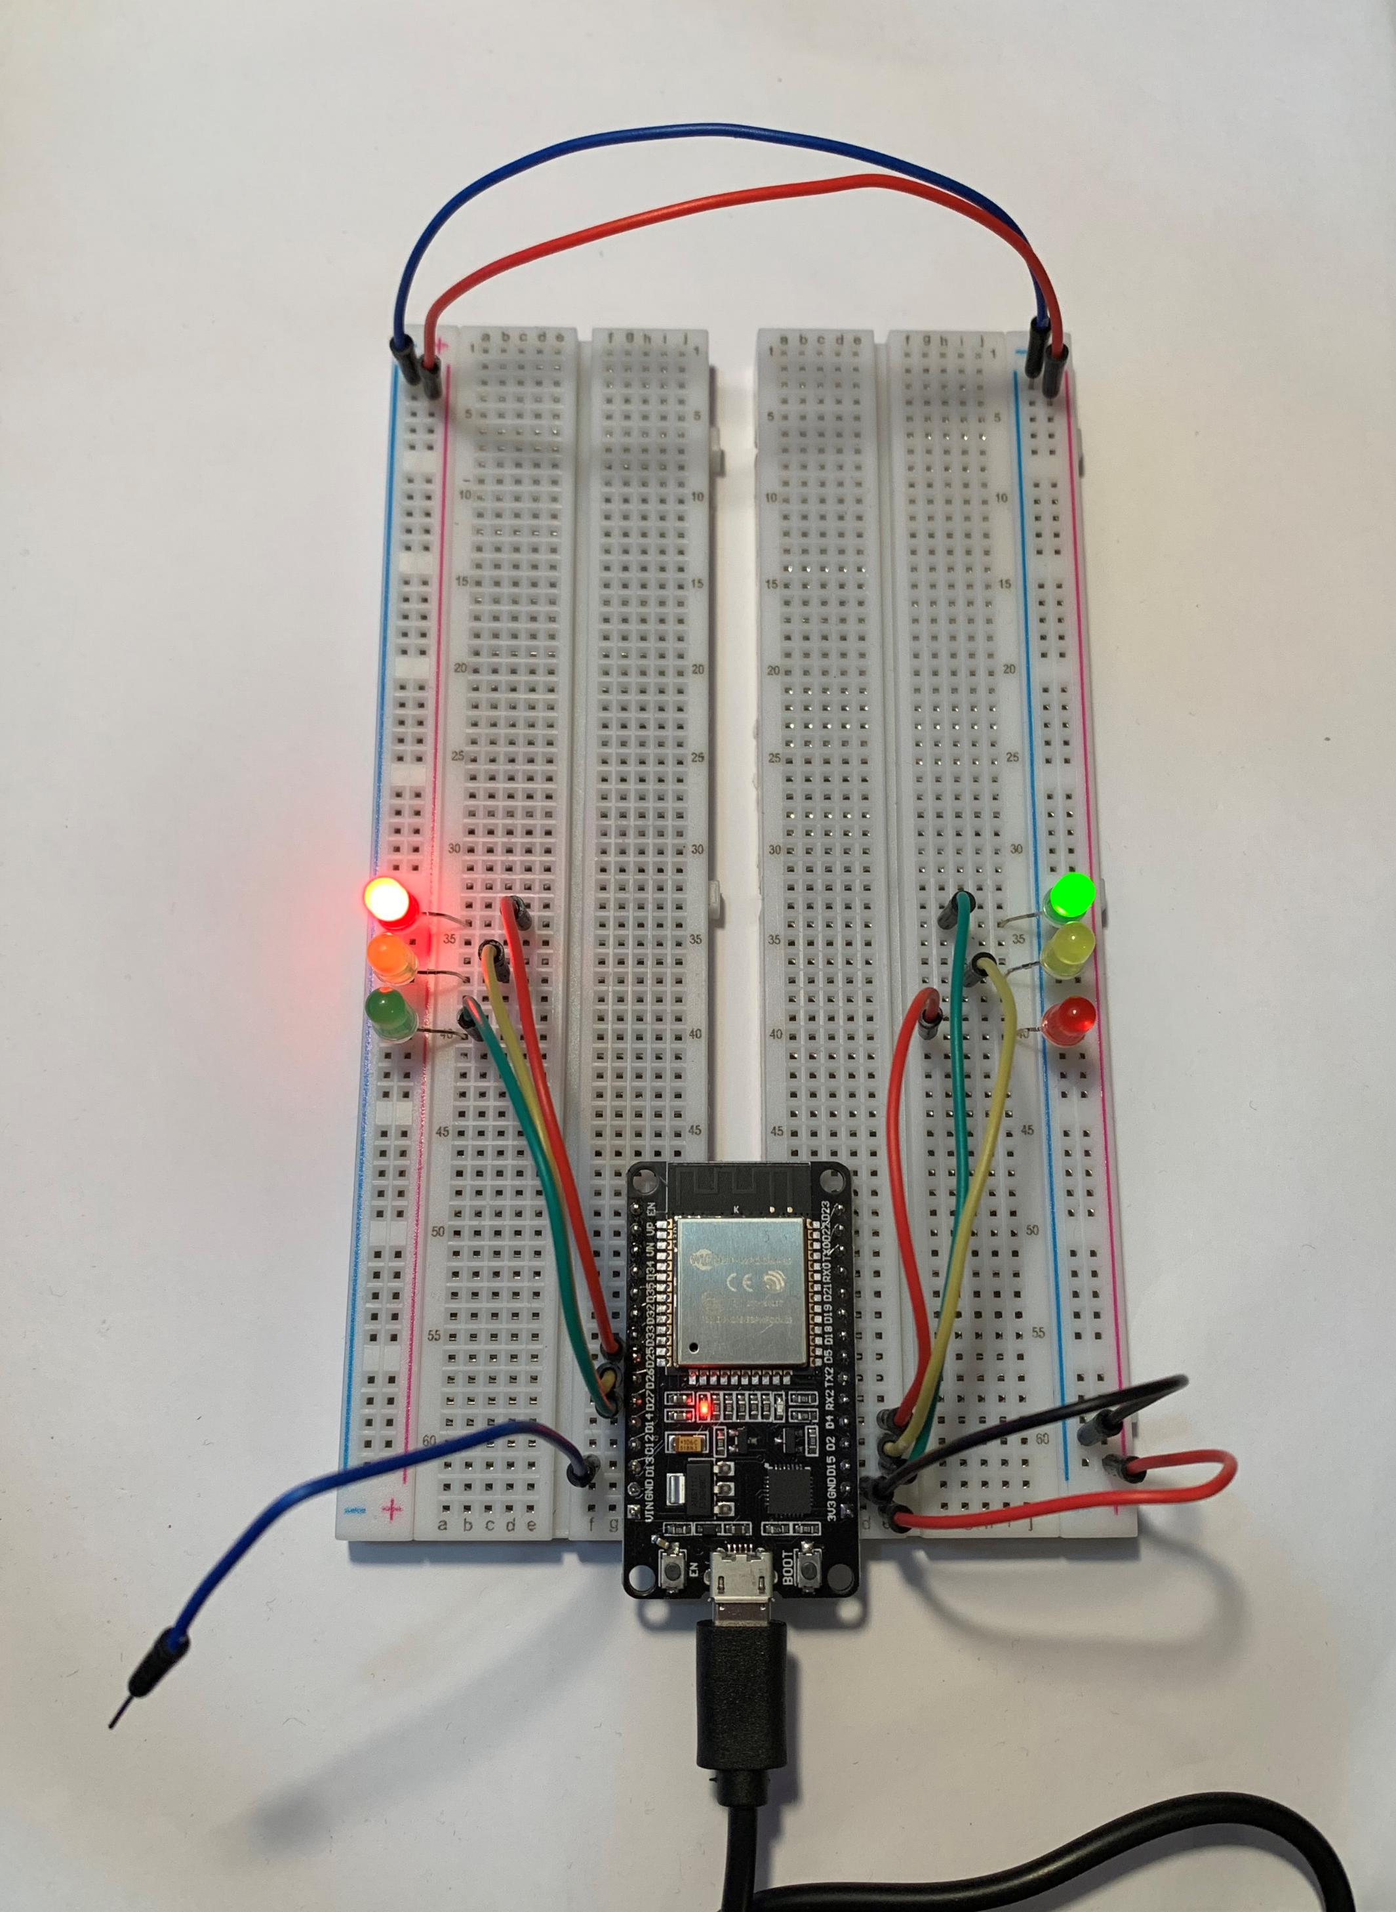
Picture of
Circuit
ESP32 Board
Two sets of Colored LEDs: Red, Yellow and Green
Touch Sensor (Wire connected to GPIO 13)
Wires
Breadboard

Slide 15
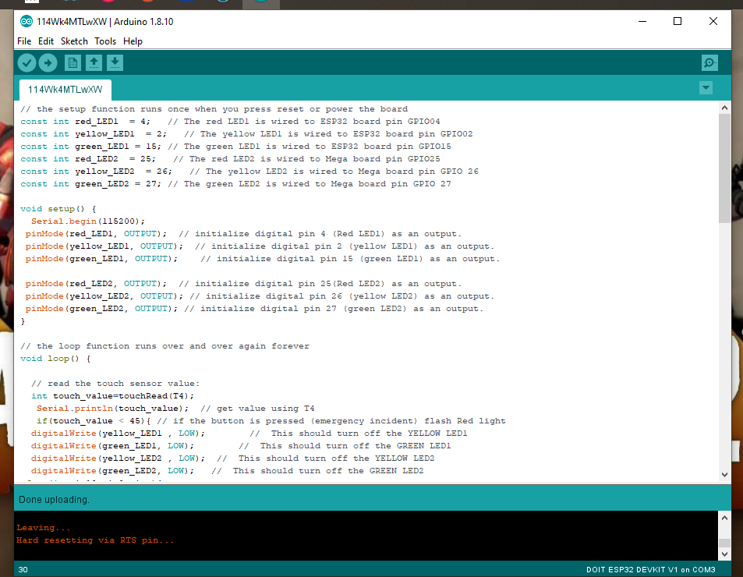
Screenshot of Arduino IDE
Screenshot of code in Arduino IDE

Slide 16
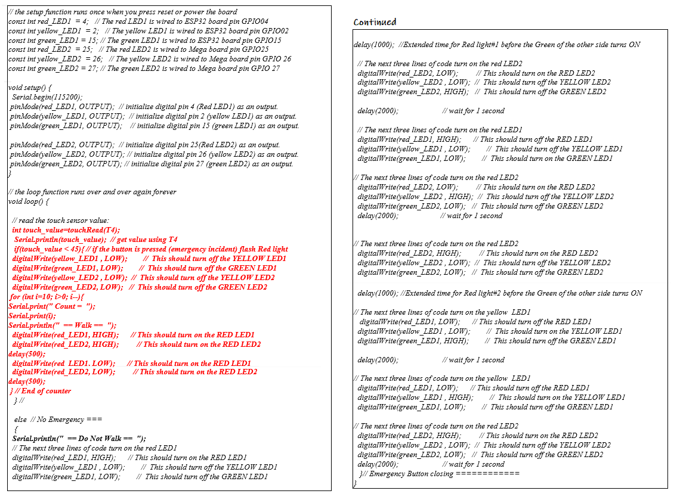
Code for Two Traffic Lights

Slide 17
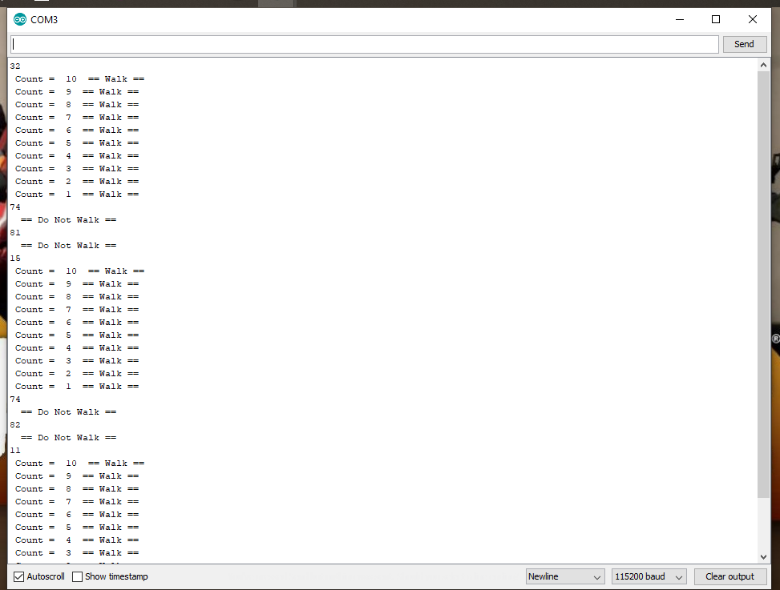
Screenshot of Serial Monitor
Screenshot of output in Serial Monitor

Slide 18
Creating a Multiple Traffic Light Controller with Cross Walk and Buzzer
Module 5
Now an LCD unit is added to the circuit to display a message when the touch sensor wire is activated.
Then a buzzer is added to alert that the cross-walk also active.
At this point in the development the circuit is set up with:
  ESP32 Board
  Two sets of Colored LEDs: Red, Yellow and Green
  Touch Sensor (Wire connected to GPIO 13)
  LCD Unit
  Buzzer
  Wires
  Breadboard
A new part of the code is added to operate the circuit at this point.
Then the serial monitor is opened to display if the pedestrian should walk or do not walk and is also displayed on the LCD screen.

Slide 19
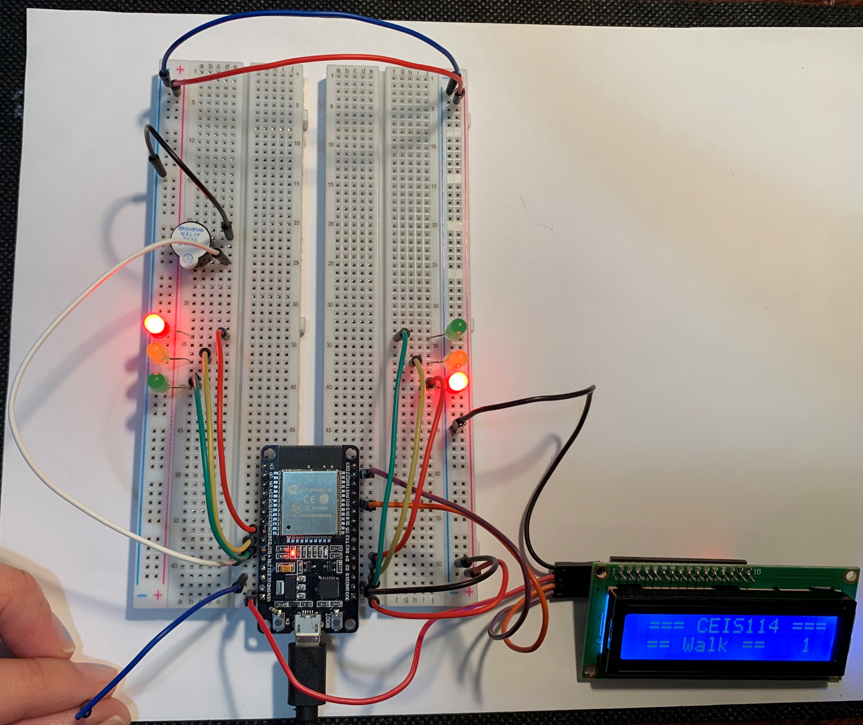
Picture of
Circuit
ESP32 Board
Two sets of Colored LEDs: Red, Yellow and Green
Touch Sensor (Wire connected to GPIO 13)
LCD Unit
Buzzer
Wires
Breadboard

Slide 20
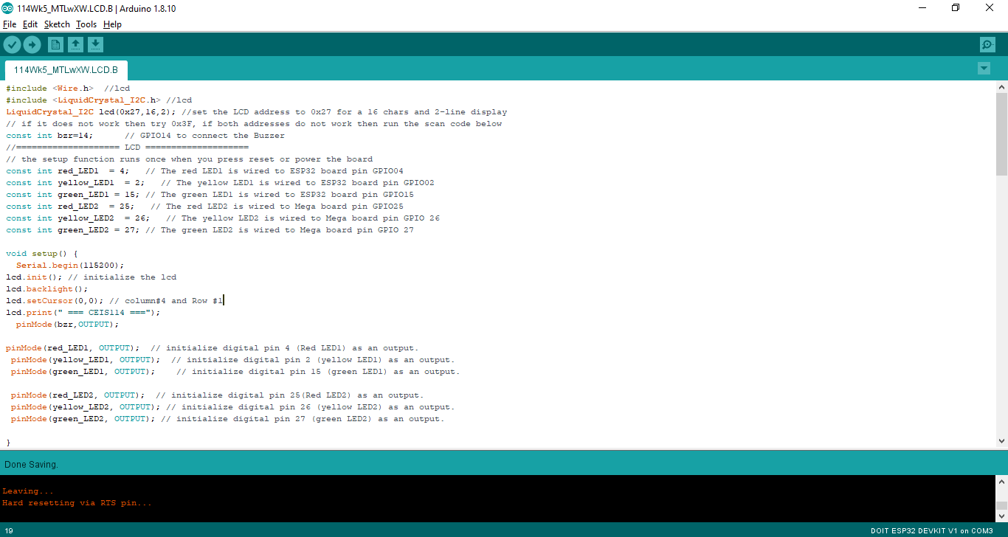
Screenshot of Arduino IDE
Screenshot of code in Arduino IDE

Slide 21
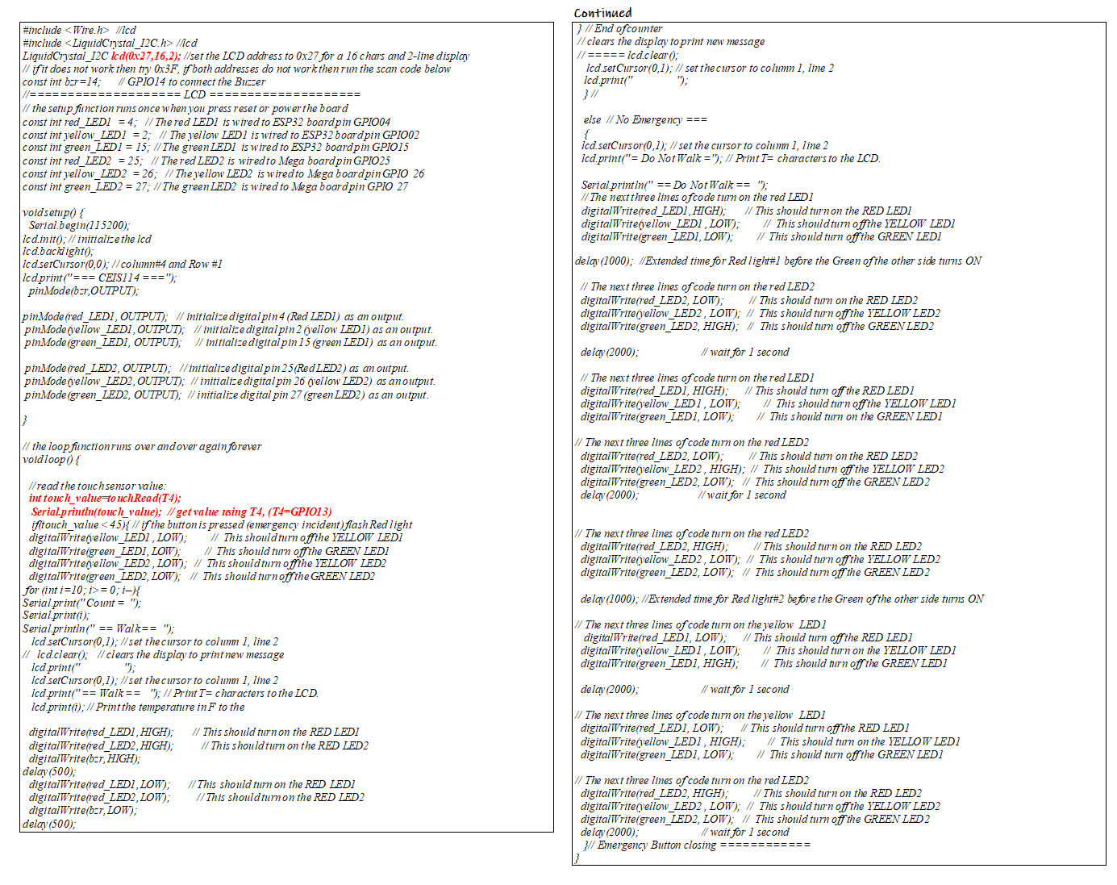
Code for Two Traffic Lights, Cross-walk, and Buzzer

Slide 22
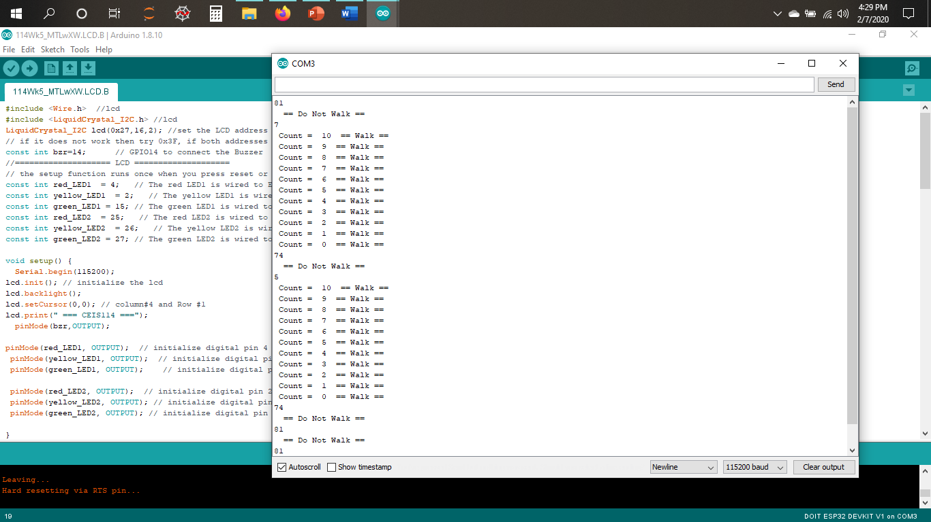
Screenshot of Serial Monitor
Screenshot of output in Serial Monitor

Slide 23
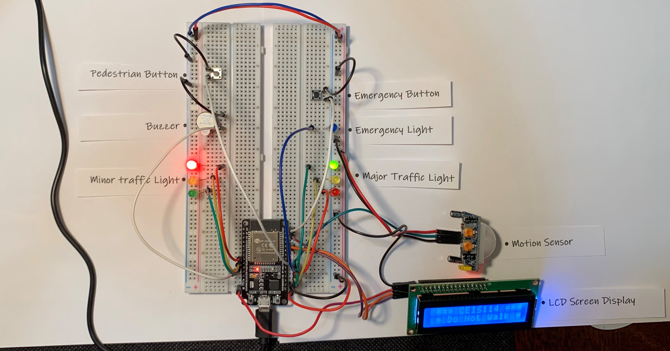
Multiple Traffic Light Controller with a Cross Walk and an Emergency Buzzer with a SMART Sensor
Module 6
In the final part of the development of the IoT traffic controller the touch sensor wire is removed, and a button is added to replace it.
Another item added to the circuit is an emergency button and a blue LED light.
The last item added to the circuit is a motion sensor:
  When motion(cars) is detected on the minor street the major streetlight will turn yellow and proceed to red.
When the final code is uploaded the circuit is now a fully functional IoT traffic controller.

Slide 24
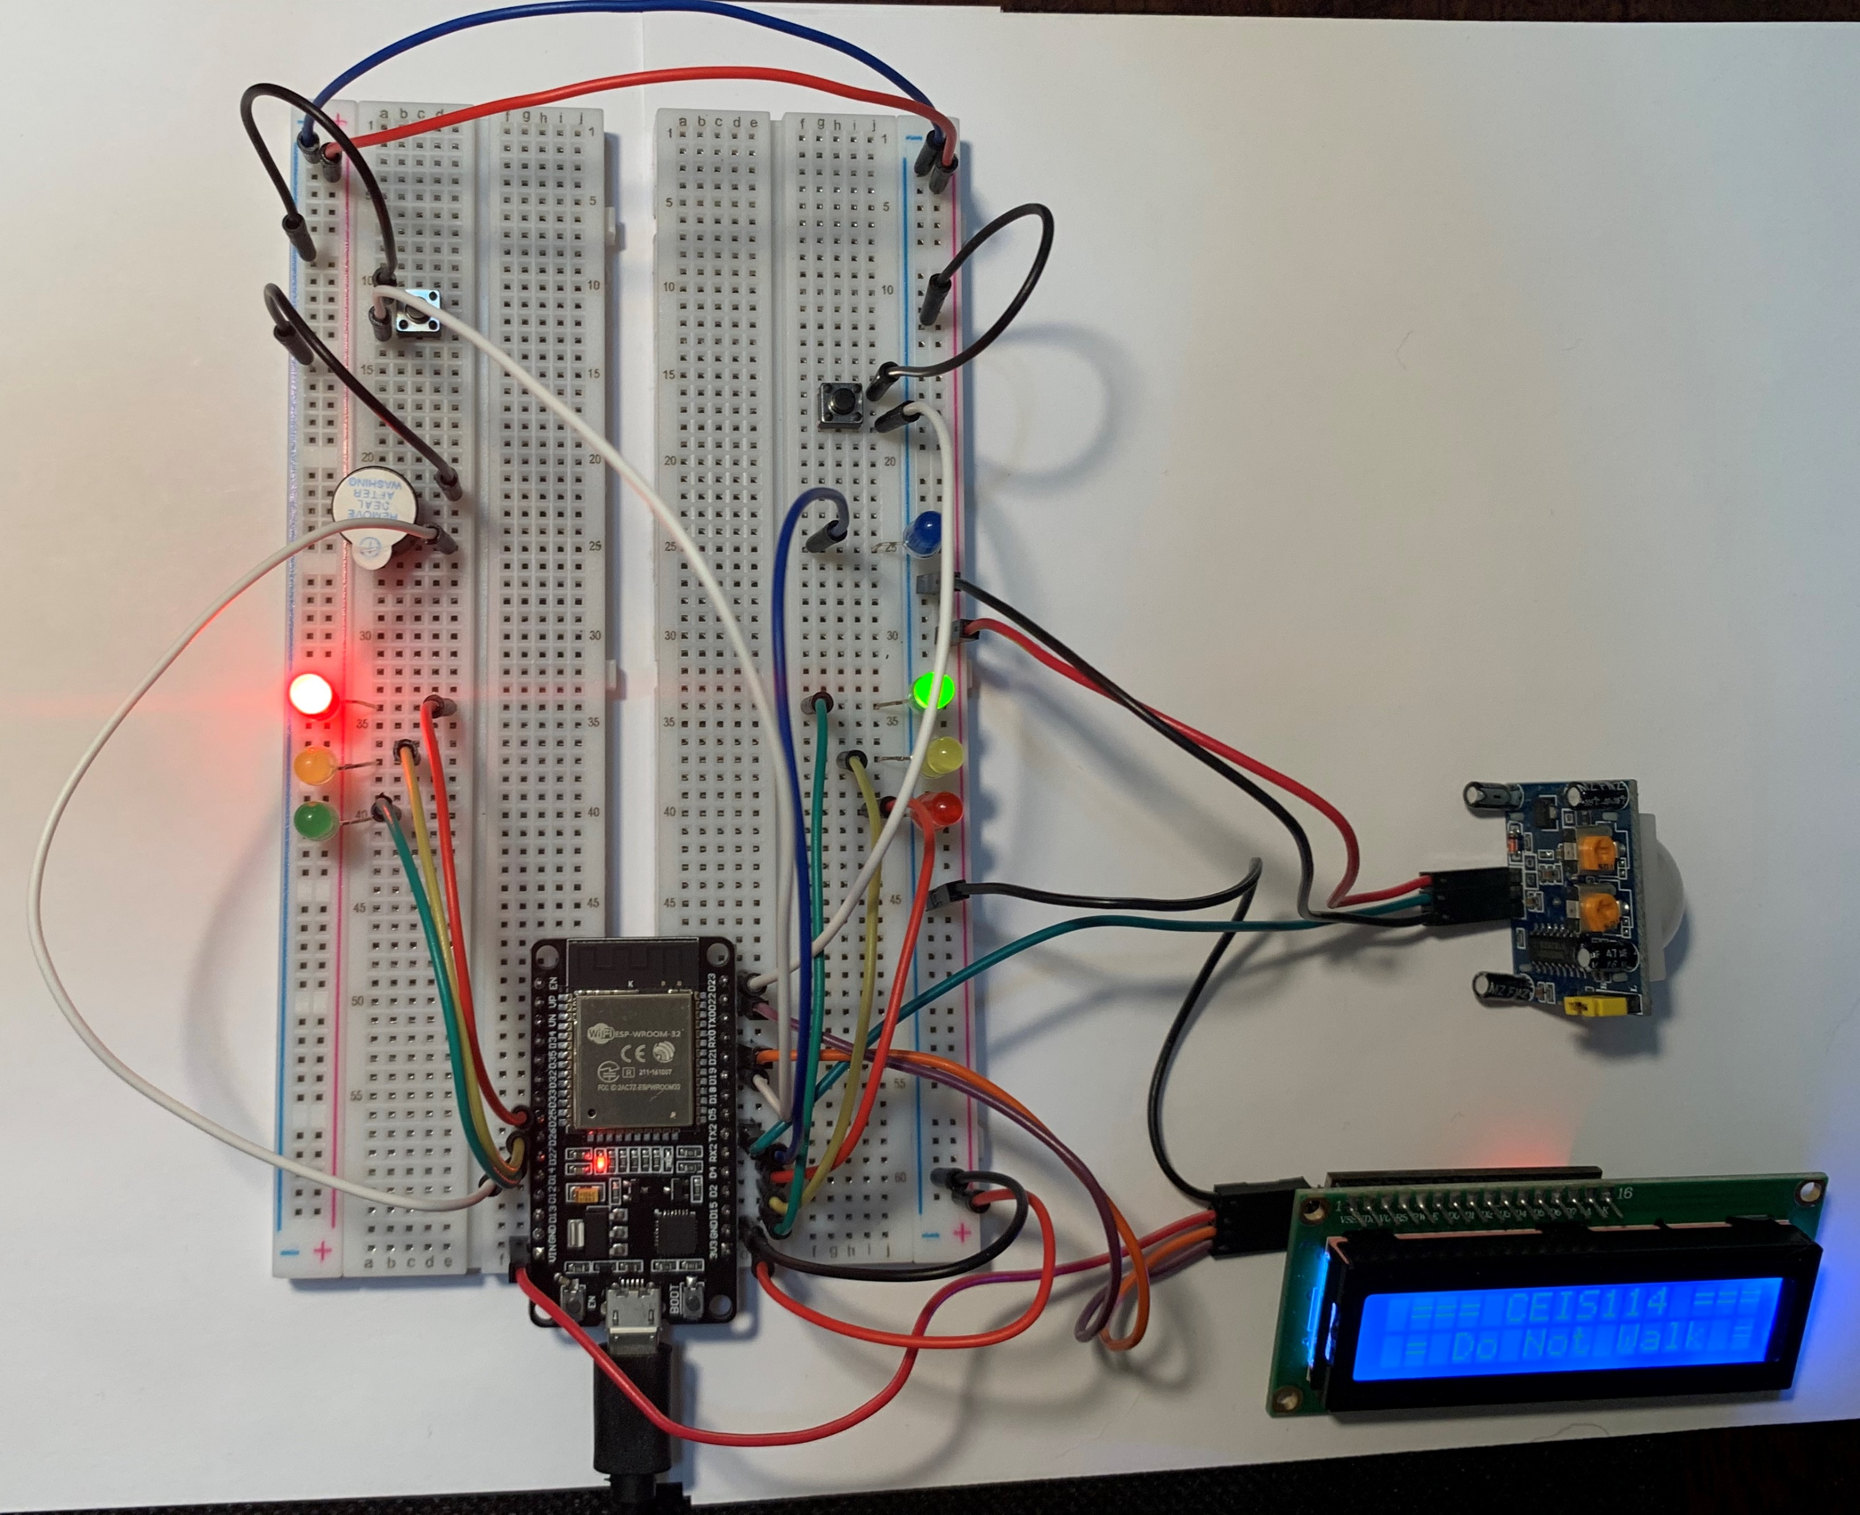
Picture of
Circuit
ESP32 Board
Two sets of Colored LEDs: Red, Yellow and Green
One Blue LED
Push Buttons
LCD Unit
Buzzer
Motion Detector
Wires
Breadboard

Slide 25
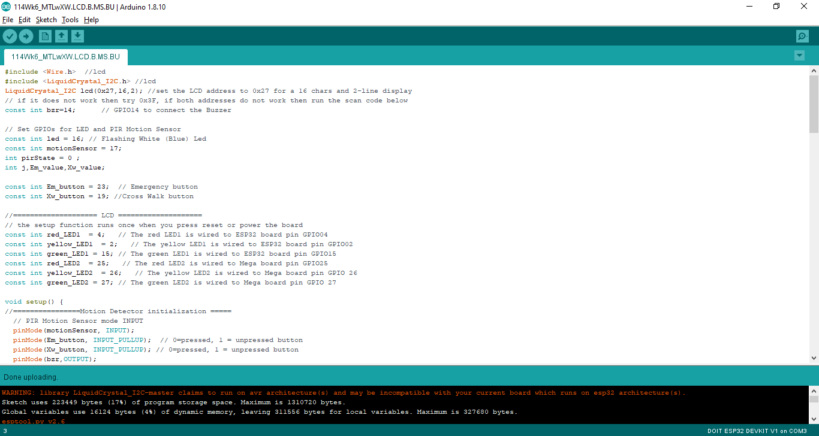
Screenshot of Arduino IDE
Screenshot of the code in Arduino IDE

Slide 26
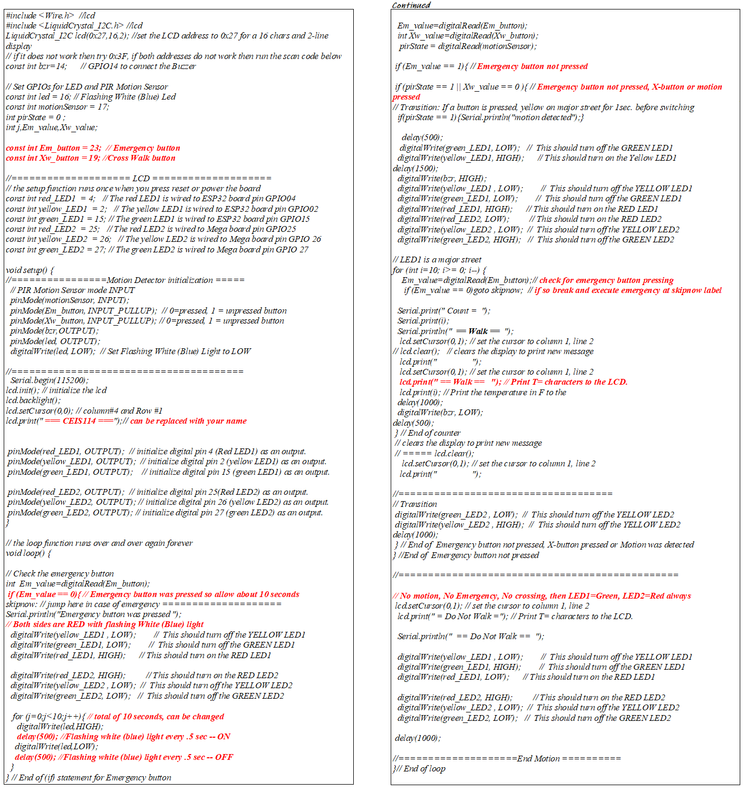
Code for IoT Traffic Light with Motion Detector

Slide 27
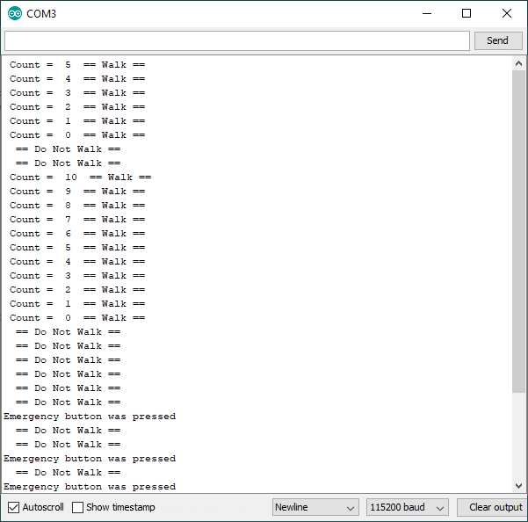
Screenshot of Serial Monitor
Screenshot of output in Serial Monitor

Slide 28
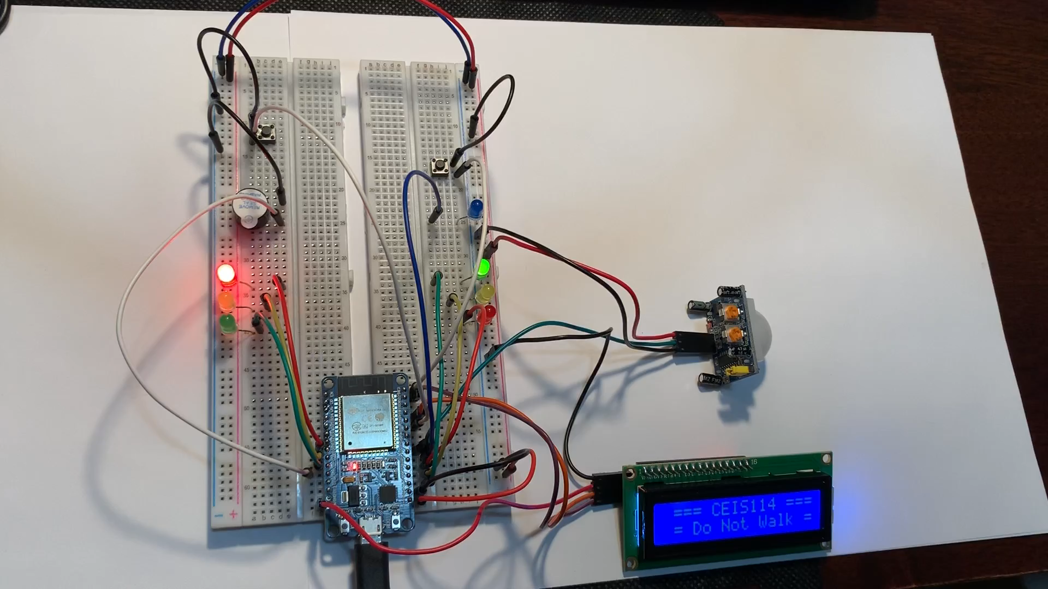
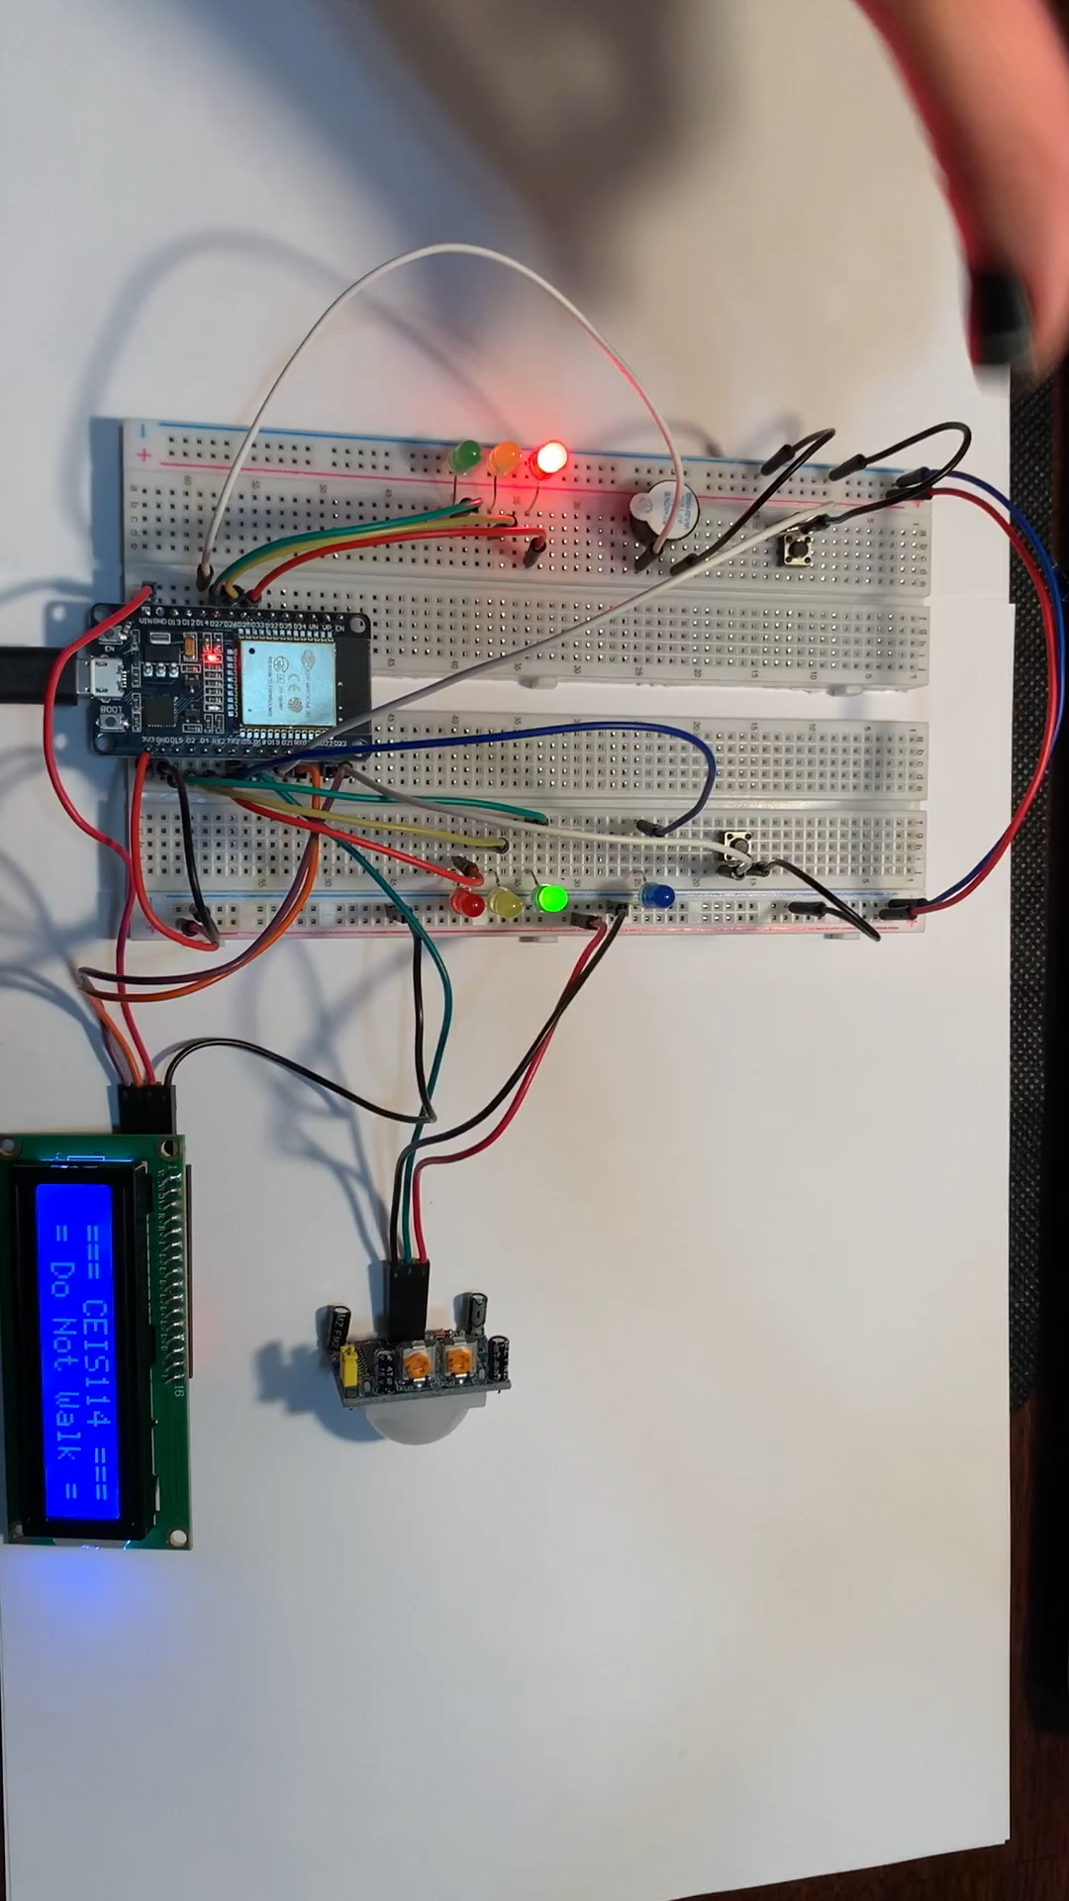
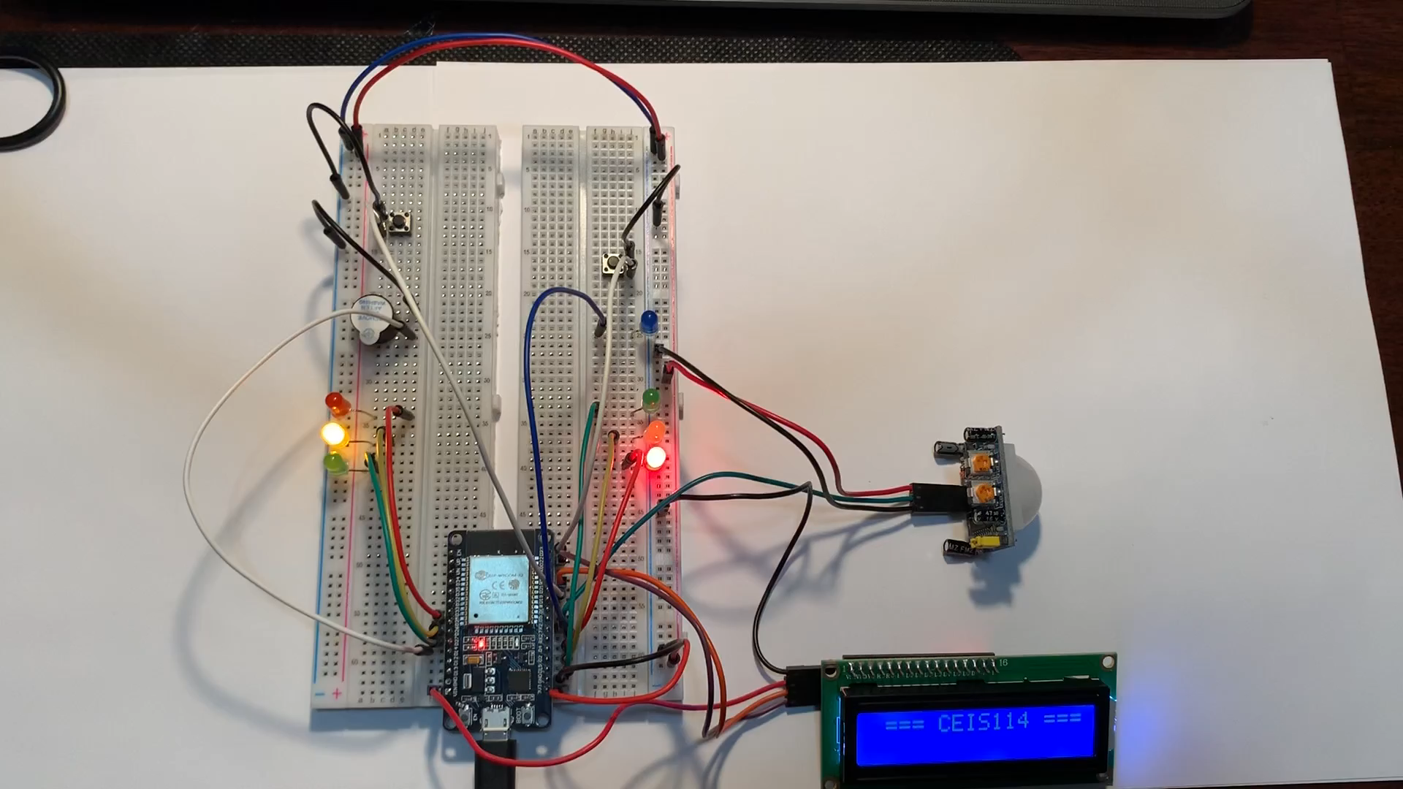
Functional IoT Traffic Controller
When the emergency button is pressed the both streetlights will turn red and the blue light will begin alerting.
The traffic light controller is always set to the major traffic light green and the minor street red.
When motion is detected on the minor street, the major street will proceed to turn yellow and then to red.
The cross-walk button is pressed and displays the message “Walk” on the LCD screen with the allotted time a pedestrian has to walk.
The buzzer will sound when the cross-walk is available

Slide 29

Challenges
The LCD screen was blank when plugged in during module 5’s set up noting that the code was not uploaded yet. This issue was fixed by adjusting the back of the LCD unit until white squares appeared.
When running the code from module 5 the LCD screen did not display any text. The code on line 3 was changed from “lcd (0x3F,16,2)” to “lcd (0x27,16,2)”, the code was uploaded, and then it successfully displayed the message.
During module 5 and during the code upload a warning was displayed:
  (“WARNING: library LiquidCrystal_I2C-master claims to run on avr architecture(s) and may be incompatible with your current board which runs on esp32 architecture(s).”) and an error upload occurred.
  Proceeded to troubleshoot this warning and error by unplugging the circuit and restarting the Arduino IDE program. When program was running and while circuit was plugged in, the code was uploaded again, and no errors occurred as the circuit successfully worked.

Slide 30
Career Skills Obtained
Critical thinking/problem solving – being able to trouble shoot the traffic light controller during challenges.
Hardware skills- Using different parts of the inventory to build the IoT traffic controller
Software skills- Using the Arduino IDE program to run the IoT traffic controller.
Organizational skills- being able to plan and prepare for a successful project
Resourcefulness- was able to solve any issues or questions by using any tools or instructional guides provided during this course

Slide 31
Conclusion
The IoT is ever-growing as there are many ideas that are in the process of development or have already been created and are being improved.
The IoT traffic controller that was developed during this project is just one of many.
The IoT traffic controller simulates when data is collected, analyzed, and controlled if in the event of:
  Motion detection on the major/minor street.
  If an emergency button were activated or
  if the pedestrian button is activated.

