Slide 1

IoT Virtual System
CEIS 106
Kimberly Hernandez
DeVry University CEIS 106
12/16/19
Nabeel BAIG

Slide 2
Introduction
The IoT (Internet of Things) is ever growing as devices and applications are created every day.
Virtualization benefits the IoT by providing reliable operating systems (OS)that is cost efficient when testing devices or applications.
This project will show the fundamentals of the IoT by creating a virtual machine that will operate a circuit using Arduino IDE.
Also looking into:
    Challenges Faced In the Project
    Career skills gained

Slide 3

The development includes
  Inventory and BIOS
  Planning and Designing
  Downloading Linux and Exploring the Desktop
  Installing Arduino IDE
  RTOS
  Running the Arduino From the Virtual Machine

Slide 4
Inventory and BIOS
Module 1
Inventory of hardware was taken before starting the planning and designing process.
Inventory includes:
    Arduino Mega Board
    Potentiometer
    LED
    Breadboard
    Wires
BIOS was accessed to enable virtualization for my virtualization machine, and steps were provided as to where it was located on my Windows 10 software.

Slide 5
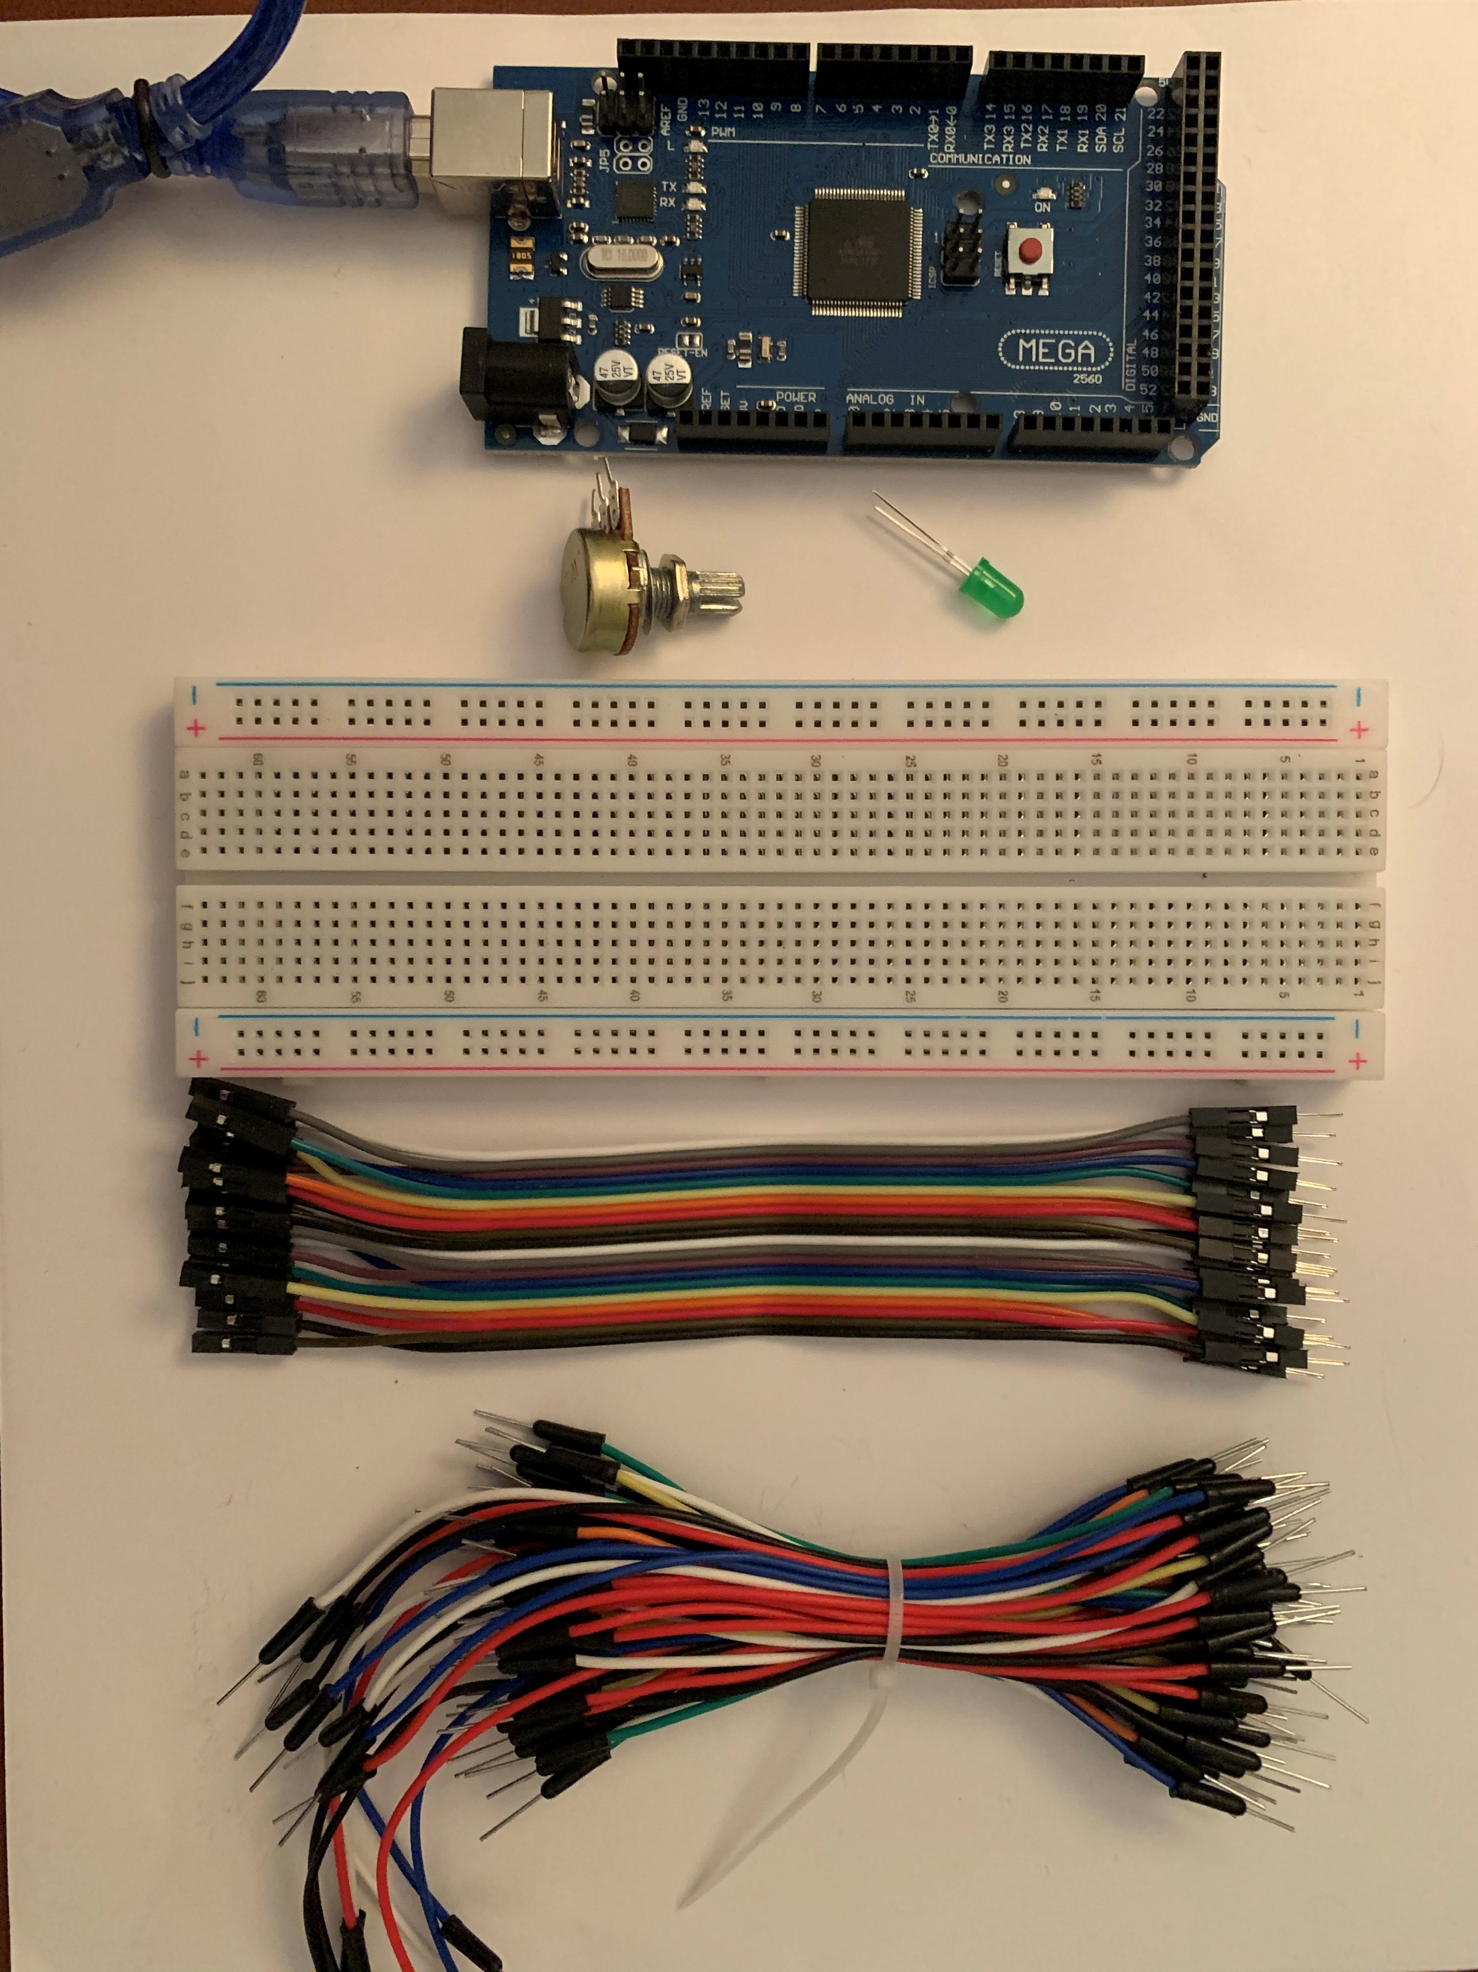
Inventory
Arduino Mega Board
Potentiometer
LED
Breadboard
Wires

Slide 6

How do you access your BIOS?
What keys/combination do you need to access the BIOS on your computer?
-While using Windows 10 software, I clicked the windows button on my keyboard and started typing in “BIOS” which brings me the option to “Change advanced startup options”. By clicking that option, it then took me to “Recovery” listing several other options. I clicked then on “Restart Now” listed under “Advanced startup” then it sent me to “Choose an option”. On this menu I went as follows to access my BIOS: Troubleshoot > Advance options > UEFI Firmware Settings > Click “Restart” > F10.
Do you have virtualization enabled on your laptop?
-It was not enabled but I enabled it.

Slide 7
Planning and Design
Module 2
When planning and designing a flowchart is used to visualize the steps to take when creating an IoT device running within a virtual machine. (Screenshot in next slide)
Since enabling the virtualization from the BIOS I am able to download the virtual machine, called VMware.

Slide 8
Flowchart
Start
Install Virtual Machine
Flowchart with the following steps:
Install Virtual machine
Install Linux on the VM
Install Arduino on the Linux image
Install the RTOS library for Arduino
Set up the Arduino hardware
Run the Arduino from the VM
Install Linux on the Virtual Machine
Install Arduino on the Linux image
Install RTOS library for Arduino
Set up the Arduino hardware
Run the Arduino from the Virtual Machine
Stop

Slide 9
VMWARE
VMware is a software that allows you to run virtual operating systems.
Few examples of operating systems that VMWARE can run are:
Linux (Ubuntu)
Windows 10 (including some older versions)
Red Hat
Oracle
With VMware installed it is now a virtual sandbox where I can run the necessary software to test my IoT device.

Slide 10
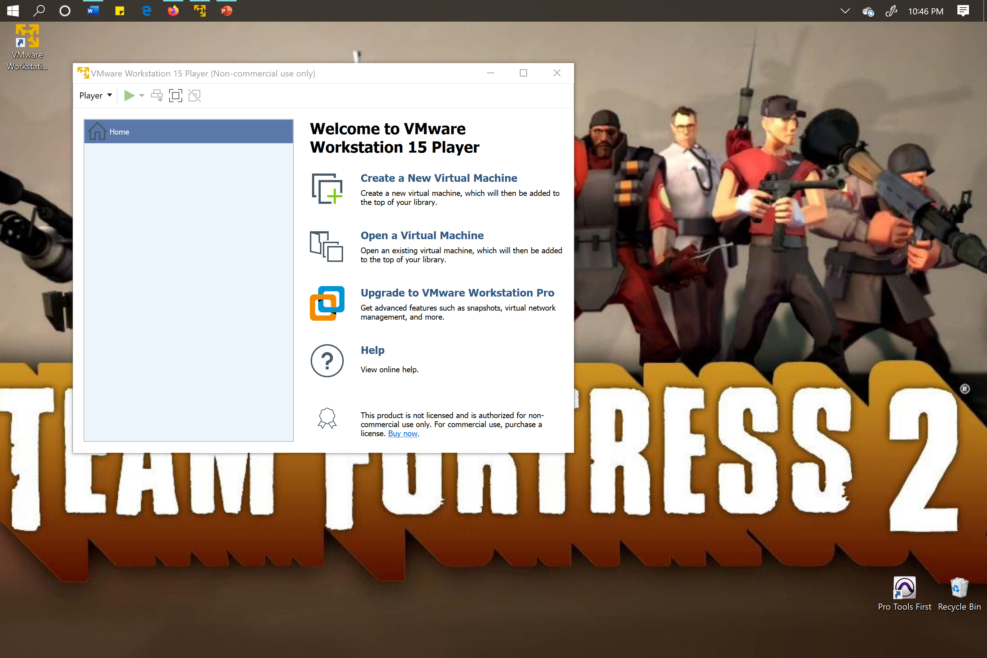
VMWare
Screenshot of VMWare installed

Slide 11
Download Linux and explore the desktop
Module 3
Linux has many open-source distributions, one of them being Ubuntu which is the chosen to use as an OS on the virtual machine.
Ubuntu is installed into my virtual machine.
Ubuntu can be navigated by using the terminal window as well as its’ graphical user interfaces or GUI.
Further exploring the desktop gives information on how to open a terminal window, which browser and office software it runs, and how it is different when compared to Windows 10 software.

Slide 12
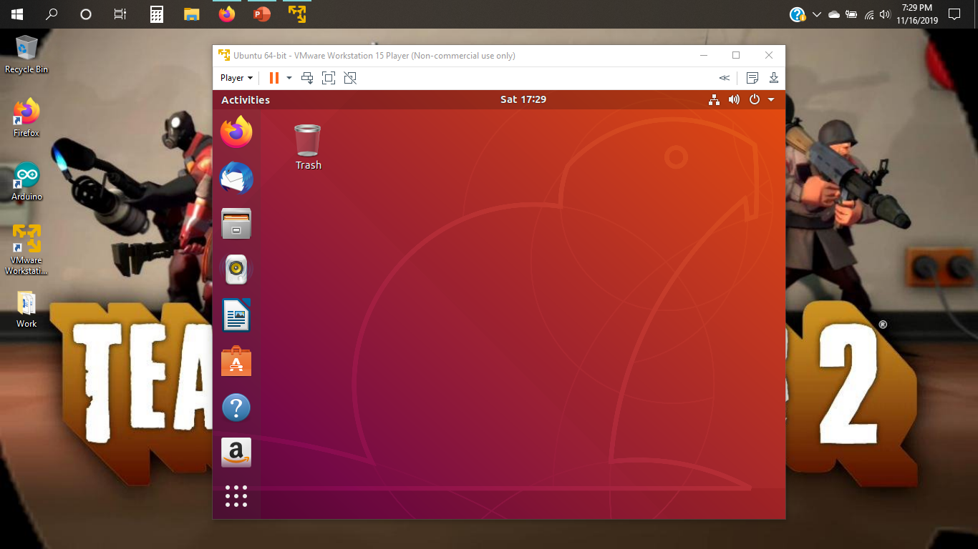
Install Linux ISO
Screenshot showing Ubuntu Linux installed

Slide 13
Explore the Linux Desktop
How do you open a terminal window?
To open the terminal window by right clicking the background and choosing the option to “Open Terminal”.
Name a browser and Office software you see in Ubuntu:
Firefox is the browser in Ubuntu. There are several Office software in Ubuntu that I have discovered like LibreOffice Calc, LibreOffice Draw, LibreOffice Impress, and LibreOffice Writer.
How would you compare the Linux desktop to other OS’s you have used (Windows)?
The Linux desktop when compared to Microsoft Windows 10 seems user friendly. When first logging in, some programs are already set up on a dock and when any other programs that are opened are docked on there too. Linux is user friendly when using the applications on it, being able to navigate through each application, and when making any basic changes to them. The applications such as the Libre Office and Mail seem comparable to Microsoft office and Microsoft Mail programs, although, the way you navigate within these programs are completely different. It might take time to learn using Ubuntu and these programs. At this point the only thing that is not user friendly is the terminal window on Ubuntu since you must know different commands and is different when compared to Microsoft’s command prompts.

Slide 14
Installing Arduino IDE
Module 4
Now that the virtual machine has an OS the Arduino IDE application can now be downloaded on to the OS.
Before installing Arduino IDE, there is further research in what a tar file and sudo command is.
There are a few ways to install the Arduino IDE so additional research is explored in comparison to installing software on Linux vs. Microsoft Windows.
The Arduino IDE application is a software that can run codes to communicate with compatible hardware and circuit set up.

Slide 15
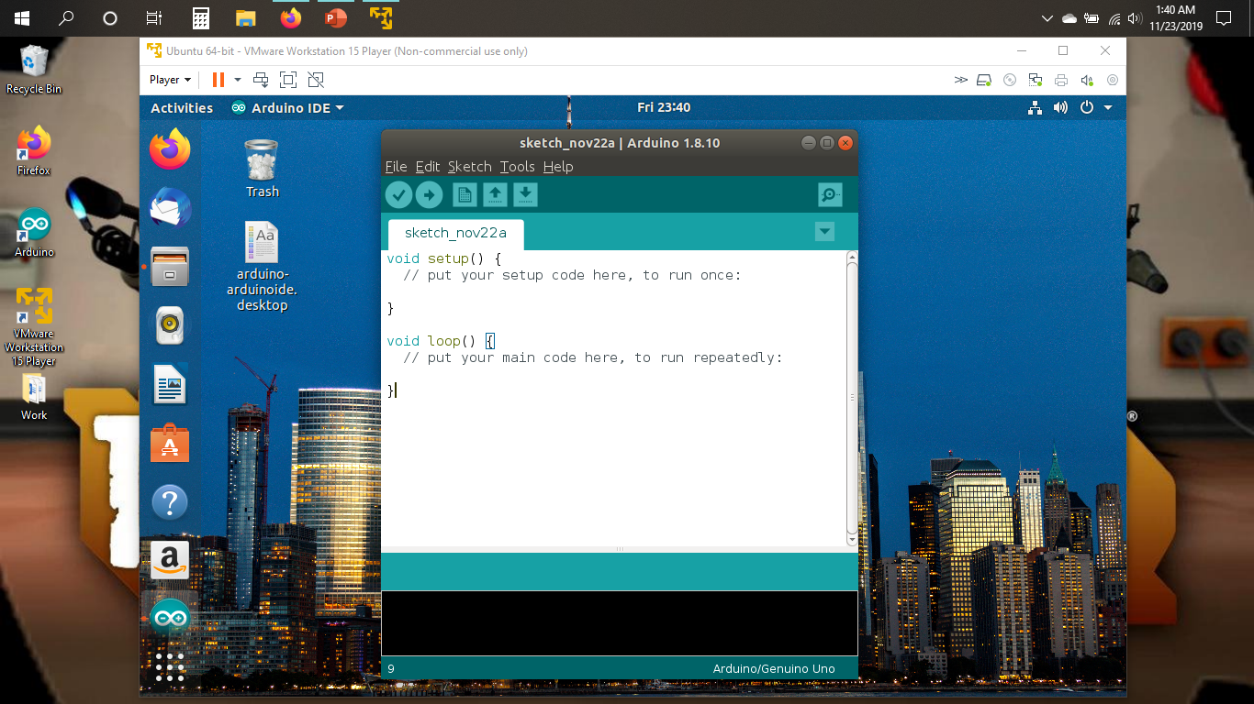
Install Arduino IDE
Screenshot showing Arduino IDE installed on Ubuntu

Slide 16
Questions about Installing files
What is a tar file?
  A tar (tape archive) file is used to create or extract archive files noting that some of these files may have an extension ending with “gz or xz”, and when an archive file is extracted it is called a tarball. It is similar to zipped folder in Microsoft Windows where you can compress different files together or if you downloaded a file and it is zipped file you would have to extract it to access the files within it.
What is the sudo command?
  The sudo command and a required password gives you access to act as the root user.
How would you compare installing software on Linux versus Windows or Mac?
  When installing software on Linux compared to Windows is similar in that you are initially downloading a file or program and finding the downloaded item(s) in the downloads folder. When you are in the downloads folder you can extract the file as you would also in Microsoft Windows. From that point it seems that Linux is a little more complicated to continue to install programs as there are different ways you can download software in Linux; by using the sudo command or going to the file > right clicking > installing through “open with software install”, or if the program is already listed under the Ubuntu Software you can click install. With Microsoft Windows the program is placed in the downloads folder, after the files are extracted, and you can double click on your downloaded software and proceed to install it. When comparing the two there are several differences and similarities in installing programs. Depending on the preference of the owner, one may be preferable to the other.

Slide 17
RTOS
Module 5
The RTOS (or Real Time Operating System) is used in this project for multitasking.
The Arduino software must have RTOS installed in order for the IoT device’s LED light to blink and read the values of the potentiometer.
Further looking into what RTOS is and why is it important to the IoT information is provided on the next slide.
Followed by a screenshot of RTOS installed onto the Arduino.

Slide 18
Questions about RTOS
What does RTOS mean?
  RTOS (Real-Time Operating Systems) is an operating system that supports real-time applications by providing logically correct results within the deadlines required.
Why is RTOS important in IoT?
  While the IoT gathers data from its ever-growing database, the RTOS provides reliability and consistency by quickly processing data on a real-time basis.

Slide 19
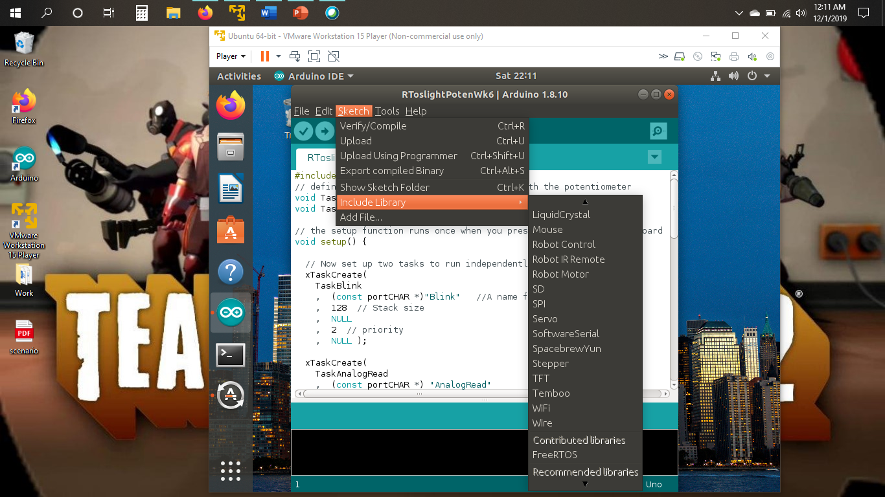
Install RTOS
Screenshot showing code in Arduino IDE

Slide 20
Running the Arduino from the virtual machine
Module 6
Now that all the software is installed, the circuit is put together to create an IoT device.
The circuit includes the Arduino Mega Board 2560, the potentiometer, an LED light, and male wires. (Picture presented in next slide)
Both tasks are running at the same time when the code is uploaded.
  The light is blinking.
  With the serial monitor open it will show the potentiometer’s values.
    When turning the nob on the potentiometer it prints different values on the serial monitor.

Slide 21
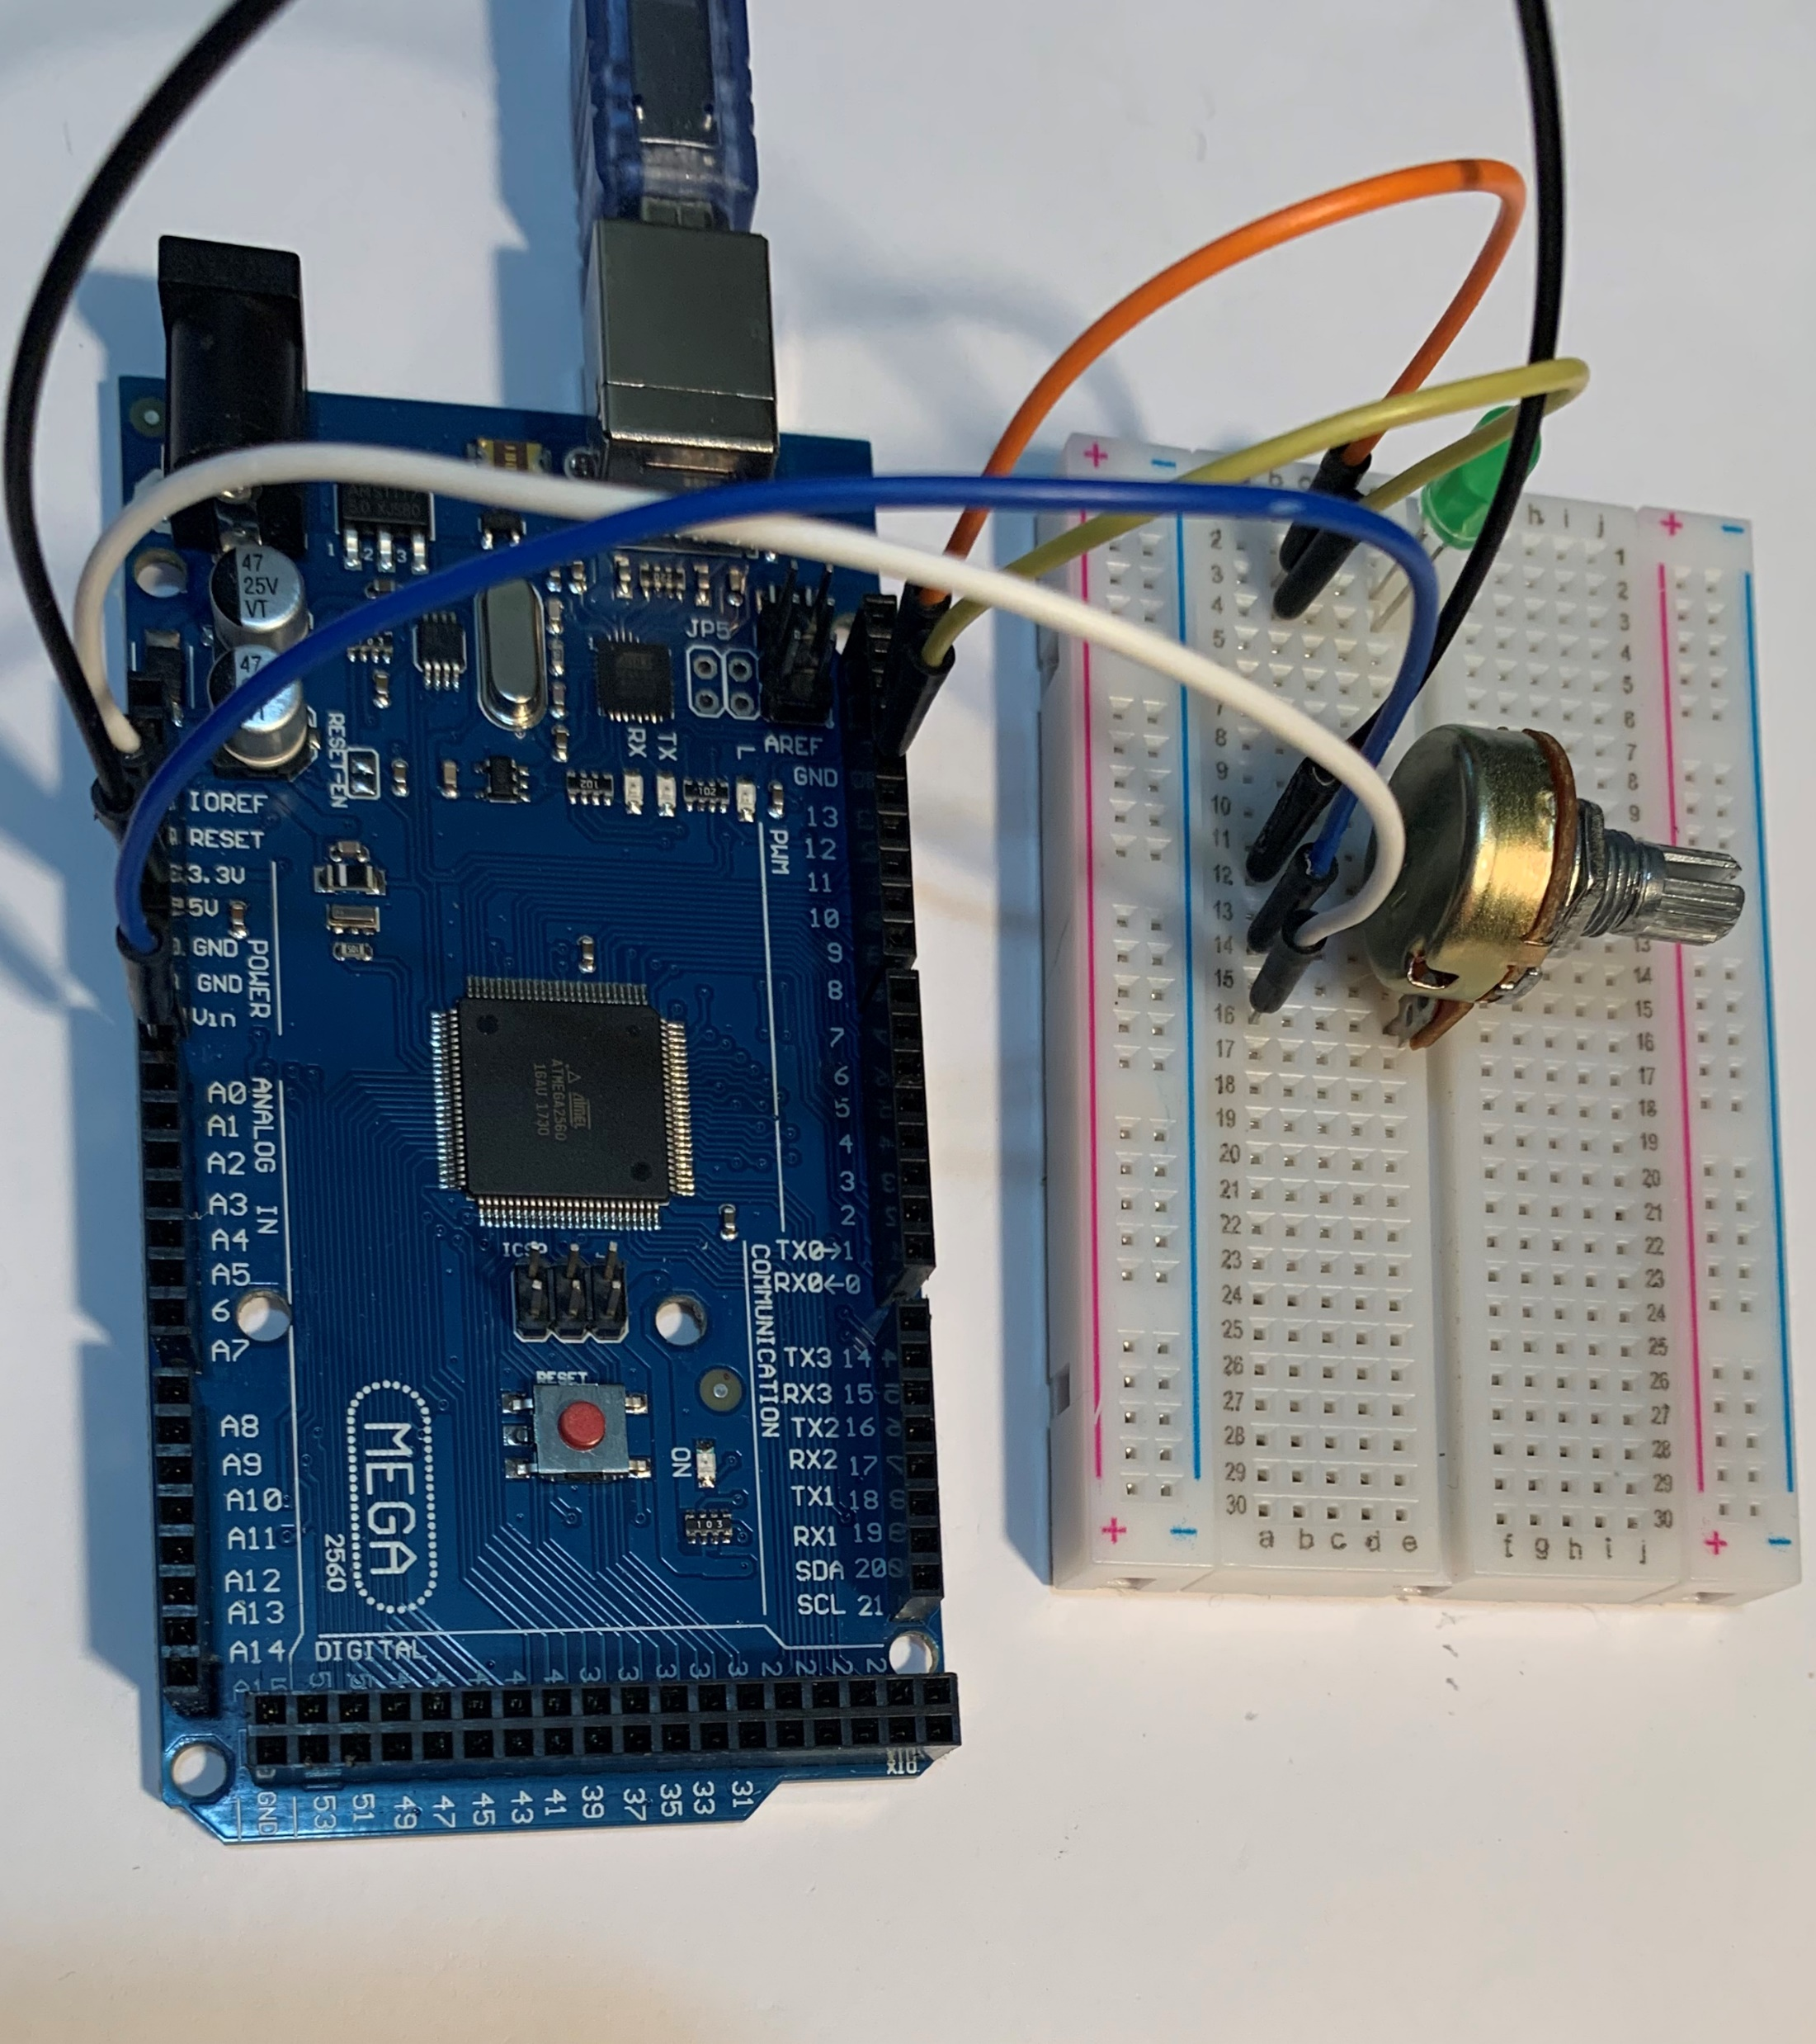
Hardware
Arduino connected to breadboard with potentiometer and LED

Slide 22
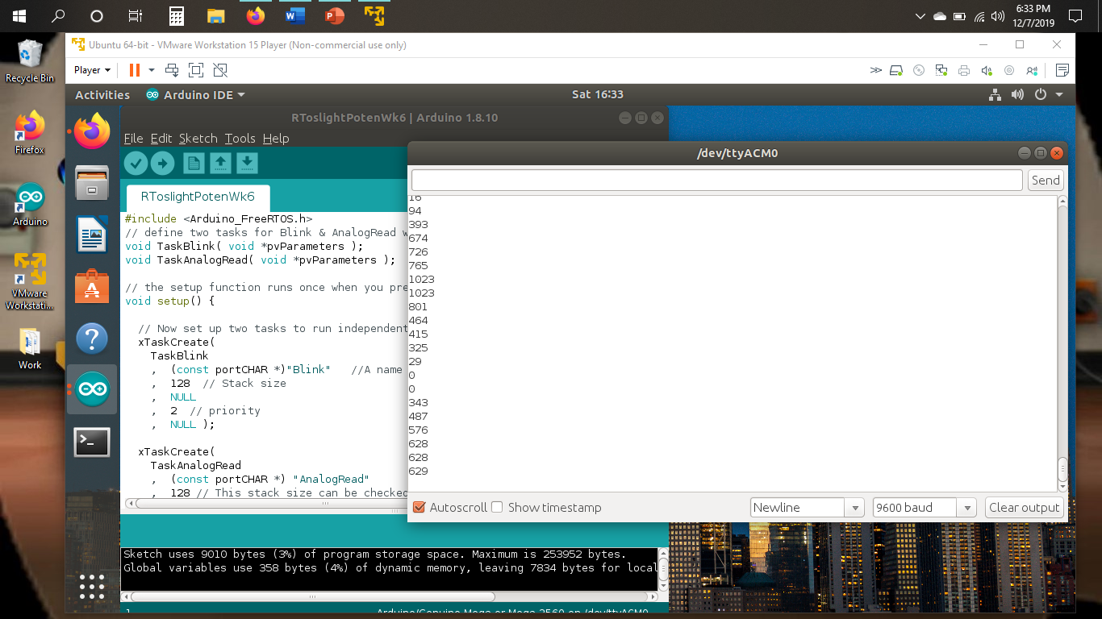
Serial Monitor
Serial Monitor showing potentiometer values Tools-> Serial Monitor

Slide 23
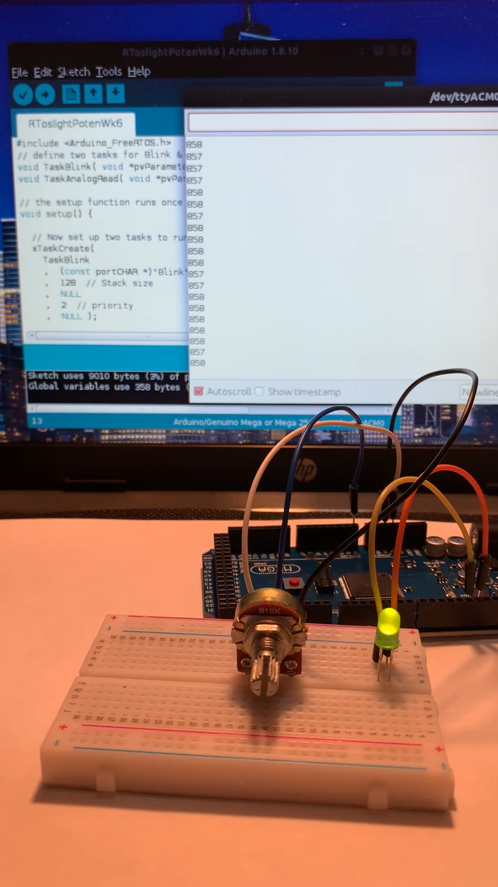
Running Circuit
LED
  The LED’s positive leg is connected to pin 13 and the other leg connected to GND; both connected to the mega board using male to male wires.
Potentiometer
  The middle blue wire is connected to the analog port 0 or A0 on the Arduino Mega board.
  The right of the potentiometer, which is the black wire, is connected to GND on the Arduino Mega board.
  The left of the potentiometer, which is the white wire, is connected to 5V on the Arduino

Slide 24
Explanation of command
What command did you use to change the permissions of the port?
  By using the “sudo usermod –a –G dialout kimhdz” allowed the change permissions for the serial port.
Why did you have to do this?
  Needing to change permissions for the serial port to run the Arduino code from the virtual machine.

Slide 25
Challenges in the project
When installing the Arduino IDE application on Ubuntu OS – Was unfamiliar with downloading applications on Ubuntu as there are several ways to download files. After downloading the Arduino IDE the steps were as followed:
  Extract Arduino tar folder and double click into the new folder that appears
  Double click into the next folder
  Right click in the current window to open the terminal window
  In the terminal window type “sudo sh install.sh” to install the Arduino IDE.
  The Arduino was installed and listed under applications.
The next challenge was receiving an “avrdude” error that appeared when uploading the code through the Arduino IDE. After changing the permissions on the serial port, typing the command “sudo usermod –a –G dialout kimhdz” in the terminal window, and restarted the virtual machine allowed the code to be uploaded and run successfully. Also making sure that the correct board and port are selected under the Arduino IDE tools setting.

Slide 26
Career skills obtained
There are several skills gained from the development of this project:
Hardware Skills- By using the hardware in this project such as the Arduino Mega Board, Potentiometer, LED light, Breadboard, and wires.
Software skills – Being able to use commands run on the Linux Ubuntu and the Arduino application to operate the circuit.
Networking skills – Being able to run the virtual machine while using a laptop as the main host.
Security skills – Having to change to the root user on Ubuntu using the terminal window and change permissions for the serial port.
Data analysis skills – With the serial monitor open and reading the different values as the nob was turned on the potentiometer.
Problem solving skills – During the challenges faced was able to figure out the issues and solve them.

Slide 27
Conclusion
Virtualization benefits the IoT by providing reliable and responsiveness operating systems to create applications and devices and all with a cost efficiency.
As an outcome of this project using a host machine:
  A virtual machine, VMware, was downloaded,
  An operating system, Ubuntu, was installed on the VMware,
  The Arduino IDE was installed onto the OS,
  Then the IoT device was created using the inventory hardware.
  Using the Arduino IDE application to run codes to the IoT device.

Slide 28
Citations
Jain, P. (2019, July 12). RTOS - Real Time Operating System. Retrieved December 5, 2019, from https://www.engineersgarage.com/article_page/rtos-real-time- operating-system/.
    Workstation Player : Run a Second, Isolated Operating System on a Single PC with VMware Workstation Player. (2019, December 12). Retrieved December 18, 2019,from https://www.vmware.com/products/workstation-
        player.html.

