Slide 1

Systems Analysis & Design
Kimberly Hernandez
DeVry University
CEIS321 Structured Analysis & Design
Professor Nana Liu
December 9, 2021

Slide 2
Table of Contents
Course Introduction
Project Objectives
  Milestone 1 – System Request Form
  Milestone 2 – Project Charter
  Milestone 3 – Data Modeling UML/OOAD
  Milestone 4 – Data & Process Modeling
Project Add-Ons
Project Challenges
Project Summary

Slide 3
Course Introduction
CEIS321 course covers the fundamentals of systems analysis and design.
Fundamentals include:
  Systems Analysis and design.
  Agile development and modeling, prototyping, and SCRUM.
  Project management and business requirements.
  Modeling with object-oriented systems analysis and design approach
  Designing databases including normalization
  I/O Design, Human Computer Interaction, & Quality Assurance
Course concepts will help the approach on a business problem and the solution.

Slide 4
Project Objectives
This project is based on an upcoming business that anticipates the need for an effective ordering system.
By applying system analysis and design, the requirements of this business problem will be defined.
Milestone objectives of the project include:
  Milestone 1 – System Request Form
  Milestone 2 – Project Charter
  Milestone 3 – UML/OOAD Data Modeling
  Milestone 4 - UML/OOAD Diagrams (Continued)

Slide 5
Milestone 1 – System Request Form
To start understanding and modeling the system, a system request form was created for the upcoming business called Wholesome Café.
The system request form includes:
  Business Problem Statement
  System Scope Statement
  High-Level Functional Requirements
  Business Benefits
  Context Level Data Flow Diagram

Slide 6
Business Problem Statement
Wholesome Café, an upcoming business, anticipates issues on order taking such as:
  Employee(s) taking orders by customer texts or phone calls.
  Inefficient payment procedures.
Implementing an effective ordering system will allow:
  Customers to place orders.
  Consistent input of delivery and payment information.
  Employee(s) to receive order information in a structured format.

Slide 7
System Scope Statement
The ordering system will be designed to:
  Centralize order placement and information.
  Provide convenient services to the customer.
  Provide convenience to the employee(s) with customer order and information in real-time.
  Allow accurate and easily accessible information for employee(s).
  Allow easy navigation to all users.

Slide 8
High-level Functional Requirements
Items available for selection on menu
Add items to cart
Cart lists items selected
Cart checkout option
Input for delivery information
Input for payment information
Business contact information is available
Electronic receipt created after order is placed
Employee(s) notified on order placed

Slide 9
Business Benefits
Makes ordering easy
Real-time item updates
Drive customer orders
Saves time and money
Avoids miscommunication
Enhances payment taking
Fewer errors on orders and customer information
Easy to manage customer orders and information
Boost in sales and profits
Build customer data
Amplify business using customer data

Slide 10
Context Level Data Flow Diagram

Slide 11
Milestone 2 – Project Charter
A project charter was created for the café ordering system to:
  Define the purpose of the Café Ordering system.
  Get funding approval to move forward with project planning.
The project charter includes:
  Project and Product Overview
  Café Ordering System Objectives
  High-level Requirements
  Major Deliverables/Milestones
  Timeline
  Budget Estimate

Slide 12
Project and Product Overview
Wholesome Café is an upcoming business in Harlingen, Texas.
Wholesome Café plans on selling and delivering coffee beverages to 24-hr facilities; plans to expand to surrounding areas.
Delivery only due to COVID-19 and concern for public safety and health.
Services start late 2022 – early 2023
Estimated project duration and budget: 12 months and $500,000.
Order system will provide convenience to all users.

Slide 13
Café Ordering System Objectives
Ordering systems will:
  Centralize order placement and information.
  Help drive the business to success.
  Business growth in maintaining customer satisfaction.
Objectives of system include:
  Customers can place orders.
  Customer can input delivery and payment information.
  Employee(s) to receive accurate order information.

Slide 14
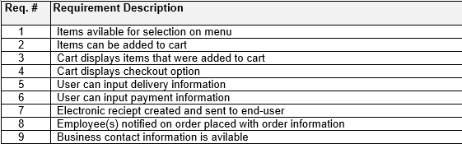
High-level Requirements
Requirements that the project’s product, service, or result must meet for the project objectives to be satisfied.

Slide 15
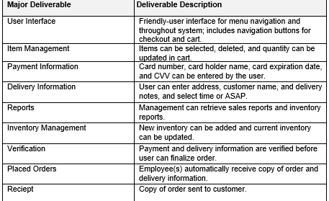
Major Deliverables/Milestones

Slide 16
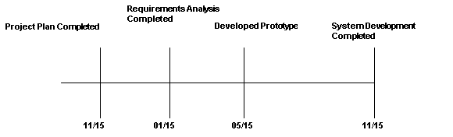
Timeline
12 Months

Slide 17
Budget Estimate
Funding Source: Grant
Estimate: $500, 000
Summary of the estimated budget to meet the Café Ordering System objectives.
This is preliminary and indicates all of investment life cycle costs.

Slide 18
Milestone 3 – Data Modeling UML/OOAD
UML improves the quality of the system analysis and design.
UML helps visualize the Café Ordering System.
Data modeling applied to the Café Ordering System Project:
  UML Use Case Diagram
  UML Class Diagram
  UML Sequence Diagram

Slide 19
UML Use Case Diagram

Slide 20
UML Class Diagram

Slide 21
UML Sequence Diagram

Slide 22
Milestone 4 – Data & Process Modeling
Data and Process modeling applied to depict user requirements.
These models capture the systems data and functionality.
Data model diagrams for database requirements include:
  Logical Entity Relationship Diagram (LERD)
  Physical Entity Relationship Diagram (PERD)
Process model diagrams for functional/process requirements include:
  Logical Data Flow Diagram (LDFD)
  Physical Data Flow Diagram (PDFD)

Slide 23
Logical Entity Relationship Diagram (LERD)

Slide 24
Physical Entity Relationship Diagram (PERD)

Slide 25
Logical Data Flow Diagram (LDFD)

Slide 26
Physical Data Flow Diagram (PDFD)

Slide 27
Project Add-Ons
Add-ons to this project include:
  More context level data flow diagrams.
  More classes to UML class diagram.
  State machine diagram.

Slide 28
Project Challenges
Challenges occurred when creating:
  The context level data flow diagram
  The Logical data flow diagram
  The Physical data flow diagram
These diagrams are similar since they all are data flow diagrams.
Determined that context flow diagram involves the entire system, data flow, and how it operates.
Determined that the logical and physical data flow diagrams are a bit more detailed involving the flow of data including databases and external entities.

Slide 29
Project Summary
In this project, a café ordering system was a business solution for Wholesome Café.
A few important points learned throughout:
  The process of system analysis and design improves on or creates a solution to a business problem.
  SCRUM development works in sprints to deliver a high-quality product.
  The UML/OOAD approach builds the quality of the system.
Thank you!

