Slide 1

SEC285
Final Project
SEC285
Kimberly Hernandez
DeVry University
10/12/20
Roger Gulledge

Slide 2
Introduction
Network security is a top priority even the best networks can be folded by malice threats, but a good and maintained network security can mitigate those threats.
Physical security which is sometimes overlooked also plays an important role as it can have a large impact on organizations.
This project includes:
  Implementing several aspects of network security using Linux based VMs.
  Creating a home security and Light control system.
    Using uPyCraft IDE
    An Esp32 and other components
Linux based VMs security aspects include:
  Vulnerability assessments
  A stateful firewall
  A BYOD security policy
  Multi-factor Authentication, Asymmetric Key Encryption, and Password Policy Enforcement
Lastly, this project covers challenges that occurred as well as skills obtained.

Slide 3
Vulnerability Assessment
In order to maintain a healthy system or network, vulnerability assessments are implemented regularly.
Vulnerability assessments identify vulnerabilities, rank them by severity, and provide an advantage on exploits with a defined vulnerability report.
In this project the Nessus Essentials tool was used to perform a vulnerability assessment providing a report on the Linux Server, known as MetaSploitable VM.
The verified vulnerabilities in the next slides show a report of:
  A critical, high, and medium severity rating along with their plugin name, risk factor, and other vital information that attackers can use to exploit a system
Questions are addressed as part of this project to further analyze vulnerability assessments and the tool that is used.

Slide 4
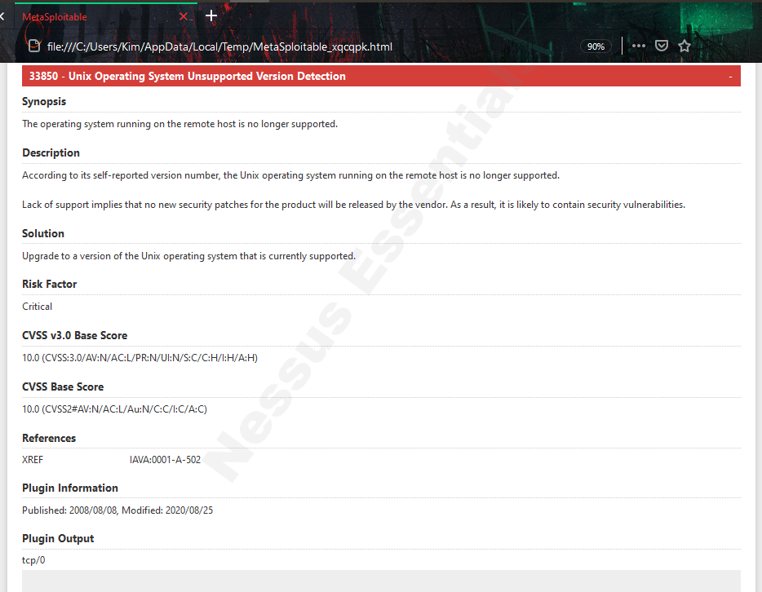
A Vulnerability of Critical Severity Rating

Slide 5
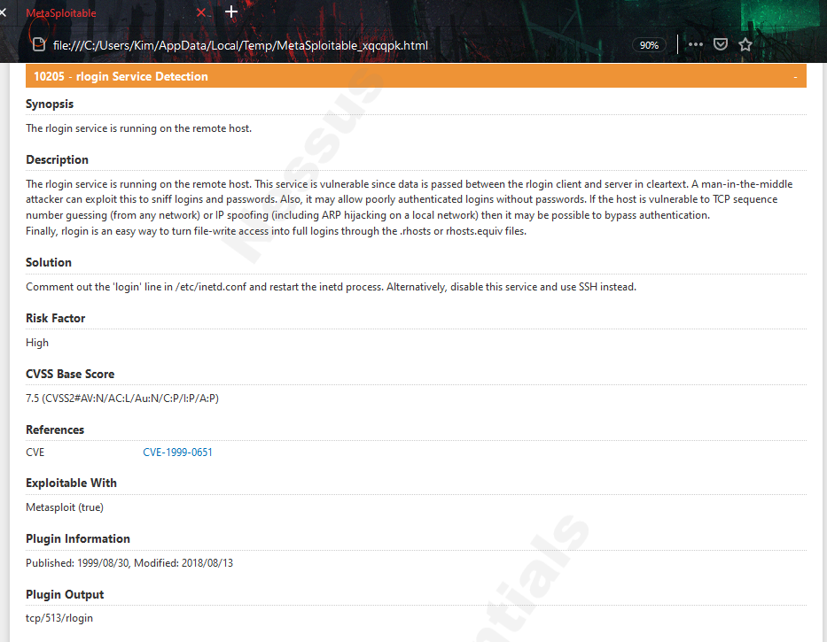
A Vulnerability of High Severity Rating

Slide 6
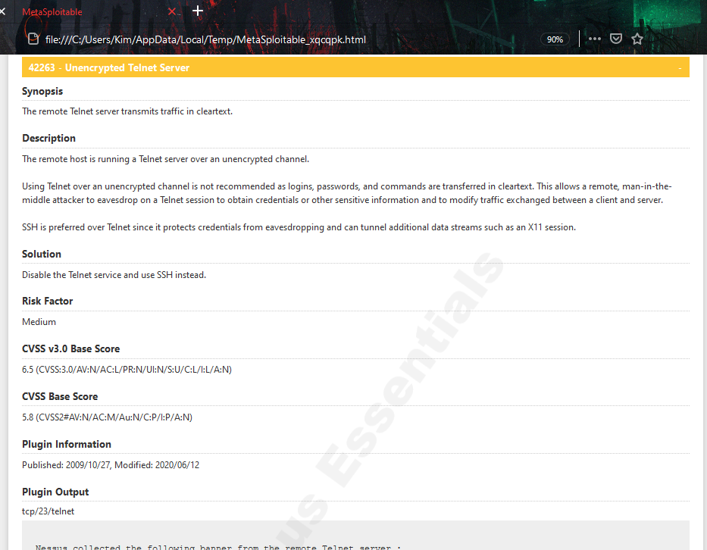
A Vulnerability of Medium Severity Rating

Slide 7
Questions on Nessus Essentials Report
What is the significance of ranking the vulnerabilities by severity level?
Being able to rank vulnerabilities by severity level is important as it prioritizes which vulnerabilities need to be addressed right away.
What is the significance of the Executive Summary in the Nessus Essentials report?
The Executive Summary report is important when it comes to vulnerability management as it provides a quick overview of the vulnerabilities while also scoring and ranking the severity of them.

Slide 8
Stateful Firewall
A stateful firewall is implemented to harden the Linux server.
This adds a layer of security to reduce vulnerabilities.
The stateful firewall will monitor traffic and data packets that move in and out of the network.
Open ports were verified using the Linux server with:
  “nmap 192.168.105.107 | more ”; resulted in a large amount of open ports which causes the system to be vulnerable to attacks.
The Linux iptables were configured to only allow The HTTP, HTTPS, SMTP, DNS, and SSH services.
The open ports were then verified again using “nmap 192.168.105.107” and after successfully configuring the iptables showed fewer open ports. (image on next slide)
The command “nmap –Pn 192.168.105.0/24” was used in the Kali Linux terminal window to verify all IP addresses that are in use on the network. (see image on the following slide)

Slide 9
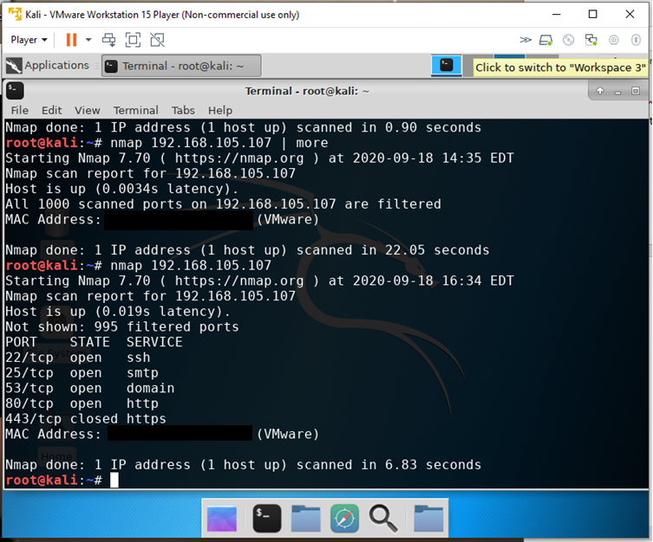
Nmap Scan Result
The screenshot shows a small number of open ports.

Slide 10
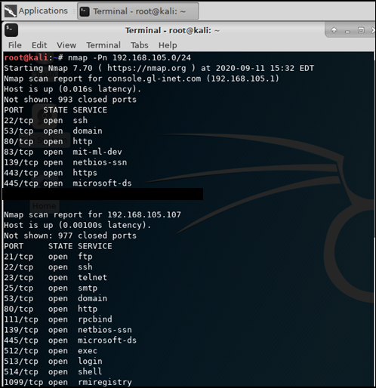
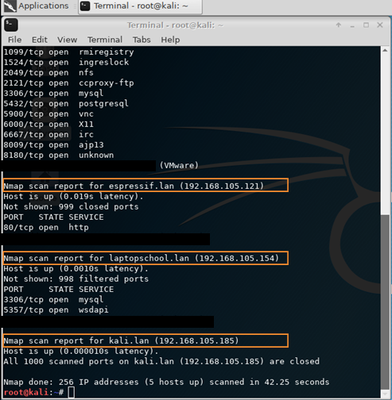
Nmap Scan
The screenshot shows the IP addresses of:
The host
Linux-Server VM,
Kali VM, and
Home Light Control System.
-Home Light Control System
-Linux-Server VM
-The Host
-Kali VM

Slide 11
Questions On iptables Tool
In what practical use case would the command sudo iptables --policy INPUT DROP be used? What effect does this command have on access to computing resources?
    The sudo iptables -- policy INPUT DROP command is used in the case of protecting classified information.
    The effect of this command where it blocks all in coming connections will secure the ports as they will not display which ports are open to other computing resources.
What is the difference between iptables -A and iptables -I? When would you use the -A option as opposed to the -I option?
  The iptables –A is to allow additional rules to the iptables
  The iptables –I is to input additional rules to the iptables policy
  The –A would be used to allow incoming and outgoing traffic.
  The -I would be used to input rules to the Iptables policy.

Slide 12
Bring Your Own Device (BYOD) Security Policy
A BYOD security policy was created to practice implementation of reducing risks on computing resources in an organization.
The BYOD policy allows employees to use devices such as smartphones, tablets, and laptops for company tasks and to enhance productivity while following policy standards.
The BYOD policy includes the:
  Overview
  Purpose
  Scope
  Policy
  Policy Compliance
  Related Standards, Policies, and Processes
  Definitions and Terms
  (See image on next slide)

Slide 13

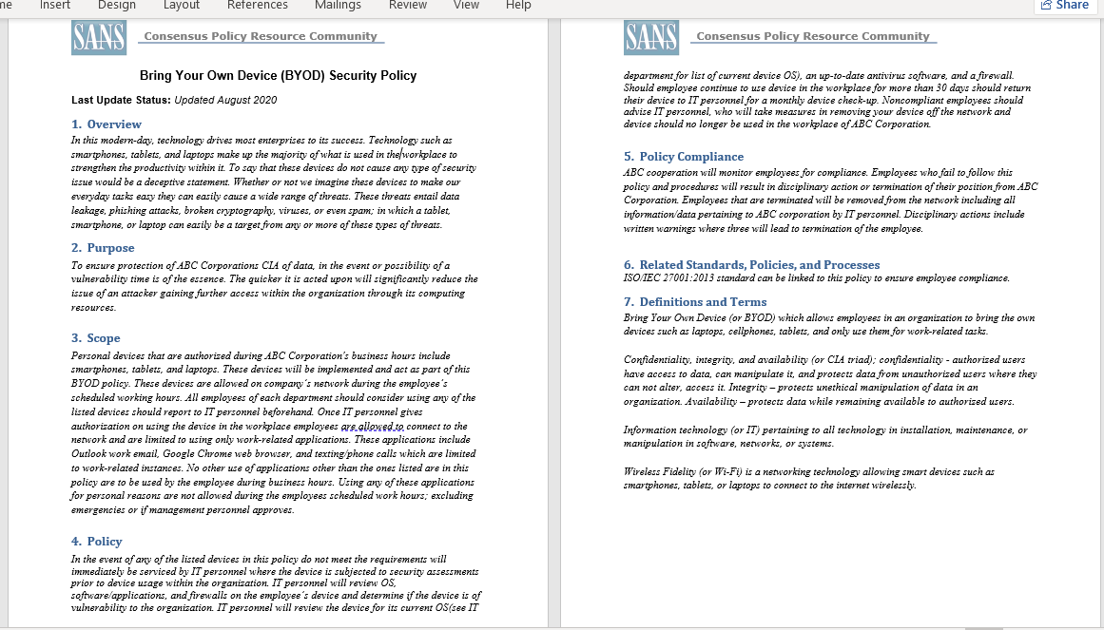
Security Policy

Slide 14

Overview Section of The Security Policy
Overview
In this modern-day, technology drives most enterprises to its success. Technology such as smartphones, tablets, and laptops make up the majority of what is used in the workplace to strengthen the productivity within it. To say that these devices do not cause any type of security issue would be a deceptive statement. Whether or not we imagine these devices to make our everyday tasks easy they can easily cause a wide range of threats. These threats entail data leakage, phishing attacks, broken cryptography, viruses, or even spam; in which a tablet, smartphone, or laptop can easily be a target from any or more of these types of threats.

Slide 15
Purpose Section of The Security Policy
Purpose
To ensure protection of ABC Corporations CIA of data, in the event or possibility of a vulnerability time is of the essence. The quicker it is acted upon will significantly reduce the issue of an attacker gaining further access within the organization through its computing resources.

Slide 16
Scope Section of The Security Policy
Scope
Personal devices that are authorized during ABC Corporation's business hours include smartphones, tablets, and laptops. These devices will be implemented and act as part of this BYOD policy. These devices are allowed on company’s network during the employee’s scheduled working hours. All employees of each department should consider using any of the listed devices should report to IT personnel beforehand. Once IT personnel gives authorization on using the device in the workplace employees are allowed to connect to the network and are limited to using only work-related applications. These applications include Outlook work email, Google Chrome web browser, and texting/phone calls which are limited to work-related instances. No other use of applications other than the ones listed are in this policy are to be used by the employee during business hours. Using any of these applications for personal reasons are not allowed during the employees scheduled work hours; excluding emergencies or if management personnel approves.

Slide 17
Policy Section of The Security Policy
Policy
In the event of any of the listed devices in this policy do not meet the requirements will immediately be serviced by IT personnel where the device is subjected to security assessments prior to device usage within the organization. IT personnel will review OS, software/applications, and firewalls on the employee’s device and determine if the device is of vulnerability to the organization. IT personnel will review the device for its current OS(see IT department for list of current device OS), an up-to-date antivirus software, and a firewall. Should employee continue to use device in the workplace for more than 30 days should return their device to IT personnel for a monthly device check-up. Noncompliant employees should advise IT personnel, who will take measures in removing your device off the network and device should no longer be used in the workplace of ABC Corporation.

Slide 18
Policy Compliance Section of The Security Policy
Policy Compliance
ABC cooperation will monitor employees for compliance. Employees who fail to follow this policy and procedures will result in disciplinary action or termination of their position from ABC Corporation. Employees that are terminated will be removed from the network including all information/data pertaining to ABC corporation by IT personnel. Disciplinary actions include written warnings where three will lead to termination of the employee.

Slide 19
Related Standards, policies, and processes Section of The Security Policy
Related Standards, Policies, and Processes
ISO/IEC 27001:2013 standard can be linked to this policy to ensure employee compliance.

Slide 20
Definitions and Terms Section of The Security Policy
Definitions and Terms
Bring Your Own Device (or BYOD) which allows employees in an organization to bring the own devices such as laptops, cellphones, tablets, and only use them for work-related tasks.
Confidentiality, integrity, and availability (or CIA triad); confidentiality - authorized users have access to data, can manipulate it, and protects data from unauthorized users where they can not alter, access it. Integrity – protects unethical manipulation of data in an organization. Availability – protects data while remaining available to authorized users.
Information technology (or IT) pertaining to all technology in installation, maintenance, or manipulation in software, networks, or systems.
Wireless Fidelity (or Wi-Fi) is a networking technology allowing smart devices such as smartphones, tablets, or laptops to connect to the internet wirelessly.

Slide 21
Questions On Security Policies
In what way does risk assessment impact the development of Program (security) Policies?
  Risk assessment impacts the development in where it already looks ahead to implement in the policy any risk factors that the organization could have.
When is it appropriate to review an organization's Issue-specific (security) Policy?
  It is appropriate when reviewing the specific guidelines for technology in an organization.

Slide 22
Multi-factor Authentication, Asymmetric Key Encryption, and Password Policy Enforcement
Network security controls such as authentication, encryption, access controls, and authorization are used to reduce vulnerabilities.
In addition to the initial password login, a two-factor authentication was implemented on the Linux Ubuntu VM by adding an OTP(one-time-password).
  Google Authenticator was used generating a verification code every 30 seconds.
Next an asymmetric key encryption was performed by generating a public key and private key using GPG (Gnu Privacy Guard) in the Kali Linux VM.
  A “testfile.txt” was then created, encrypted, and decrypted.
Following the asymmetric key encryption a password policy was enforced on the Linux Ubuntu where:
  Keeps track of the password history and prevents the last 5 passwords from being used.
  Then a lockout policy will take place if the user fails to enter the correct password after 3 times and is then locked out for 5 minutes.
Adding layers of security with tools such as these can prevent unauthorized users access to important data assets.

Slide 23
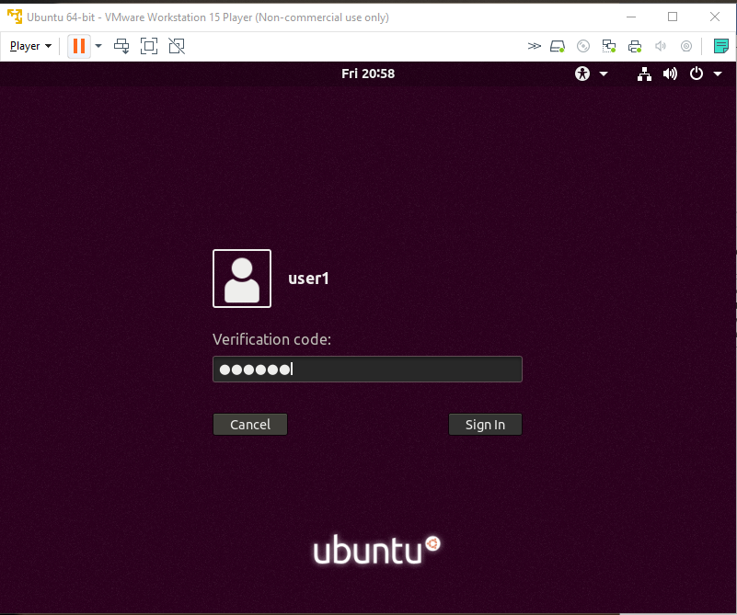
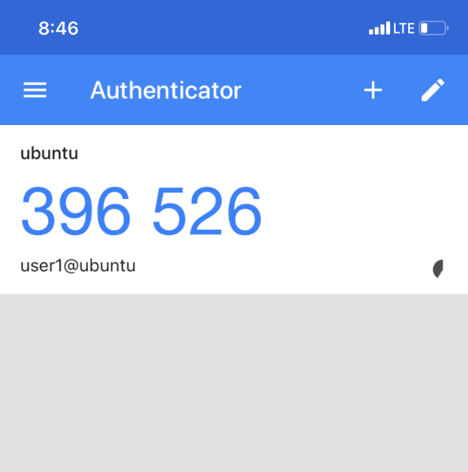
User1 logon Screen
The verification code screen and google authenticator screen.

Slide 24
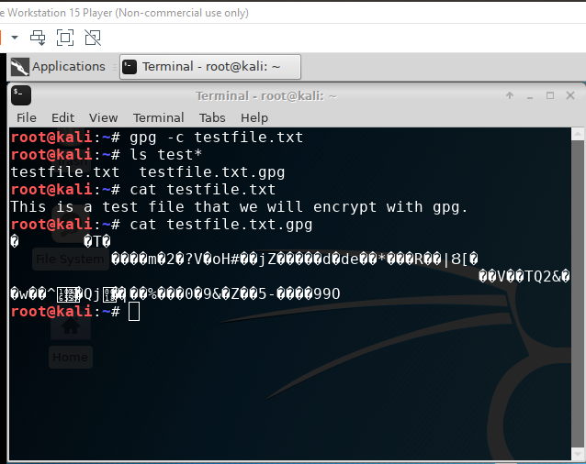
File Encryption
The screenshot shows:
content of the plaintext file
content of the encrypted file

Slide 25
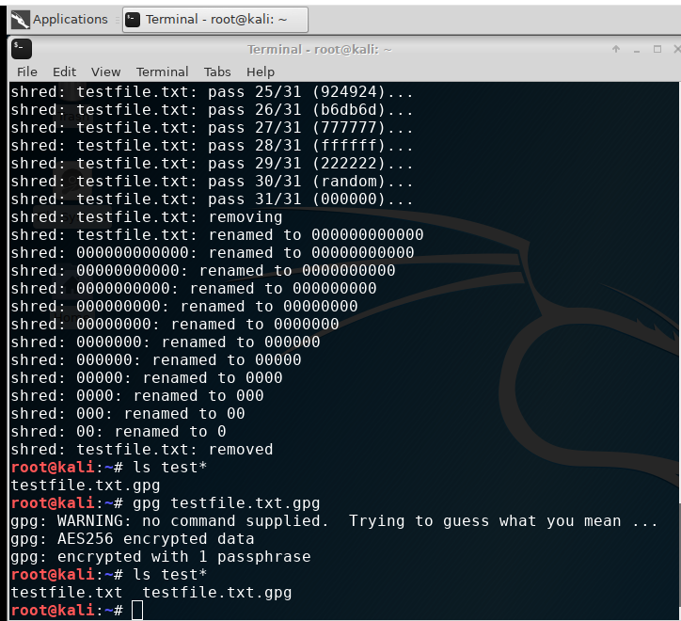




File Decryption
The screenshot shows:
1. the single encrypted file being listed
2. the decrypting process
3. both the encrypted file and the original plaintext file being listed.

Slide 26
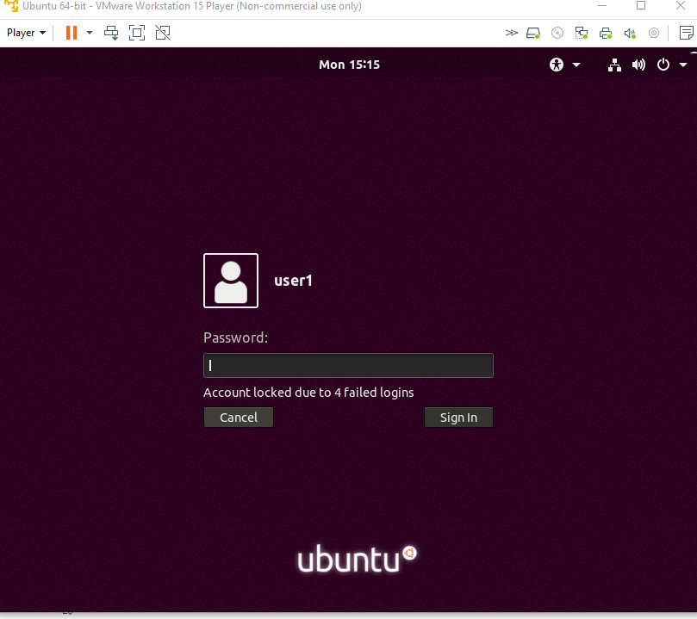
Account Lockout Screen
The screenshot shows the “Account locked out due to x failed logins” message.

Slide 27

Home Security System
A home security system was created to demonstrate physical security.
Components and software:
  Esp32 microcontroller
  Breadboard
  Active buzzer
  Passive buzzer
  PIR motion sensor
  Wires
  uPyCraft IDE
The 1st setup will alert that motion is detected and the passive buzzer will sound and an output on the uPyCraft will show:
  “Sensor 1 Motion detected! Interruption source: Pin(14)”
  When motion is no longer detected the output will show: “Sensor 1 Motion stopped!”
The 2nd setup will alert that motion is detected and the active buzzer will sound and an output on the uPyCraft will show:
  “Sensor 2 Motion detected! Interrupt caused by: Pin(27)”
  When motion is no longer detected the output will show: “Sensor 2 Motion stopped!”

Slide 28
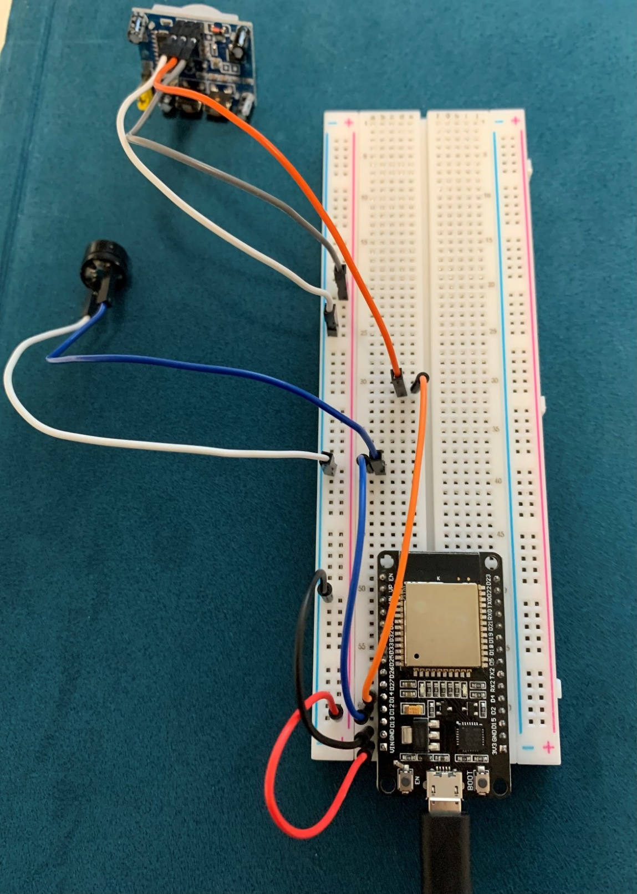
Passive Buzzer Breadboard Layout
Connected components:
ESP32
Passive buzzer
Motion sensor
Wires

Slide 29
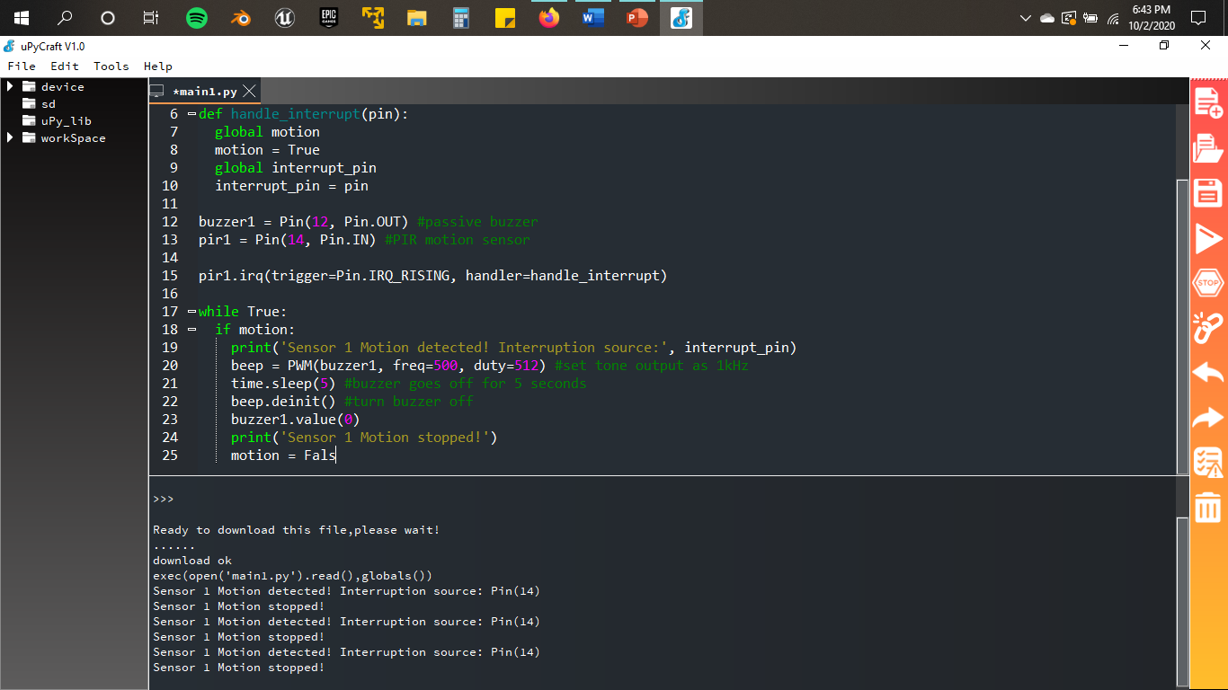
Passive Buzzer System Output
The screenshot shows:
1. “Motion detected” message
2. Interruption source
3. “Motion stopped” message

Slide 30
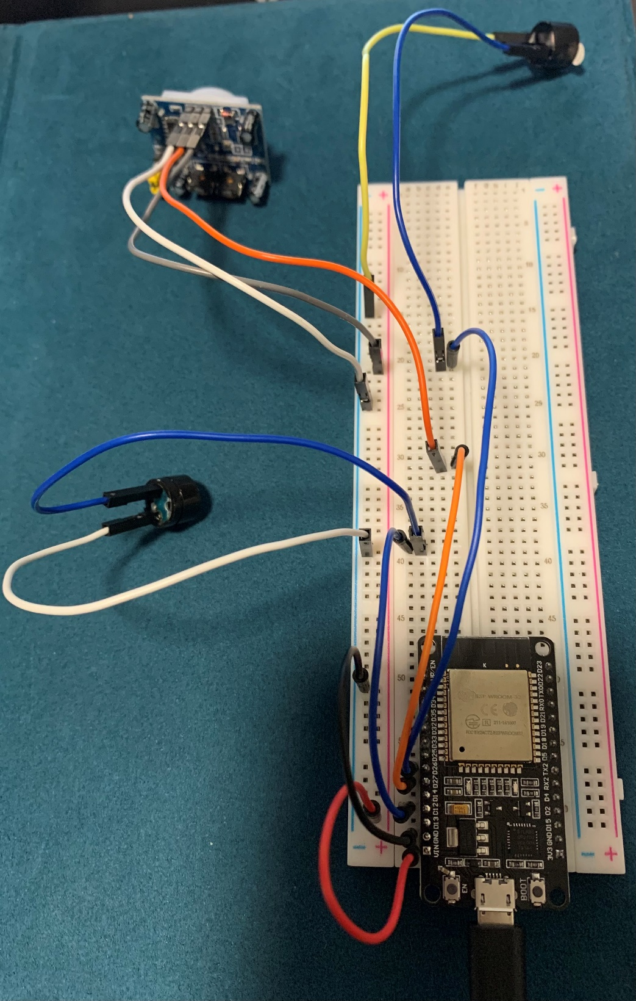
Active Buzzer Breadboard Layout
The picture shows:
ESP32
Passive buzzer
Active buzzer
Motion sensor
Wires

Slide 31
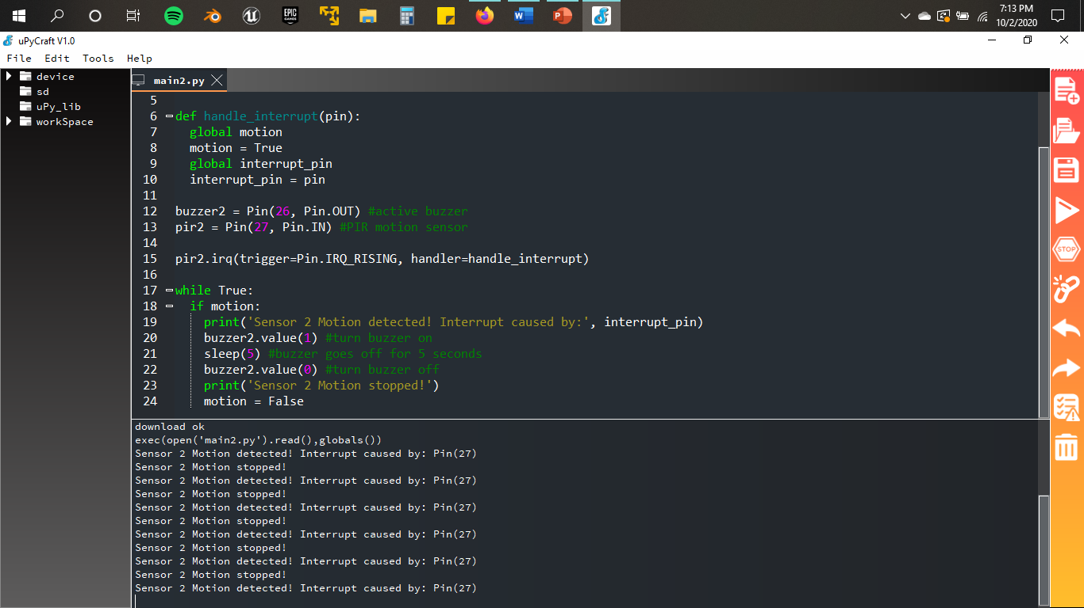
Active Buzzer System Output
The screenshot shows:
1. “Motion detected” message
2. Interruption source
3. “Motion stopped” message

Slide 32
Light Control System
Another aspect of physical security is lighting specifically standby lighting where lights are manually operated to light an area in the event of any suspicious activity.
In this case a home light system was created to keep light controls in a centralized area allowing the user to manually operate a living room and kitchen lights.
  Then a bedroom light was added on as a challenge.
Components of this light control system included:
  Yellow travel router & HP laptop
  An ESP32
  Two red LED Lights
    A third red LED light was added as a challenge for bedroom light
  Two 220 Ohm Resistors
    A third 220 Ohm resistor was added for the las led light
  Wires
After setting up the components, the laptop was connected to the yellow travel router, The ESP32 was plugged into the HP laptop, and a code was added and run on the uPyCraft IDE.
A smartphone was used to connect to the yellow travel router, the ESP32 IP address (that was from the uPyCraft code output) was entered in the web address bar of the smart phone which then proceeded to the “Smart Light System” page.

Slide 33
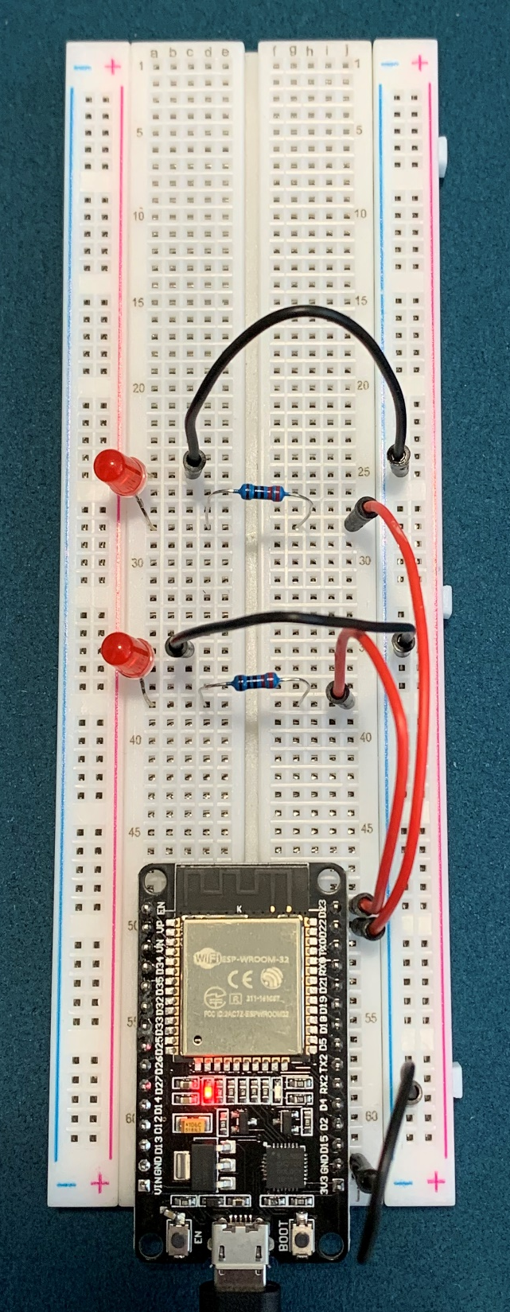
2-Light Breadboard Layout
ESP32
Two red LED Lights
Two 220 Ohm Resistors
Wires

Slide 34
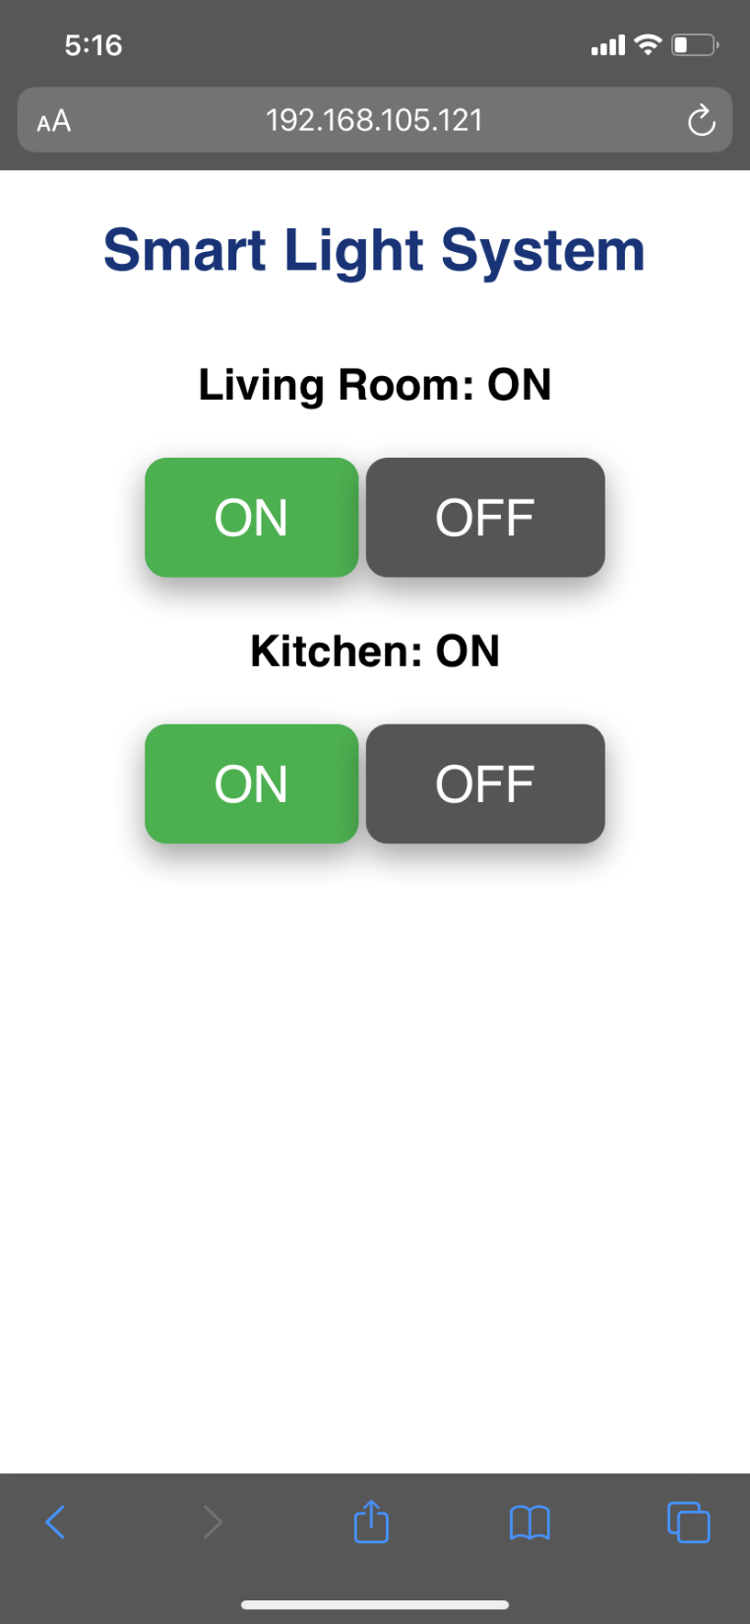
2-Light Control Web Interface
The screenshot shows:
  Living room button control light and kitchen button control light
  Both living room and kitchen lights are switched to “ON”.
  The IP address of the ESP32 is in the browser URL.

Slide 35
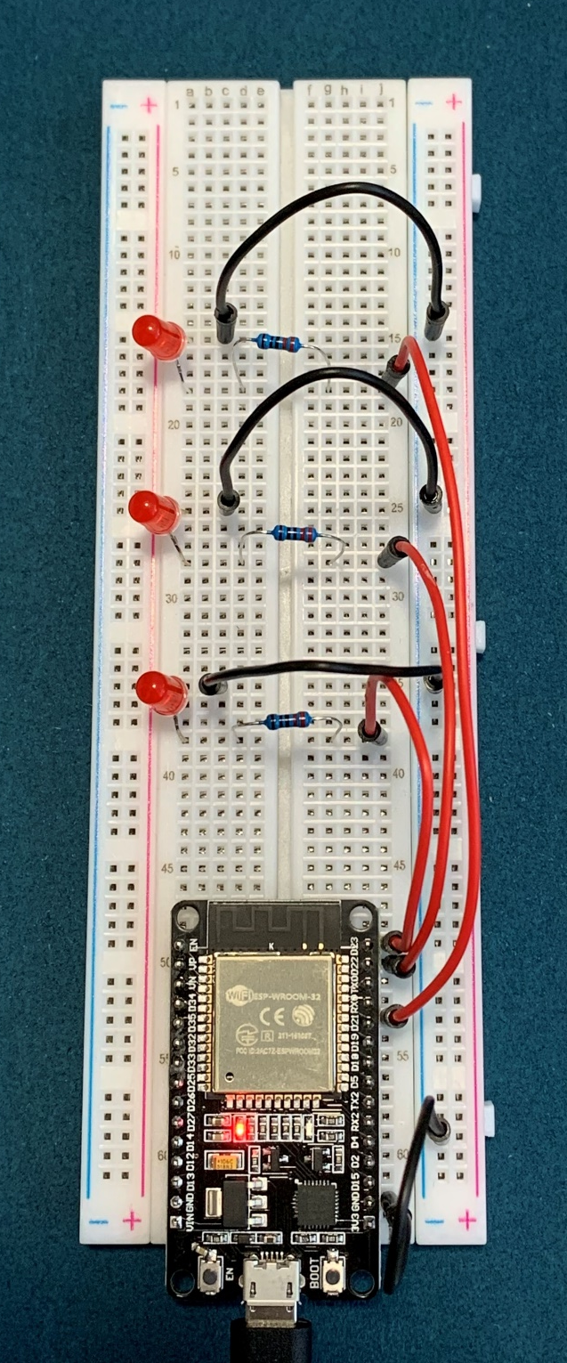
3-Light Breadboard Layout (challenge)
ESP32
Three red LED lights
Three 220 Ohm Resistors
Wires

Slide 36
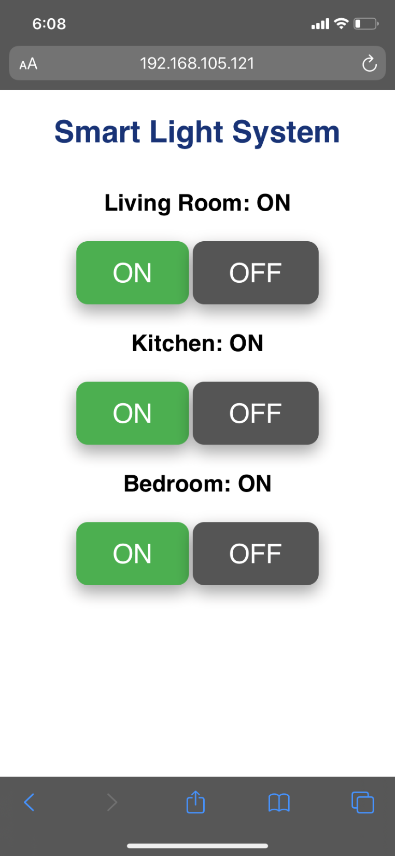
3-Light Breadboard Layout (challenge)
The screenshot shows:
  Living room button control light, kitchen button control light, and bedroom button control light.
  The living room, kitchen, and bedroom lights are switched to “ON”.
  The IP address of the ESP32 is in the browser URL.

Slide 37
Challenges In The Project
One minor challenge occurred during the “Smart light control system” project.
When reaching the point of using the ESP32 IP address in the smart phone’s web address bar the connection was unsuccessful.
Steps take to address this issue were:
  Verifying the connection between the phone and the yellow travel router.
  Verifying the code to make sure the correct login information was entered in.
  Lastly disconnecting the cellular data from the smart phone.
After following through these steps, the ESP32 IP address was reentered and the “Smart light System” page loaded.

Slide 38
Career Skills Obtained
Problem solving skills – Solving the issue that occurred during the “Light control system” project.
Communication skills – Communicating and helping other peers who had issues on any of the projects that were in this course.
Network security skills – When using nmap to verify active network connections and using iptables firewall to minimize open ports in Kali Linux VM.
  When implementing a Multi-factor Authentication, Asymmetric Key Encryption, and Password Policy Enforcement
Programming – Editing the uPyCraft IDE code to control 3 lights.
Risk analysis and mitigation skills – Using Nessus Essentials with vulnerability assessments.

Slide 39
Conclusion
Network security as well as physical security are important when it comes to organizations and protecting their data assets.
Without these two types of security organizations are vulnerable to threats.
This project implemented several aspects of network security using Linux based VMs
As well as implementing a few aspects of physical security by creating a home security and light control system.
Thank you!

