Slide 1

Data Structures and algorithms
– CEIS295
Kimberly Hernandez
DeVry University
04/19/21
Kurt Diesch

Slide 2
Introduction
The amount of data produced as time goes by is endless.
To optimize data, we can use data structures and algorithms.
Using data structures, we can organize, store, and manage data;
And depending on the data structure, we can implement algorithms to handle data more efficiently.
This is not only important for data handling but also important for the development of computer programs or applications as it can “make or break” them.
This presentation will cover real-world speeds on ‘ClientData.csv’ files using:
ArrayList
LinkedList
Binary Search Tree
Queue
Bubble Sort
Selection Sort
Insertion Sort
Shell Sort
Quicksort
Merge Sort
Linear Search
Binary Search

Slide 3
Speed Test for ArrayList Data Structure
ArrayLists are much like arrays but are dynamic when elements are stored.
With ArrayLists we can remove, add, or retrieve data.
Before implementing the ArrayList, import time is used to run “Hello Everyone” 1,000 times to review execution time.
A Client.py code is created based on UML diagram
  Data from ‘ClientData.csv’ file is used for client object.
On main, ArrayList is used to test the speed of 3 scenarios with the data unsorted and sorted using quick sort.
  Speeds are compared.

Slide 4
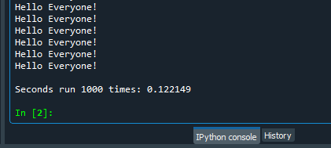
TimeProcess.pY Python Code
#Name: Kimberly Hernandez
#Date: 3/5/2021
import time # use time library to time the code executions
# get current time before the process
start_time = time.time()
# run the process
for i in range(1000):
print( "Hello Everyone!" )
# get current time after the process
end_time = time.time()
# subtract start time from end time to get time used by process
total_time = end_time - start_time
# Show the result. Note: .6f means “show six decimal places”
print("\nSeconds run 1000 times: {:.6f}".format(total_time))
Testing process speed of displaying “Hello Everyone” 1,000 times.

Slide 5
Client.py Python Code
#Name: Kimberly Hernandez
#Date: 3/5/2021
class Client:
def __init__(self, client_id=0, first_name="Unknown", last_name="Unknown", phone="Unknown", email="Unknown"):
self.__client_id = client_id
self.__first_name = first_name
self.__last_name = last_name
self.__phone = phone
self.__email = email
# classes that compare objects must implement __eq__ and __lt__ method
#__lt__ means "less than" and it must return a boolean
#__eq__ means "equals" and it must return a boolean
def __lt__(self, other):
return self.__client_id < other.__client_id
def __eq__(self, other):
return self.__client_id == other.__client_id
# __str__() method is automatically called when you print the object
def __str__(self):
return str(self.__client_id) + ", " + self.__last_name + ", " + self.__first_name
# Getters and Setters
def get_client_id(self):
return self.__client_id
def set_client_id(self, client_id):
self.__client_id = client_id
def get_first_name(self):
return self.__first_name
def set_first_name(self, first_name):
self.__first_name = first_name
def get_last_name(self):
return self.__last_name
def set_last_name(self, last_name):
self.__last_name = last_name
def get_phone(self):
return self.__phone
def set_phone(self, phone):
self.__phone = phone
def get_email(self):
return self.__email
def set_email(self, email):
self.__email = email
Attributes include:
__client_id
__first_name
__last_name
__phone
__email
Behaviors include:
__eq__
__str__
The getters and setters of Client.py are seen in code

Slide 6
ArrayListActualSpeed.py Python Code
#Name: Kimberly Hernandez
#Date: 3/5/2021
from ArrayList import ArrayList
from Client import Client
from Quicksort import Quicksort
from datetime import date
import time # Use this library to time the code executions
import random # Use to generate random numbers
import sys # Use to terminate the application early
# Display name and date in output
print("Kimberly Hernandez")
print("Date: ", date.today())
print()
# Create a list
clients = []
# Read the records from ClientData.csv file
# into client objects and place the client objects into the list
input_file_name = 'ClientData.csv'
with open(input_file_name) as infile:
for line in infile:
# Split the line based on the commas
s = line.split(',')
client_id = int( s[0] ) # Convert the default string to an int
f_name = s[1]
l_name = s[2]
phone = s[3]
email = s[4]
# Create a client object using the data from the file
clt = Client(client_id, f_name, l_name, phone, email)
# Add the client object to the list
clients.append(clt)
# Sort the clients list
Quicksort.sort(clients)
# How many client objects do we have
num_records = len(clients)
# Create an ArrayList object
my_array_list = ArrayList()
# Scenario 1: Printer Queue or Call Queue
section_title = "Scenario: Printer Queue or Call Queue"
print(section_title)
print("-" * len(section_title))
# How long does it take to add the client records to the ArrayList
start_time = time.time()
for i in range(num_records):
my_array_list.append(clients[i])
end_time = time.time()
total_time = end_time - start_time
print("Seconds to add records: {:.6f}".format(total_time))
# How long does it take to remove records from the front of the ArrayList
start_time = time.time()
for i in range(num_records):
my_array_list.remove_at(0)
end_time = time.time()
total_time = end_time - start_time
print("Seconds to remove records from the front: {:.6f}".format(total_time))
# Scenario 2: Customer Service Center
answer = input("Continue (y/n)?")
if answer.lower() != "y":
sys.exit() # End the application
section_title = "Scenario: Customer Service Center"
print(section_title)
print("-" * len(section_title))
# Add clients back to ArrayList
for i in range(num_records):
my_array_list.append(clients[i])
# How long does it take to randomly display 1000 records?
start_time = time.time()
for i in range(1000):
smallest_id = 100001
largest_id = smallest_id + num_records
random_num = random.randint(smallest_id, largest_id)
#print(my_array_list.search(Client(random_num)))
print(my_array_list.search_sorted(Client(random_num)))
end_time = time.time()
total_time = end_time - start_time
print("Seconds to display random records: {:.6f}".format(total_time))
# Scenario 3: Call Center
answer = input("Continue (y/n)?")
if answer.lower() != "y":
sys.exit() # End the application
section_title = "Scenario: Call Center"
print(section_title)
print("-" * len(section_title))
# How long does it take to add records, randomly display 1000 records
# and randomly remove 1000 records?
start_time = time.time()
# Add records
current_id = 100001 + num_records + 1
for i in range(1000):
my_array_list.append(Client(current_id))
current_id += 1
# Display random records
for i in range(1000):
smallest_id = 100001
largest_id = smallest_id + num_records
random_num = random.randint(smallest_id, largest_id)
#print(my_array_list.search(Client(random_num)))
print(my_array_list.search_sorted(Client(random_num)))
# Remove random records
for i in range(1000):
smallest_id = 100001
largest_id = smallest_id + num_records
random_num = random.randint(smallest_id, largest_id)
#print(my_array_list.search(Client(random_num)))
#print(my_array_list.search_sorted(Client(random_num)))
my_array_list.remove_at(random_num)
end_time = time.time()
total_time = end_time - start_time
print("Seconds to add, display, and remove records: {:.6f}".format(total_time))
Working with a ClientData.csv file to test ArrayList data structure with quicksort algorithm to:
Read records into application
Test process speeds of (sorted):
  Records that are added to the end of data structure.
  Records that are removed from beginning of data structure.
  Records displayed randomly.
  Records that are added, randomly displayed, and randomly removed.
Screenshots of running code on next slide

Slide 7
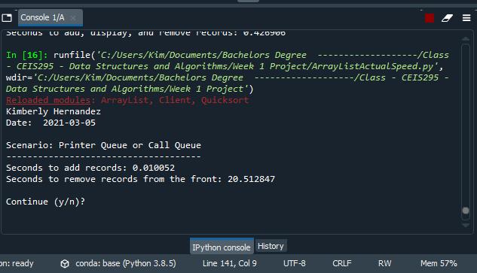
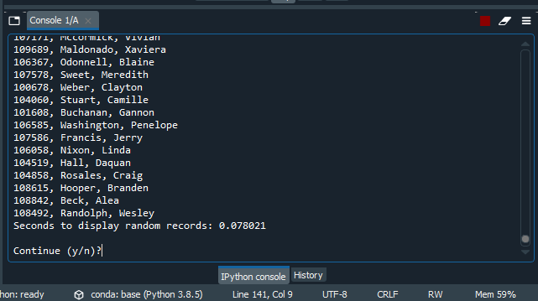

Screenshots of Running Code
Scenario 1: Sorted
Scenario 2: Sorted
Scenario 3: Sorted
Compared unsorted and sorted speeds on next slide

Slide 8
Table of Speeds

Slide 9
Speed Test for LinkedList Data Structure
LinkedList is a linear structure that consists of nodes that are linked by pointers.
Is also dynamic and used with stacks and queues for easy insertion and deletion.
Can traverse one way with a singly-LinkedList and traverse back with a doubly-LinkedList.
The same Client.py file is used to create a client object using the data from ‘ClientData.csv’ file.
On main, LinkedList is used to test the speed of 3 scenarios.
  Speeds are then compared to ArrayList speeds.

Slide 10
LinkedListActualSpeed.py Python Code
#Name: Kimberly Hernandez
#Date: 3/11/2021
from LinkedList import LinkedList
from Client import Client
from datetime import date
import time # Use this library to time the code executions
import random # Use to generate random numbers
import sys # Use to terminate the application early
# Display name and date in output
print("Kimberly Hernandez")
print("Date: ", date.today())
print()
# Create a list
clients = []
# Read the records from ClientData.csv file
# into client objects and place the client objects into the list
input_file_name = 'ClientData.csv'
with open(input_file_name) as infile:
for line in infile:
# Split the line based on the commas
s = line.split(',')
client_id = int( s[0] ) # Convert the default string to an int
f_name = s[1]
l_name = s[2]
phone = s[3]
email = s[4]
# Create a client object using the data from the file
clt = Client(client_id, f_name, l_name, phone, email)
# Add the client object to the list
clients.append(clt)
# How many client objects do we have
num_records = len(clients)
# Create an LinkedList object
my_linked_list = LinkedList()
# Scenario 1: Printer Queue or Call Queue
section_title = "Scenario: Printer Queue or Call Queue"
print(section_title)
print("-" * len(section_title))
# How long does it take to add the client records to the back LinkedList
start_time = time.time()
for i in range(num_records):
my_linked_list.add_last(clients[i])
end_time = time.time()
total_time = end_time - start_time
print("Seconds to add records to the end: {:.6f}".format(total_time))
# How long does it take to remove records from the front of the LinkedList
start_time = time.time()
for i in range(num_records):
my_linked_list.remove(clients[i])
end_time = time.time()
total_time = end_time - start_time
print("Seconds to remove records from the front: {:.6f}".format(total_time))
# Scenario 2: Customer Service Center
answer = input("Continue (y/n)?")
if answer.lower() != "y":
sys.exit() # End the application
section_title = "Scenario: Customer Service Center"
print(section_title)
print("-" * len(section_title))
# Add clients back to LinkedList
for i in range(num_records):
my_linked_list.add_last(clients[i])
# How long does it take to randomly display 1000 records?
start_time = time.time()
for i in range(1000):
smallest_id = 100001
largest_id = smallest_id + num_records
random_num = random.randint(smallest_id, largest_id)
print(my_linked_list.search(Client(random_num)))
end_time = time.time()
total_time = end_time - start_time
print("Seconds to display random records: {:.6f}".format(total_time))
# Scenario 3: Call Center
answer = input("Continue (y/n)?")
if answer.lower() != "y":
sys.exit() # End the application
section_title = "Scenario: Call Center"
print(section_title)
print("-" * len(section_title))
# How long does it take to add records, randomly display 1000 records
# and randomly remove 1000 records?
start_time = time.time()
# Add records
current_id = 100001 + num_records + 1
for i in range(1000):
my_linked_list.add_last(Client(current_id))
current_id += 1
# Display random records
for i in range(1000):
smallest_id = 100001
largest_id = smallest_id + num_records
random_num = random.randint(smallest_id, largest_id)
print(my_linked_list.search(Client(random_num)))
# Remove random records
for i in range(1000):
smallest_id = 100001
largest_id = smallest_id + num_records
random_num = random.randint(smallest_id, largest_id)
my_linked_list.remove(Client(random_num))
end_time = time.time()
total_time = end_time - start_time
print("Seconds to add, display, and remove records: {:.6f}".format(total_time))
Working with a ClientData.csv file to test LinkedList data structure to:
Read records into application
Test process speeds of:
  Records that are added to the end of data structure.
  Records that are removed from beginning of data structure.
  Records displayed randomly.
  Records that are added, randomly displayed, and randomly removed.
Screenshots on next slide

Slide 11
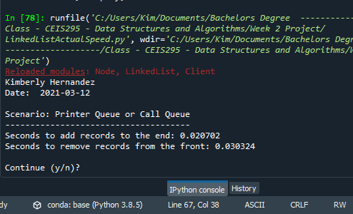
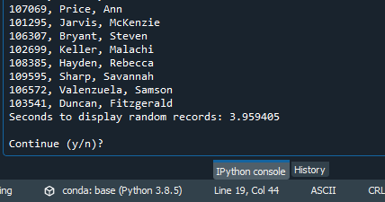
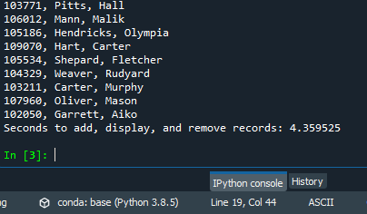
Screenshots of Running Code
Scenario 1:
Scenario 2:
Scenario 3:
Compared unsorted and sorted speeds of an ArrayList to LinkedList speeds on next slide

Slide 12
Table of Speeds

Slide 13
Speed Test for queue abstract data type
An Abstract data type (ADT) is operations and values that are already created or set.
A Queue is a first-in-last-out ADT and is used with a LinkedList or an ArrayList.
A Call.py code is created and is used for a Call object on main with the ‘ClientData.csv’ file.
On main, an 'Automatic Call Distributor' simulation code is created to take the user input of how many seconds to run it.
This simulation will enqueue and dequeue calls.
  Enqueue adds calls to the end of the queue.
  Dequeue removes and returns calls from front of the queue.

Slide 14
Call.py Python Code
#Name: Kimberly Hernandez
#Date: 03/18/21
from time import strftime # Used for current date and time
class Call:
def __init__(self, client_id=0, customer_name="Unknown", customer_phone="Unknown"):
self.client_id = client_id
self.customer_name = customer_name
self.customer_phone = customer_phone
self.call_date = strftime("%m/%d/%Y")
self.call_time = strftime("%H:%M")
#str __str__() method is automatically called when you print the object
def __str__(self):
return str(self.client_id) + ", " + self.customer_name + \
"\n\tPhone: " + self.customer_phone + \
"\tDate/Time: " + self.call_date + "@ " + self.call_time
Attributes include:
  call_id
  customer_name
  customer_phone
  call_date
  call_time
Behaviors include:
  __str__

Slide 15
AutomaticCallDistributor.py Python Code
#Name: Kimberly Hernandez
#Date: 03/18/2021
from Queue import Queue
from Call import Call
from datetime import date
import time #To pause the application
import random #To generate random numbers
#Display authors name and the date in the output
print ("Name:", "Kimberly Hernandez")
print ("Date:", date.today())
print()
# Create a list
calls = []
# Read the call records into the list
input_file_name = "ClientData.csv"
with open(input_file_name) as infile:
for line in infile:
# Split the line based on commas
s = line.split(',')
client_id = int(s[0])
customer_name = s[1]
customer_phone = s[2]
# Create a call object based on the data from the line
a_call = Call(client_id, customer_name, customer_phone)
# Add the Call object to the list
calls.append(a_call)
# Queue object for our calls
calls_waiting = Queue()
call_number = 0
# How long is the simulation?
seconds = int(input("How many seconds do you want to simulate? "))
# Run the simulation for the given number of seconds
for i in range(seconds):
print("-" * 40)
time.sleep(2) #Pause the application for the # of given seconds
random_event = random.randint(1, 3)
# Do the event based on the random number generated
if random_event == 1:
print("Call recieved. Caller added to the queue.")
calls_waiting.enqueue( calls[call_number] )
call_number +=1 # Set up the next call
print("\tNumber of calls waitingin queue:", calls_waiting.get_length())
elif random_event == 2:
print("Call sent to representative for service.")
if calls_waiting.get_length() > 0:
print("Caller Information:")
print(calls_waiting.dequeue())
else:
print("The call waiting queue is empty.")
print("\tNumber of calls waiting in queue:", calls_waiting.get_length())
else:
print("Nothing happened during this second in time.")
print("\tNumber of calls waiting in queue:", calls_waiting.get_length())
print("\nThe 'Automatic Call Distributor' simulation has completed. ")
Simulation of Queue abstract data type:
  Ask user how many times to repeat
  On each loop:
    Randomly generate a number from 1 to 3
    If 1, add call to queue
    If 2, remove call from queue
    If 3, do nothing
Screenshot next slide

Slide 16
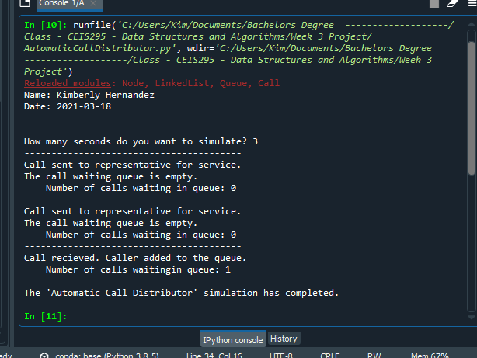
Screenshot of Running Code

Slide 17
Speed Test for Sorting Algorithms
When data is stored in a sorted manner it can optimize searching.
The following sorting algorithms are tested:
  Bubble Sort
  Selection Sort
  Insertion Sort
  Shell Sort
  Quicksort
  Merge Sort
Client.py is updated.
These sorting algorithms are used on datasets that include 100 records, 1000 records, 10000 records, and 100000 records. (Screenshot of MergeSort)
  Speeds are compared.

Slide 18
Client.py Python Code
#Name: Kimberly Hernandez
#Date: 3/25/2021
class Client:
def __init__(self, client_id=0, first_name="Unknown", last_name="Unknown", phone="Unknown", email="Unknown"):
self.__client_id = client_id
self.__first_name = first_name
self.__last_name = last_name
self.__phone = phone
self.__email = email
# classes that compare objects must implement __eq__ and __lt__ method
#__lt__ means "less than" and it must return a boolean
#__le__ means "less than or equal to" and it must return a boolean
#__eq__ means "equals" and it must return a boolean
def __lt__(self, other):
this_full_name = self.__last_name + " " + self.__first_name
other_full_name = other.__last_name + " " + other.__first_name
return this_full_name < other_full_name
def __le__(self, other):
this_full_name = self.__last_name + " " + self.__first_name
other_full_name = other.__last_name + " " + other.__first_name
return this_full_name <= other_full_name
def __eq__(self, other):
return self.__client_id == other.__client_id
# __str__() method is automatically called when you print the object
def __str__(self):
return self.__last_name + ", " + self.__first_name
# Getters and Setters
def get_client_id(self):
return self.__client_id
def set_client_id(self, client_id):
self.__client_id = client_id
def get_first_name(self):
return self.__first_name
def set_first_name(self, first_name):
self.__first_name = first_name
def get_last_name(self):
return self.__last_name
def set_last_name(self, last_name):
self.__last_name = last_name
def get_phone(self):
return self.__phone
def set_phone(self, phone):
self.__phone = phone
def get_email(self):
return self.__email
def set_email(self, email):
self.__email = email
Attributes include:
  __client_id
  __first_name
  __last_name
  __phone
  __email
Behaviors include:
  __lt__
  __le__
  __eq__
  __str__
The getters and setters of Client.py are seen in code

Slide 19
SortingActualSpeed.py Python Code
#Name: Kimberly Hernandez
#Date: 3/25/2021
from MergeSort import MergeSort
from Client import Client
from datetime import date
import time # Use this library to time the code executions
# Display name and date in output
print("Kimberly Hernandez")
print("Date: ", date.today())
print()
#input_file_name = 'ClientData100.csv'
#input_file_name = 'ClientData1000.csv'
#input_file_name = 'ClientData10000.csv'
input_file_name = 'ClientData100000.csv'
# Create a list
clients = []
# Read the records from ClientData.csv file
# into client objects and place the client objects into the list
with open(input_file_name) as infile:
for line in infile:
# Split the line based on the commas
s = line.split(',')
client_id = int( s[0] ) # Convert the default string to an int
f_name = s[1]
l_name = s[2]
phone = s[3]
email = s[4]
# Create a client object using the data from the file
clt = Client(client_id, f_name, l_name, phone, email)
# Add the client object to the list
clients.append(clt)
# How many client objects do we have
num_records = len(clients)
# Scenario: Sorting records from a data file
section_title = "Scenario: Sorting " + str(num_records) + " Records"
print(section_title)
print("-" * len(section_title))
# How long does it take to sort the records?
start_time = time.time()
# Call the static sort method in the class
MergeSort.sort(clients)
end_time = time.time()
total_time = end_time - start_time
print("Seconds to sort {0} records: {1:.6f}".format(num_records, total_time))
# Display the sorted list
#for clt in clients:
# print(clt)
Working with data sets of 100, 1000, 10000, and 100000 from ClientData.csv files to:
Read records into application
Test sorting algorithm speeds with:
  Bubble Sort
  Selection Sort
  Insertion Sort
  Shell Sort
  Quicksort
  Merge Sort
Screenshot using MergeSort with 100,000 records on next slide

Slide 20
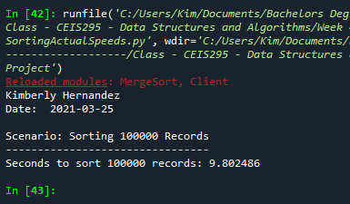
Screenshot of Running Code
Screenshot using MergeSort with 100,000 records.
  Table comparing all sorting algorithms on next slide

Slide 21
Table of Sorting Speeds

Slide 22
Speed Test for Searching Algorithms
Linear Search checks each element and will still go through the entire list returning that the list was exhausted if no elements were found.
Binary Search splits an array in half checking the middle element and continues this method until a specific element is found if any.
  Sorting before a binary search makes this algorithm run more efficiently; without sorting it has a longer runtime.
Same Client.py is used.
These searching algorithms are used on datasets that include 100 records, 1000 records, 10000 records, and 100000 records.
  Speeds are compared.

Slide 23
Client.py Python Code
#Name: Kimberly Hernandez
#Date: 04/01/2021
class Client:
def __init__(self, client_id=0, first_name="Unknown", last_name="Unknown", phone="Unknown", email="Unknown"):
self.__client_id = client_id
self.__first_name = first_name
self.__last_name = last_name
self.__phone = phone
self.__email = email
# classes that compare objects must implement __eq__ and __lt__ method
#__lt__ means "less than" and it must return a boolean
#__le__ means "less than or equal to" and it must return a boolean
#__eq__ means "equals" and it must return a boolean
def __lt__(self, other):
return self.__client_id < other.__client_id
def __le__(self, other):
return self.__client_id <= other.__client_id
def __eq__(self, other):
return self.__client_id == other.__client_id
# __str__() method is automatically called when you print the object
def __str__(self):
return str(self.__client_id) + ", " + self.__last_name + ", " + self.__first_name
# Getters and Setters
def get_client_id(self):
return self.__client_id
def set_client_id(self, client_id):
self.__client_id = client_id
def get_first_name(self):
return self.__first_name
def set_first_name(self, first_name):
self.__first_name = first_name
def get_last_name(self):
return self.__last_name
def set_last_name(self, last_name):
self.__last_name = last_name
def get_phone(self):
return self.__phone
def set_phone(self, phone):
self.__phone = phone
def get_email(self):
return self.__email
def set_email(self, email):
self.__email = email
Attributes include:
  __client_id
  __first_name
  __last_name
  __phone
  __email
Behaviors include:
  __lt__
  __eq__
  __str__
The getters and setters of Client.py are seen in code

Slide 24
SearchingActualSpeed.py Python Code
#Name: Kimberly Hernandez
#Date: 04/01/2021
from LinearSearch import LinearSearch
from BinarySearch import BinarySearch
from Quicksort import Quicksort
from Client import Client
from datetime import date
import random # Use to generate random numbers
import time # Use this library to time the code executions
import sys # Use to exit the application early
# Display name and date in output
print("Kimberly Hernandez")
print("Date: ", date.today())
print()
input_file_name = 'ClientData100.csv'
#input_file_name = 'ClientData1000.csv'
#input_file_name = 'ClientData10000.csv'
#input_file_name = 'ClientData100000.csv'
# Create a list
clients = []
# Read the records from ClientData.csv file
# into client objects and place the client objects into the list
with open(input_file_name) as infile:
for line in infile:
# Split the line based on the commas
s = line.split(',')
client_id = int( s[0] ) # Convert the default string to an int
f_name = s[1]
l_name = s[2]
phone = s[3]
email = s[4]
# Create a client object using the data from the file
clt = Client(client_id, f_name, l_name, phone, email)
# Add the client object to the list
clients.append(clt)
# How many client objects do we have
num_records = len(clients)
# Scenario: Search for 1000 records from a data file
section_title = "Scenario: Searching through " + str(num_records) + " Records"
print(section_title)
print("-" * len(section_title))
# MUST SORT THE DATA TO DO A BINARY SEARCH
Quicksort.sort(clients)
# Start and end record numbers
start_record = 100001
end_record = start_record + num_records
# How long does it take to sort the records?
start_time = time.time()
# How long does it take to do a random linear search through the records?
for i in range (1000):
client_id = random.randint(start_record, end_record)
clt = Client(client_id)
result = BinarySearch.search(clients, clt)
if result is None:
print(clt, " was not found.")
else:
print(result)
end_time = time.time()
total_time = end_time - start_time
print("Seconds to linear search for" + " " + str(num_records) + " " + "random records: {0:.6f}".format(total_time))
Working with data sets of 100, 1000, 10000, and 100000 from ClientData.csv files to:
Read records into application
Test algorithm speeds of:
  Linear Search
  Binary Search
Screenshot using MergeSort with 100,000 records on next slide

Slide 25
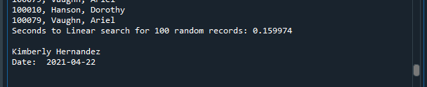
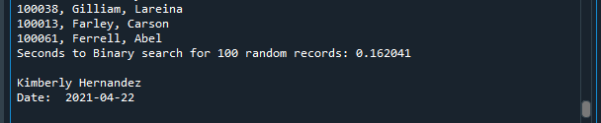
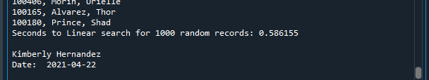

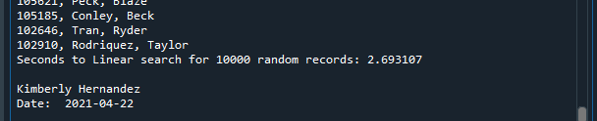
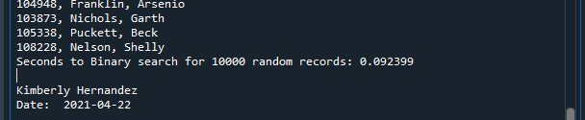
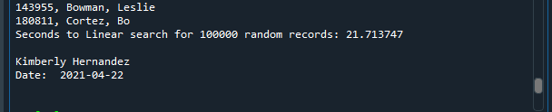
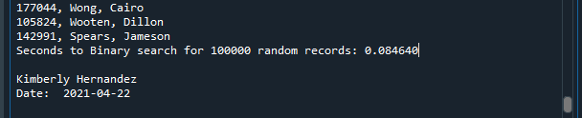
Screenshots of Running Code
Linear Search:
Binary Search:
Table of speeds on next slide

Slide 26
Table of Searching Speeds

Slide 27
Speed Test for Binary search tree
Binary search tree is node-based tree where:
  Starting from the root, the left sub-trees node’s keys should be less than or equal to the parent key.
  Starting from the root, the right sub-trees node’s keys should be greater than or equal to the parent key.
binary search trees are a form of hierarchy in which we can search, insert, or delete data accurately and at quick speeds.
Client.py file is used to create a client object using the ‘ClientData.csv’ file.
Speeds are tested on datasets that include 100 records, 1000 records, 10000 records, and 100000 records.
  Then speeds are compared to ArrayList and LinkedList.

Slide 28
BinarySearchTreeActualSpeed.py Python Code
#Name: Kimberly Hernandez
#Date: 04/08/21
from BinarySearchTree import BinarySearchTree
from Client import Client
from datetime import date
import time # Use to time the code executions
import random
import sys
# Display author's name and the date in the output
print ("Name:", "Kimberly Hernandez")
print ("Date:", date.today())
print()
# Create a list
clients = []
# Read records into the list
input_file_name = "ClientData.csv"
with open(input_file_name) as infile:
for line in infile:
# Split the line based on the commas
s = line.split(',')
client_id = int(s[0]) # Convert the default string to an int
f_name = s[1]
l_name = s[2]
phone = s[3]
email = s[4]
# Create client object using the data from the line
clt = Client(client_id, f_name, l_name, phone, email)
# Add the client object to the list
clients.append(clt)
# How many client objects do we have?
num_records = len(clients)
# Create the binary search tree to test real-world speeds
my_bst = BinarySearchTree()
# Scenario 1: Printer Queue or the Call Queue or Service Queue
section_title = "Scenario: Printer Queue or the Call Queue or the Service Queue"
print(section_title)
print("-" * len(section_title))
# How long does it take to add the client records to the binary search tree?
start_time = time.time()
for i in range(num_records):
my_bst.insert(clients[i])
end_time = time.time()
total_time = end_time - start_time
print("Seconds to add records: {:.6f}".format(total_time)) # .6f means 6 decimal places
# How long does it take to remove records from the front (smallest) of the BST
start_time = time.time()
for i in range(num_records):
my_bst.remove_minimum()
end_time = time.time()
total_time = end_time - start_time
print("Seconds to remove records: {:.6f}".format(total_time)) # .6f means 6 decimal places
# Scenario 2: Customer Service Center
answer = input ("Continue (y/n)?")
if answer.lower() != "y":
sys.exit() # End the application
section_title = "Scenario: Customer Service Center"
print(section_title)
print("-" * len(section_title))
# Add clients to Binary Search Tree
for i in range(num_records):
my_bst.insert(clients[i])
# How long does it take to randomly display 1000 client records to the binary search tree?
start_time = time.time()
for i in range(1000):
smallest_id = 100001
largest_id = smallest_id + num_records
random_num = random.randint(smallest_id, largest_id)
print( my_bst.search(Client(random_num)))
end_time = time.time()
total_time = end_time - start_time
print("Seconds to display 1000 random records: {:.6f}".format(total_time)) # .6f means 6 decimal places
# Scenario 3: Call Center
answer = input ("Continue (y/n)?")
if answer.lower() != "y":
sys.exit() # End the application
section_title = "Scenario: Call Center"
print(section_title)
print("-" * len(section_title))
# Add clients to Binary Search Tree
for i in range(num_records):
my_bst.insert(clients[i])
# How long does it take to add more client records,
# randomly display 1000 records, and randomly remove 1000 records from the BST?
start_time = time.time()
# Add records
current_id = 100001 + num_records + 1
for i in range(1000):
my_bst.insert(Client(current_id))
current_id +=1
# Display records
for i in range(1000):
smallest_id = 100001
largest_id = smallest_id + num_records
random_num = random.randint(smallest_id, largest_id)
print( my_bst.search(Client(random_num)))
# Remove 1000 records
for i in range(1000):
smallest_id = 100001
largest_id = smallest_id + num_records
random_num = random.randint(smallest_id, largest_id)
my_bst.remove(Client(random_num))
end_time = time.time()
total_time = end_time - start_time
print("Seconds to add records,")
print("display 1000 random records, ")
print("and remove 1000 random records: {:.6f}".format(total_time)) # .6f means 6 decimal places
Working with a ClientData.csv files to test Binary Search Tree data structure to:
Read records into application
Test process speeds of:
  Records that are added to the end of data structure.
  Records that are removed from beginning of data structure.
  Records displayed randomly.
  Records that are added, randomly displayed, and randomly removed.
Screenshots of running code on next slide

Slide 29
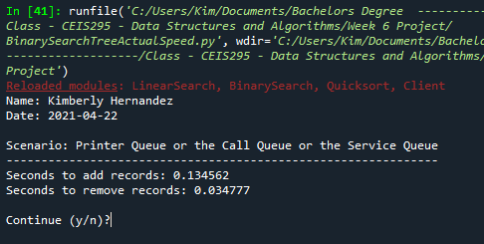
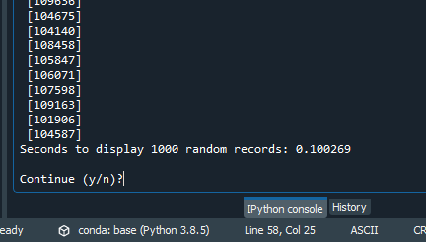
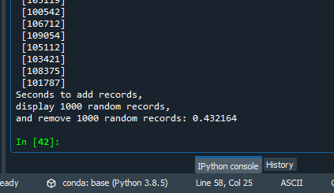
Screenshots of Running Code
Scenario 1:
Scenario 2:
Scenario 3:

Slide 30
Table of Speeds

Slide 31
Final Analysis
LinkedList
ArrayList
Binary Search Tree
Slow when retrieving random records.
Slow when adding, displaying, and removing random records.
Best scenario is #1, in which adding records was fast in this case.
Slow altogether when unsorted.
Extremely slow when sorted and pulling records off the front.
Best scenario is #2, when sorted and displaying random records.
Slow when adding, displaying, and removing records
Best Scenario is #1 in pulling records from the front.

Slide 32
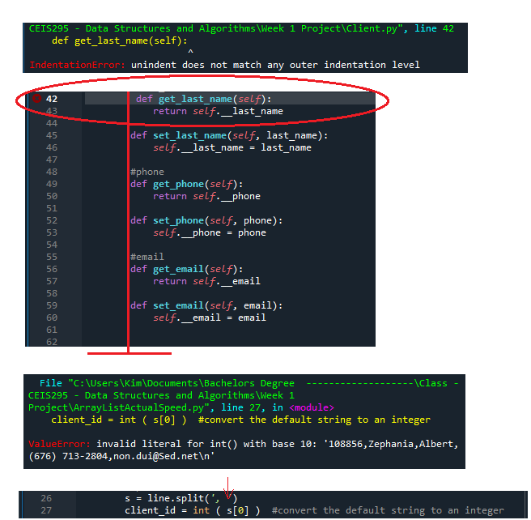
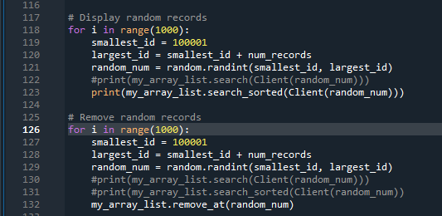
Challenges
One challenge that occurred was an indentation error causing the code to break.
  This was due to indentation or spacing of the code being off. (see 1st image)
  After corrected the code ran without issues.
Another issue faced was a value error.
  This was due to one space on line 26 that needed to be removed and the issue was fixed. (see 1st image)
Last issue was records not being removed when code executed.
  This was due to line 123 and line 131 being the same. (2nd image)
  my_array_list.remove_at(random_num) was added on line 132; when ran the records deleted.

Slide 33
Programming – Using Python in Spyder IDE.
Software – Using Excel and PowerPoint.
Troubleshooting - Fixing errors that occurred.
Career skills
Problem solving - Determining which data structure is optimal under different scenarios.

Slide 34
Conclusion
Using data structures and algorithms we can optimize data, as well as the development of computer programs or applications.
Without these data structures, programs and applications can run poorly or even cause data to be meaningless.
This project presented real-world speeds of data structures and algorithms.
Thank you!

