Slide 1
CEIS 101
IoT Home Security System
Kimberly Hernandez
DeVry University CEIS 101
12/16/19
Gina Cooper

Slide 2
Iot device Introduction
The IoT (Internet of Things) is growing at a fast rate as devices and applications are being developed every day.
This project will show the development and fundamentals of an IoT device that simulates a home security system.
The development includes:
  Inventory and Organization
  Planning and Design
  Installing Arduino IDE and Running the Blink Code
  Adding the Motion Sensor to the home security system
  Data Display
  Networking and Security

Slide 3
Inventory and Organization
Module 1
First step in the development process was to gather inventory from the course materials for the home security system.
The items needed for the home security system are:
  Arduino Megaboard
  Resistor - 220Ω & 10K
  LED
  Breadboard
  Motion Sensor
  Wire(s)
  Buzzer
  Esp32 Board
  Mini-Smart Router
  USB - micro USB Cable
  Images were taken of the inventory needed for this project on next 2 slides

Slide 4


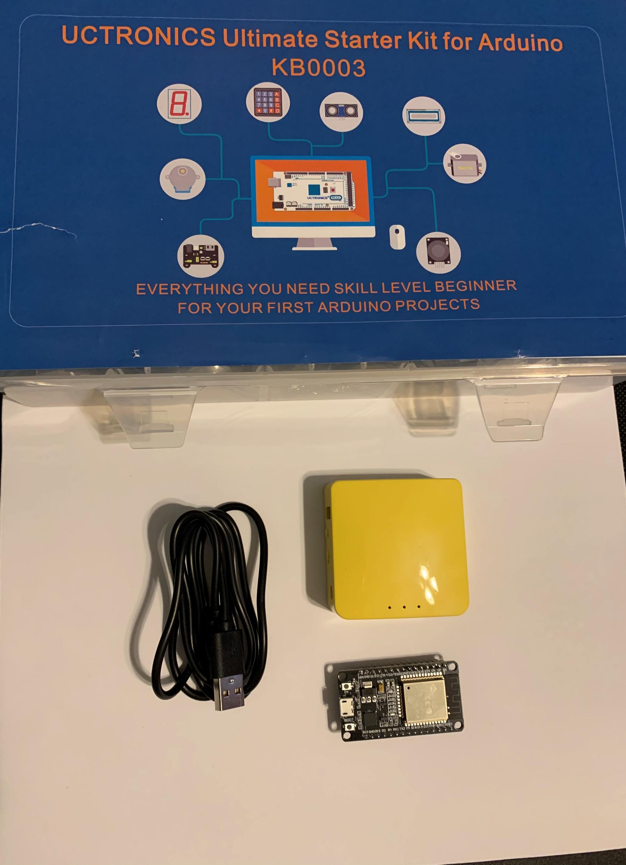
Inventory
Arduino Starter Kit
Mini-Smart Router
USB - micro USB Cable
Esp32 Board

Slide 5
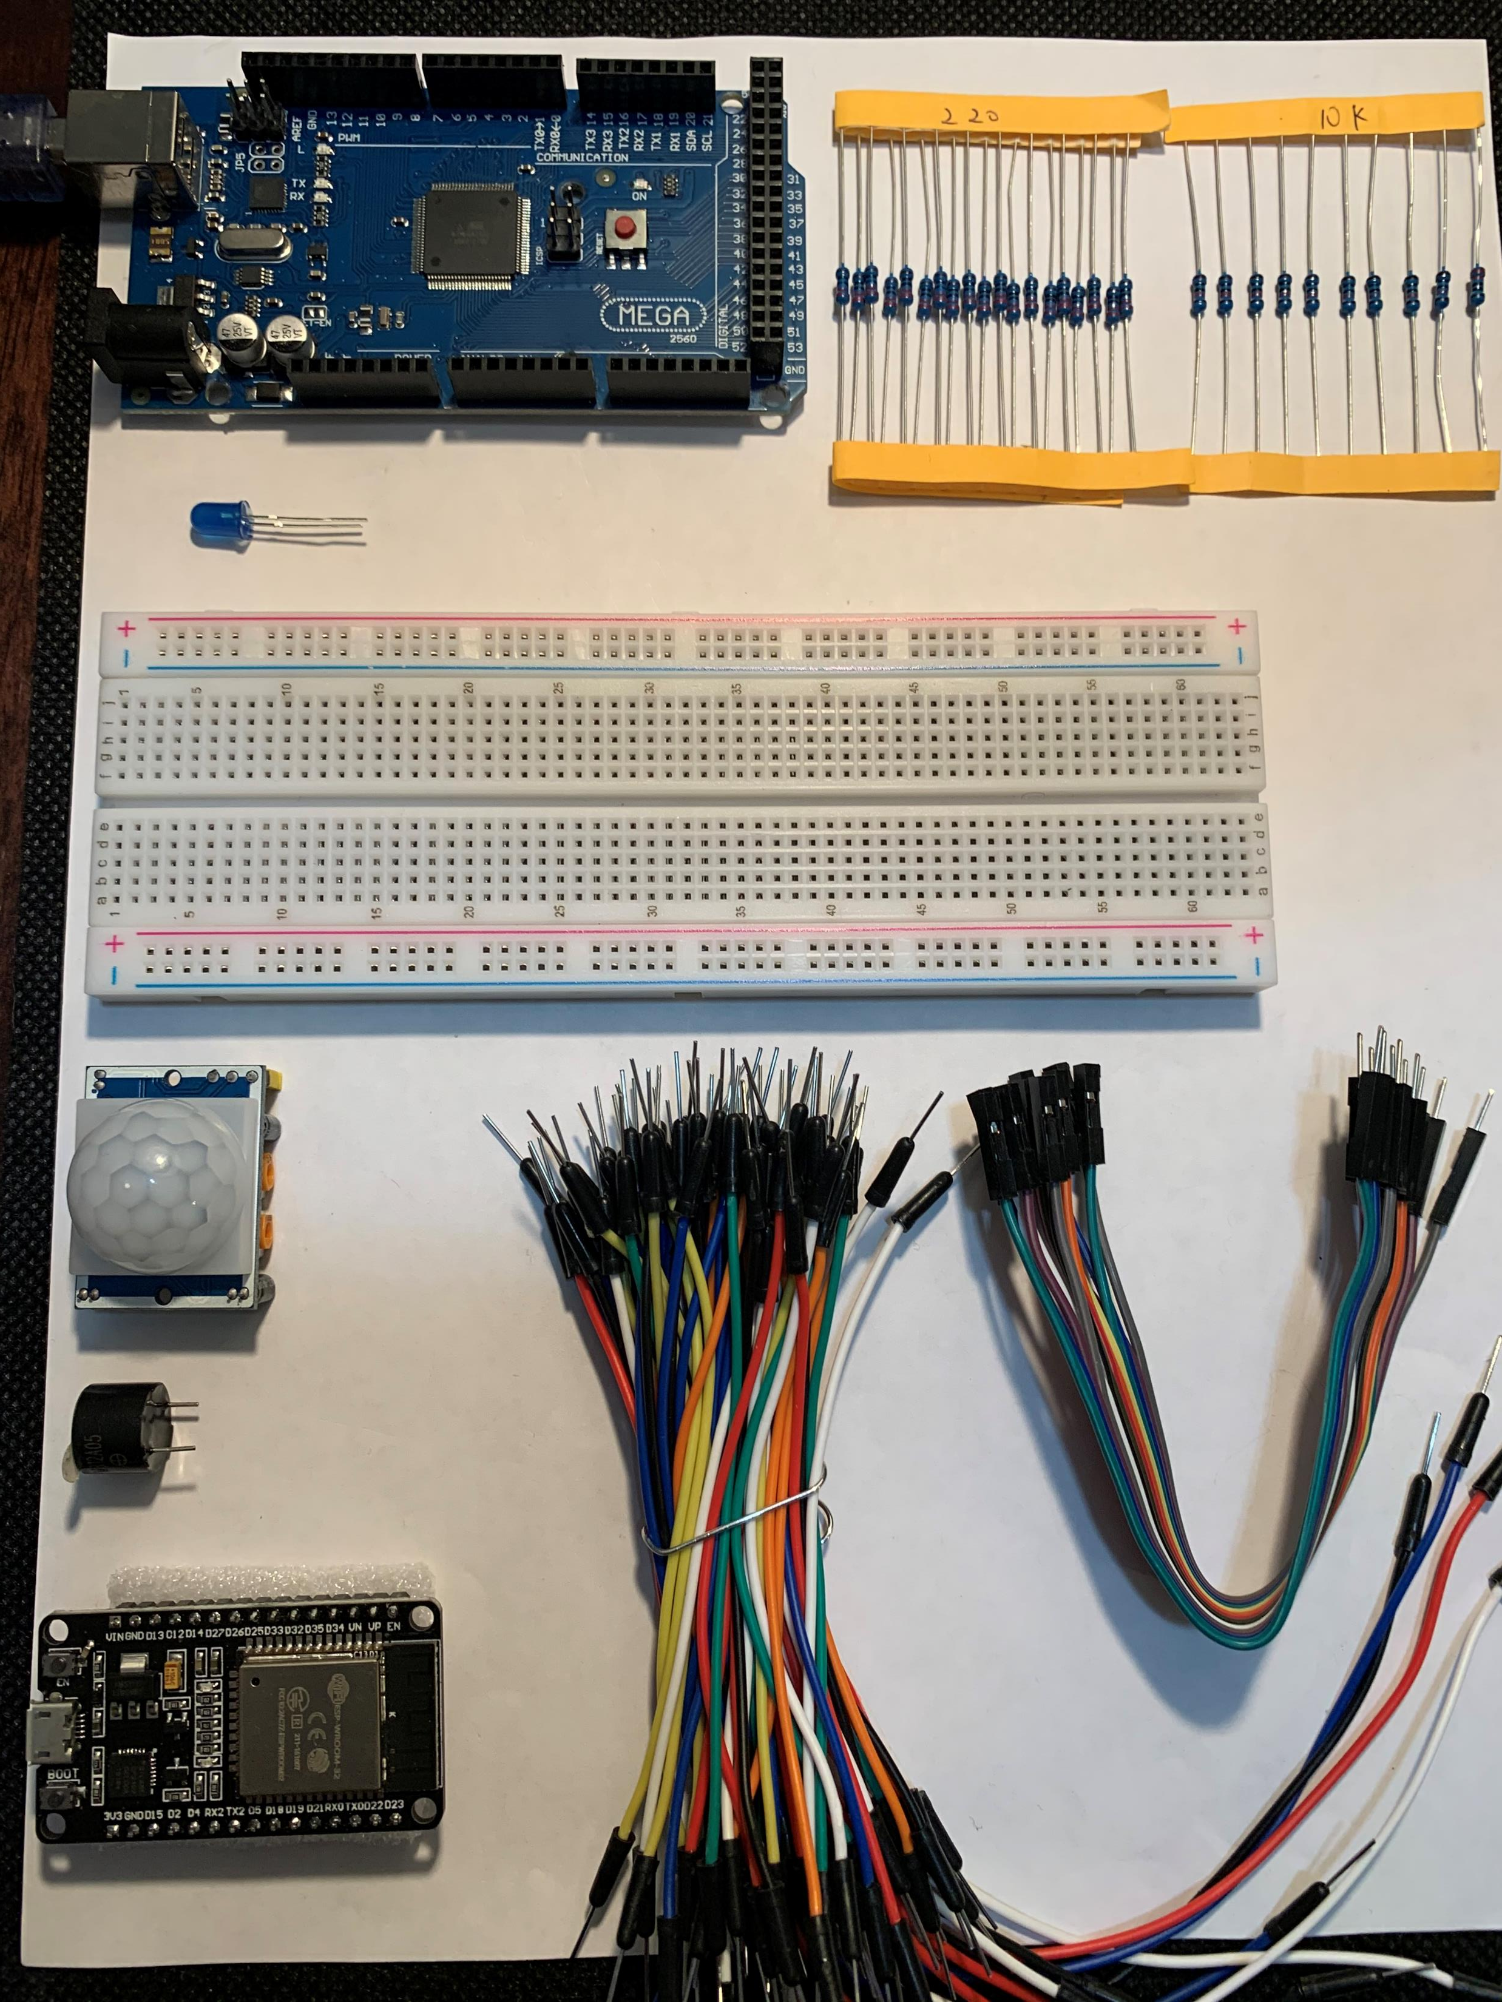
Organization
Arduino Megaboard
Resistor - 220Ω & 10K
LED
Breadboard
Motion Sensor
Wire(s)
Buzzer
Esp32 Board

Slide 6
Planning and design
Module 2
Flowcharts are part of the planning and designing of any IoT device.
Further research into flowcharts shows an idea of:
  What companies use flowcharts and why they use flowcharts.
When planning and designing a flowchart is used to visualize how the home security system will operate.
The flowchart shows the input, process, and output of the device.

Slide 7
Who uses Flowcharts
Research flowcharts
What companies use flowcharts?
There are many companies that use flow charts and to name a few would be: Apple, Microsoft, Amazon, or even The Walt Disney Company.
Why might they use flowcharts?
Many companies that use engineering, computer programing, or a form of entertainment use flow charts to help them start their next big idea. These companies might create a new application, a new gaming platform, or even a new roller coaster and use flowcharts to plan this new project, document a process, manage data, or map computer algorithms.

Slide 8
Input – Processing - Output
Input | Process | Output
Motion detection near sensor | System is not set off until motion is detected and notifies user. | Buzzer will alert the user and LED light will turn on

Slide 9
Flowchart
Start
Input: Movement
near sensor
Flowchart with three shapes
Processing:
Motion detected
Output:
Buzzer and
LED light
Stop

Slide 10
Installing the Arduino IDE and Running the Blink Code
Module 3
The home security system will use the Arduino IDE program to upload the codes to the Arduino Megaboard and to the circuit.
The Arduino IDE is installed to my computer and the code is put into the program. (Screenshot on next slide)
A basic circuit is set up with a 220Ω resistor, LED light, and two male wires.
Once the code was uploaded the to the Arduino Megaboard the LED light started blinking.

Slide 11
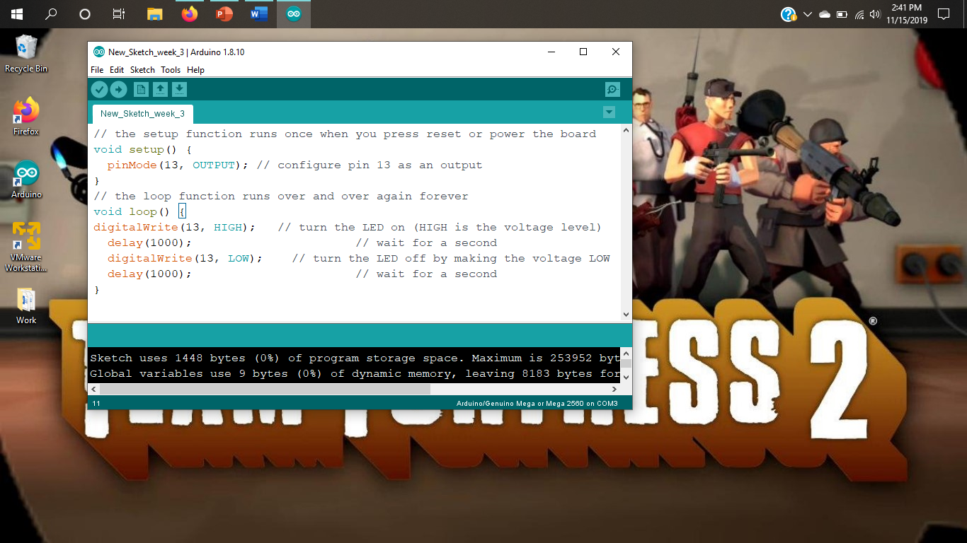
Code
Screenshot of code in Arduino IDE

Slide 12
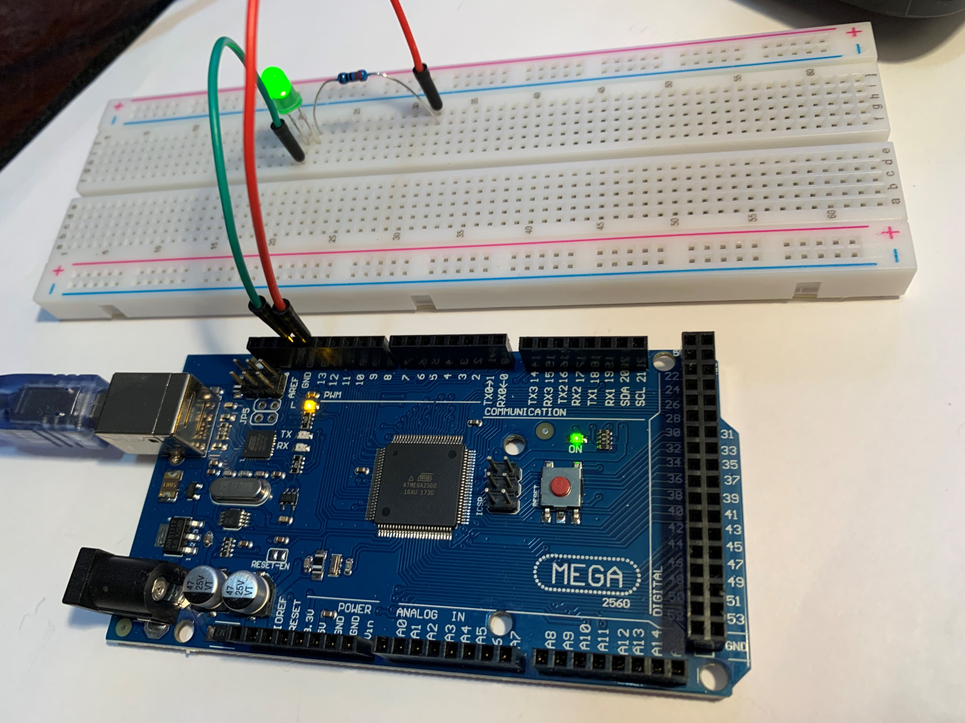
Circuit
Arduino and breadboard with LED connected to breadboard

Slide 13
Setting Up the Home Security System With a Motion Sensor
Module 4
The motion sensor was added to the circuit set up.
  Left Image shows motion sensor with LED light and 220Ω resistor.
  Video on the right shows motion sensor buzzer and 220Ω resistor.
Both codes were individually uploaded to the Arduino program at separate times to test both circuits.
  When the sensor detected motion, the LED light blinked. (Left image)
  When the sensor detected motion, the buzzer emits noise. (Video on the right)
  The code is reviewed to see the input and output pin, and how many times the setup function runs.

Slide 14
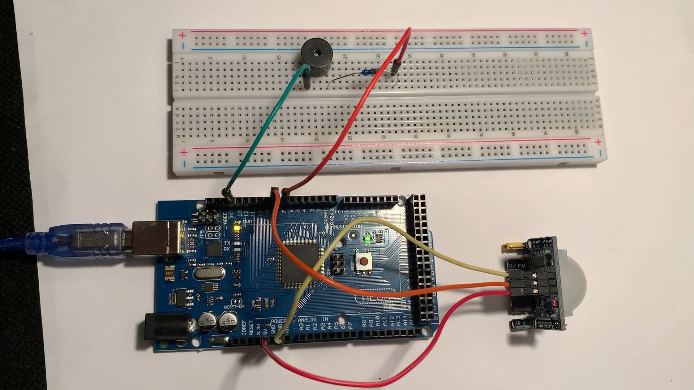
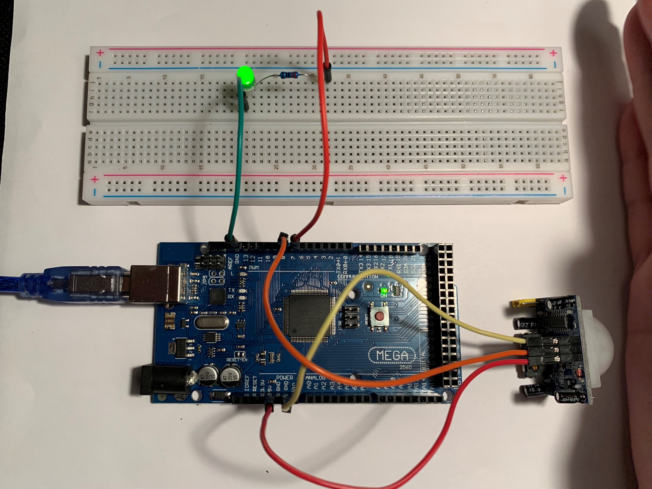
Circuit
Arduino with breadboard including motion sensor
Motion Sensor With The LED and 220Ω Resistor
Motion Sensor With The Buzzer and 220Ω Resistor

Slide 15
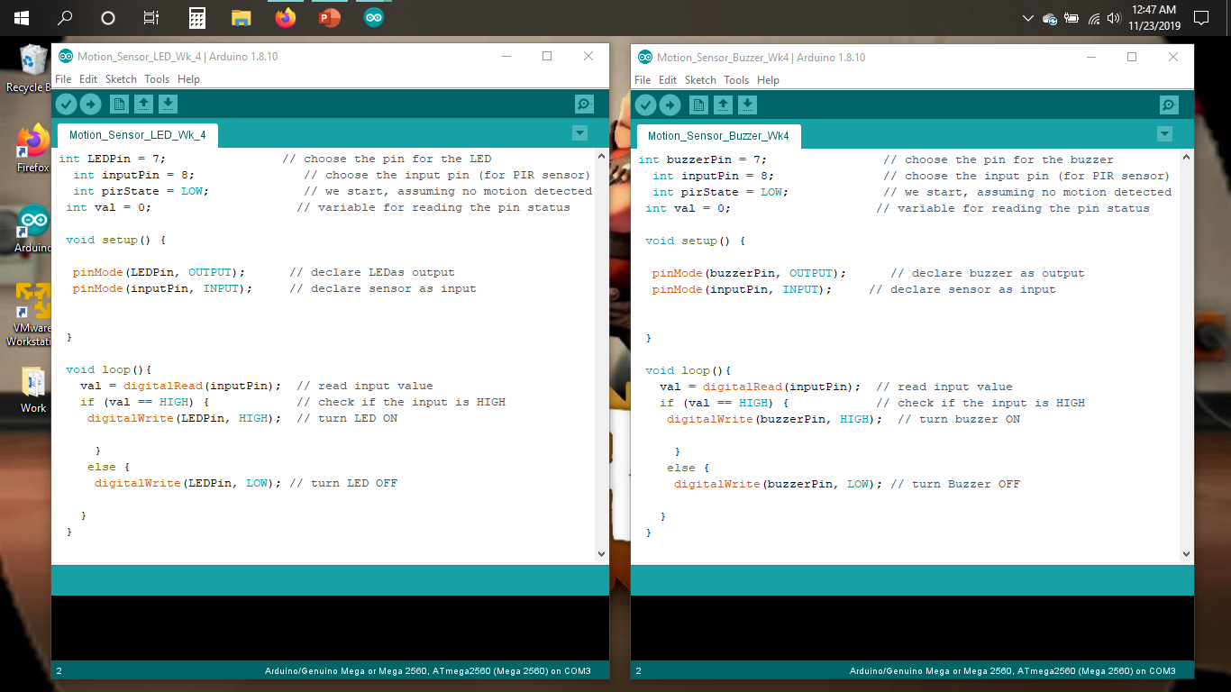
Code
Screenshot of code in Arduino IDE

Slide 16
Code explanation
Review the code
What pin is the input pin? What pin is the output pin? How do you know?
The function on line 2 in both codes reads “int inputPin = 8”, which shows that the input pin is 8. The sensor’s middle pin is connected using a wire, then that wire is connected to pin 8, and when motion is detected pin 8 receives data through the middle pin from the sensor. The function on line 8 in the “Motion_Sensor_LED_Wk_4” code reads “pinMode(LEDPin, OUTPUT)”, which means the output pin is the LED. When motion is detected it causes the output, the LED to light up. The function on line 8 in the “Motion_Sensor_Buzzer_Wk4” code reads “pinMode(buzzerPin, OUTPUT)”, which means the output pin is the buzzer. When motion is detected it causes the output, the buzzer to make noise.
How many times does the Arduino IDE setup() function run?
The Arduino IDE setup () function only runs once.

Slide 17
Data Display
Module 5
Monitoring data is important with a home security system as it can track real-time data when the sensor detects motion.
The home security system’s resistor is replaced with a 10K resistor to see what other data is given when motion is detected by using the serial monitor in the Arduino IDE program.
  -When motion is detected the buzzer does not emit noise.
When motion is detected the serial monitor displays the voltage difference, the count of how many times motion has been detected, and a message to the user.
The code is reviewed to determine which part of the code prints how many times motion has been detected and when viewing data on the serial monitor how it gives you information on the circuit.

Slide 18
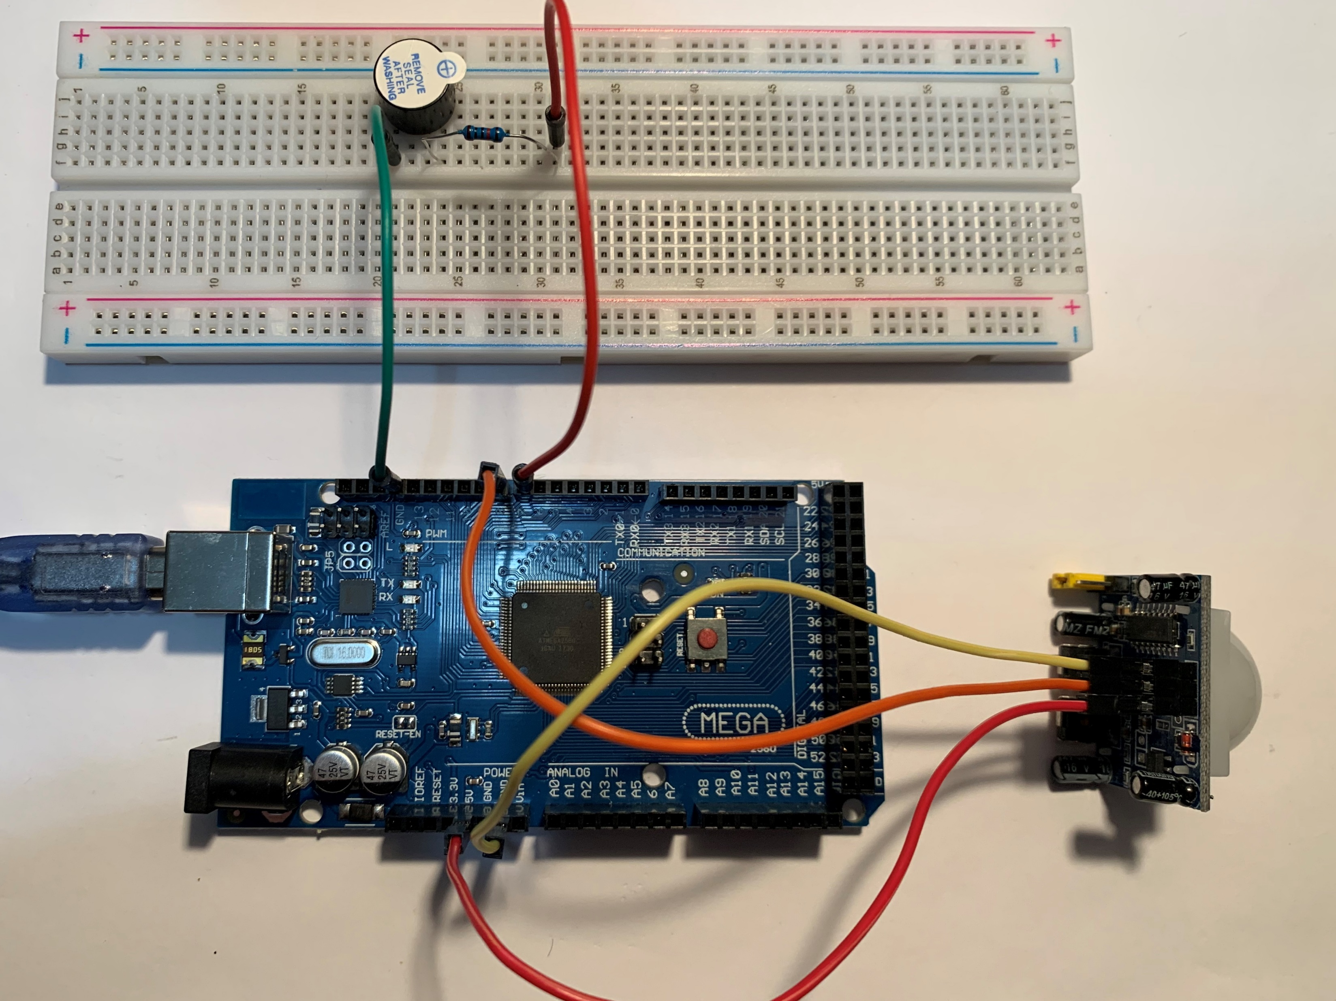
Circuit
Motion Sensor Circuit With 10K Resistor

Slide 19
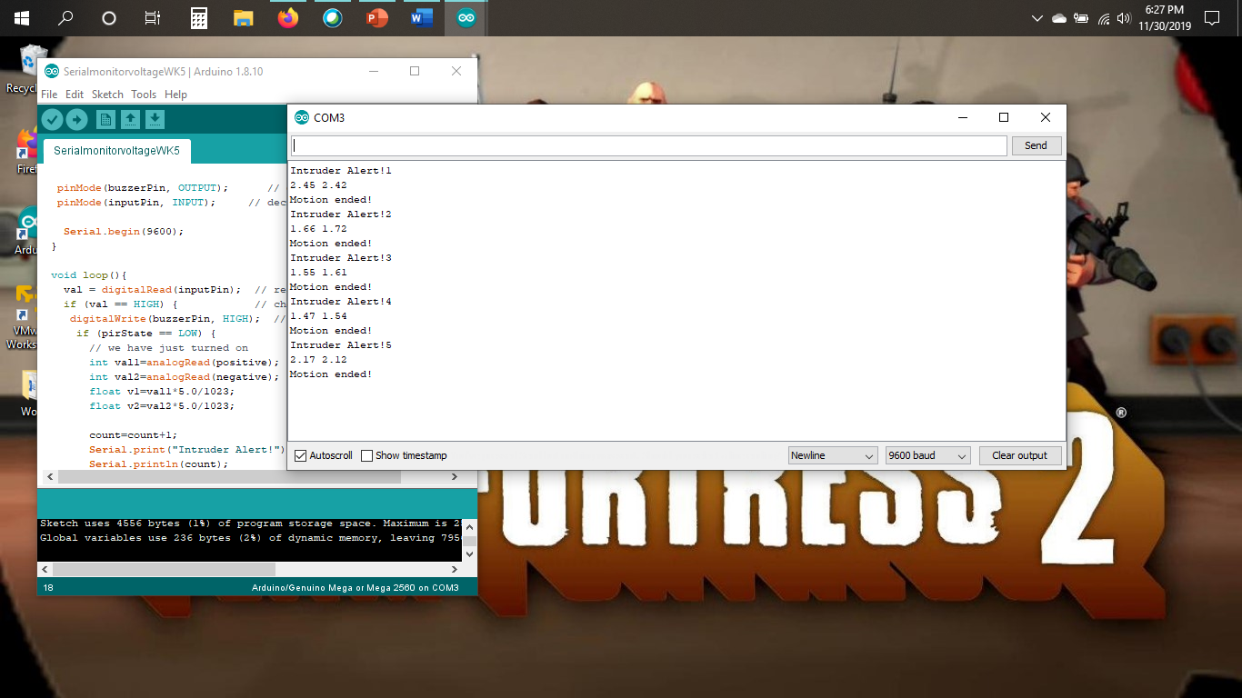
Serial monitor
Screenshot of serial monitor showing voltage difference and count of motion detected.

Slide 20
Data display
Review the code
What is the code that displays the count of how many times motion has been detected?
The code that displays the count of how many times motion has been detected is “Serial.println(count)”.
How can viewing data on the serial monitor give you information about your circuit?
When viewing the data from the serial monitor, it prints information on how many times motion has been detected, the calculated voltage difference, and when motion is no longer detected. The “Time Stamp” option on the bottom of the screen displays the time of each printed information. Overall, it visually gives you information that your circuit is responding to its’ set up.

Slide 21
Networking and Security
Module 6
By adding an ESP32 to the breadboard gives the home security system the ability to connect to the internet.
Starting by setting up the Mini-Smart Router WAN port to my household router.
  Changed the SSID and password for security of the device.
The LED light was added to the circuit.
A webpage was created to control the on and off switch for the LED light while connected to the internet.
Challenge assignment tested successful with ESP32, motion sensor, LED light, and Buzzer connected to the breadboard.

Slide 22
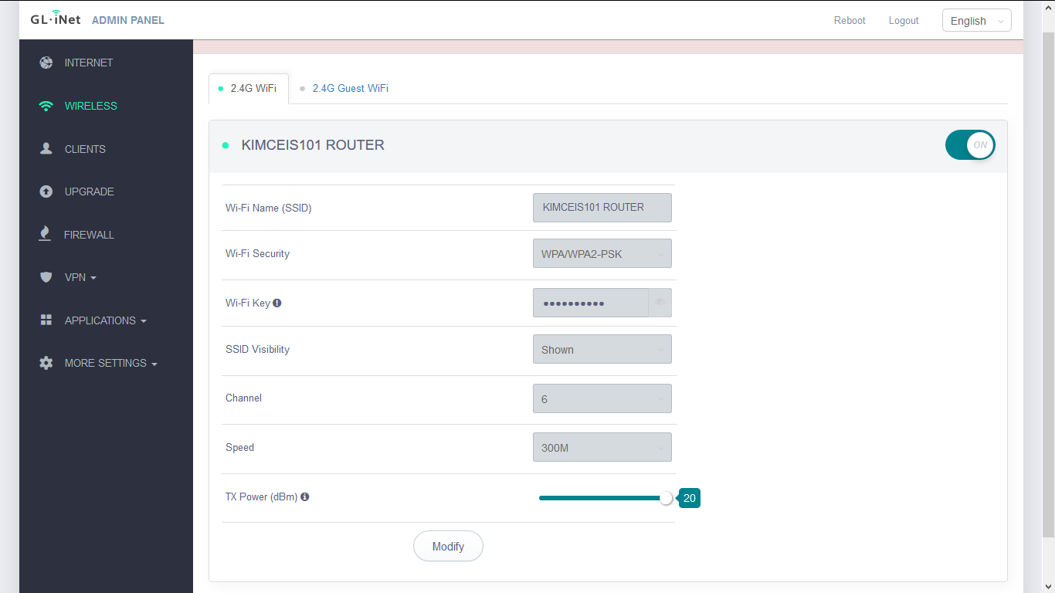
Router setup
Screenshot of router setup page

Slide 23
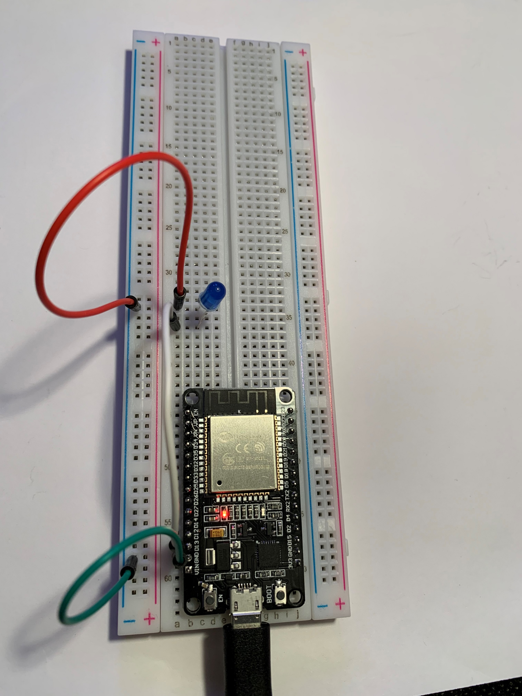
Circuit (Picture)
Picture of circuit with ESP32 board on breadboard with LED

Slide 24
Web page
The webpage was created by:
  Installing the esp32 by Espressif System add-on to the Arduino IDE program
  Added a Wi-Fi server code to the Arduino IDE program
  Upload speed is 115200 and the board is DOIT ESP32 DEVKIT V1
  Select file > Examples > Wi-Fi > Wi-Fi scan on Arduino IDE program
  Clicked upload
  Hold the boot button while it is uploading letting go after the code is done uploading
  The serial monitor is opened, clicked EN button on the ESP32 and it will display the address.
  When the address is typed in the web browser the web page is then displayed.

Slide 25
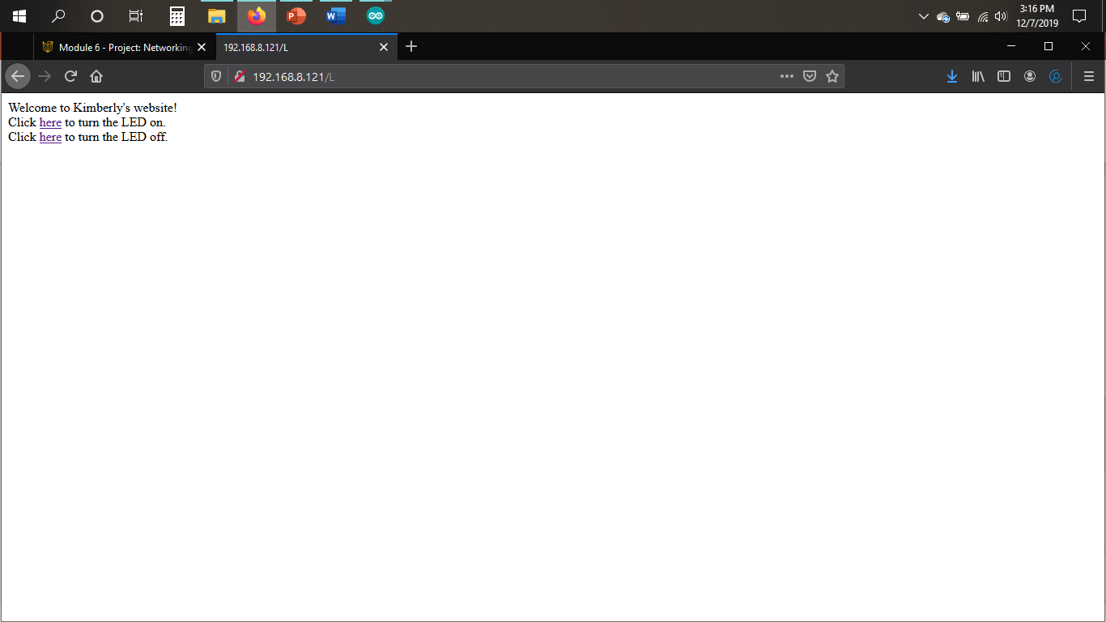
Web page (Screenshot)
Web server screenshot showing turning on and off the light from the web.

Slide 26
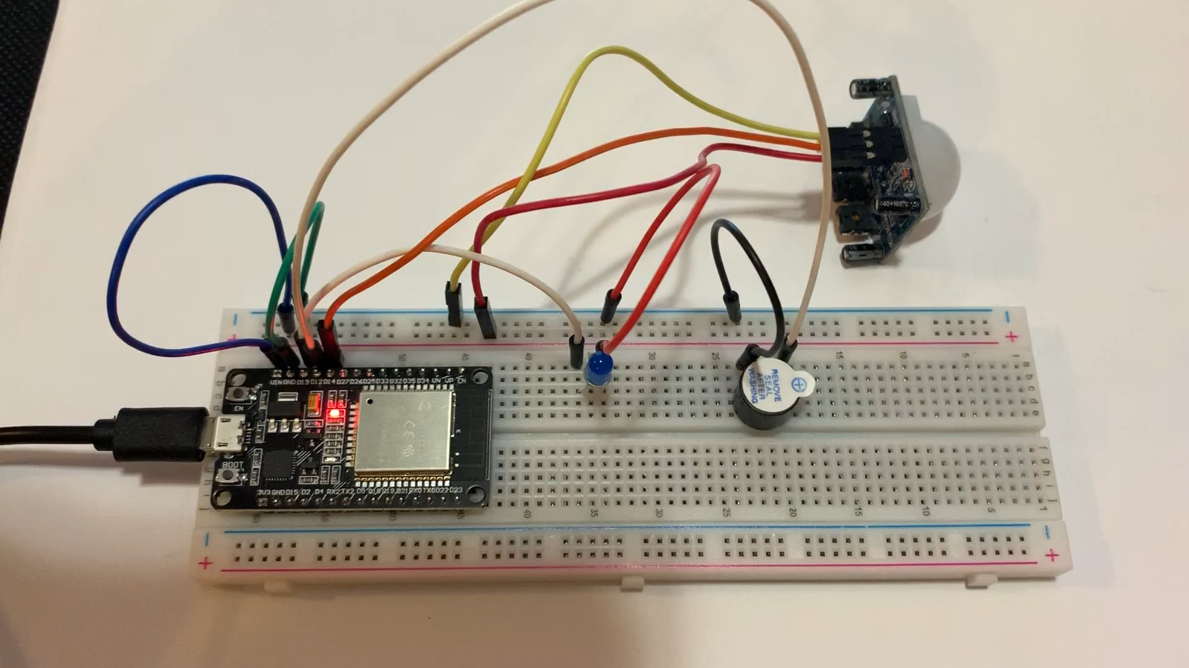
Challenge Assignment including the buzzer

Slide 27
Challenges in the project
There were a few challenges that were encountered when working on the home security system:
  Blink code set LED light flashing at a fast rate- After a few adjustments to the delay number slowed down the blinking rate.
  The motion sensor and the sensitivity level - When motion was detected the led light did not respond until a few seconds later. After adjusting it numerous of times and after several attempts the sensor would respond right when motion was detected, and the light would immediately turn on.
  Retrieving the address for the webpage - The proper steps were taken to upload code to the circuit, and an error code was received. The code was not able to process due to the wrong board was selected under tools. The board was changed from “Mega 2560” to “ESP32 DEVKIT V1” and the code was able to upload successfully, and then the address was retrieved.

Slide 28
Career skills gained from project
With this being the first project of an IoT device conducted several skills were gained.
Computer skills – Using a computer as a part to develop an IoT device. For example, downloading the Arduino IDE program and running codes to successfully operate the home security system.
Problem solving skills - Being able to solve challenges during this project. For example, solving the error code that was displayed when uploading the code for the webpage by using the standardized process.
Hardware/software skills – By using the hardware in this project such as the Mega 2560 board, ESP32, resistors 220Ω & 10K, buzzer, wires, breadboard. The software skills gained are from getting hands on experience with the Arduino IDE application.
Networking/Security skills – By setting up, adding security, and connecting the mini router to the internet, and connecting and controlling the device through the webpage.
Data analysis skills– Able to look at the difference in voltage difference and count of motion when viewing the serial monitor. Also viewed change data when adding the 10K resistor.

Slide 29
Conclusion
IoT devices are developed every day and many more to come in future years.
As an outcome, a simulated home security system was created by using the ESP32, motion sensor, LED light, and a buzzer connected to the breadboard.
When the sensor detects motion the buzzer emits noise and the LED light is turned on. The LED light is turned off when motion is no longer detected.

