Slide 1
CEIS110
IoT Temperature/Humidity Sensor
Final Project
Kimberly Hernandez
DeVry University CEIS 110
02/21/20
Genevieve Sapijaszko

Slide 2



Introduction
As technology grows so does the Internet of Things (IoT) and as it is ever-growing so is the data that it produces.
For example, phones, computers, cars, smart cities, and even smart homes all create thousands of data daily!
This project will show the development of an IoT Temperature/Humidity Sensor.
Also looking into the data that the IoT Temperature/Humidity Sensor creates and the process of analyzing the data.
The following modules will explore the development and process of:
  Inventory and Software Installation
  Design and Library setup
  Monitoring Temperature and Humidity
  Saving Serial data with python
  Reading and Manipulating data from the Arduino
  Develop Graphical Models and Interpret Results
Then looking into challenges and career skills obtained during this project.

Slide 3
Inventory and Software Installation
Module 1
Before starting an inventory of items were collected for the IoT Temperature/Humidity sensor.
The inventory items include (image on next slide):
  Arduino Mega board
  Breadboard
  Wires
  DHT11 Temperature and Humidity sensor
  Cable to connect Arduino to computer
Following by an inventory of software that is needed for the sensor to run, generate, collect, process, manipulate, and lastly analyze the data.
The three software that are needed in order to complete this process are:
  Python- Anaconda/ Spyder
  Arduino IDE
  Microsoft Excel

Slide 4
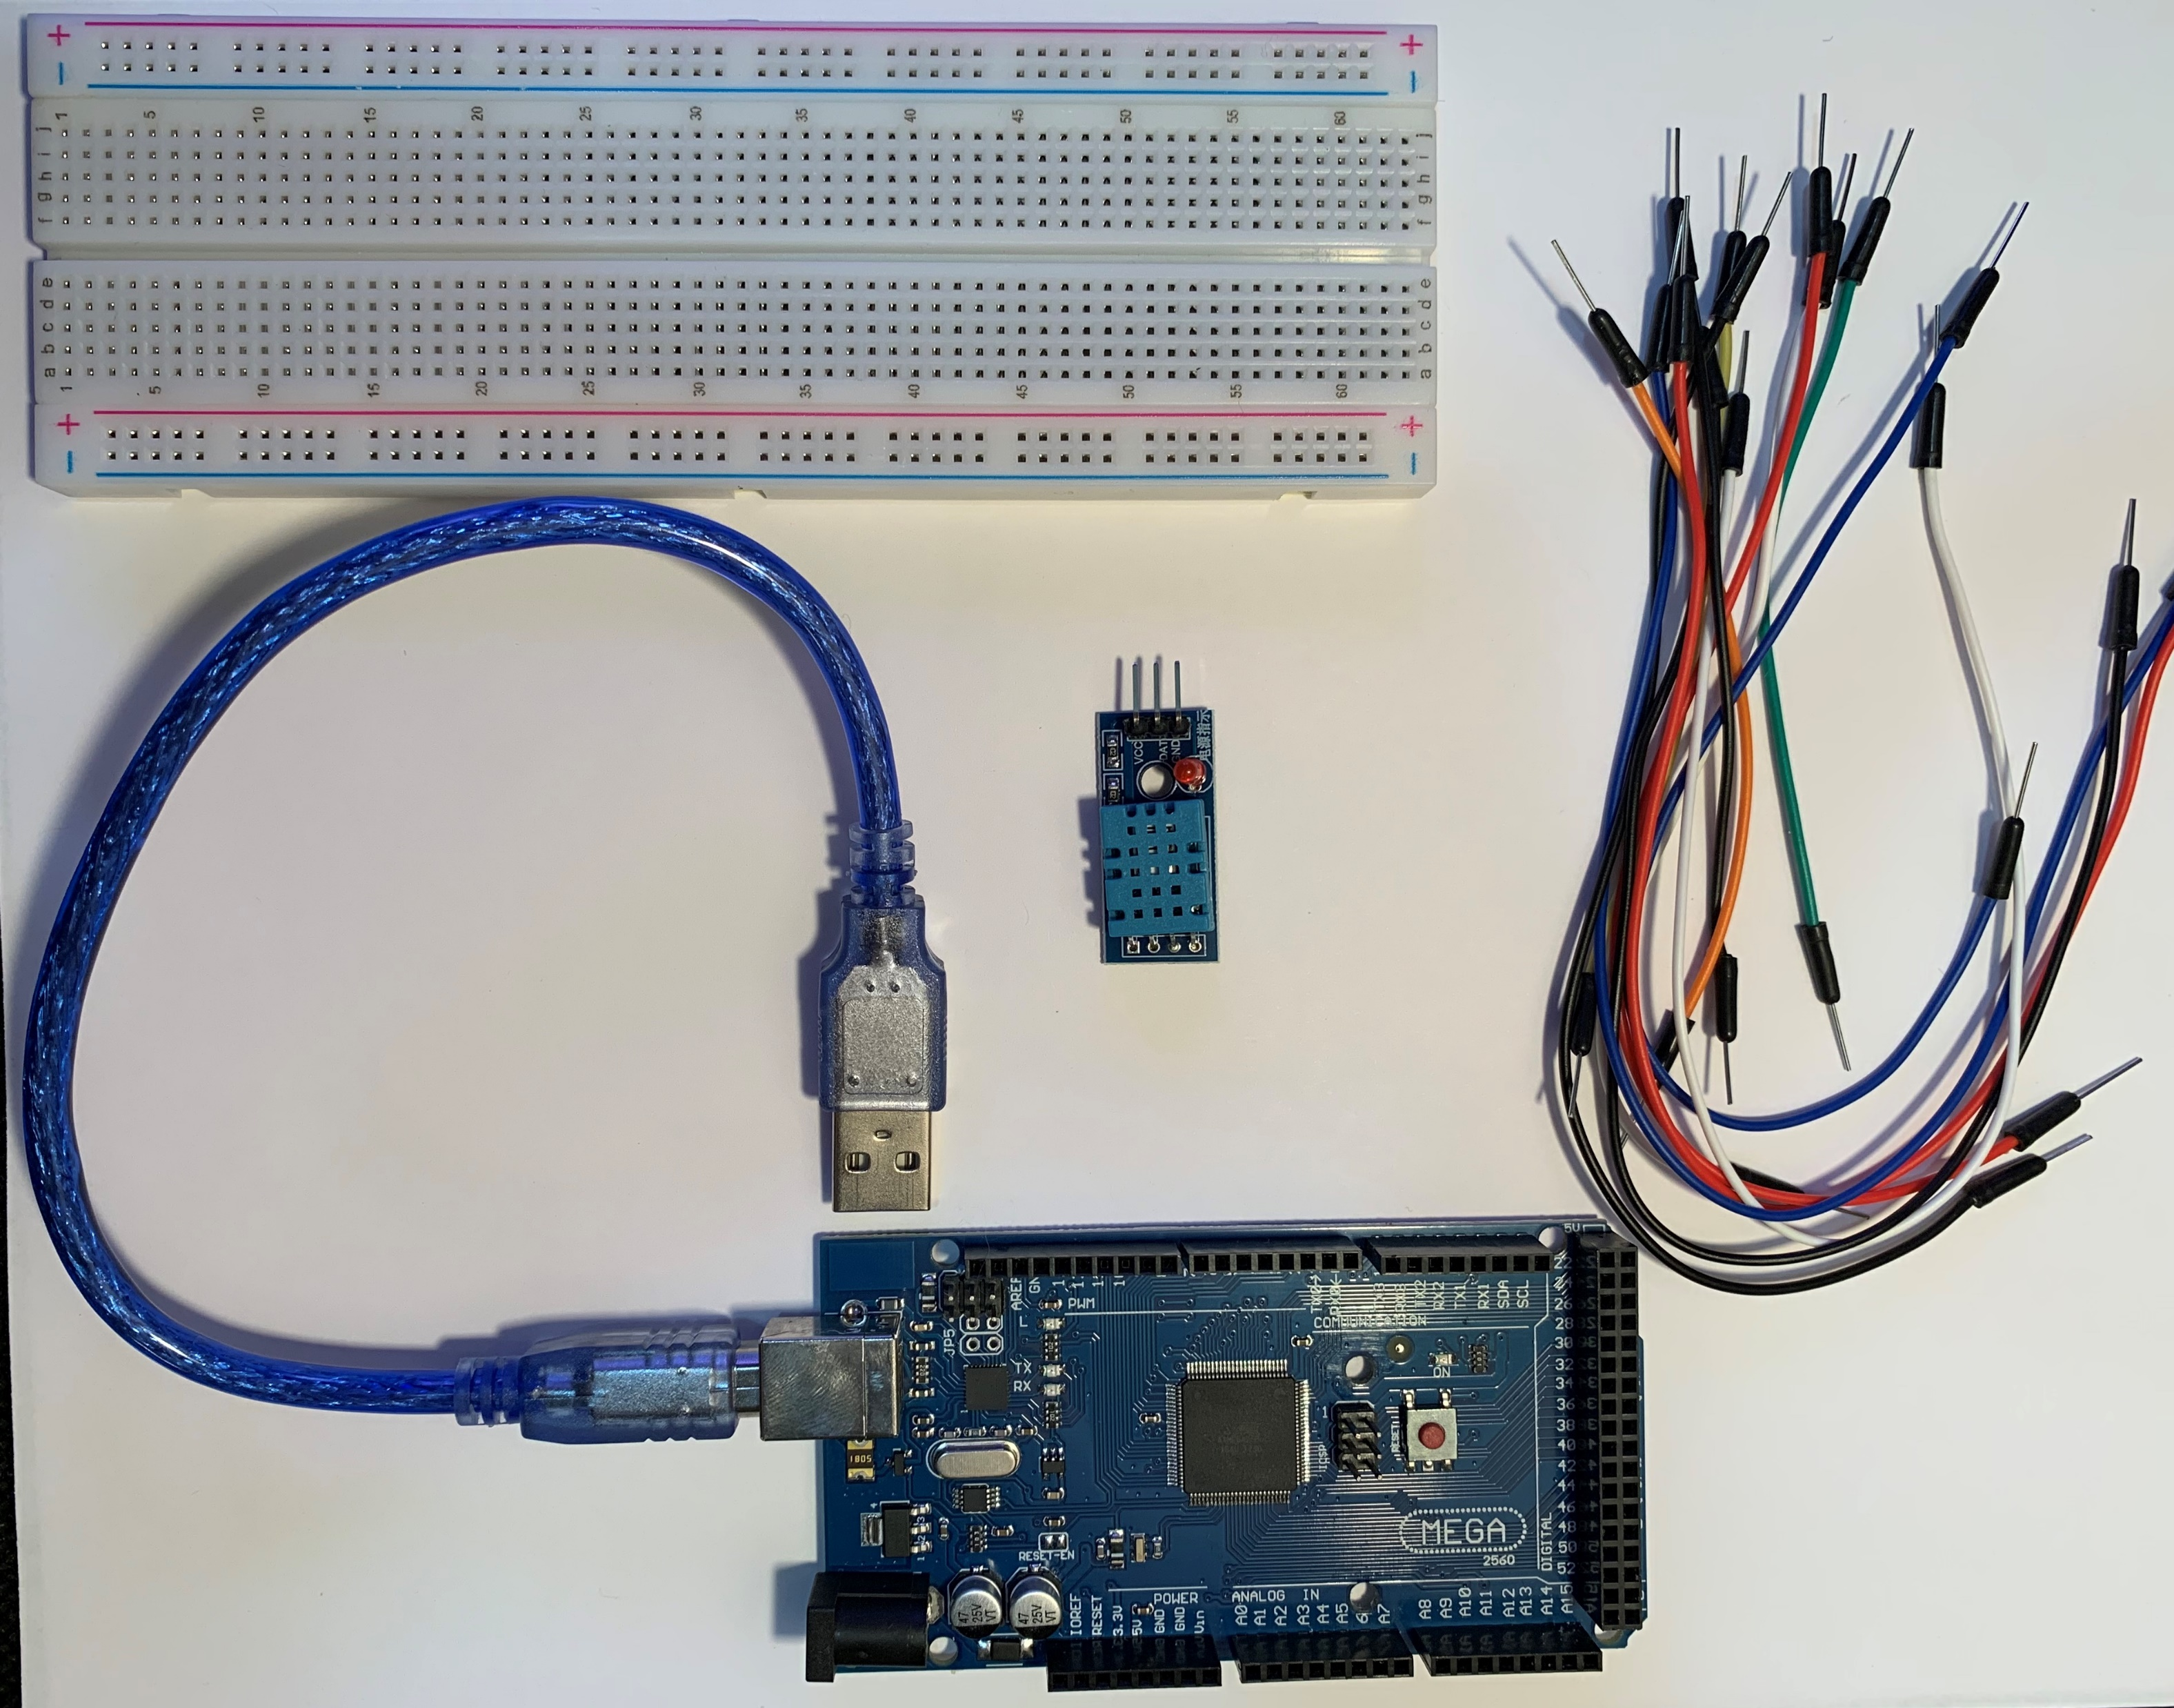
Inventory (Picture)
Arduino Mega board
Breadboard
Wires
DHT11 Temperature and Humidity sensor
Cable to connect Arduino to computer

Slide 5
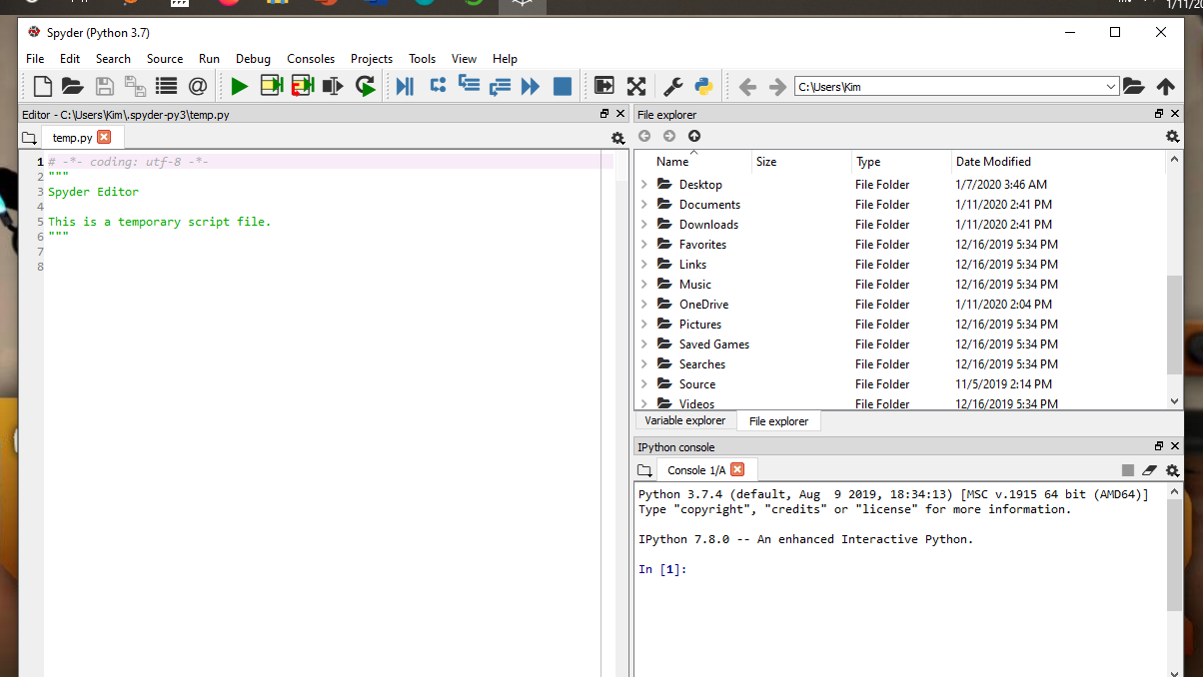
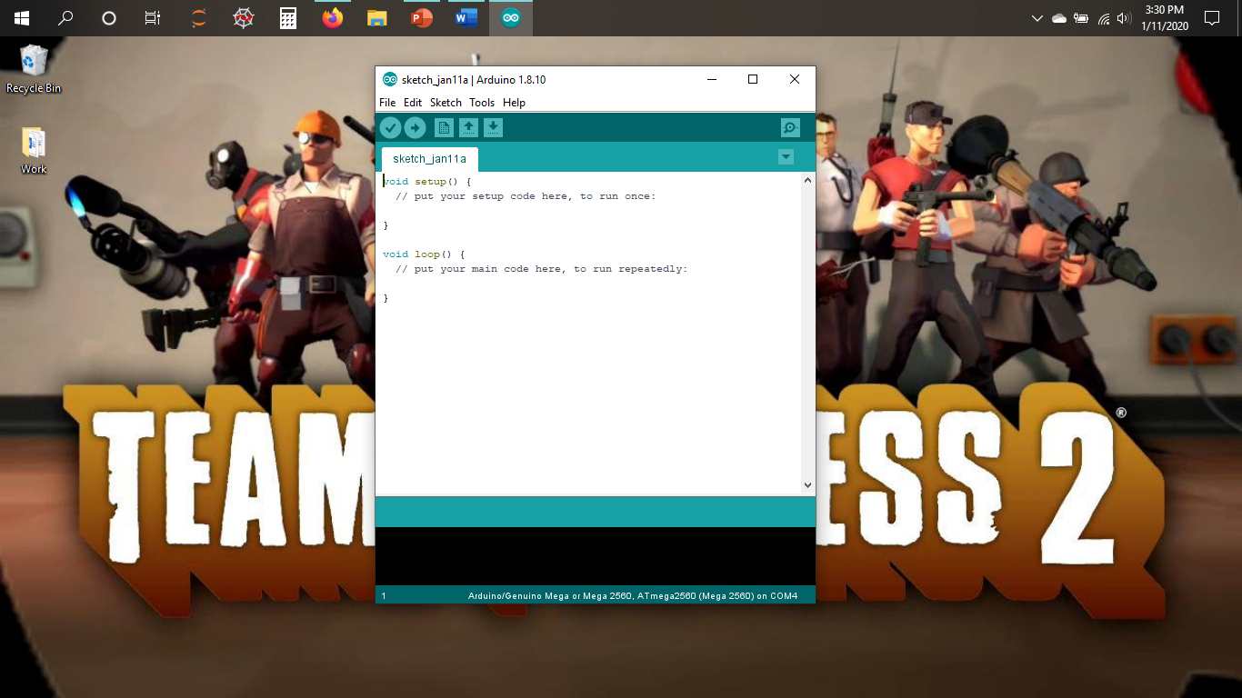
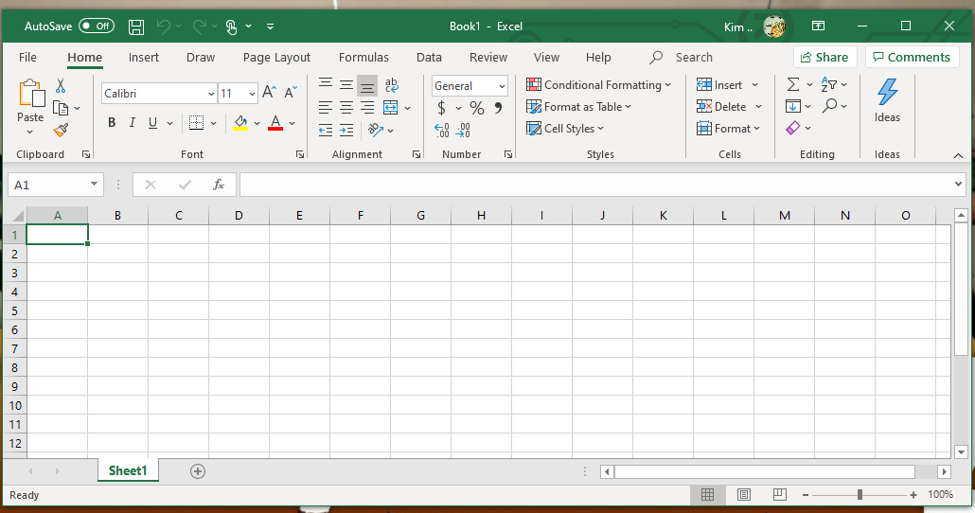
Software Inventory
(Screenshots)
Python- Anaconda/ Spyder
Arduino IDE
Microsoft Excel

Slide 6
Design and
Library setup
Module 2
A flow chart was created to show the process of the IoT Temperature/Humidity Sensor.
The flowchart shows the process of:
  Install python
  Use Temperature/Sensor on Arduino to monitor temperature and humidity
  Save serial data to a comma separated file with python
  Cleanse data from Arduino
  Use Excel to manipulate data
  Use python data analytics modules to develop graphical models
Then two sensor libraries were added to the Arduino IDE libraries.
  This is needed specifically for Arduino IDE to run the IoT Temperature/Humidity sensor.
A new directory was created called “Arduino Library” to keep all necessary project files together.

Slide 7
Flowchart
Include the following processes:
Install python
Use Temperature/Sensor on Arduino to monitor temperature and humidity
Save serial data to a comma separated file with python
Cleanse data from Arduino
Use Excel to manipulate data
Use python data analytics modules to develop graphical models

Slide 8
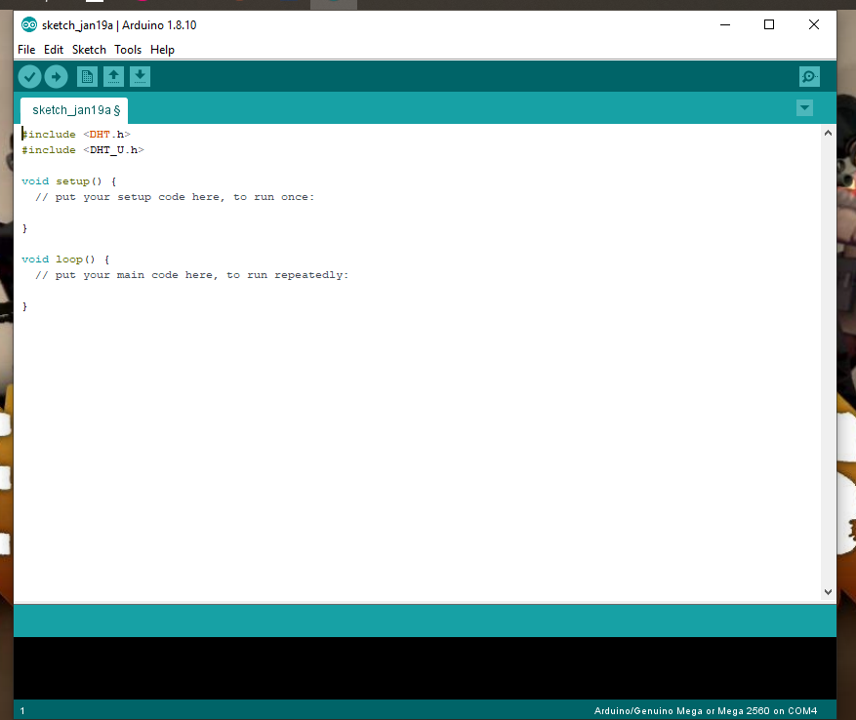
Software Inventory
(Screenshot)
Include screenshot of DHT11 library installed
Download the two sensor libraries (DHT_sensor_library.zip , and Adafruit_Sensor_master.zip)
Open the Arduino IDE and go to Sketch-> Include Library -> Add .ZIP library
Add both libraries one at a time

Slide 9
Monitoring Temperature and Humidity
Module 3
Now the circuit is ready to be set up with the following items:
  Arduino Mega board
  Breadboard
  Wires
  DHT11 Temperature and Humidity sensor
The circuit was plugged into the computer and the code was put into the Arduino IDE software.
Before the code was uploaded a few adjustments to the software were made listed under “Tools”:
  The “Arduino/Genuino Mega or Mega 2560” setting was changed to the correct board.
  The “ATmega2560 (Mega 2560O)” was selected as the processor.
  The “COM4 (Arduino/Genuino Mega or Mega 2560)” was selected as the correct com port.
After the code was uploaded, in order to view the data displayed on the Serial Monitor, the baud was changed to 9600.

Slide 10
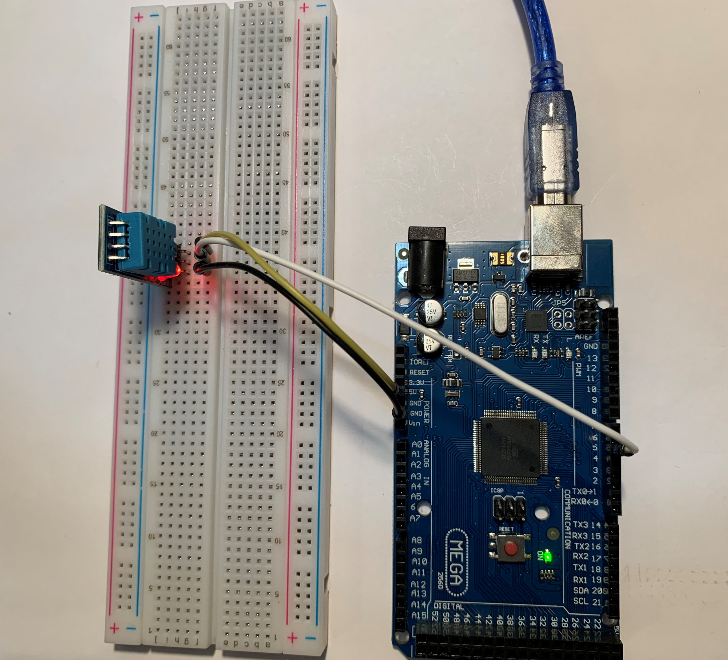
Circuit (Picture)
Arduino Mega board
Breadboard
Wires
DHT11 Temperature and Humidity sensor

Slide 11
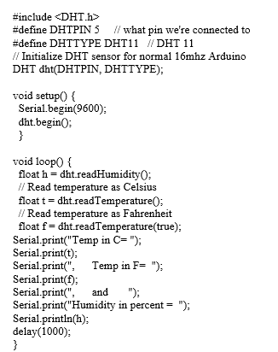
The Temperate/Humidity Sensor Code
The code was input into the Arduino IDE to run the IoT Temperature/Humidity Sensor.
When the code was uploaded successfully and began to detect the temperature in Celsius, Fahrenheit, and Humidity.
The serial monitor was opened to view the current readings of the room.

Slide 12
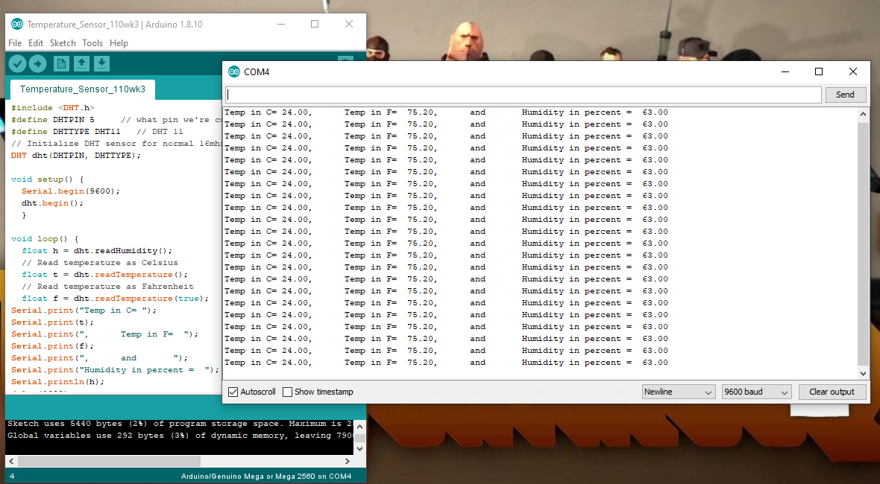
Serial Monitor
(Screenshot)
Screenshot of serial monitor showing temperature and sensor output data

Slide 13
Saving Serial data with python
Module 4
After a few readings were displayed on the Arduino IDE serial monitor the Python program was opened to save the readings as a text file (or .txt file).
The SaveSerial.py was put into the Python program and saved under the “Arduino Library” directory for the next part of this project. (Image on next slide)
Adjustments were made before running the SaveSerial.py code to ensure the correct com port was entered (making sure it matches the Arduino IDE com port).
The code was run once creating a new text file under the “Arduino Library” directory as “mydata.txt”.
Then the code was run again but this time with manipulation of the temperature sensor (by blowing on it and holding fingers over sensor), and it saved another text file as “mydata2.txt”.

Slide 14
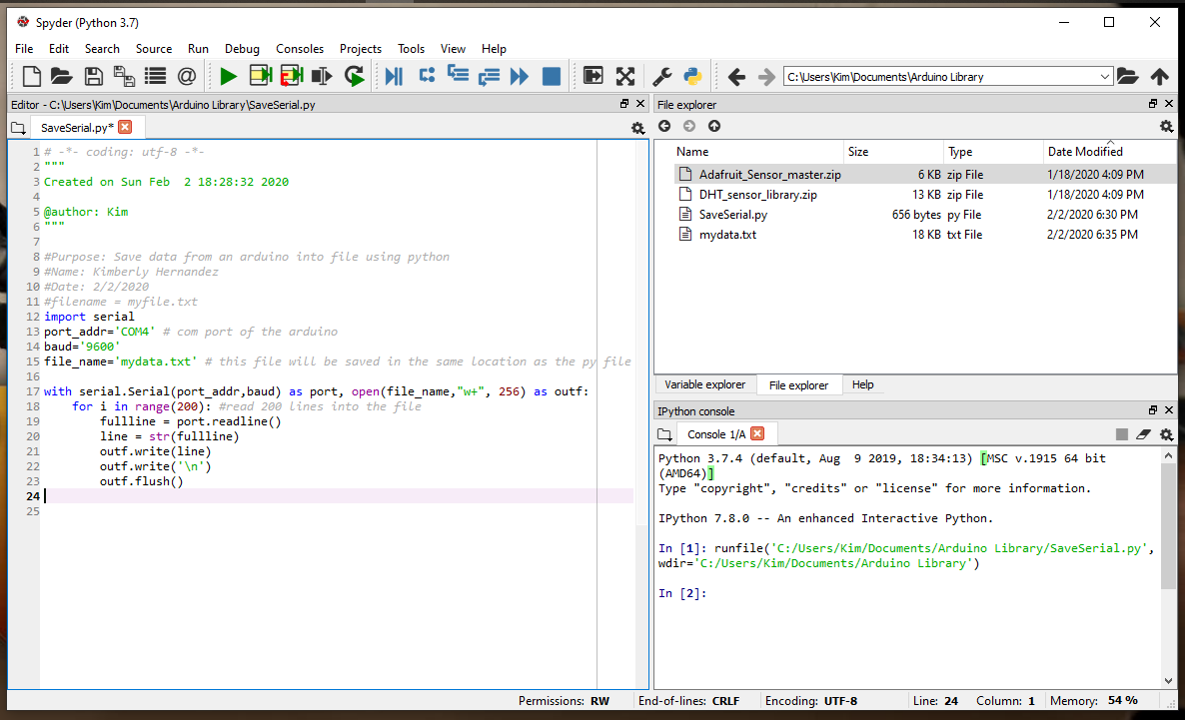
SaveSerial.py code
(Screenshot)
The SaveSerial.py code

Slide 15
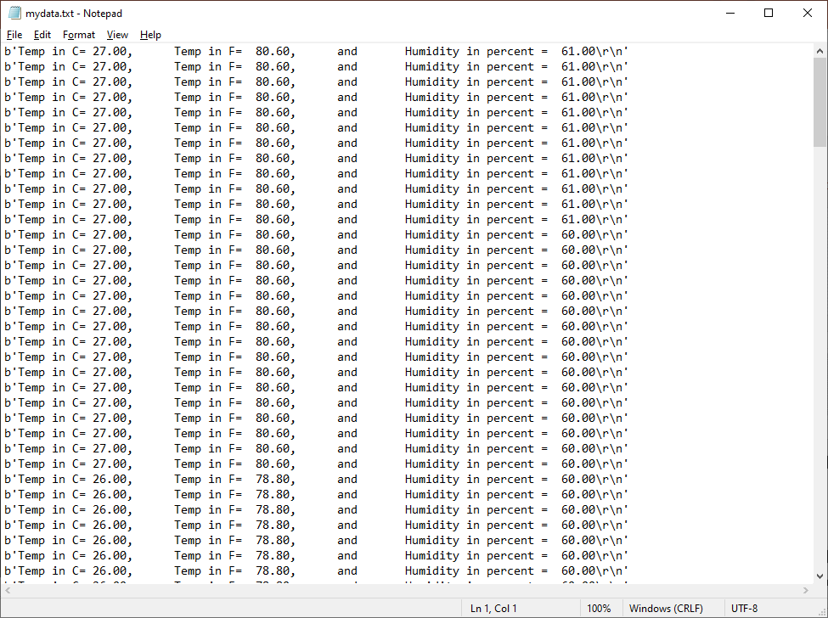
Mydata.txt
(Screenshot)
Copy and paste the mydata.txt file (screenshot of file or the actual file)

Slide 16
Reading and Manipulating data from the Arduino
Module 5
Data cleansing is necessary when proceeding to manipulate the data.
Starting by viewing the mydata.txt file to see if there is any inconsistency and removing that part out of the file.
A new code called CleanseData.py is saved in the same “Arduino library” directory.
The code is ran extracting all the data from the “mydata.txt” file and it creates a list of Celsius, Fahrenheit, and humidity (only extracting the numbers); which can now be opened in Microsoft Excel as it has now changed the file to “formatdata.csv”.
Then the code is ran again for the “mydata2.txt” and follows through the same and changes the file to “formatdata2.csv”.
Both new files were then saved through Microsoft Excel as “formatdata.xlsx” and “formatdata2.xlsx”.
A chart is created in Excel to see the variation between Celsius, Fahrenheit, and Humidity.

Slide 17
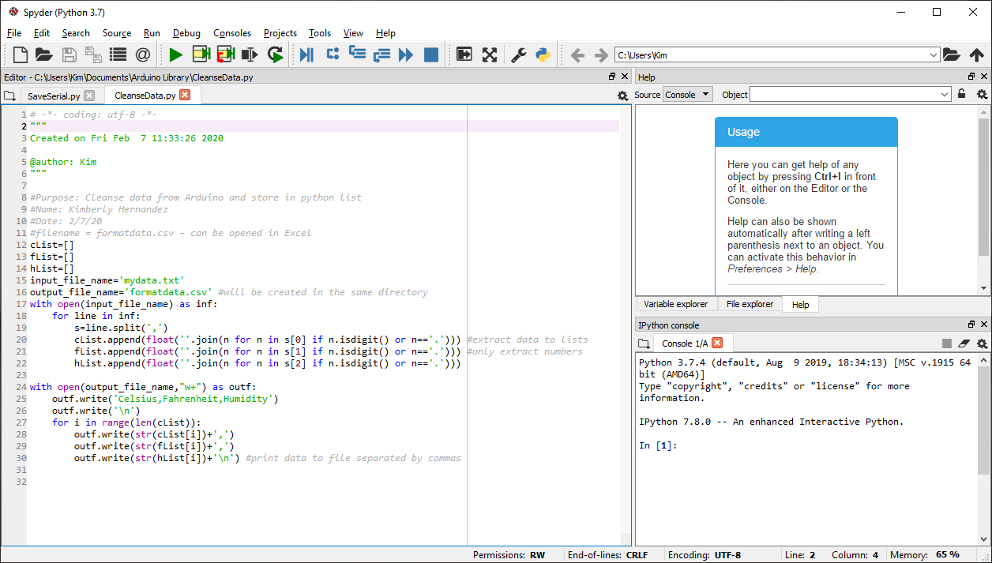
Python code (Screenshot)
Python code CleanseData.py

Slide 18
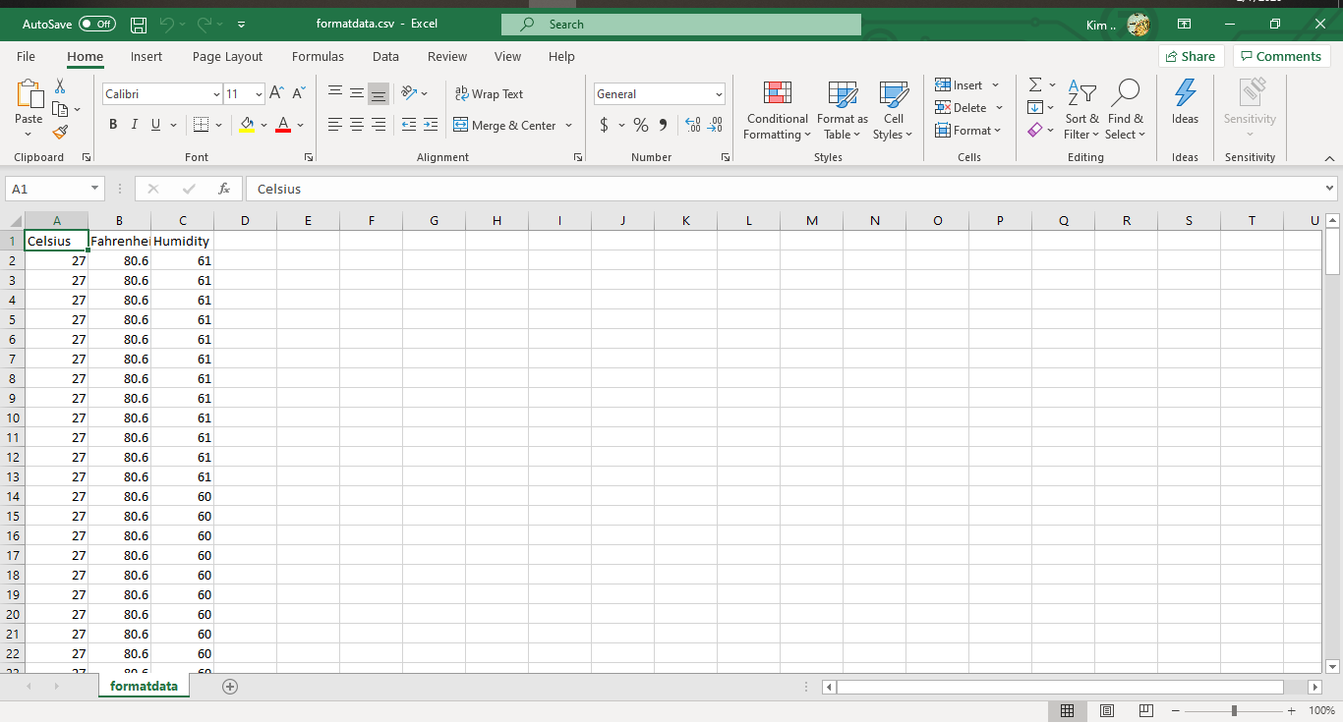
Read Data into csv format (Screenshot)
Formatdata.csv file in Excel

Slide 19
Temperature and Humidity Chart(Graph)
Excel chart based on data from Arduino

Slide 20
Develop Graphical Models and Interpret Results
Module 6
To review and analyze the data several plots were created using PANDAS and matplotlib in Python.
Each code used in Python captures the data from the “formatdata.csv” trial 1 and “formatdata2” trial 2 and creates a plot.
The first plot created was a Line Plot and compares the Celsius in both trials of the “formatdata” file. (Image on next slide)
The next plot created was a Histogram Plot and compares the Humidity of both trials.

Slide 21
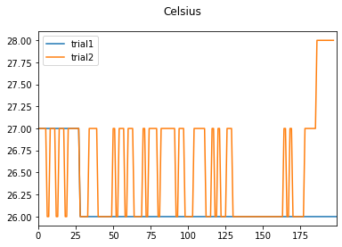
Plot #1 - Line
The code is as follows for plot line:
###################################################
#Compare trial plot
###################################################
#Purpose: Create Celsius plot comparing trial 1 and trial 2
#Name: Kimberly Hernandez
#Date: 2/11/20
import pandas as pd
import matplotlib.pyplot as plt
df1 = pd.read_csv("formatdata.csv") #baseline data is trial 1
df2 = pd.read_csv("formatdata2.csv") #data with variation such as finger over sensor and blowing on sensor is trial2
plt.figure(); df1.Celsius.plot(label = 'trial1'); df2.Celsius.plot(label = 'trial2'); plt.legend(loc='best'); plt.suptitle(‘Celsius')
plt.show()

Slide 22
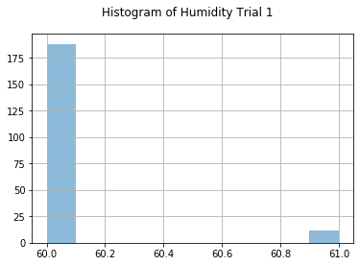
Plot #2 – Histogram (Screenshots)
The code is as follows for Histogram Trial 1:
#################################################
#Histogram
#################################################
#Purpose: Create a histogram of humidity data from the first trial
#Name: Kimberly Hernandez
#Date: 2/11/20
import pandas as pd
import matplotlib.pyplot as plt
df1 = pd.read_csv("formatdata.csv")
df2 = pd.read_csv("formatdata2.csv")
df1['Humidity'].hist(bins=10, alpha=0.5); plt.suptitle('Histogram of Humidity Trial 1')
plt.show()

Slide 23
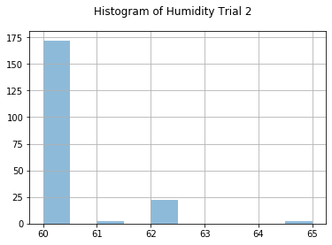
Plot #2 – Histogram (Screenshots)
Continued..
The code is as follows for Histogram Trial 2:
####################################
#Histogram
####################################
#Purpose: Create a histogram of humidity data from the second trial
#Name: Kimberly Hernandez
#Date: 2/11/20
import pandas as pd
import matplotlib.pyplot as plt
df1 = pd.read_csv("formatdata.csv")
df2 = pd.read_csv("formatdata2.csv")
df2['Humidity'].hist(bins=10, alpha=0.5); plt.suptitle('Histogram of Humidity Trial 2')
plt.show()

Slide 24
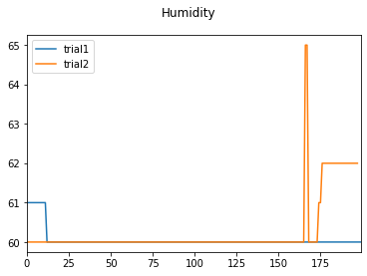
Analysis
  Chart:
  With the current data from Trail 1 and Trial 2, What which data had more humidity?
  The chart shows a huge spike in humidity on trial 2 showing that there was more humidity on trial 2.

Slide 25
Prediction- Develop A Prediction Based on the Data.
One prediction would be, in Texas the humidity level would spike without manipulation of the temperature sensor if there were readings gathered early in the morning.
Another prediction would be gathering data in different parts of living spaces in my apartment. This would show different temperature readings even though the air condition is set at a specific temperature.

Slide 26
Challenges
A few challenges were faced during this project:
  During module 4 an issue occurred when the SaveSerial.py code was run due to a com port error. The com port was verified to ensure it was the same as the Arduino IDE com port. The pyserial package was not installed and after adding this package and restarting Python the code ran successfully.
  The baud rate was not set to 9600 causing no output temperature readings.
  The serial monitor was open during the SaveSerial.py preventing the code from successfully running.

Slide 27
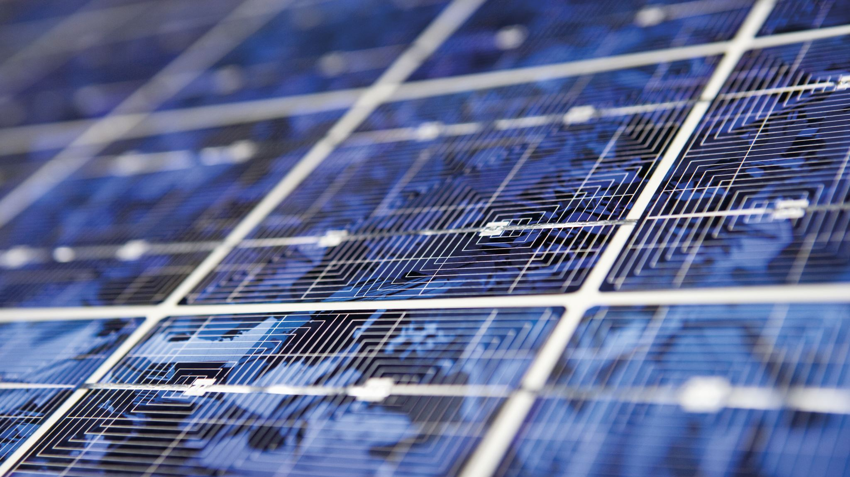
Career Skills
Analytical skills – When reviewing and manipulating the data from “formatdata.csv” and “formatdata2.csv” then looking at the analysis and creating predictions of this data.
Problem solving skills- Being able to resolve any issues that were faced during this project.
Programming skills- By using Anaconda/Python and PANDA/matplotlib within Python.
Software skills – Using the Arduino IDE, Python- Anaconda/ Spyder, and Microsoft Excel.
Organizational Skills- Being able to plan and design this project and keep track of the data being juggled by each program as it was manipulated, processed, and analyzed.

Slide 28
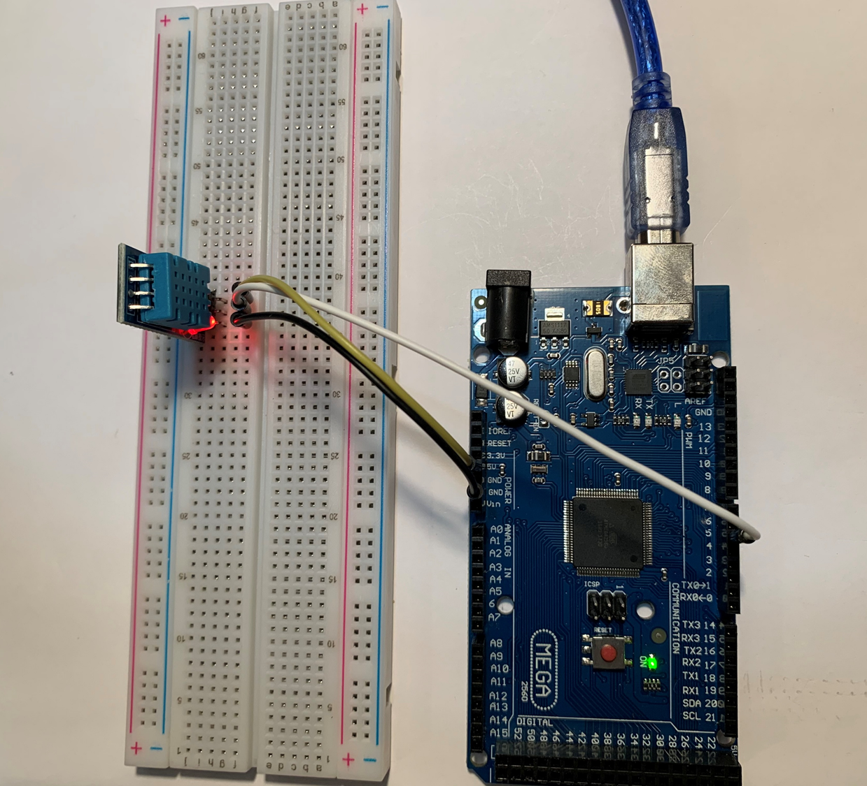


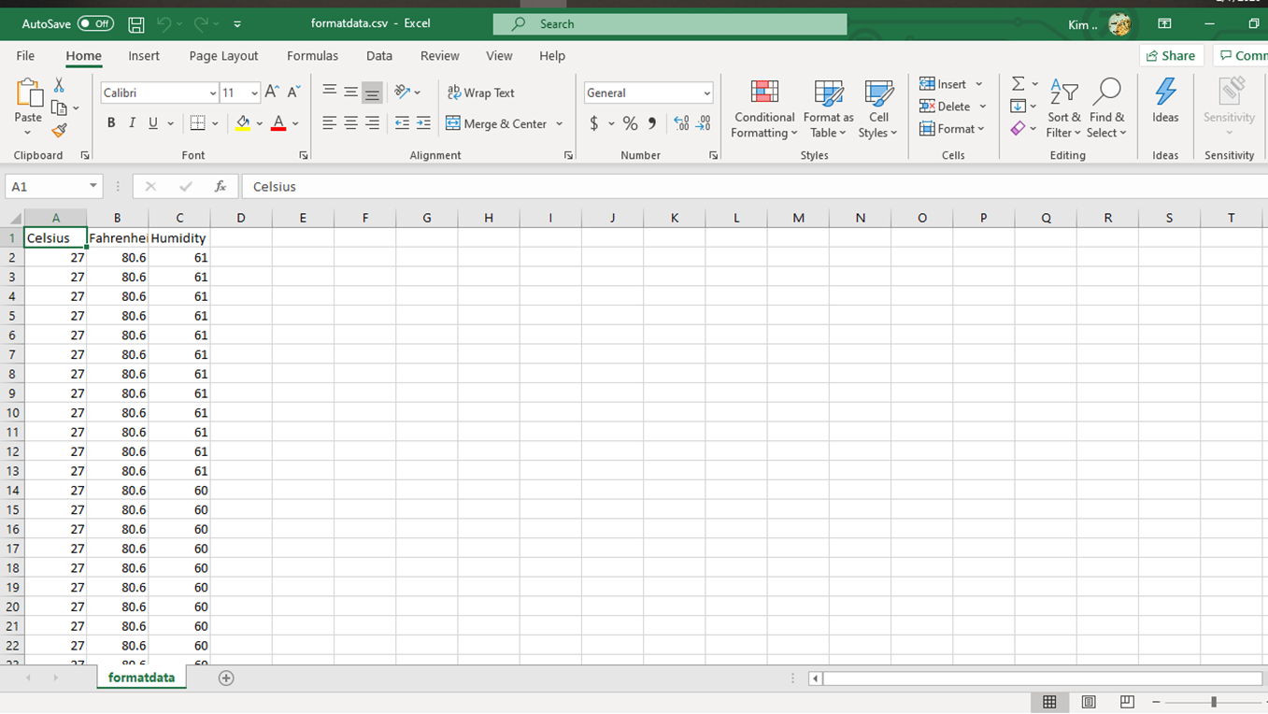
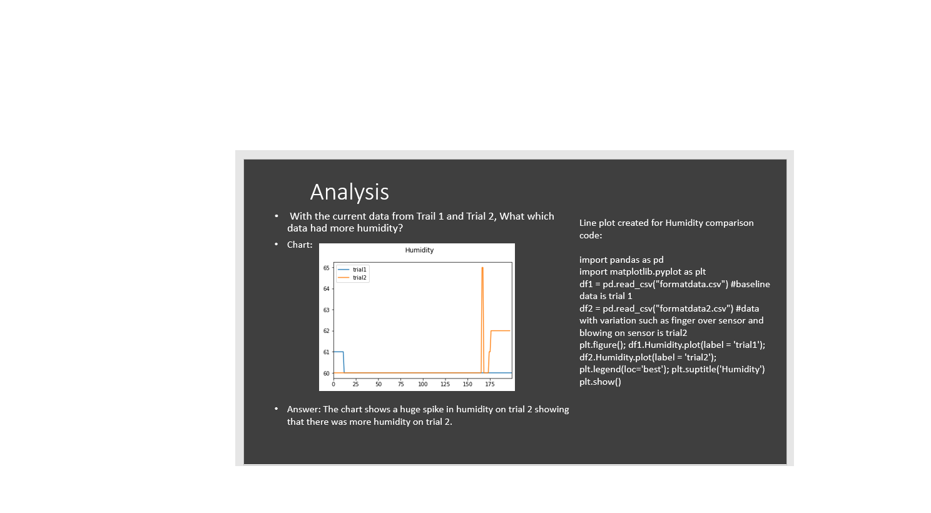
Conclusion
The Internet of Things(IoT) and its’ data is ever-growing.
This project benefits the idea of when an IoT device produces data that data can be collected, processed, manipulated, and analyzed.
The IoT Temperature/Humidity Sensor produced data by collecting the temperature and humidity of the room and during this project the data was standardized.

