Slide 1

Landscaping Application
Kimberly Hernandez
CIS355A – Business Programming with Lab
Professor Nana Liu
4/23/2022

Slide 2
Introduction
This landscaping application project covers concepts learned in business application programming using Java programming language, Microsoft Visio, NetBeans, and MySQL workbench.
To start, a simple BMI console to GUI, burger ordering, & grade management applications were created using Java and NetBeans to revisit object-oriented programming & GUI features and apply them to the landscaping project.
The following steps were taken to develop the landscaping application:
  • Designing wireframe and diagrams
  • Starting the landscaping application GUI
  • Applied advanced controls to GUI
  • Added tabs, Jlist, and ArrayList
  • Added read & write to file feature
  • & switched feature to read & write to a database

Slide 3
Applications Prior to Main Project
A simple console application was created in NetBeans to calculate the BMI of the user.
A class called HealthProfile was created for the name, age, weight, and height of the user.
Then after the console was tested and working, a GUI is created to:
  allow the user to enter their information
  allow the user calculate or clear the entered information by clicking the assigned buttons.
The burger ordering system allowed the user to click checkboxes and radio buttons while automatically updating the order & order total.
The grade management system took the student’s name and 3 test scores to create a GPA and letter grade and show them on a JTable.
  (Application images on next 2 slides)

Slide 4
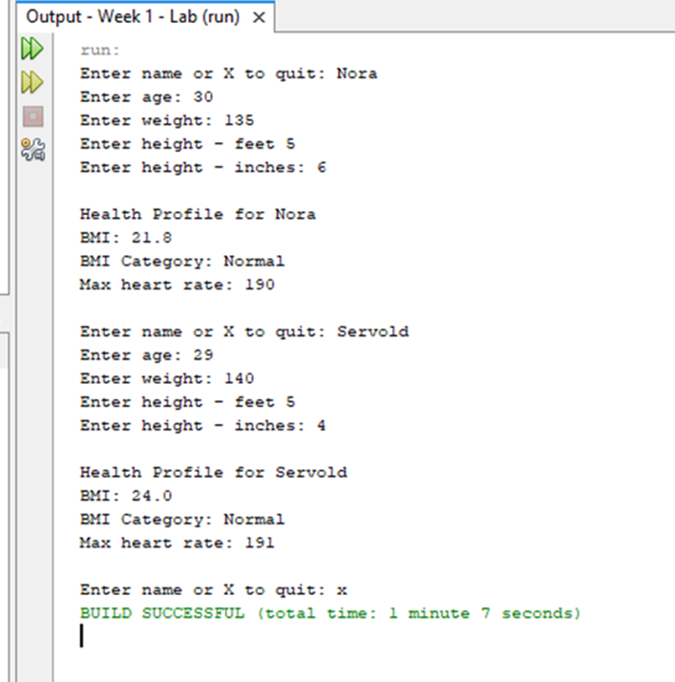
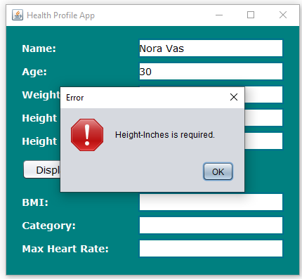
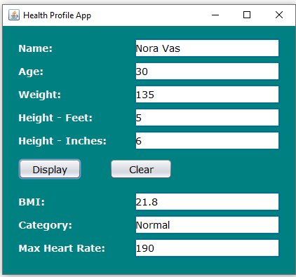
BMI Console to GUI Application

Slide 5
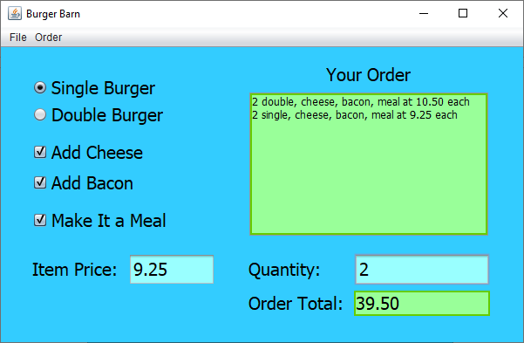
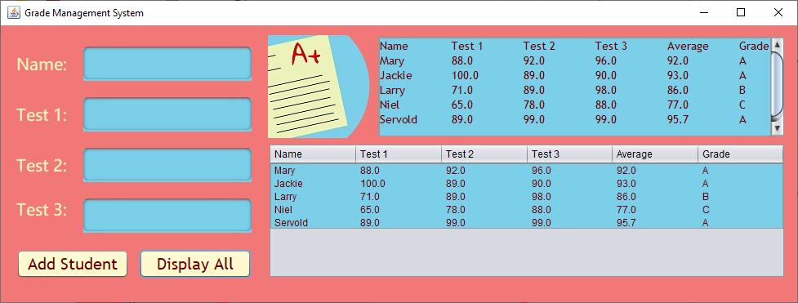
Burger Ordering and Grade Management Applications

Slide 6
Designing Wireframe & Diagrams
Designing the application is important:
  to visualize what GUI features the end user will have before developing it.
  saves time in development.
  prepares what programming lies ahead.
The wireframe in the next slide show:
  Menu options at the top
  The user can pick either grass or gravel
  Text fields for customer information & calculate and submit order buttons
  & Load and delete customer & order information.
The class diagrams in the next slide show:
  Customer and database classes & methods.

Slide 7
GUI Wireframe and Class Diagrams Images

Slide 8
Starting the Landscaping Application
The customer diagram seen previously was used to create a class in NetBeans called ‘Customer”.
A GUI for the first JFrame was created in NetBeans based off the wireframe diagram to accept the user information. (Images on next slide)
  Buttons, labels, and textfields were added.
  Events were created to handle the calculate button event.
The Customer class was added to the java main called LanscapeGUI.java.
When the calculate button event was clicked:
  It triggered the event method
  validated user input
  & displayed it on the ‘Order Summary’ textbox.

Slide 9
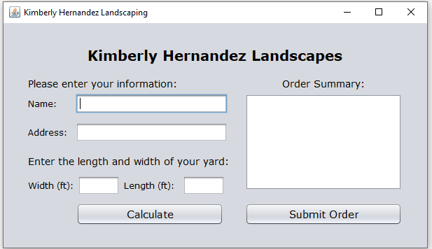
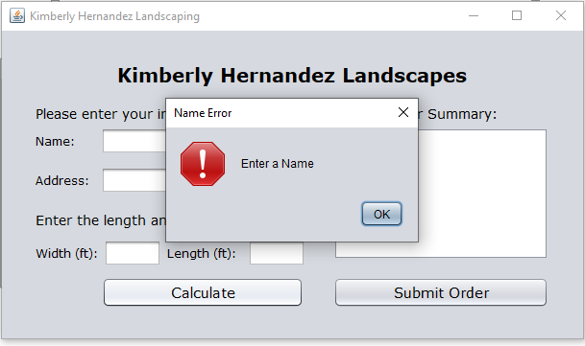
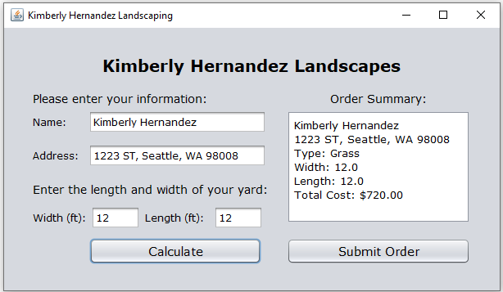
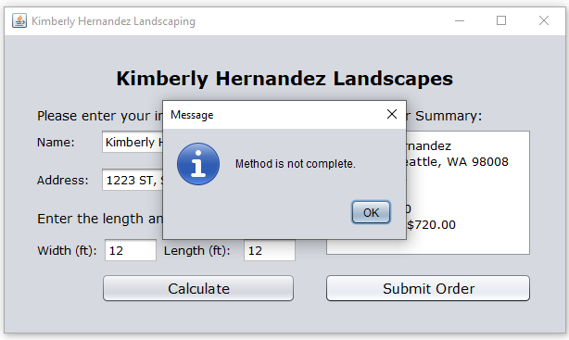
GUI wireframe diagram for Customer Info

Slide 10
Adding Advanced Controls to GUI
Now another JFrame is added to create the ‘Welcome’ window of the application (making this JFrame the second window –Images on next slide).
GUI components that are added:
  2 radio buttons
  2 Buttons & a few labels to display information to the user
  and a menu (File > Exit | Order > Submit Order or Reset )
  Grass, gravel, and dirt images were added to enhance the application.
A few event methods were programmed:
  Radio button - displaying grass or gravel based on user selection.
  Menu Item ‘Reset’ - to reset the screen back to dirt.
  Menu item ‘Exit’ - to close the application.
  ‘Next’ button - launches the ‘Information’ window.

Slide 11
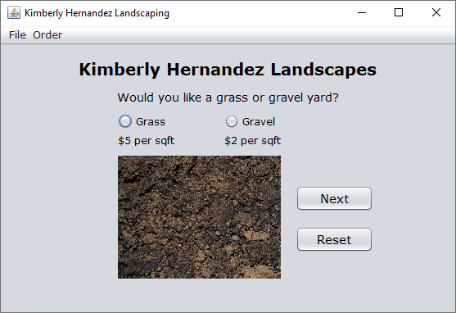
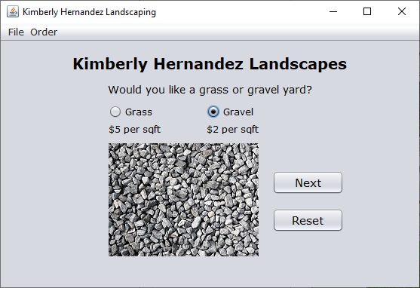
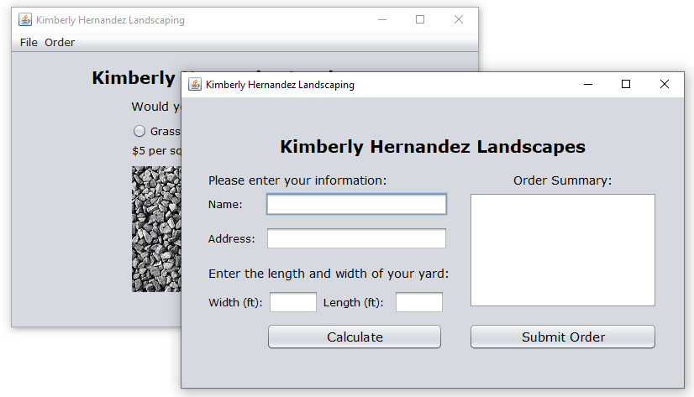
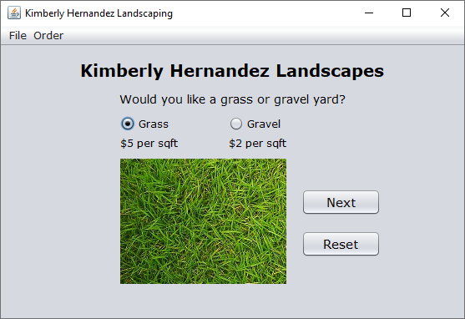
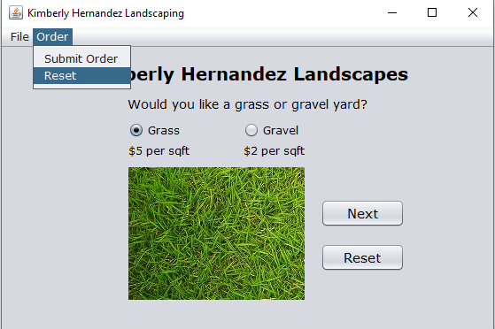
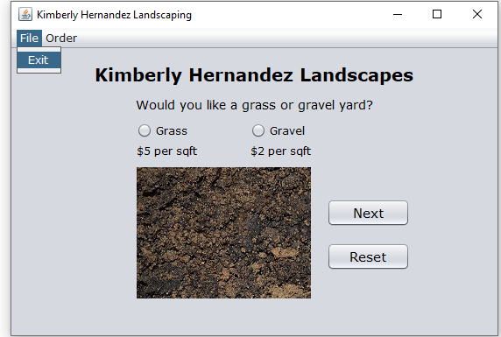
Screenshots of Application with Menu

Slide 12
Adding Tabs, Jlist, & ArrayList
Tabbed windows can make the application easier to navigate through.
JPanels were added for each window with the last one called ‘Customer List’.
The ‘Customer List’ GUI was created to show customer and order information along with ‘Load Customer’ and ‘Delete Customer’ buttons. (Images on next slide)
The following was done on the GUI:
  Implemented a JList to hold an array of customer objects and show customer data in the ‘Customer List’ tab.
  DefaultListModel implemented to process multiple customer objects.
  The DefaultListModel was added to the JList container.
  ‘Delete Customer’ button method was programmed.
  Menu item ‘Submit Order’ method was programmed.

Slide 13
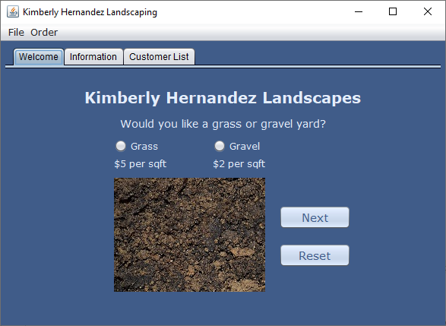
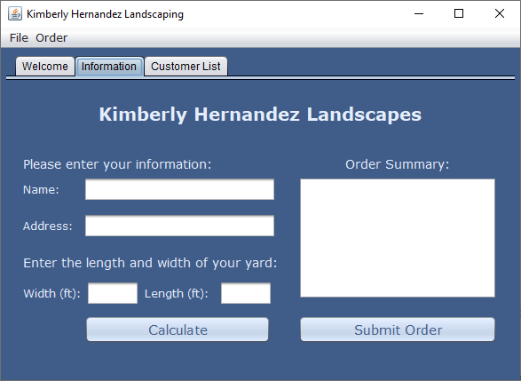
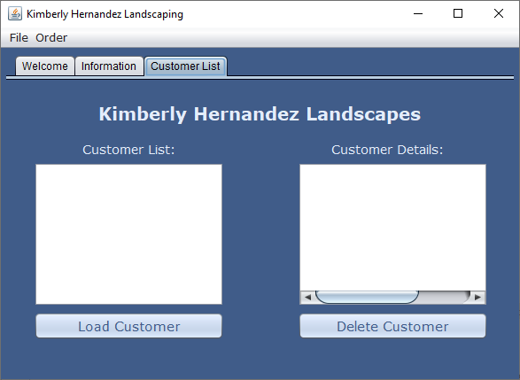
Screenshot of Application with Tabs

Slide 14
Read & Write to Files
Reading and writing to files allows the application to save or load the customer and order information; closing it won’t lose the data.
A DataIO class was created with an add() method to:
  Open the file, write the customer information, & close the file.
Then, a getList() method was added to the DataIO class to:
  Open the file, read the customer information from the file, and close the file.
The ‘Submit Order’ method was updated to create an DataIO object, call the add() method, & call the ‘Load Customers’ method.
The ‘Load Customers’ method was updated to create a DataIO object and call the getList() method.
The delete() method in the DataIO class was created to delete the old file and create a new file and remove the customer that the user selected.
Finally, the ‘Delete Customer’ button event method was updated to delete the selected customer and display the remaining ones.

Slide 15
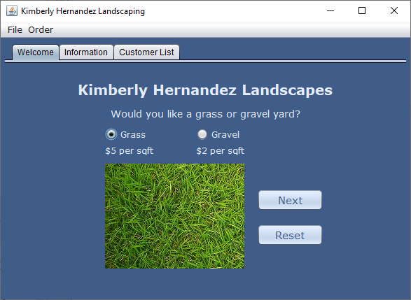
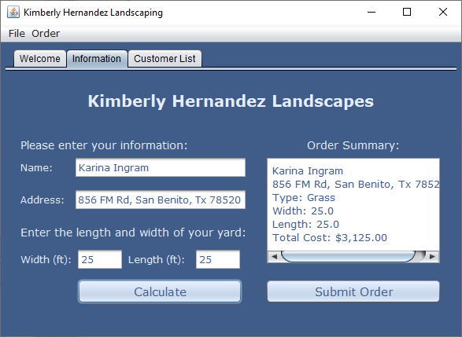
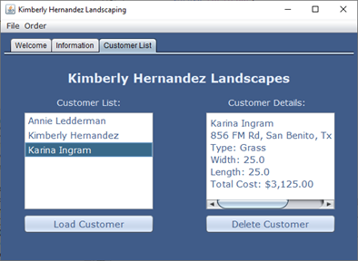
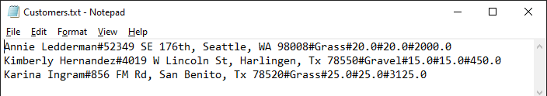
Screenshots of Application Saving to File

Slide 16
Read & Write to Database
Read & Writing to a database allows the data to be accessed in different areas.
The file feature was replaced with a database feature.
A CIS355A database is created in MySQL workbench with a customer table holding a CustomerName, CustomerAddress, LandscapeType, YardLength, YardWidth, & LandscapeCost.
The DataIO add(), getList(), & Delete() methods were changed (Shown on next slide).
The ‘Submit Order’, ‘Load Customer’, & ‘Delete Customer’ event methods were changed to run the updated DataIO class methods.

Slide 17
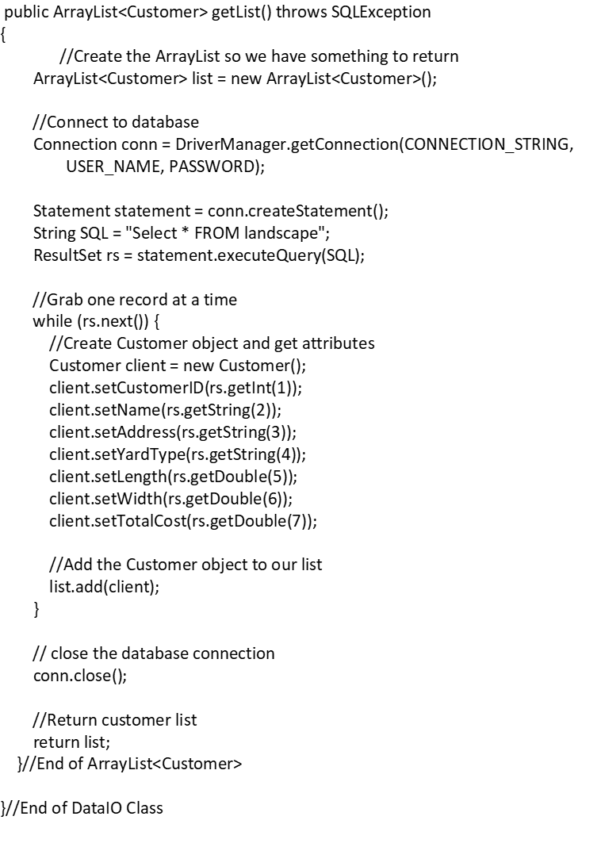
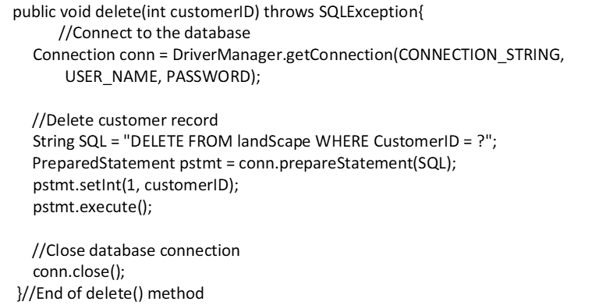
DataIO Methods

Slide 18
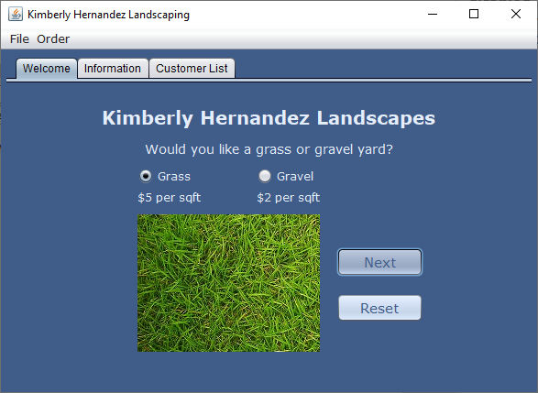
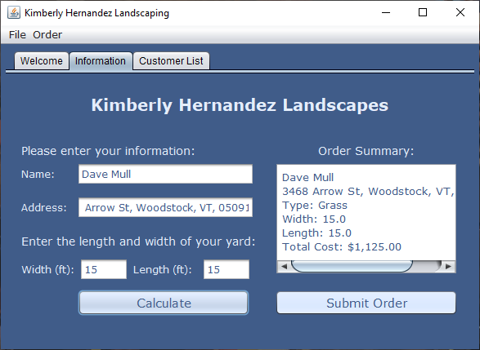
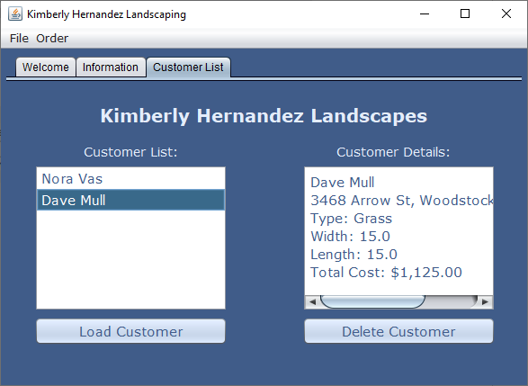
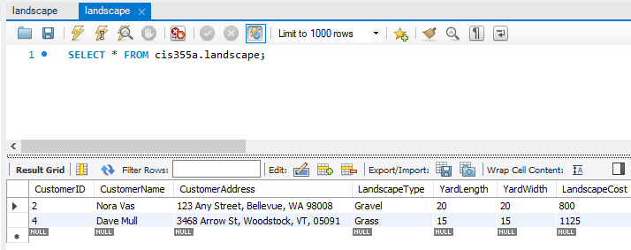
Screenshots of Final Application

Slide 19
Challenges
One challenge faced was aligning the GUI components when the screen is maximized and minimized.
  This was fixed by changing the ‘horizontal alignment’ to ‘Center’ for the calculate & order buttons.
Another challenge was getting an error called “java.sql.SQLSyntaxErrorException: Table 'cis355a.landscpe' doesn't exist”.
  Determined that the issue was in the line in DataIO class “String strSQL = "INSERT INTO landscpe (CustomerName, CustomerAddress, “ + "LandscapeType, YardLength, YardWidth, LandscapeCost) " + "VALUES(?, ?, ?, ?, ?, ?)“’;
  Fixed by changing ‘landscpe’ to ‘landscape'; database name was misspelled.
Another challenge was getting each tab to be the same color of the background as they remained silver.
  This is still to be determined but will be updated on the application soon.

Slide 20
Career Skills Obtained
Java programming skills - Using NetBeans to create the landscaping application.
Database skills – Creating a database to apply it to the application.
Software skills – Using NetBeans, MySQL, and Microsoft Visio.
Prototyping skills– Creating the wireframe diagram using Microsoft Visio.
Object-Oriented Design (OOD) skills – Creating class diagrams for the application.
Troubleshooting skills – Figuring out issues that occurred during programming.

Slide 21
Conclusion
This landscaping application covered concepts learned in business application programming.
A simple console to GUI, burger ordering, & grade management application were created to revisit object-oriented programming & GUI features.
The landscaping application was designed before programing took place.
The final landscaping application allowed the user:
  To pick either grass or gravel
  Enter customer information & submit order
  & retrieve customer & order information from a database.
Thank you!

