Slide 1

Introduction to
Mobile Device & Programming
Preparing App for Google Play

Slide 2
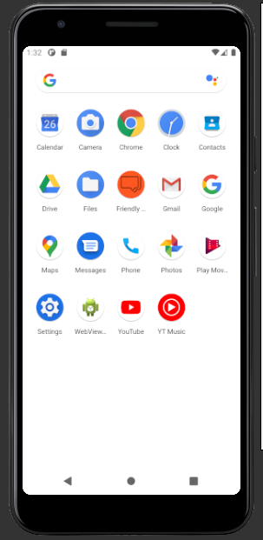
A screenshot of corrections from week 7.
App Icon displayed for Friendly Advice.

Slide 3
Description of Friendly Advice app in HTML format.
<h1><b>FRIENDLY ADVICE</b></h1>
Download <b>Friendly Advice</b> to join others who seek advice and want a safe zone to let it all out. Whether you are having a good day or not Friendly Advice is the way to seek quick advice and jot down how your day went or how you are feeling at any point in the day.
<b>Use Friendly Advice to:</b>
-Receive suggestions of advice.
-Write how you are feeling with daily journal entries.
-Keep track of each day with saved journal entries.
<b>Friendly Advice Features:</b>
-Receive Advice – With a click of a button you can randomly receive suggestions and advice.
-How are you doing today? - Here is where you can jot down anything. This journal section saves your entries with the time and date stamps so you can keep track of how each day went. Music plays in the background to sooth and comfort you.

Slide 4
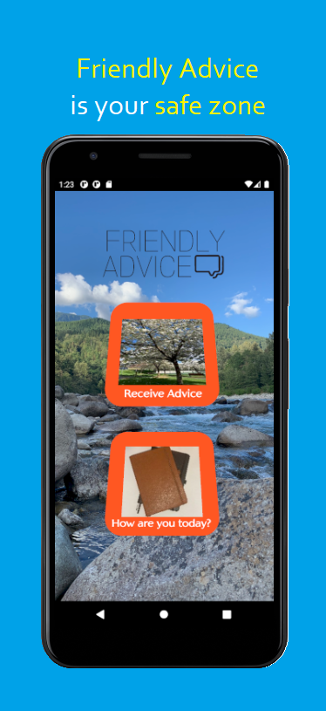
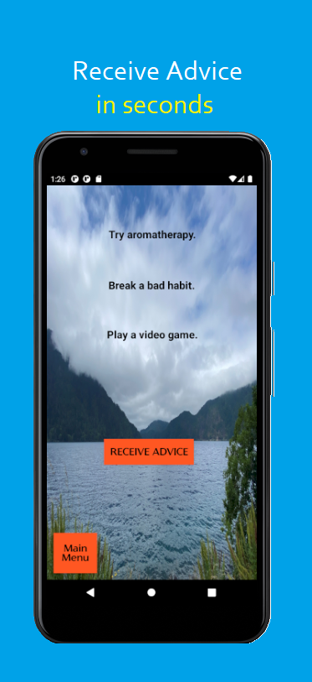
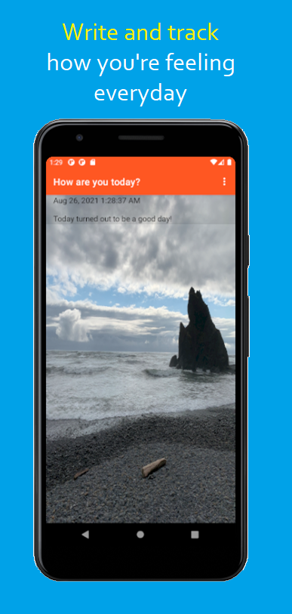
Screenshots of Friendly Advice app.

Slide 5
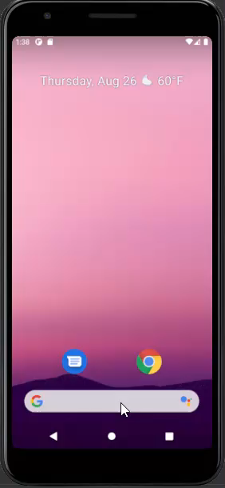
Video of Friendly Advice app.

