Slide 1
FINAL PROJECT
Fundamentals of
Infrastructure Security
Kimberly Hernandez
DeVry University SEC290
12/17/2022
Professor Larry Burnette

Slide 2
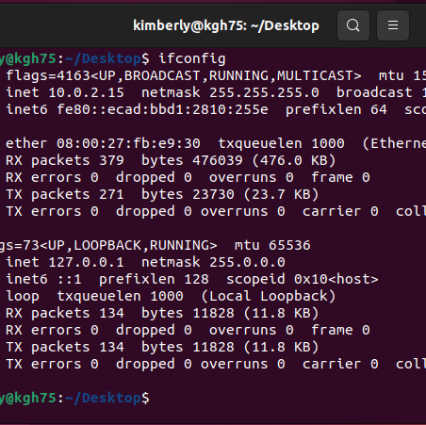
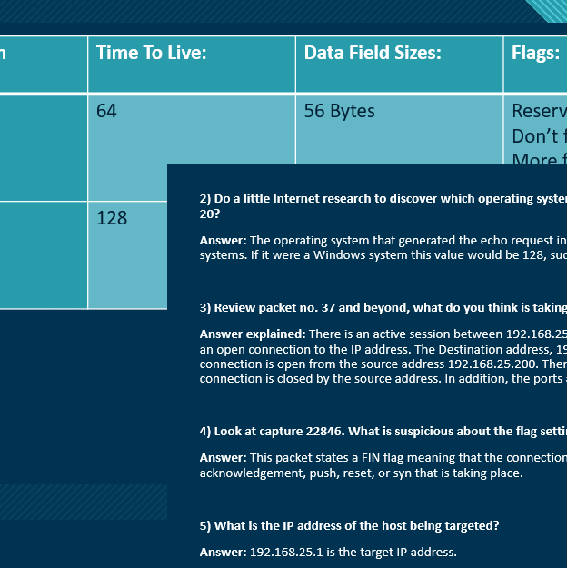
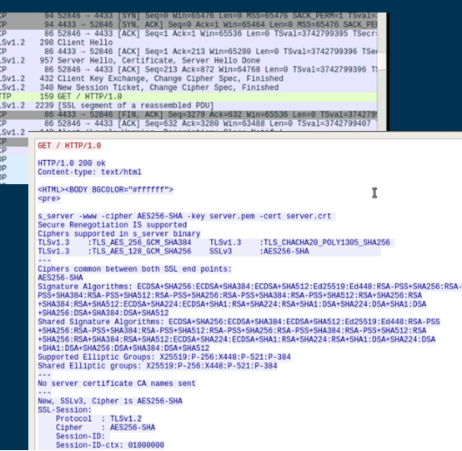
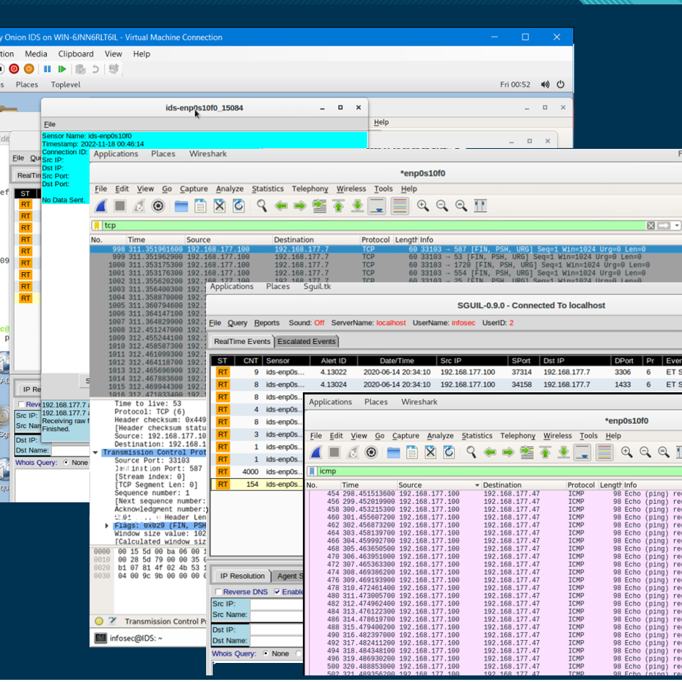
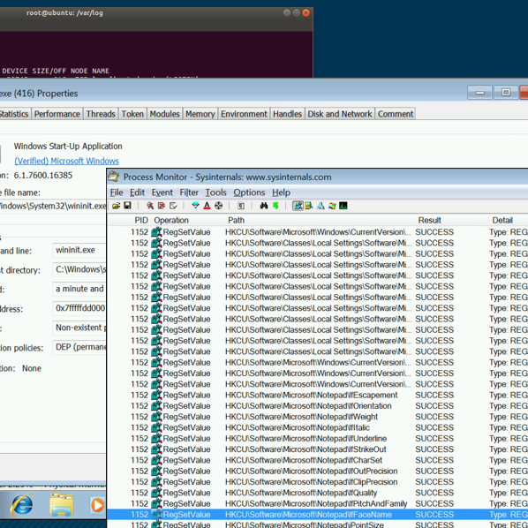
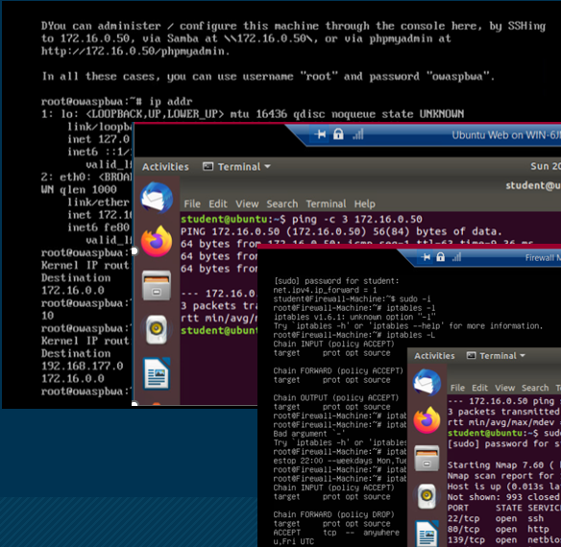
Introduction
This final project includes several concepts covered in the Fundamentals of Infrastructure Security course, including the labs completed through InfoSec Learning Environment.
I explored system vulnerabilities & exploits, analyzed traffic information, handled & analyzing SSL files, worked with open-source intrusion prevention systems, conducted a live memory analysis, and configured network defenses.
The following sections in this project are performed using various tools in Windows, including those through the Hyper-V Manager with Windows and Linux VMs:
Vulnerability Analysis
Intrusion Analysis
Open SSL
Snort
Live Memory Analysis
Firewall

Slide 3
Module 1 – Vulnerability Analysis
A manual vulnerability analysis was performed targeting Easy - Windows Server 2003 and Malware - Windows 7 machines using an Ubuntu Web VM.
Both machines were then exploited and accessed.
The following slides will view the:
  ‘nbtscan –v –s : 192.168.177.0/24’ on the Ubuntu Web machine.
  MS08-067 vulnerability check for the Easy - Windows Server 2003.
  MS17-010 vulnerability check for the Malware - Windows 7.
  And the exploitation and access of both target machines.

Slide 4
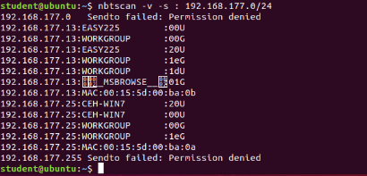
Enumerate The Machines
Using the command nbtscan –v –s : 192.168.177.0/24 to enumerate the machines.

Slide 5
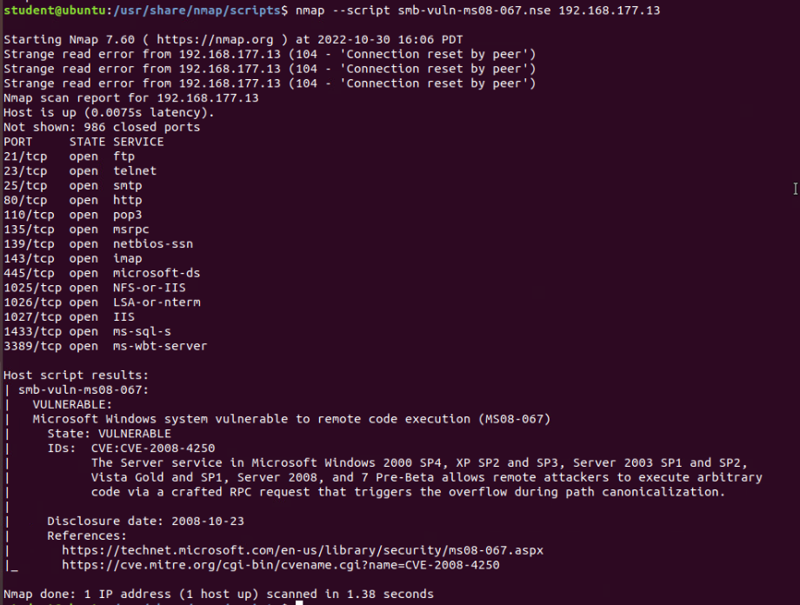
Nmap Script: MS08-067 Vulnerability
Nmap script: ‘smb-vuln-ms08-067.nse’ used on Easy - Windows Server 2003 machine, that has an IP address of 192.168.177.13

Slide 6
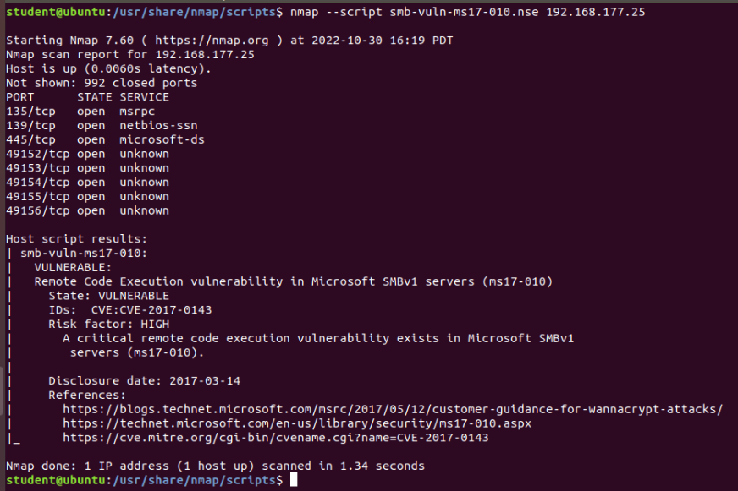
Nmap Script: MS17-010 Vulnerability
Nmap script: ‘smb-vuln-ms17-010.nse’ used on Malware - Windows 7 machine that has an IP address of 192.168.177.25

Slide 7
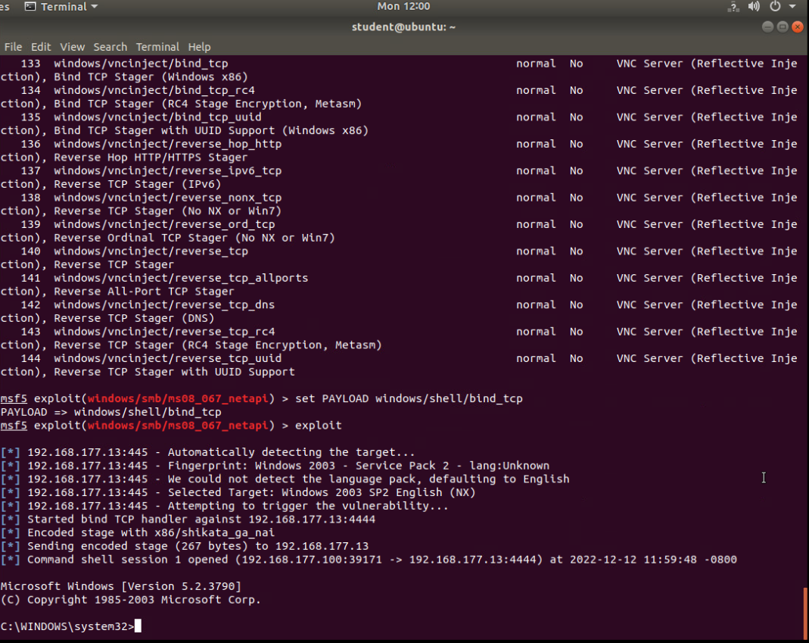
Exploiting and Gaining Access
Adjusting the payload, exploiting, and gaining access to the Easy - Windows Server 2003 Machine.

Slide 8
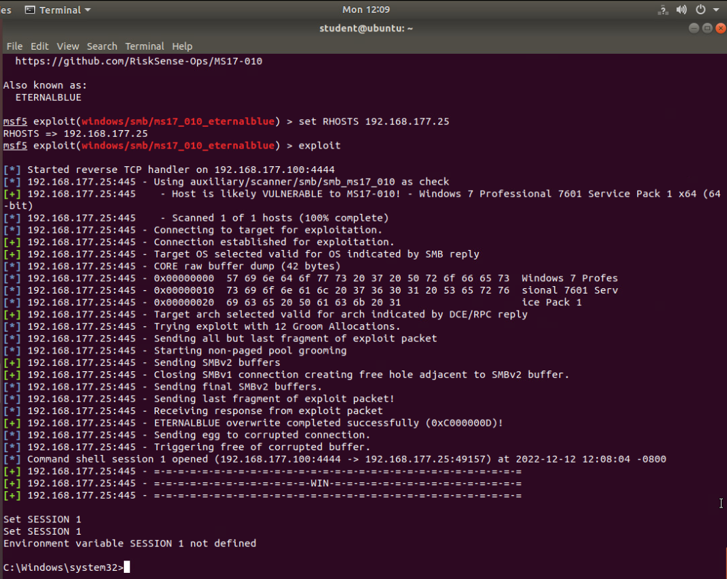
Exploiting and Gaining Access (cont.)
Exploiting and gaining access to the Malware - Windows 7 Machine.

Slide 9
Module 2 - Intrusion Analysis using Wireshark
The Wireshark tool was used to conduct a basic attack analysis to view traffic information along with the packets involved in the network.
The following were reviewed on Wireshark with an imported packet capture file:
  Differences in captures 20 & 22.
  Operating system information.
  What is taking place based on the captured data?
  What is taking place based on the flag information?
  The target host IP address.

Slide 10
Basic attack analysis
Table showing the differences in captures 20 and 22
Differences In Captures: | Time To Live: | Data Field Sizes: | Flags: | Packet Length:
20 | 64 | 56 Bytes | Reserved bit: Not set Don’t fragment: Set More fragments: Not set Fragment offset: 0 | 98
22 | 128 | 32 Bytes | Reserved bit: Not set Don’t fragment: Not set More fragments: Not set Fragment offset: 0 | 74

Slide 11
Basic attack analysis (Continued)
2) Do a little Internet research to discover which operating systems use the specific values in their ping commands. What operating system generated the echo request in capture 20?
Answer: The operating system that generated the echo request in capture 20 was a Linux/Unix operating system. This is verified by the TTL = 64, which represents the Linux/Unix systems. If it were a Windows system this value would be 128, such as capture 22.
3) Review packet no. 37 and beyond, what do you think is taking place here? Half-open/Stealth Scan & recon probe; explanation below.
Answer explained: There is an active session between 192.168.25.200 and 192.168.25.1. The communication is initiated at 192.168.25.200 where its flag info is SYN, that represents an open connection to the IP address. The Destination address, 192.168.25.1, flag states [RST, ACK] communicating that the ports are closed and acknowledged the that the connection is open from the source address 192.168.25.200. There is never an ACK flag from the source IP address but instead eventually has a FIN flag that represents the TCP connection is closed by the source address. In addition, the ports are searched randomly.

Slide 12
Basic attack analysis (Continued)
4) Look at capture 22846. What is suspicious about the flag settings in this packet?
Answer: This packet states a FIN flag meaning that the connection is requesting to be closed from port 34601 to 1488. The rest of the flags are not set meaning there is no urgent, acknowledgement, push, reset, or syn that is taking place.
5) What is the IP address of the host being targeted?
Answer: 192.168.25.1 is the target IP address.

Slide 13
Module 3 - Open SSL
This section consists of creating and testing an SSL/TLS file captured on Wireshark.
The following were performed:
  Using the Ubuntu Web machine, a certificate was created along with an RSA security key by the command: openssl req -new -x509 -out server.crt -nodes -keyout server.pem -subj /CN=localhost
  An SSL server was established by the following command: openssl s_server -www -cipher AES256-SHA -key server.pem -cert server.crt
  Testing and capturing the file was done by:
    Retrieving the Firefox webpage using the command: ‘printf ‘GET / HTTP/1.0\r\n\r\n’ | openssl s_client -no_tls1_3 -ign_eof’.
    Viewing Wireshark to retrieve the GET request & SSL stream information implemented and captured. (Seen in following two slides).

Slide 14
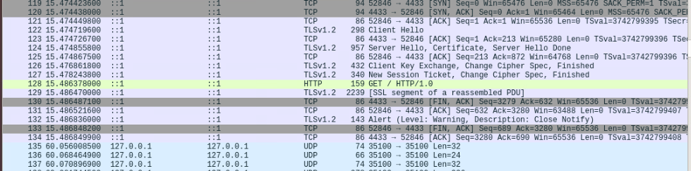
Creating and testing an SSL/TLS file
Screenshot showing GET request (in yellow) in info column.

Slide 15
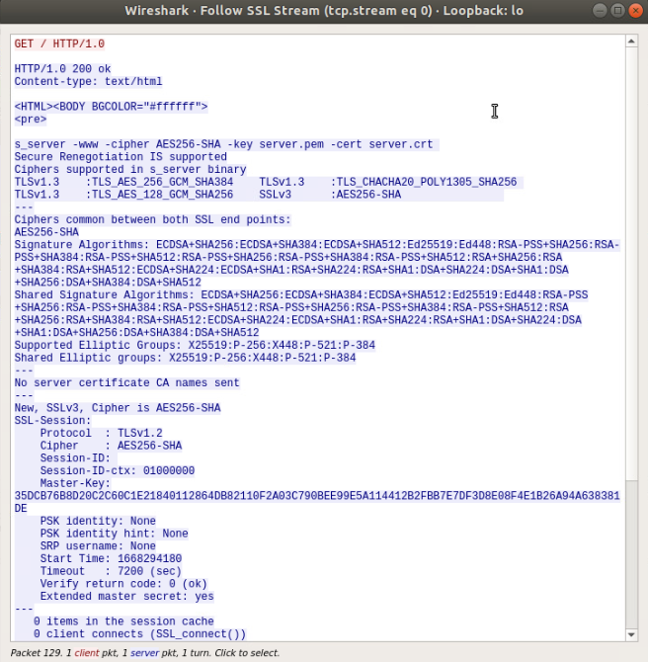
Creating and testing an SSL/TLS file (continued)
Screenshot showing the decrypted SSL stream.

Slide 16
Module 4 -Snort
Snort, an open-source network intrusion prevention system, is used to analyze network activity, including malicious activity, through a Linux VM called ‘Security Onion Intrusion Detection System (IDS)’.
Sguil, another similar tool, is used to view real-time activity and compare the information gathered on Wireshark to verify and alert intrusions in the network.
The following virtual machines (VMs) were involved in this section:
  Security Onion Intrusion Detection System(IDS)
  Ubuntu VM
  OWASP-BWA VM

Slide 17
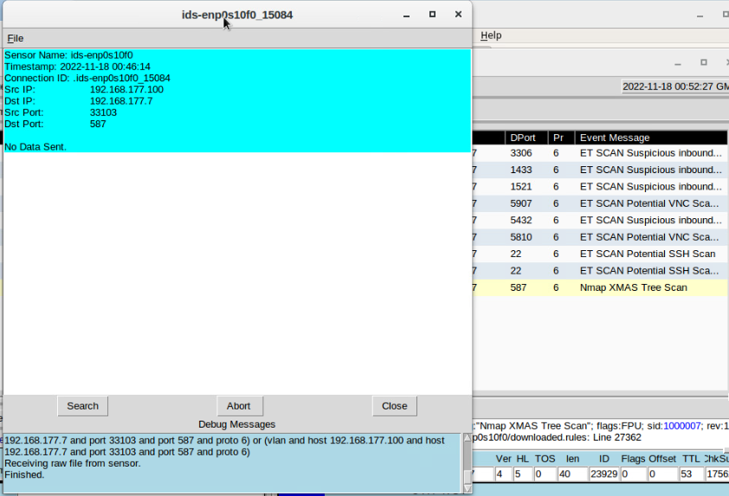
Testing Snort Rules
Screenshot the transcript of the XMAS scan alert using Sguil.
Sguil generated the alert after running the command, ‘sudo nmap –n –sX 192.168.177.0/24’ in the Ubuntu VM.

Slide 18
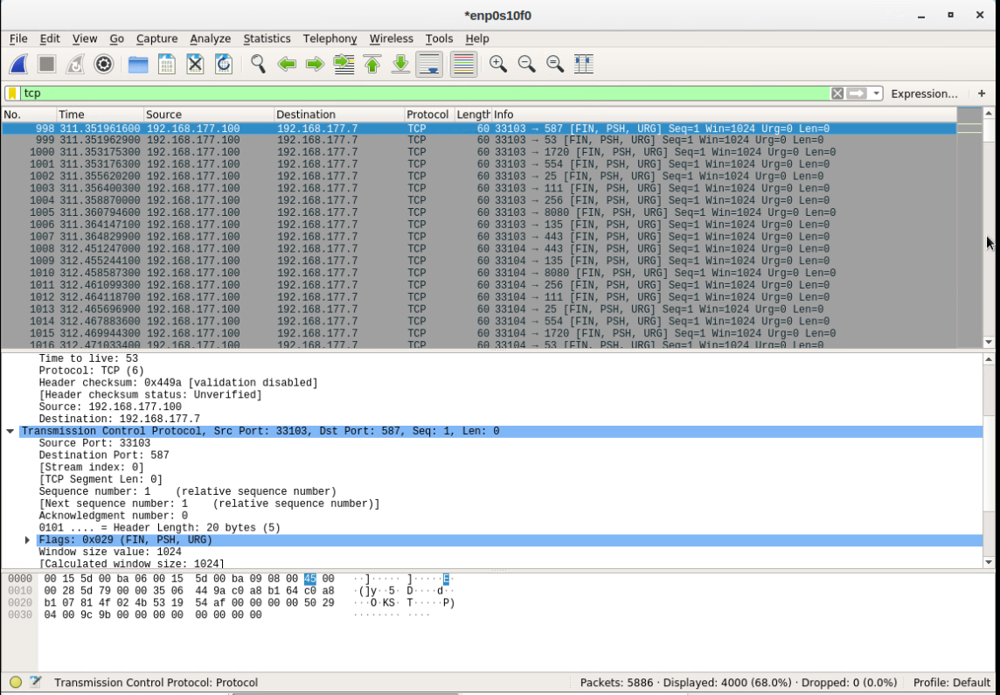
Testing Snort rules cont’d
Screenshot of the TCP packets generated by the XMAS scan using Wireshark.

Slide 19
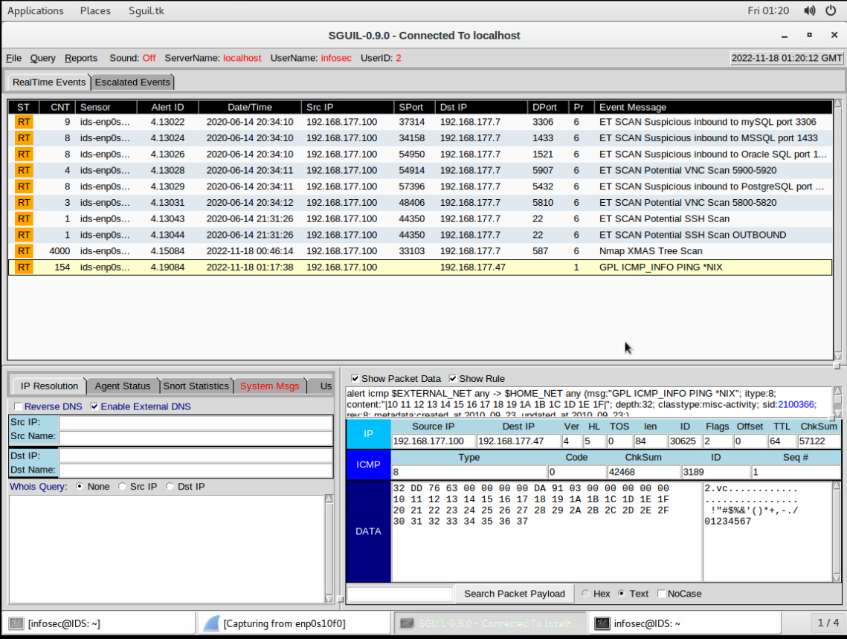
Creating Snort rules
Rules were created on the Security Onion IDS machine, and a ping was generated on the Ubuntu Web machine to the 192.168.177.47 OWASP-BWA virtual machine IP address.
The screenshot shows the ping activity alert on Sguil.

Slide 20
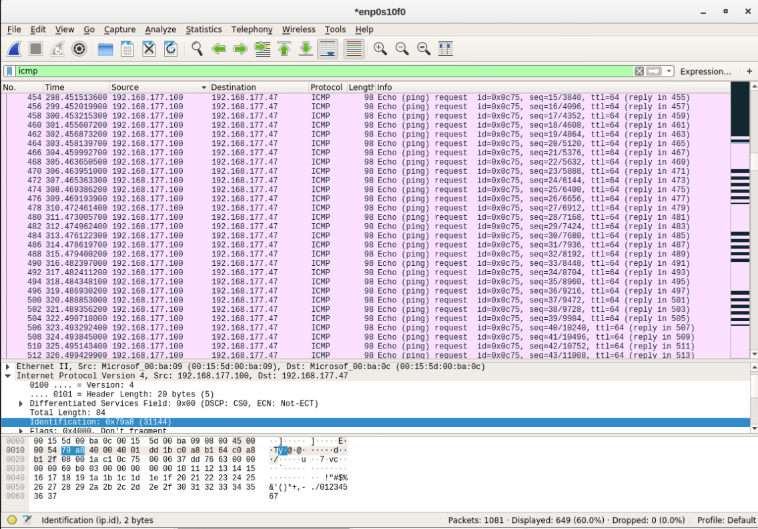
Creating Snort rules cont’d
Screenshot of the ICMP packets generated by the ping activity.

Slide 21
Module 5 - Live Memory Analysis
This section conducts a live memory analysis using the following:
  Several Linux processes on the Ubuntu Web machine, including a listening port that was set up to test connectivity.
  The Process Hacker tool on the Malware – Windows 7 machine was used to view processes and their properties.
  The Process Monitor on the Malware – Windows 7 machine covered troubleshooting, finding problems with virtualization, or settings stored for an application. Editing a Notepad and viewing the stored information are seen in this section.
  Several ‘volatility’ commands on the Ubuntu Web machine are run to explore memory dump capabilities.

Slide 22
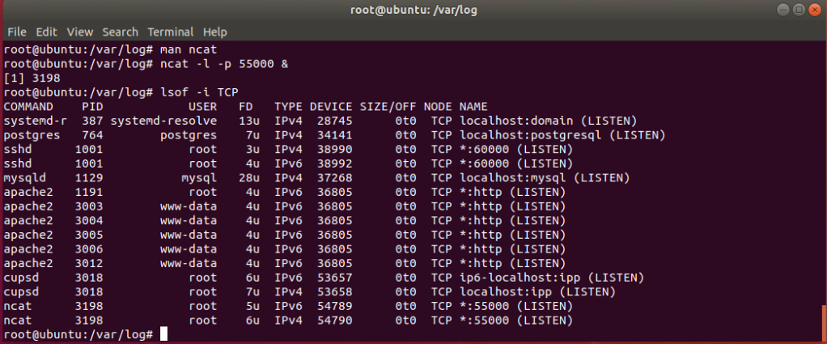
Linux Processes
Commands used:
‘ncat –l –p 55000 &’ and ‘lsof –i TCP’.
Screenshot shows “port 55000 open” for both “IPv4 and IPv6”.

Slide 23
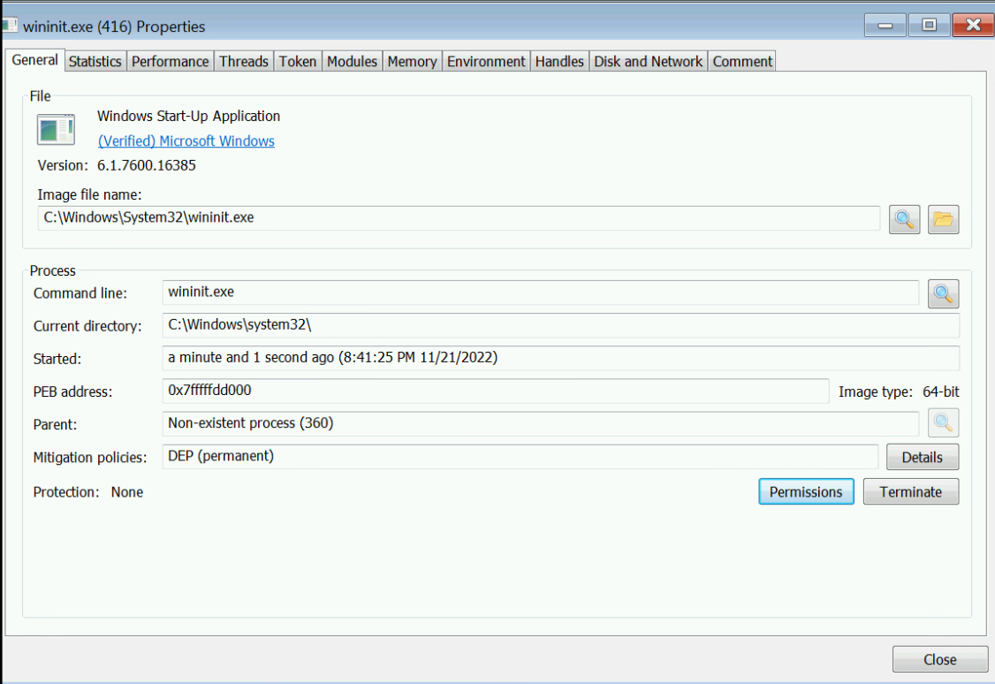
Process Hacker
Screenshot shows properties of a chosen process.

Slide 24
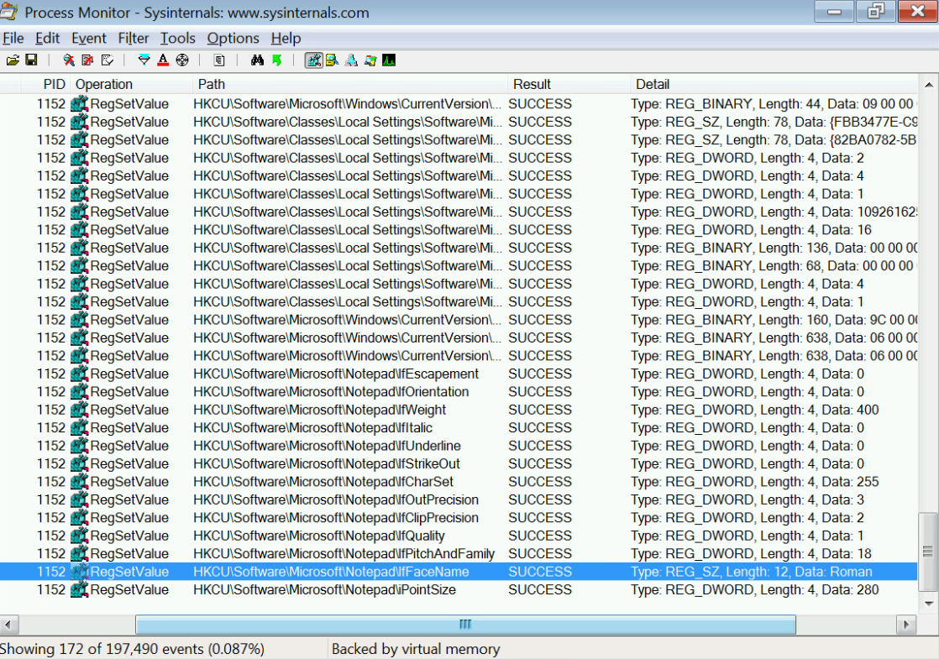
Process Monitor
Screenshot shows:
  “ifFaceName” in the Path column
  “Data: Roman” in the Detail column.

Slide 25
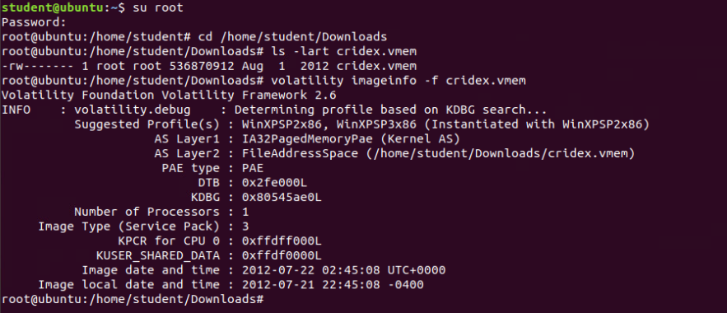
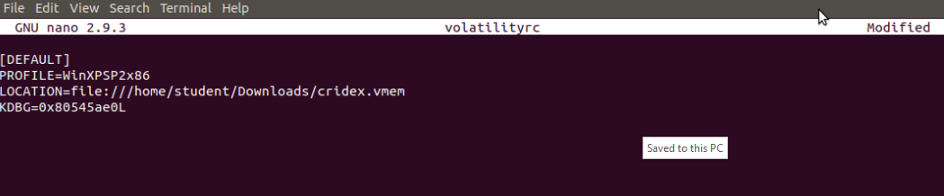
Volatility
Screenshots show:
the output of the ‘volatility imageinfo -f cridex.vmem’ command.
The created volatility configuration file.

Slide 26
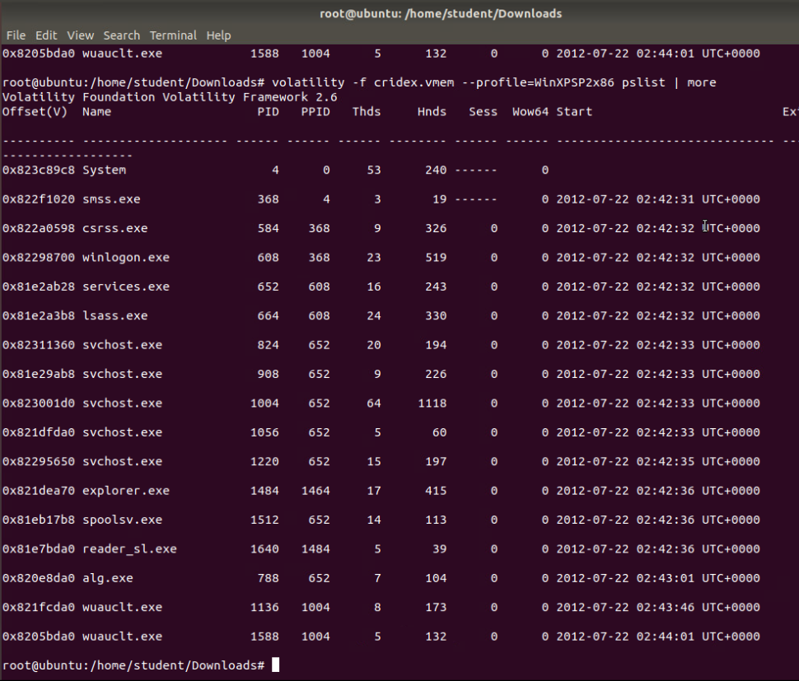
Volatility (Continued)
Screenshot shows:
the output of the ‘volatility -f cridex.vmem --profile=WinXPSP2x86 pslist | more’

Slide 27
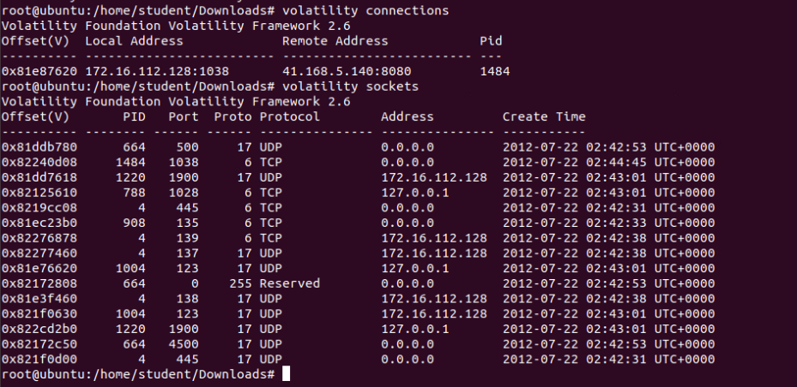
Volatility (Continued)
Screenshot shows:
the output of the ‘volatility connections’ and ‘volatility sockets’ commands.

Slide 28
Module 6 - Firewall
The following sections will consist of configuring network defenses and verifying access to SSH logins using the following:
  Time-based access using the Firewall, Ubuntu Web, and DMZ VMs.
  Dynamic network address translation (NAT) using the DMZ VM.
  Brute Force using the Ubuntu Web and Firewall VM.

Slide 29
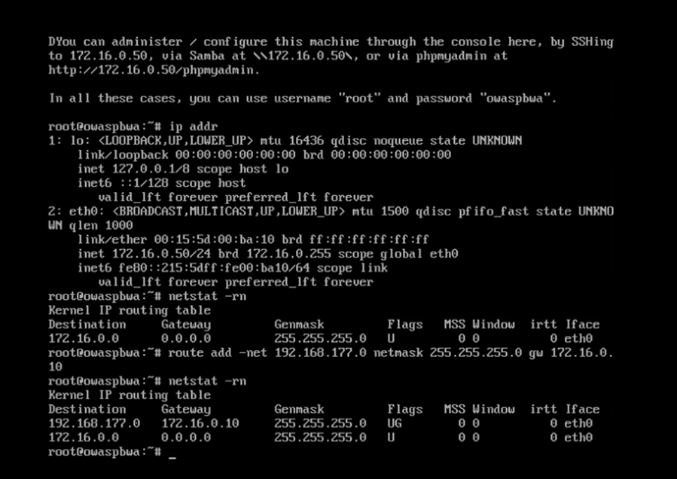
Time-based Access
Screenshot shows the DMZ Route Table.

Slide 30
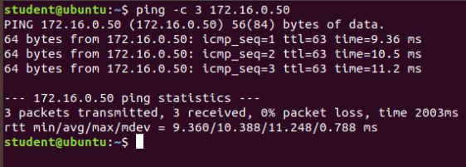
Time-based Access
Screenshot shows a successful ping from the Ubuntu Web VM and the DMZ VM

Slide 31
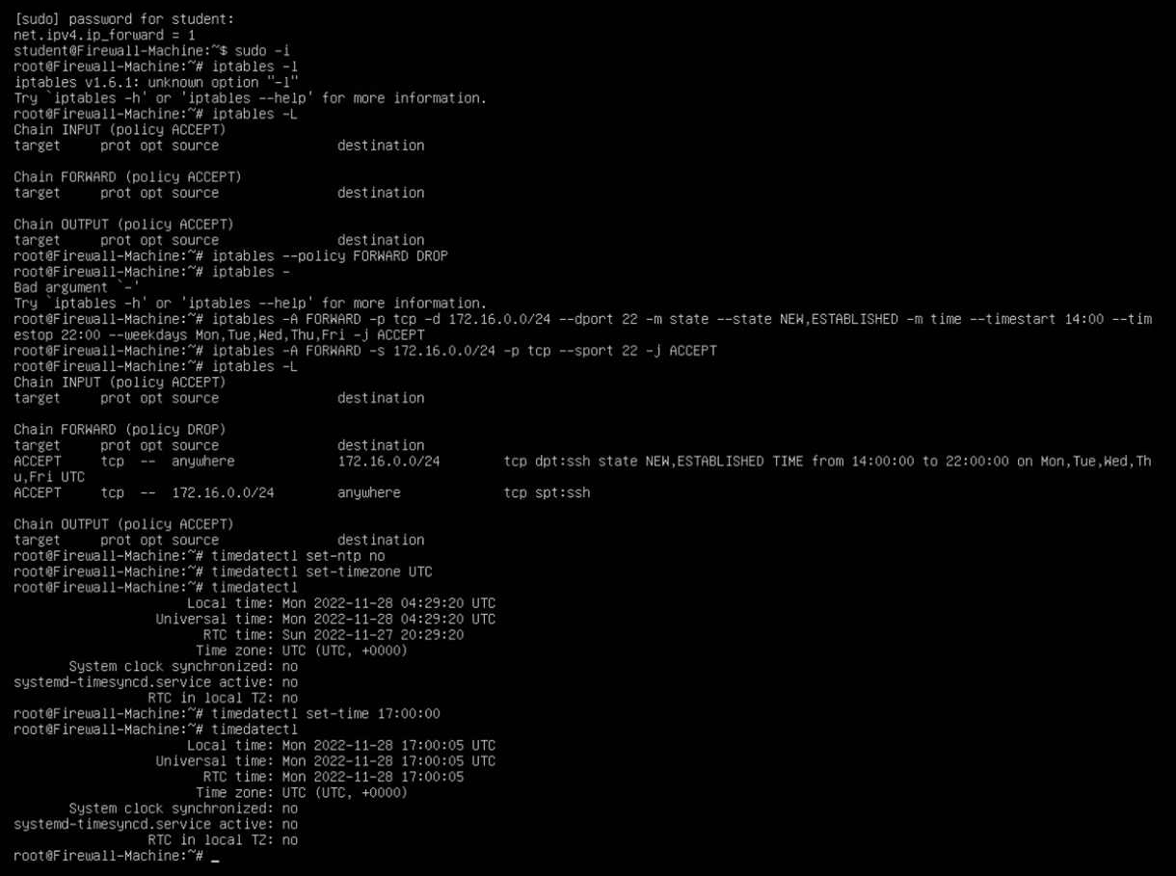
Time-based Access
Screenshot shows two time-based access rules in the FORWARD chain

Slide 32
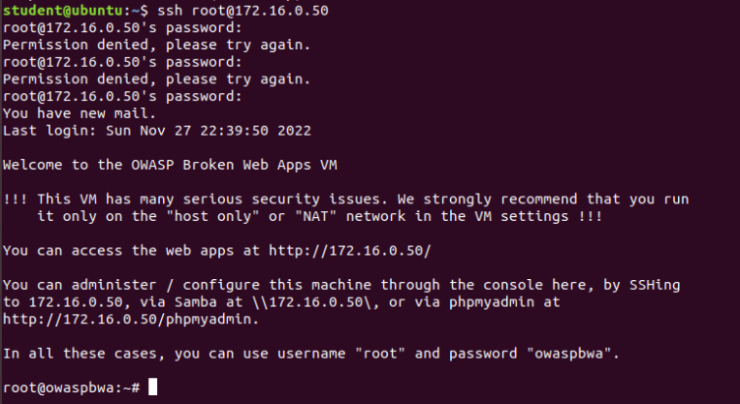
Time-based Access: SSH Connection
Screenshot shows the successful log-in from Ubuntu VM to DMZ machine.

Slide 33
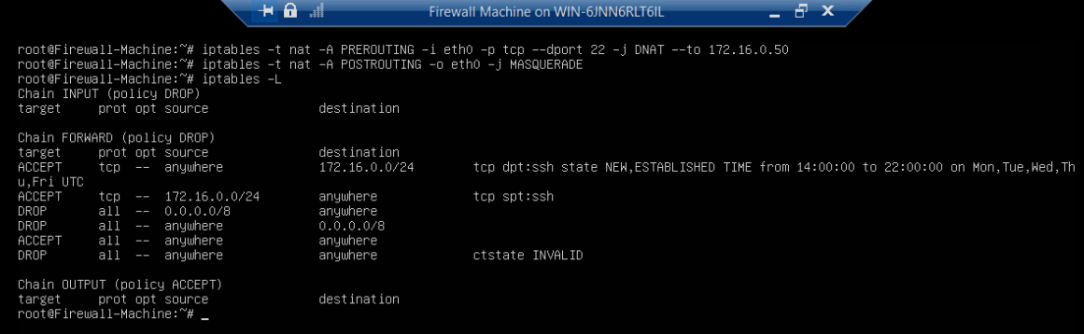
Dynamic NAT
Pre-routing configurations: ‘iptables -t nat -A PREROUTING -i eth0 -p tcp --dport 22 -j DNAT --to 172.16.0.50’.
Post-routing configurations: ‘iptables -t nat -A POSTROUTING -o eth0 -j MASQUERADE’.
Screenshot shows the completed table.

Slide 34
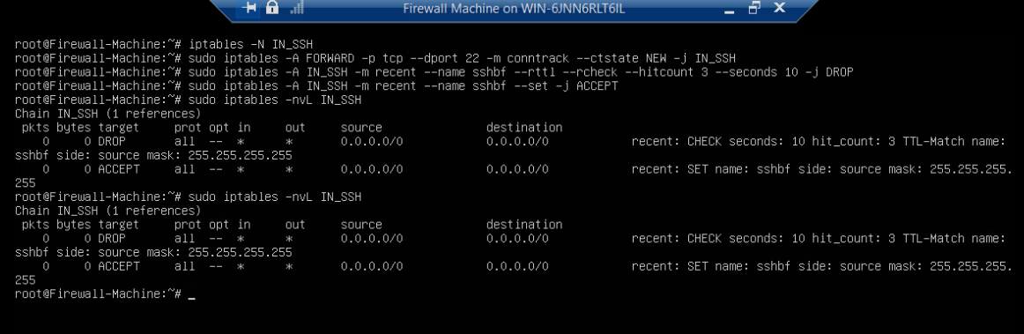
Brute Force
Screenshot shows the completed configurations.

Slide 35
Challenges
One main issue occurred in all the labs and virtual machines (VMs) where the keyboard inputs would duplicate or continuously place additional random characters.
  To solve this issue, I retrieved and used the on-screen keyboards of the VMs, which stopped the duplication.
Another issue was that the packets on Wireshark were not generating after executing the ping command on the Ubuntu Web Machine.
  To solve this issue and successfully capture packets, I closed Wireshark, closed the OWASP-BWA machine, and proceeded to open Wireshark, open the OWASP-BWA machine, and ping the OWASP-BWA machine using the Ubuntu Machine.
These challenges helped me understand different forms of troubleshooting, including alternative solutions and the steps needed to reach the objectives of the labs.

Slide 36
Career Skills Obtained
The following skills obtained by performing the labs and using the different tools through the VMs have allowed me to explore how these skills are used in the cybersecurity field:
  Command Line Interface (CLI) skills - Running commands on virtual machines (VMs) for opening tools and implementing configurations.
  Scripting skills - Using Nmap scripts to determine machine vulnerability.
  Networking Analysis skills - Viewing and determining networking, packet, flag, and intrusion alert information.
  VMs Skills- Working with multiple VMs using the Hyper-V Manager tool in Windows to reach lab objectives.
  Software skills: Using Metasploit, Nmap Scripting Engine Tools, and Hyper-V Manager.

Slide 37
Conclusion
This Fundamentals of Infrastructure Security’s final project covered the following:
System vulnerabilities & exploits
Analyzing traffic information using Wireshark
Handling & analyzing SSL files
Working with open-source intrusion prevention systems
Conducting a live memory analysis
And configuring network defenses.
The concepts, skills, and challenges learned from this course will become valuable for a future in the cyber security field.

Slide 38
Thank You!

Slide 39
References:
Bailey, C. R. (2022, November 7). Week 3 course project –OpenSSL Lab-7 Nov2022 [Video]. DeVry Webex. https://devry.webex.com/recordingservice/sites/devry/recording/e359dbcb413e103ba7fe00505681b568/playback
DeVry University. (n.d.). DeVry sec 290 – Module 1: Manual Vulnerability Analysis. InfoSec Learning, Inc. https://lab.infoseclearning.com/course/GFHTMCLELH/lab/SIQSQERECF?check_logged_in=1
DeVry University. (n.d.). DeVry sec 290 – Module 2: Intrusion Analysis using Wireshark. InfoSec Learning, Inc. https://lab.infoseclearning.com/course/GFHTMCLELH/lab/DKBONSOYMN?check_logged_in=1
DeVry University. (n.d.). DeVry sec 290 – Module 3: Open ssl. InfoSec Learning, Inc. https://lab.infoseclearning.com/course/GFHTMCLELH/lab/AEIQEZKWOP?check_logged_in=1
DeVry University. (n.d.). DeVry sec 290 – Module 4: Snort. InfoSec Learning, Inc. https://lab.infoseclearning.com/course/GFHTMCLELH/lab/NUEOEBUQUU?check_logged_in=1
DeVry University. (n.d.). DeVry sec 290 – Module 5: Live Memory Analysis. InfoSec Learning, Inc. https://lab.infoseclearning.com/course/GFHTMCLELH/lab/GIJWCQQCLN?check_logged_in=1
DeVry University. (n.d.). DeVry sec 290 – Module 6: Firewall InfoSec Learning, Inc. https://lab.infoseclearning.com/course/GFHTMCLELH/lab/ZQTYOOMTNN?check_logged_in=1
Fox, N. (2021, June 2). Process hacker: Advanced task manager overview. Varonis. https://www.varonis.com/blog/process-hacker
Gurubaran, S. (2022, June 25). Operating systems can be detected using ping command. GBHackers on Security. https://gbhackers.com/operating-systems-can-be-detected-using-ping-command/
KeyCDN. (2018, October 4). TCP Flags. https://www.keycdn.com/support/tcp-flags
Palani, S. (2021, September 20). How To Identify Operating System Using TTL Value And Ping Command. OS Technix. https://ostechnix.com/identify-operating-system-ttl-ping/
Roy, D. (2021, November 25). Stateless vs stateful packet filtering firewalls. GeeksforGeeks. https://www.geeksforgeeks.org/stateless-vs-stateful-packet-filtering-firewalls/
Stanton, L. (2021, July 9). How to read packets in Wireshark. Alphr. https://www.alphr.com/read-packets-wireshark/

